Slide 1



Principles and guidance for prehabilitation within the support and management of people with cancer
Catherine Neck
Clinical Project Manager, South, Central and West Commissioning Support Unit
4th March 2020

Slide 2
The purpose of prehabilitation in cancer
enables people with cancer to prepare for treatment through promoting healthy behaviours and through individualised needs-based prescribing of exercise, nutrition and psychological interventions.
is part of a continuum to rehabilitation.
benefits can be seen in as little as 2 weeks.
empowers people with cancer to enhance their own physical and mental health and well-being and thereby supports them to live life as fully as they can.

Slide 3

Variable | Control | Intervention | p
 | n=63 | n=62
Hospital LOS | 13 (20) | 8 (8) | 0.078
ICU LOS | 4 (13) | 1 (2) | 0.078
Surgical re-intervention | 6 (10%) | 2 (3%) | 0.273
Patients with complications | 39 (62%) | 19 (31%) | 0.001
Complications per patient | 1.4 (1.6) | 0.5 (1.0) | 0.001
Mortality | 1 (2%) | 1 (2%) | 1.000
Barberan-Garcia Annals of Surgery 2017

Slide 4

Prehabilitation in the cancer care pathway
Personalised prehabilitation care plan
Overseen by cancer MDTs
Interventions should start as early as possible
Notes:
5. Prehabilitation, as a component of rehabilitation, should underpin the whole cancer pathway and is an approach we seek for all people with cancer through co-developing a personalised prehabilitation care plan (PPCP) as part of their overall care plan. Prehabilitation can optimise cancer treatment by promoting health and well-being as part of a continuum of preventative, restorative, supportive and palliative rehabilitation interventions. Prehabilitation, specifically including exercise, nutrition and psychological support, should be integral to the care of all people with a cancer diagnosis.
6. All cancer treatments are led through cancer multidisciplinary teams (MDT). The cancer MDT should have representation from those delivering prehabilitation therefore providing oversight of the prehabilitation needs of the person to ensure prehabilitation is taking place. Community hub MDTs also have an important role to play in supporting people with cancer with physical activity and exercise, nutrition and psychological support. This will be in collaboration with specialist, hospital based oncology teams.
7. Personalised prehabilitation care plans (PPCP), as part of a person’s care plan, should be a document that encompasses nutrition, physical and psychological screening for all people with cancer to identify need for more detailed assessment, individualised assessment according to need, and an individualised intervention prescription based on the screening and assessment process along with on-going support and evaluation to aid uptake and adherence.
8. Interventions targeted at improving physical and/or mental health should start as early as possible and in advance of any cancer treatment (not just the first cancer treatment).

Slide 5
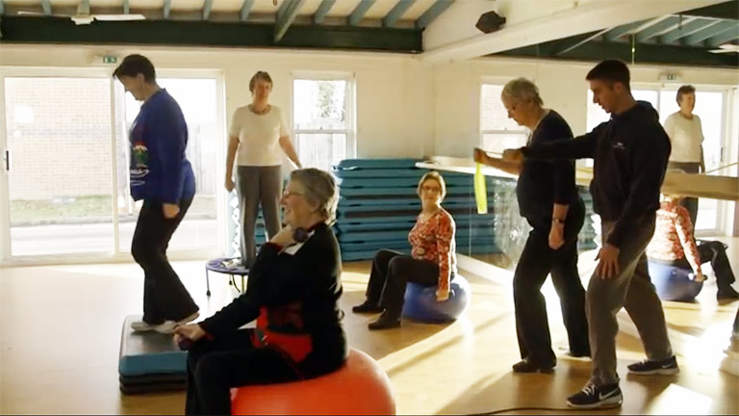
Screening for prehabilitation
Notes:
9. Identification of people with cancer requiring prehabilitation (i.e. screening) should occur as early as possible from diagnosis (and in some cases before a confirmed diagnosis), and in advance of each treatment. Screening should use validated tools to identify the need for more detailed assessment in order to inform the prescription of targeted or specialist interventions. Screening should be aligned to the Holistic Needs Assessment (HNA) and should include psychological risk factors, physical fitness and nutrition including evaluation of weight loss, poor intake, body mass index and nutrition impact symptoms.

Slide 6
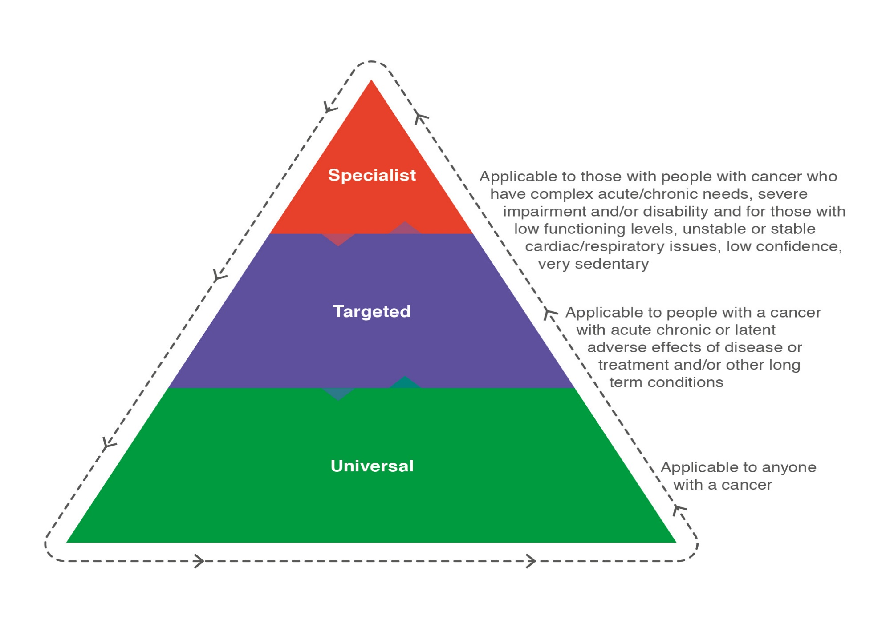
Prehabilitation interventions
Monitoring of interventions should be proportionate to need. Universal interventions should be self-monitored and recorded via the HNA or equivalent process. Targeted and specialist interventions should be monitored for adherence and effectiveness using appropriate validated measures.

Slide 7
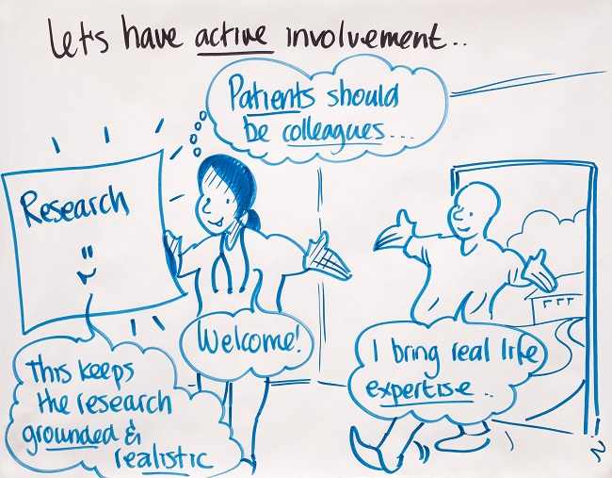
Service development
The principal focus should be on optimising the efficiency and timeliness of current pathways from the moment of consideration of treatment onwards, without unnecessarily delaying scheduled treatment.
Notes:
13. Prehabilitation is a means of transforming patient care to achieve sustainable high-quality services within the current mandated performance framework . The principal focus should be on optimising the efficiency and timeliness of current pathways from the moment of consideration of treatment onwards, without unnecessarily delaying scheduled treatment (patients best interests should be considered on a case by case basis and this may, in some circumstance, result in delaying treatment).
14. People with cancer as well as carers, relatives and a person’s wider network should be supported to engage with and adhere to available prehabilitation services defined by a jointly agreed PPCP.
15. Services delivering prehabilitation should be co-designed and produced with patients and carers.

Slide 8
Up to ~50 days
2-14 days
First formal physiological assessment
Symptom
GP referral
Diagnostic tests / tumour staging
UHS clinic
Surgical clinic
MDT
Pre-assessment
clinic
Surgery
Contemplation of surgery
Previous Cancer Pre-Op Pathway at University Hospital Southampton

Slide 9
Up to 62 days
Symptom
GP referral
Diagnostic tests / tumour staging
UHS clinic
Surgical clinic
Pre-assessment
Clinic –final preparations
Stratified perioperative package
MDT
“Patient staging” with CPET
Contemplation of surgery
Cheap & simple
risk screening
Low risk
Surgery School – patient education /exercise intervention /smoking cessation / group support
Medium risk
High risk
Bolt-on’s as needed – anaemia management / comprehensive geriatric assessment / renal, cardiac, respiratory optimisation
High Risk Clinic – risk discussion / collaborative decision making with MDT / tailored medical interventions
New Pre-op Pathway
Notes:
Tumour Staging and PATIENT STAGING

