Slide 1
How To Get Lymphoma Patients To CAR-T Therapy In The UK
Dr Sanne Lugthart
(Dr Stephen Robinson)
University Hospital Bristol
20 June 2019

Slide 2
Scope Of Talk
Current CAR T products available for NHS patients
The CAR T pathway (up to re-infusion)
Patients Cases

Slide 3
Relapsed/Refractory DLBCL The Current Paradigm
Cured
CMR
PR
SD/
PD*
AutoSCT
Palliate
Trial
AlloSCT
Relapsed
DLBCL
PMBCL
TxFL
1st Line
2nd Line
PET-CT
2nd Line Salvage?
Trial?
Palliate?
(AlloSCT?)
AlloSCT
CAR T
NCCP Lymphoma Definitions:-
Refractory disease:- progressive disease as the best response to the last line of systemic therapy OR stable disease (<6 months duration) as the best response after at least 2 cycles of the last line of therapy
*Progressive disease must be defined radiologically as per RECIST version 1.1 and be based on CT or MR scans. Progressive disease cannot be defined on just an increased SUV on a PET scan.

Slide 4
NHS patients have access to three indications for CAR T cell therapy - a potentially curative complex and distributive innovation
For a CAR-T cell therapy to become an approved medicine in the UK it needs to be recommended by NICE. There are lots of different types of CAR-T cell therapies in development; however currently there are three that are recommended by NICE. The table below provides more detail on the approved indications.
Note that tisagenlecleucel and axicabtagene ciloleucel for lymphoma treat the same 200 patients – the two products are in competition
 | Tisagenlecleucel |  | Axicabtagene ciloleucel
Product name / Company | Kymriah®/ Novartis | Kymriah®/ Novartis | Yescarta®/ Gilead
Condition | Lymphoblastic leukaemia (ALL) | Diffuse large B-cell lymphoma (DLBCL) | Diffuse large B-cell lymphoma (DLBCL) and primary mediastinal B-cell lymphoma
Age | Patients up to the age of 25 years (day before their 26th birthday) | Adults (over 18 years) | Adults (over 18 years)
Expected number of patients | c.15 – 30 patients per year | c.200 patients per year | c.200 patients per year
Number of providers | 9 providers with 3 paediatric providers | 7 providers | 7 providers

Slide 5
CD19 CAR T-cell products in pivotal trials for NHL treated with at least two lines of systemic therapy
Axicabtagene® (ZUMA-1)
Kite, a Gilead Company^{1,2}
Tisagenlecleucel
(JULIET)
Novartis^{1,3}
Lisocabtagene maraleucel
(TRANSCEND-NHL-001)
Juno Therapeutics¹
VL
FMC63
VL
FMC63
VL
FMC63
Anti-CD19 scFv
VH
VH
VH
Hinge
Transmembrane
Costimulatory domain
CD28
4-1BB
4-1BB
Activation domain
CD3ζ
CD3ζ
CD3ζ
Gene transfer
γ-retrovirus
Lentivirus
Lentivirus
Starting material
PBMCs
PBMCs
CD4 : CD8
NHL indication
Adult patients with R/R DLBCL and PMBCL, after ≥2 lines of systemic therapy²
Adult patients with R/R DLBCL, after ≥2 lines of systemic therapy³
Lisocabtagene maraleucel is not currently licensed in Europe
Adapted from van der Steegen SJ et al. 2015¹
CD, cluster of differentiation; DLBCL, diffuse large B-cell lymphoma; NHL, non Hodgkin lymhpoma; PBMC, peripheral blood mononuclear cell; PMBCL, primary mediastinal large B-cell lymphoma; R/R, relapsed/refractory; VH , variable heavy; VL, variable light. 1. van der Steegen SJ et al. Nat Rev Drug Discov 2015; 14: 449–509; 2. Gilead Sciences Ltd. YESCARTA® (axicabtagene ciloleucel) Summary of Product Characteristics; 3. Novartis. Kymriah (tisagenlecleucel) Summary of Product Characteristics.

Slide 6
Chimeric Antigen Receptor T Cells Per Protocol vs Intention To Treat Analysis
Trial | n PP ITT |  | ORR PP ITT |  | CR PP ITT
JULIET¹ (Tisagenlecleucel) | 81 | 124 | 53% | 35% | 40% | 26%
TRANSCEND² (Lisocabtagene) | 91 | 120 | 74% | 56% | 52% | 39%
ZUMA-1³ (Axicabtagene) | 101 | 111 | 82% | 75% | 54% | 50%
(¹Schuster ASH 2017 Abstract 577, ²Abrahamson Abstract ASH 2017, ³Neelapu NEJM 2017)

Slide 7
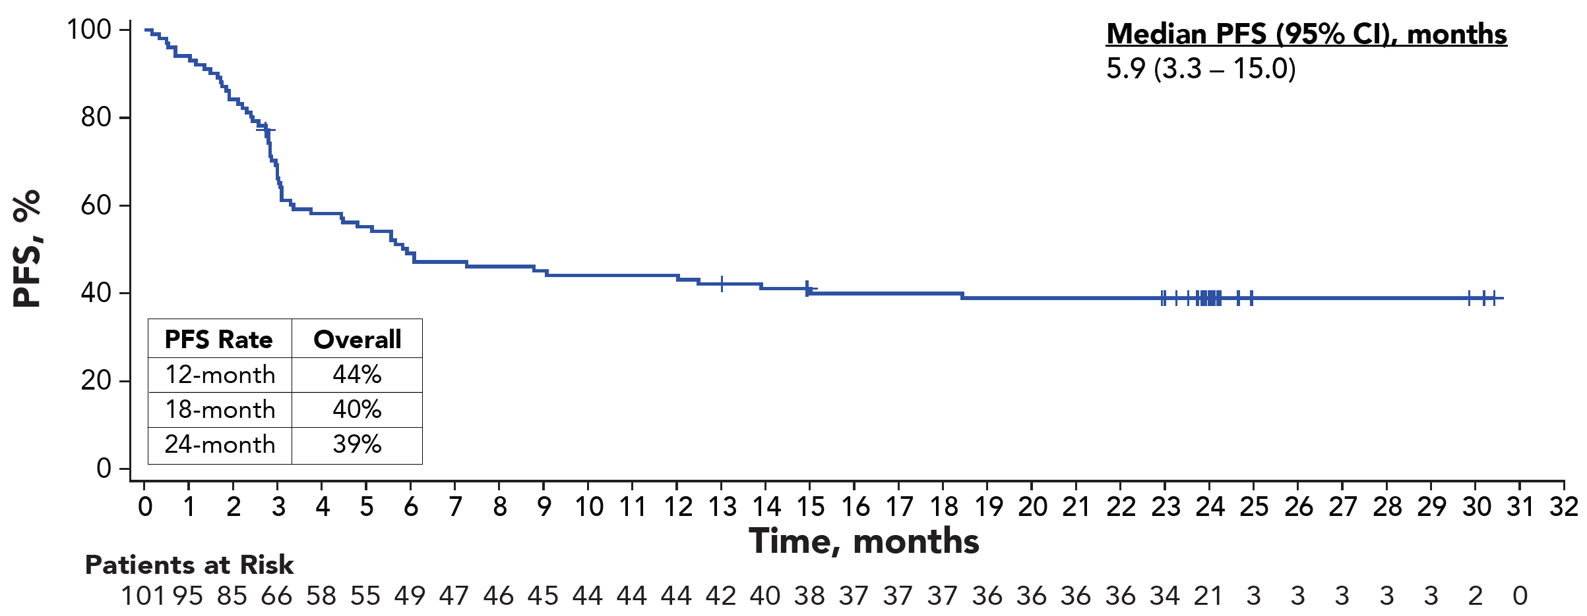
ZUMA-1 (Axicabtagene) Progression-Free Survival (median follow up 24 months)
ORR 82%, CR 54% (Neelapu NEJM 2017)
(Neelapu ASH 2018)

Slide 8
JULIET (tisagenlecleucel): Progression-Free Survival (median follow up 14 months)
ORR 52%, CR 40% (Schuster NEJM 2019)
1.0
CR patients
0.8
0.6
Probability of Remaining Progression Free (%)
0.4
All patients
0.2
Median follow-up, 14 mo (max, 26 mo)
0.0
0
2
4
6
8
10
12
14
16
18
Time since infusion (months)
(Schuster NEJM 2019)
Notes:
Median PFS was not reached for patients in CR and 2.9 months for all patients

Slide 9
Evolution Of CAR T Cell Trials
Currently 271 “chimeric antigen receptor” trials registered at ClinicalTrials.gov
143 trials registered under “lymphoma and chimeric antigen receptor”

Slide 10
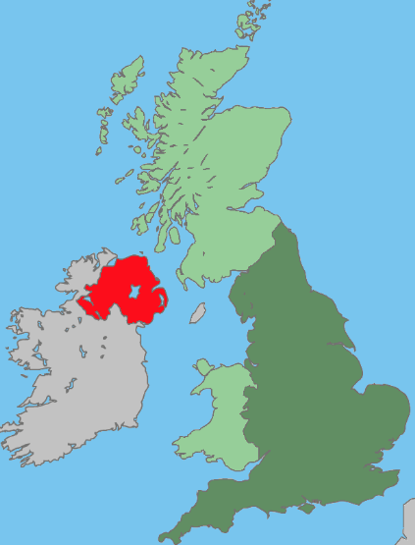
The National Clinical CAR T Panel (NCCP lymphoma)
First wave CAR T Centres
2nd wave CAR T Centres
Newcastle
MRI
Leeds
Christie
Birmingham
Cambridge
UCLH
Bristol
Marsden
Kings

Slide 11
The NCCP Lymphoma Pathway
Patient considered potentially eligible?
Assessment At Regional AlloSCT Centre (Trial? CART? Other?)
3-6 weeks
Assessment At CAR T Centre
(Regional AlloSCT Centre)
Case Presented At Weekly NCCP
Patient Considered Ineligible
(may be reconsidered)
Patient Considered Eligible And assigned CAR T Centre
1-3 weeks
Leucopheresis

Slide 12
NHS England Patient Selection For CAR T
NICE recommends YESCARTA® for use within the Cancer Drugs Fund as an option for R/R DLBCL/PMBCL in adults after ≥2 systemic therapies, if the following criteria are met:^{1,2}
NICE also recommends KYMRIAH® for use within the Cancer Drugs Fund as an option for R/R DLBCL in adults after ≥2 systemic therapies.³
PATIENT CHARACTERISTICS:
DISEASE STATUS:
PREVIOUS TREATMENTS:
≥18 YEARS of age
CONFIRMED HISTOLOGICAL DIAGNOSIS DLBCL/PMBCL/TFL to DLBCL
A full-dose ANTHRACYCLINE-CONTAINING REGIMEN
ECOG PS 0/1
Re-BIOPSY PERFORMED (unless unsafe or progressive disease at site of previous disease)*
≥1 PRIOR ANTI-CD20
monoclonal antibody
SUFFICIENT END ORGAN FUNCTION
NO KNOWN CNS INVOLVEMENT
(no primary CNS lymphoma)
NO PREVIOUS GENETICALLY
MODIFIED IMMUNOTHERAPY
Autologous or allogeneic
With or without prior
AUTO- OR ALLO-SCT
*If re-biopsy is unsafe, there must be progressive disease at previously documented sites of active disease and previous histology of DLBCL or PMBCL.
Allo-SCT, allogeneic stem cell transplant; auto-SCT, autologous stem cell transplant; CNS, central nervous system; DLBCL, diffuse large B-cell lymphoma; ECOG, Eastern Cooperative Oncology Group, PMBCL, primary mediastinal large B-cell lymphoma, PS, performance score; R/R, relapsed/refractory; TFL, transformed follicular lymphoma.
1. National Institute for Health and Care Excellence. Technology appraisal guidance 559. January 2019. 2. NHS England. Cancer Drugs Fund List. March 2019; 3. National Institute for Health and Care Excellence. Technology appraisal guidance 567. March 2019

Slide 13
^{The CAR T Pathway}
Patient Reassessment
PS?
Infection?
Organ Function?
Enrolment/ leukapheresis
Lymphodepleting chemotherapy
Infusion
In-patient daily monitoring
10-14 days
First tumour assessment
Referral and screening
NCCP Panel
Day –5
Day –4
Day –3
Day 0
Day 0-10
Day 30
Manufacturing time:
17 days (ZUMA-1)
26–29 days (UK practice)
Daily toxicity assessments
Doctors, nurses, caregivers
Any grade CRS/NE: ICU
Bridging therapy
Patient to stay close to treatment centre for 28 days

Slide 14
Case Histories – The Bristol Experience
“Holding Therapy” Bridging Therapy
52 yo DLBCL 2003
RCHOP
Relapse 2018
RCNOP +RT-Ref
RESHAP-Ref
R-GDP
R-GDP
62 yo TxFL 2010
RCHOP
Relapse 2014
RIVE +ASCT
Relapse 2019
No Holding
No Bridging
Flu/Cyclo CART
Leucopheresis
64 yo DLBCL 2017
RCHOP
Relapse 2018
RGDP-Ref
RminiBEAM-Ref
PEP-C
PEP-C
55 yo DLBCL 2018
RCHOP-ref
RBenda-Ref
RICE-Ref
RT+Steroids
No Bridging

Slide 15
Case Histories – The Bristol Experience
“Holding Therapy” Bridging Therapy
40 yo Tx FL 2016
RBenda-PR
2017 HG Tx
RCHOP-CR
2019 Rel
RDHAP-Ref
RIVE-Ref
R-miniBEAM
R-miniBEAM +MP
Flu/Cyclo CART
54yo DLBCL 2018
RCHOP-CR
2019 Rel
RESHAP-Ref
Leucopheresis
R-GDP
RGDP
70 yo DLBCL 2018
RCHOP-Ref
RGDP+RT-Ref
R-ICE
? R-ICE

Slide 16
“Holding Therapies”
Prompt referral for consideration of CAR T
Holding therapy frequently required
Various regimens may be employed
Nothing, palliative regimens, RT, Steroids, R-GDP, R-ICE, R-ESHAP, R-miniBeam
Try and avoid nephrotoxicity and prolonged cytopaenias
Wash out period between holding therapy and leucopheresis?
5 half-lives or 2 weeks (whichever is shorter)
At least 1 week after steroids
At least 3 half-lives after check-point inhibitor (CPI)
Keep CAR-T center informed about holding therapy !

Slide 17
Bridging Therapies
Frequently required to control disease/maintain patient PS
CR/PR is not required prior to CAR T reinfusion
PS 0-1, adequate organ function and sepsis free is required
Numerous regimens
Benda-R, MP+R, Dex (KITE recommended)
RT
R-ICE, R-GDP,R-miniBEAM
Try to avoid nephrotoxicity and prolonged cytopaenias
Wash out period between Bridging and CART?
Steroids may be given within 1 days of lymphodepletion

Slide 18
Take Home Messages
Prompt referral to regional alloSCT centre/CAR T centre
Close liaison between primary treatment centre and CAR T centre
Choice and timing of holding and bridging therapies challenging (DW CAR T centre)
Management of patient expectations
Alternative non- CAR T therapy may be required for the patient

Slide 19
Thank you for your attention – Any Questions ?

