Slide 1
Desmoid-type fibromatosis
Update on management guidelines
Gareth Ayre
Sarcoma SSG
12th Feb, 2019

Slide 2
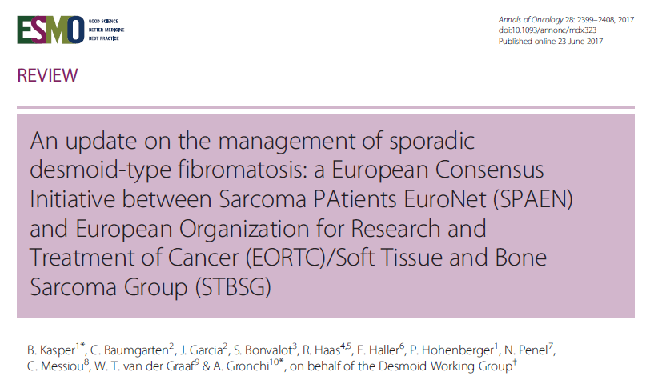

Slide 3
Introduction
Desmoid-type fibromatosis (DF) is a rare monoclonal, fibroblastic proliferation characterized by a variable and often unpredictable clinical course.
Peak age 30 – 40
5 – 10% occur in the context of FAP (Gardner’s syndrome)
Diagnosed on biopsy
Positive nuclear immunostaining for β-catenin in 85-90%
Confirmed by CTNNB1 activating mutation in equivocal cases
β-catenin and APC mutations are mutually exclusive
MRI

Slide 4
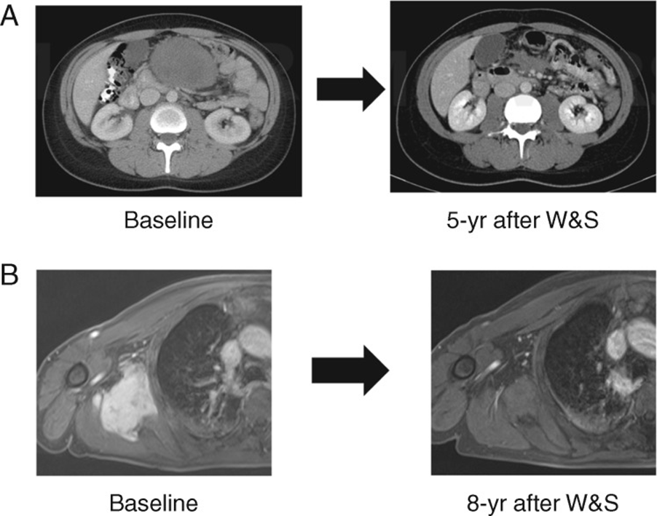
Indications for treatment
Upfront treatment is rarely indicated
Only ½ of patients
progress within 5 years
with observation
Spontaneous regression
seen in 20-30%

Slide 5
Indications for treatment
Pain No
Pregnancy No (40-50%) progress but usually self-limiting
May wish to delay pregnancy
Cosmesis Possibly
Abdo desmoid causing Yes
obstruction or perforation

Slide 6
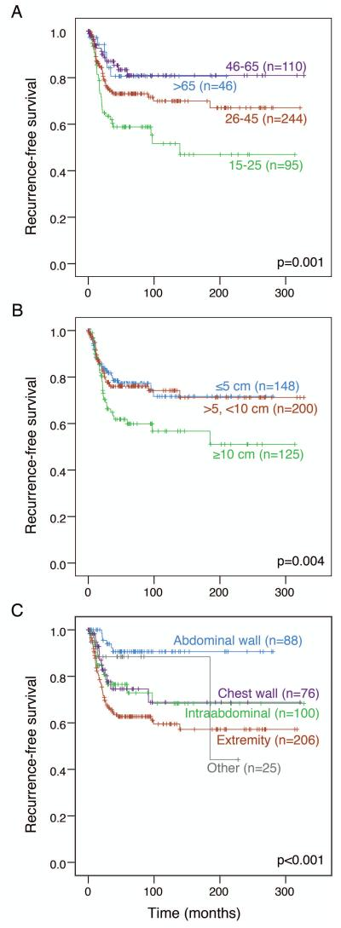
Should anyone have upfront surgery?
Initial observation generally appropriate for all
Surgery on progression an option if likely to control disease with minimum morbidity:
Age > 25
Tumour < 10cm
Abdominal wall site
??Upfront surgery if progression would make surgery significantly more morbid and patient fits the criteria above
Aim for microscopically negative margins
But function preservation takes priority

Slide 7
E.g.
32 year old
8 cm desmoid
Surgical control at 5y:
Abdo wall 90%
Extremity 57%

Slide 8
Watch and wait protocol
Year 1 3 monthly review
Years 2 – 5 6 monthly review
MRI at 6m intervals
Early imaging if clinical progression
If clinically appropriate, wait until 3 scans have shown progression (1-2 years) before starting active treatment

Slide 9
Management algorithm

Slide 10
Treatment options
Surgery Discussed
S + adjuvant RT No benefit if completely excised
Reduces recurrence is excision incomplete
Especially if surgery for recurrent disease
Medical Anti-hormonal treatment
NSAIDs
Low-dose chemo (e.g. oral vinorelbine)
Tyrosine kinase inhibitors
Full dose chemo (e.g. Caelyx)
RT alone

Slide 11
Medical treatment
Hormonal Tamoxifen 20mg bd +/- NSAID (e.g. meloxicam)
Radiological response rare (1/2 enlarge)
Symptomatic benefit in 32%
Reduction in T2 signal intensity correlates with benefit
Chemo Failure of hormonal treatment
Aggressive growth
Critical anatomic site
Originally weekly iv chemo for 1-2 years
50% RECIST response, 80% symptomatic response
mPFS 6 years
Oral vinorelbine also an effective option
Full-dose chemo as last resort for abdo / H&N cases
TKI Imatinib arrests progression in ½ at 2 years

Slide 12
Others
RT Effective – 70 – 80% local control at 10 years
Generally reserved for progressive, inoperable, symptomatic patients
2nd cancer risk – especially in young
Reduced mobility in deep tumours
ILP An alternative for progressive extremity tumours where surgery would lead to loss of function
Cryo / thermal
ablation Only 1 centre has published but excellent outcomes

Slide 13
Management algorithm

Slide 14
Abdo wall
Hormonal treatment
Surgery on progression (or upfront in selected cases)

Slide 15
Intra-abdominal
W & W
Surgery on progression (not in FAP)
Medical therapy if inoperable or recurs
Retroperitoneal / Pelvic
W & W
Medical therapy
Different medical treatment / surgery if resectable / RT

Slide 16
Extremities / Limb girdle / Chest wall
W & W ( consider early treatment if lesion threatens vessels / nerves)
Medical therapy
Surgery
RT
ILP

Slide 17
Patient perspective
Diagnosis often delayed
Uncertainties regarding diagnosis, treatment, possible recurrence
Peak age 35 / female predominance impacts on family planning
Psych input / patient support groups may help some

