Slide 1
Single centre experience of ovarian adult granulosa cell tumours
Jo Moffatt ST4
Claire Newton
St Michael’s Hospital, Bristol

Slide 2
Background
Aims and methods
Results
Conclusions

Slide 3
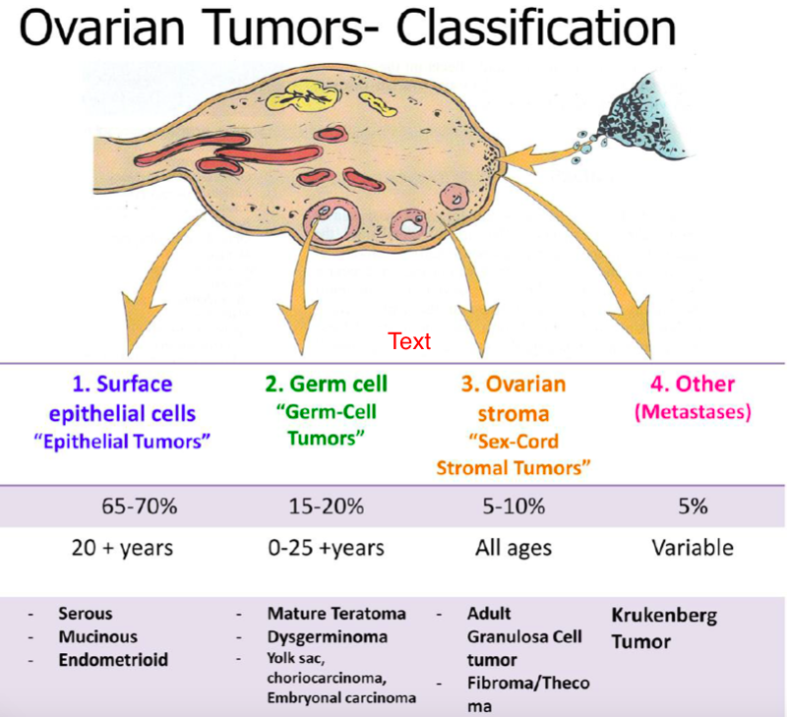
Adult granulosa cell tumours
Type of sex cord stromal tumours
5% ovarian cancer

Slide 4
ESMO 2018

Slide 5
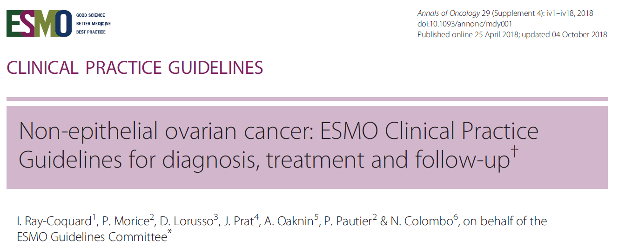

Slide 7
Questions to consider
Is laparoscopic approach safe?
  Current evidence shows no detrimental effect on oncological success with laparoscopic surgery
Is fertility preserving surgery safe? Does it increase recurrence risk?
  Fertility preserving surgery seems to have higher rate of recurrence over 10 year period but overall survival appears unchanged
  Completion surgery should be considered when family is complete
What is the optimal management of recurrence?
  Majority of current data supports surgery over chemotherapy
  Complete cytoreduction at time of surgery reduces risk of further recurrence
  Role of chemotherapy as first line management for recurrence controversial
MITO-9 Study, Zhao et al 2020

Slide 8
Methods
All histologically confirmed adult granulosa cell ovarian tumours since 2006 identified (n=14)
Retrospective analysis of all available hospital notes, pathology results and imaging reports
  Notes unavailable for 2 patients

Slide 9
Demographics
Median age at diagnosis: 50 years (27 – 73)
92% stage 1 at diagnosis

Slide 10
Diagnosis
CA125
HCG
CA19.9
CEA
Oestradiol
Inhibin
AFP
Notes:
8 women had adnexal masses on pre-op imaging. 2 women were diagnosed after oophrectomy for another reason (atypical hyperplasia, emergency laparotomy for torsion) with normal or no previous imaging. Imaging not available for 2 patients.
Inhibin and oestradiol are used for monitoring for recurrence. Studies have reported 100% have raised inhibin at diagnosis – unfortunately not performed routinely in our trust

Slide 11
Primary surgery
Open 58.3% and 41.7% laparoscopic
Cyst rupture in 33.3%
16.7% operative complication
25% had completion surgery
100% reported as ‘nil residual disease’
0% adjuvant treatment
Fertility preserving surgery?
5 women <45 years
Notes:
Complications:
Decompensation of chronic liver disease
Peritonitis post-op leading to death (NB. ESRF on periotneal dialysis)

Slide 12
Recurrence?
4 patients (33.3%) patients had recurrence
25% 1A, 75% 1C
Average time to 1st recurrence: 1502 days (49 months)
Average time to 2nd recurrence: 561 days (18 months)
Average time to 3rd recurrence: 717 days (23 months)

Slide 13
Recurrence?
Complete cytoreduction after surgery:
3 (100%) in first recurrence
3 (100%) in second recurrence
1 (50%) in 3rd recurrence
Surgical complications:
1 (33%) in first recurrence (pelvic collection)
1 (33%) in second recurrence (vascular injury)
None in third recurrence
Notes:
3rd recurrence – 2 had chemo and subsequent surgery, a third is considering surgery after chemo

Slide 14
Survival
Median duration of follow-up: 6 years
Median age at death: 54 years
Deceased (n=2):
Within 1 month of surgery due to post-op complication
9 years after diagnosis
Living with disease:
1 under active surveillance
1 considering further debulking surgery
Notes:
NB. Patient who died within a month of primary surgery had ESRF on peritoneal dialysis and died from peritonitis

Slide 15
Discussion
Is laparoscopic approach safe?
  No increase in complications
  25% recurrences had laparoscopic surgery
Is the fertility sparing approach safe?
  2 women had fertility sparing surgery and no evidence of recurrence
  1 live birth, 1 currently pregnant
What is the optimal management of recurrence?
  Survival rate for patients with recurrence 75%
  All managed primarily with surgery
  Further surgical debulking in majority
    Increased risk of complications
    Majority successful complete cytoreduction

Slide 16
References
Cancer Research UK. Sex cord stromal tumours. Available from: https://www.cancerresearchuk.org/about-cancer/ovarian-cancer/types/sex-cord-stromal [accessed Septemeber 2021]
I. Ray-Coquard, P. Morice, D. Lorusso, J. Prat, A. Oaknin, P. Pautier & N. Colombo, on behalf of the ESMO Guidelines Committee. Non-Epithelial Ovarian Cancer: ESMO Clinical Practice Guidelines. Ann Oncol (2018) 29 (Suppl 4): iv1–iv18.
Mangili G, Sigismondi C, Gadducci A, et al. Outcome and Risk Factors for Recurrence in Malignant Ovarian Germ Cell Tumors: A MITO-9 Retrospective Study International Journal of Gynecologic Cancer 2011;21:1414-1421.
Zhao, D., Zhang, Y., Ou, Z. et al. Characteristics and treatment results of recurrence in adult-type granulosa cell tumor of ovary. J Ovarian Res 13, 19 (2020). https://doi.org/10.1186/s13048-020-00619-6.

