Slide 1
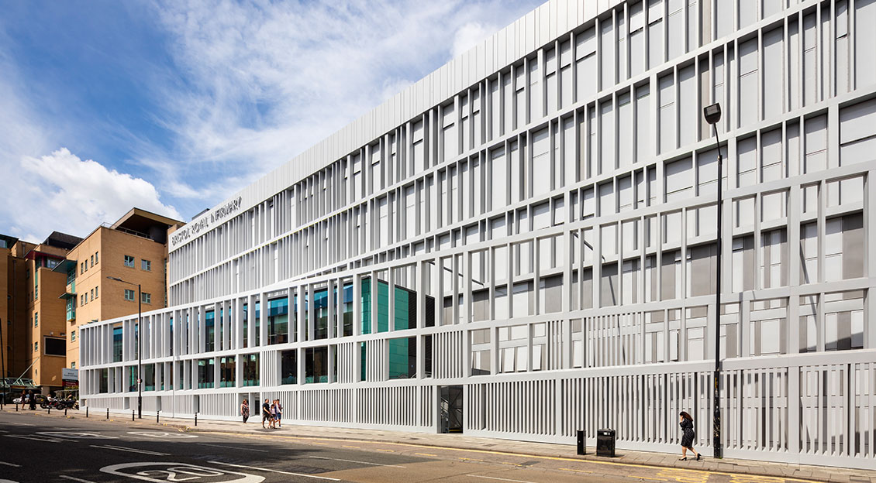
BRI Thoracic surgery service update: SWAG meeting 14/05/2024
Igor Saftić
Consultant thoracic surgeon
Clinical director for Thoracic surgery

Slide 3
Measures employed
Extended lists: Monday, Wednesday and Robotic
Glanso lists on most of the Weekends
4 additional monthly list to accommodate 6 th consultant
Changes in consultant job plans now and in the future

Slide 4
Theatre
New VATS instruments (8 complete sets)
3D operative preplanning (for segmentectomies)
Robotic surgery led to initial decrease of LOS
First 50+ cases done with no major issues
Powered staplers trial
Nav Bronch: C arm time under consideration
Cryo biopsy
Laser

Slide 5
LVRS
Plans underway to restart the service:
EBV and LVRS (surgery)
Full support from the Division

Slide 6
Team expansion
Lung cancer nurse employed
Lung MDT navigator
ANP (in the process)
6 doctors in training
6 consultants
Ward capacity

Slide 7
Nurse led follow up
Present in some SWAG regions
Aim to deliver it across the Alliance with business cases to support it
Patient to be d/c from surgery
Surgeon’s time reallocated

Slide 8
Forward planning
Second robot
Additional lists in 2025
Unification of service

