Slide 1
Colon Capsule Endoscopy experience at North Bristol
Dr Ana Terlevich
Gastroenterologist
Endoscopy lead

Slide 2
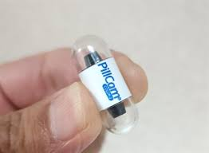
Colon capsule history
Capsule endoscopy first performed in 2004 in UK with small bowel capsule.
Colon capsule (CCE) first introduced in 2007
The currently available second-generation CCE (Medtronic), consists of a swallowable video capsule (11.6 mm × 31.5 mm), which has an optical system allowing for nearly 360° coverage via two 172° angle cameras.
The battery life is about 10 hours.
Adaptive frame rate function, which modulates the frame rate according to capsule progression speed in order to save battery and optimise video length. The frame rate alternates between 4–35 images per second depending on the motion of the capsule.
Capsule can also go into “sleep mode” in stomach and the “wake up” once small bowel mucosa detected.

Slide 3
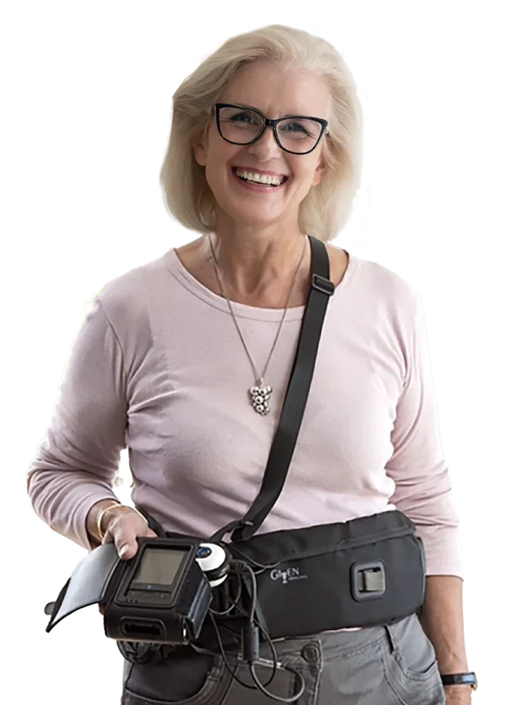
Colon capsule procedure explained
Patient follows standard bowel prep (low residue diet, oral Iron)
Split dose PEG prep at 7pm evening prior and 6am morning of procedure with clear fluid only from 10am day prior to procedure.
Patient presents to endoscopy unit at 10am where consented and belt and monitor attached
Patient swallows capsule and leaves with booster pack TTA dispensed by nurse:
50ml gastrografin and 30ml Fleet into 1l cold water taken 2 hours after swallowing
Further 50ml gastrografin and 15ml Fleet in 500ml cold water 3 hours after first booster (if capsule not passed)
Bisacodyl suppository 2 hours after second booster
Patient advised not to eat until capsule seen to pass or third booster used
Monitor and belt returned following day to endoscopy unit to download video

Slide 4
Contraindications to CCE
Avoid in patients with known strictures or history of obstruction. If any doubt, a dissolvable patency capsule can be used first.
Significant bowel prep – caution in patients at risk of electrolyte disturbance with bowel prep (renal disease, heart failure, antihypertensive meds)
Not advised for patients with swallowing difficulties
To avoid need for additional procedure, Complete studies with excellent bowel prep are key. Less likely in patients with history of constipation or diseases associated with slow transit (eg diabetes, Parkinson’s)

Slide 5
Logistics of our service
Within our endoscopy department. facilitated by a group of experienced capsule endoscopy nurses. Runs out of one of our admission rooms.
To accommodate CCE, we have 3 readers who have completed the online training course – all are able to read studies remotely.
Initially open to 2ww, low risk patients:
FIT <100
FIT<20 with clinical concern
absence of IDA
All potential suitable patients vetted
Expanded to include polyp surveillance patients (routine 3 year surveillance patients only)

Slide 6
Post CCE outcomes
Normal study with good views – discharged
Incomplete study or poor views – Colonoscopy (or flexi sig) with patient remaining on 2ww pathway
Pathology encountered requiring follow-up endoscopy – either colonoscopy or flexible sigmoidoscopy normally with down grading of urgency
We did not report 1-2 sub 5mm polyps (in-line with our trust CTC reporting policy, although we agreed we would consider in those aged<40)
Surveillance patients could also be deferred for 1 year or 3 years depending on number and size of polyps found.

Slide 8
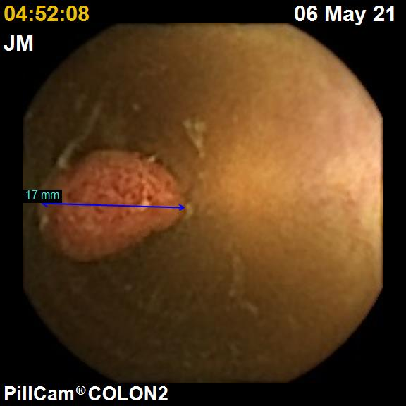
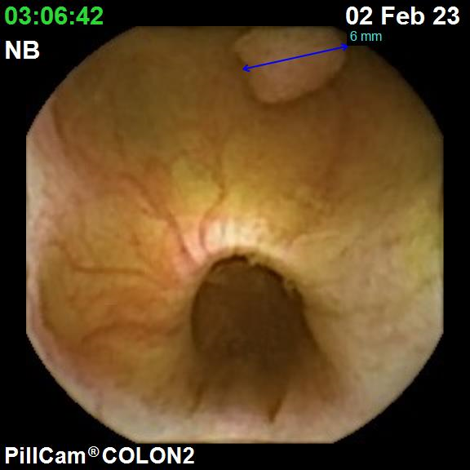
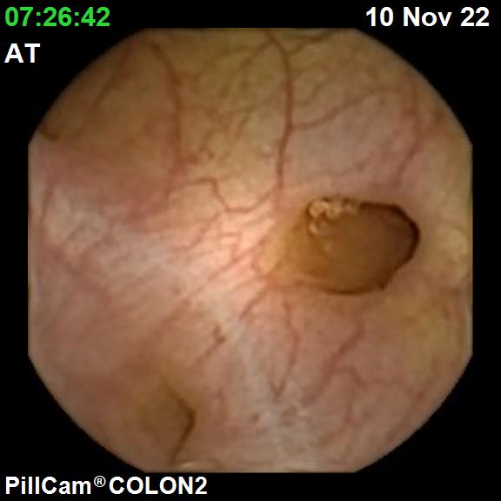
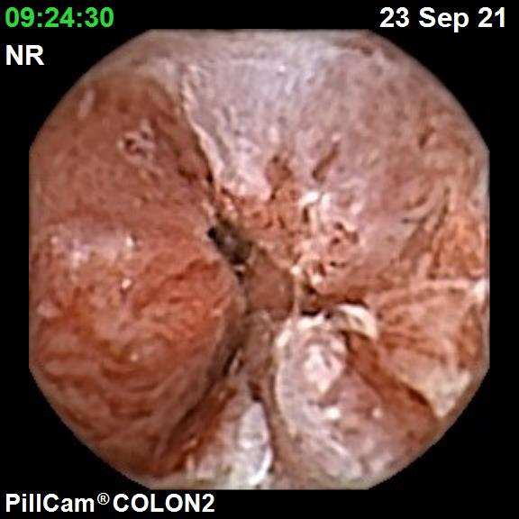
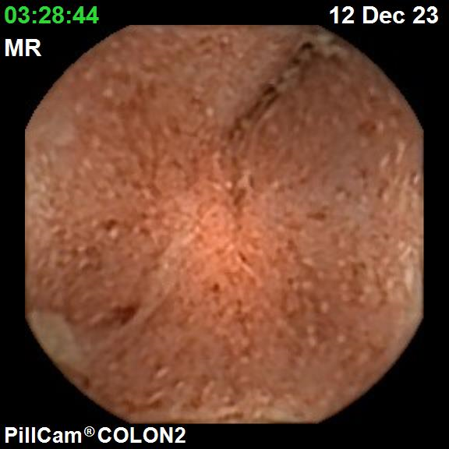

Slide 9
Results
104 CCE performed since May 2021
81 2WW criteria
9 polyp surveillance
14 other –
patient declining colonoscopy or requesting CCE to clinician.
Abnormality on CTC with failed colonoscopy – to characterise further.

Slide 10
NBT outcomes
indication | No additional | Colonoscopy | Flexi sig | Avoiding colonoscopy | Deferred colonoscopy
2ww | 29 (35%) | 37 (45%) | 13 (16%) | 42 (51%) | n/a
Polyp surveillance | 0 | 6 (67%) | 1 (11%) | 3 (33%) | 2(22%)
Other | 9 (64%) | 5 (35%)

Slide 11
Outcomes
Complete studies in 72% overall. Rising to 74% in 2ww criteria
One CRC in all of these studies (not seen on capsule as did not reach rectum – diagnosed at follow-up 2ww colonoscopy)
One patient with Oesophageal cancer and retention of capsule at GOJ.
Most polyps seen largely accurately placed, however slight tendency to over-call size.
Good feedback from patients.

Slide 12
National data
Pilot closed end of March. Full data outcome awaited.
Interim data shows of 8306 capsules swallowed:
CCE completion 74% (inter site variation between 81 and 72%)
Higher completion rate in male patients and those aged <70
Prucalopride improves completion rates to 78%
51% did not need further endoscopy
30% still needed colonoscopy but only 14% needed colonscopy urgently post CCE

Slide 13
Challenges
Getting patients vetted, capsule performed and then reported within 2 week timeframe was not possible. Best times 3-4 weeks.
Time consuming to read each study – between 30-60 minutes each. We did not find that came down considerably with experience.
Our trust colonoscopy waiting times reduced significantly over the course of the study so incentive to find patients for colon capsule dwindled.
Polyp surveillance patients were difficult to convince unless they had had previous difficult procedure. Those that found the bowel prep worst part of test preferred to wait for a colonoscopy instead.
We did not manage to introduce use of prucalopride to improve completion rates (off licence use)

Slide 14
Future development?
Finding the right group of patients that will have good prep with complete procedures and unlikely to have significant disease requiring additional endoscopy is the key to where CCE should be placed.
Future developments with AI assisted reading would make CCE much more attractive as a pre- colonoscopy screening tool ?lower qFIT group
Potential for centralised vetting and reading teams with CCE procedure pushed into the community is attractive and would speed up turnaround times

