Slide 1
FIT for Purpose
David Messenger
Consultant Colorectal Surgeon & Colorectal Cancer Lead UHBW

Slide 2
Audit & Research studies
The faecal immunochemical test (FIT) audit and evaluation in adults under 50 years in SWAG
The Multi-Cancer Blood Test Programme (MCBTP)
Cancer Vaccine Launchpad (CVLP study)

Slide 3
FIT audit in adults under 50 years

Slide 4
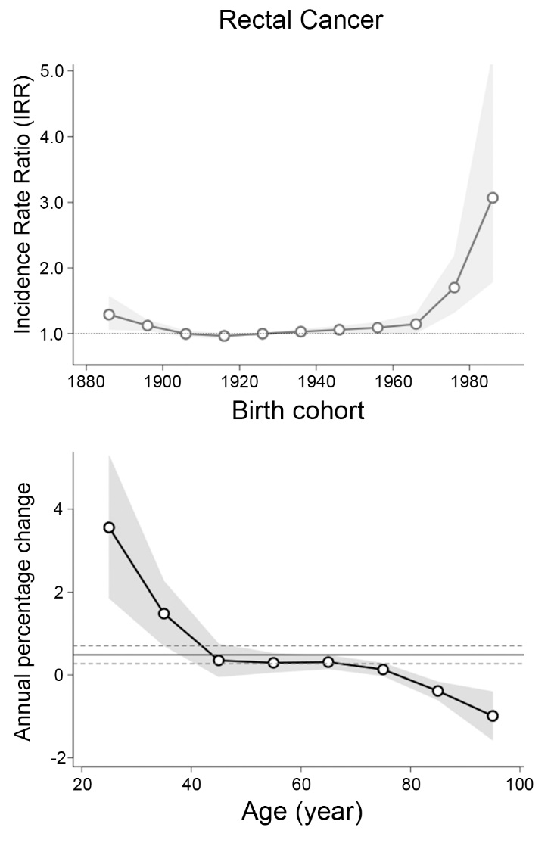
Background: Cohort effect
Why?
Chambers et al., Br J Surg 2020

Slide 5
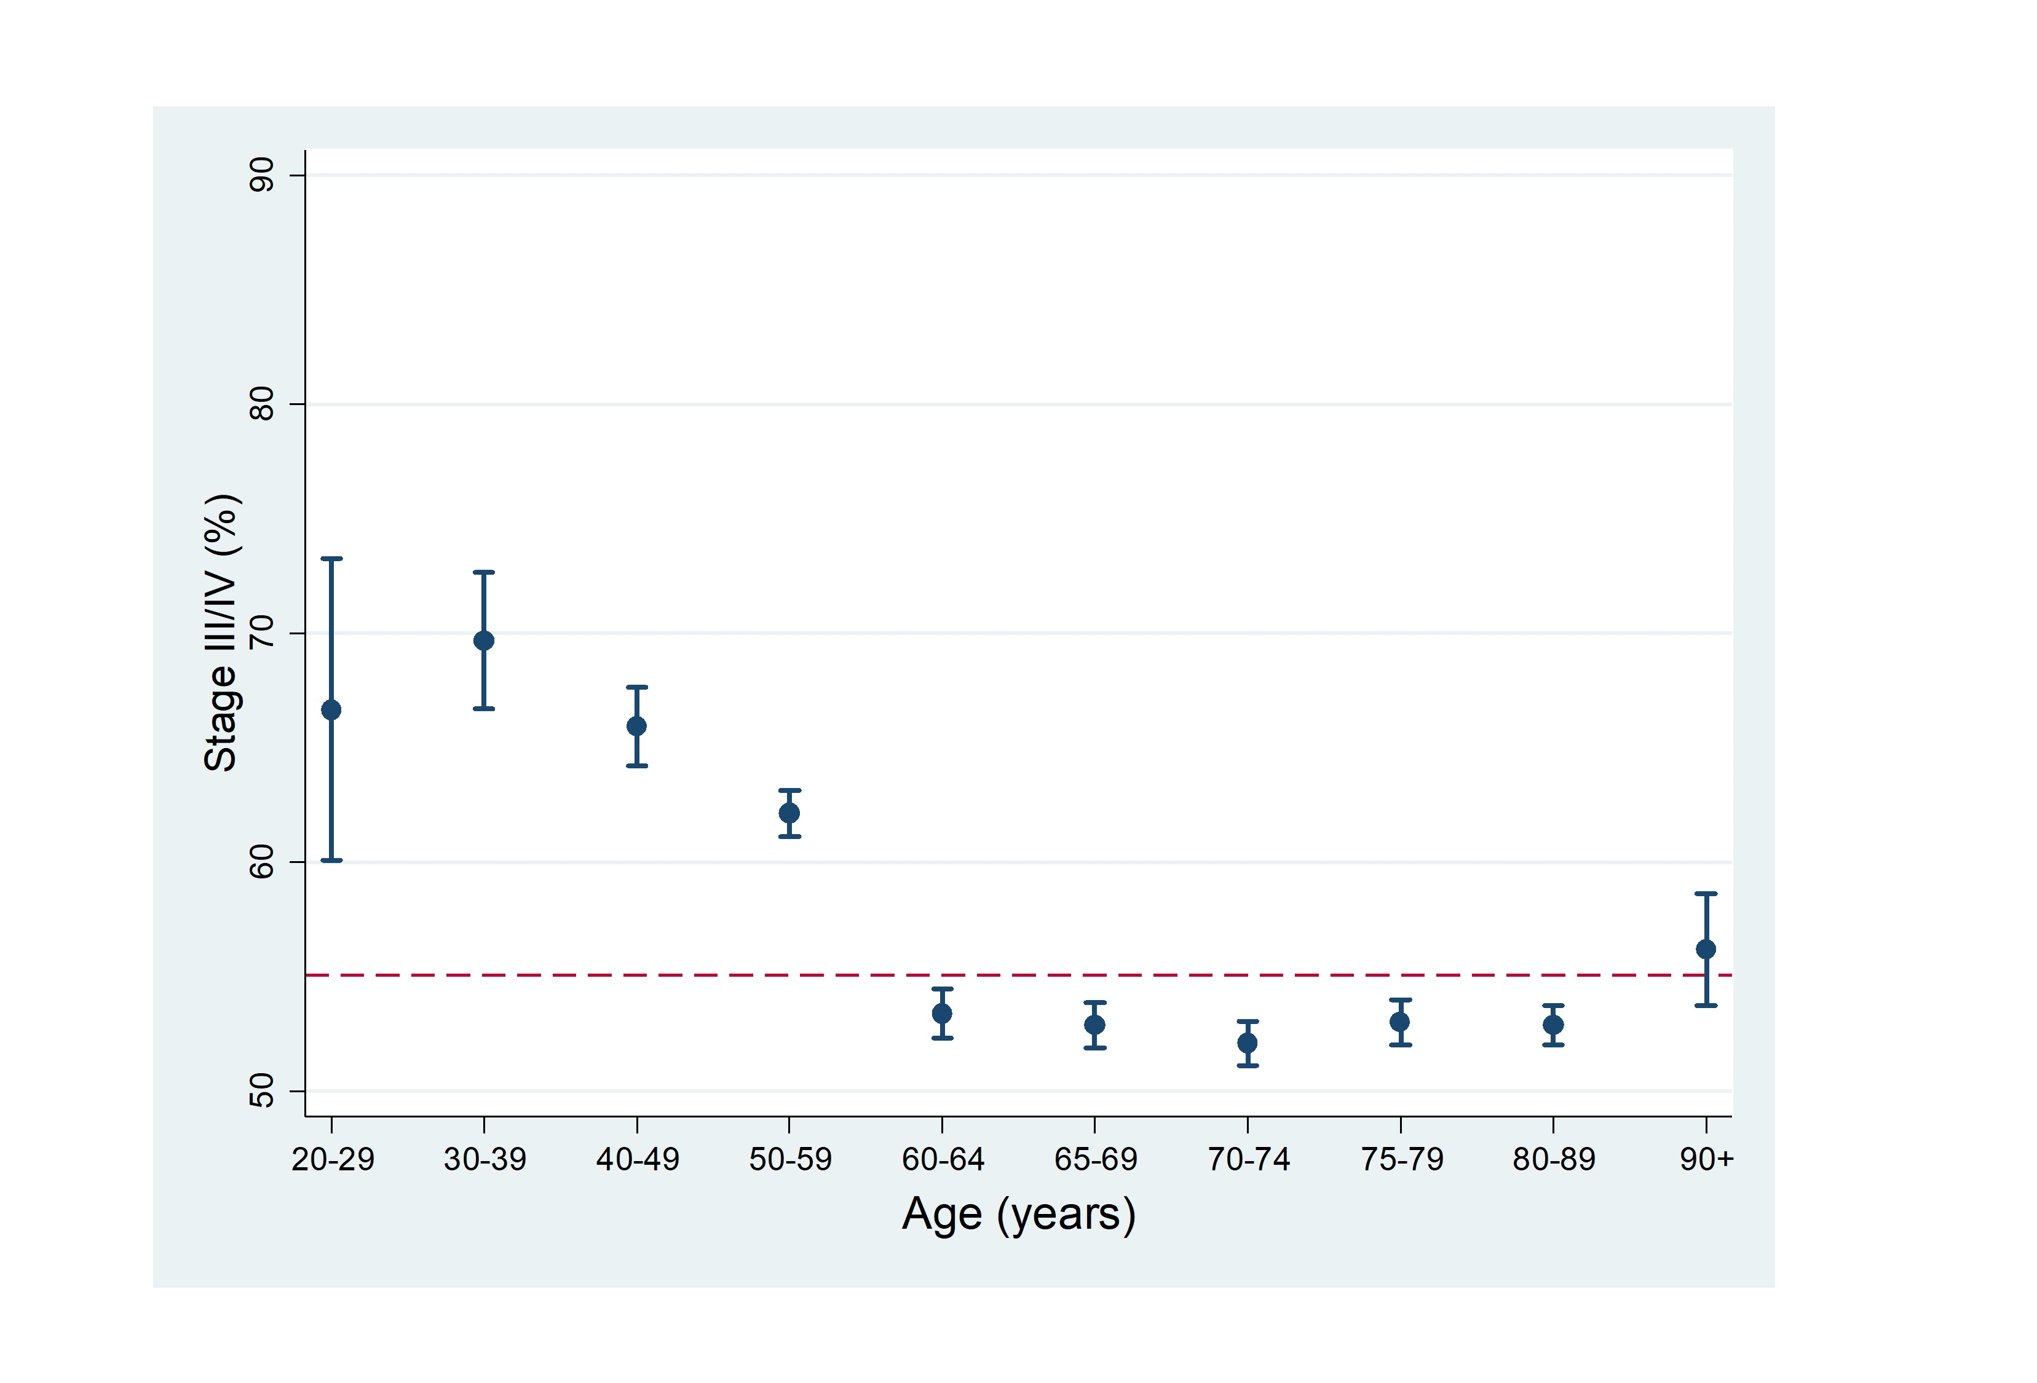
Background: Stage at diagnosis
Proximal tumours
Distal tumours
Chambers et al., Colorectal Dis 2020

Slide 6
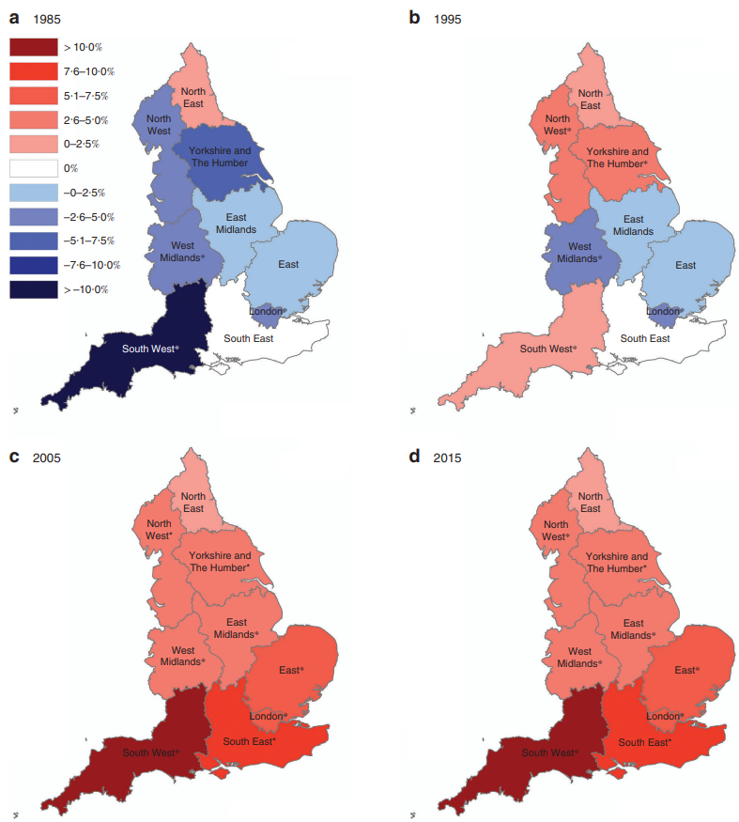
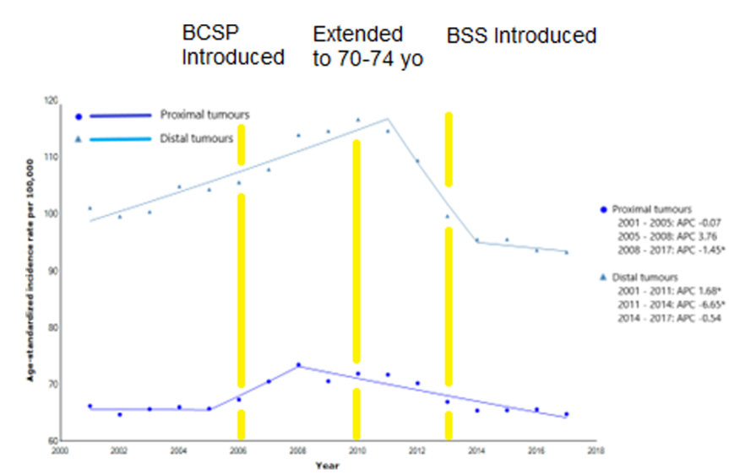
Background: Incidence trends
Granger et al., Colorectal Dis 2023
Chambers et al., Br J Surg 2020

Slide 7
Impact across the South-West of England
Age group (yrs) | 2041 population | 2041 Projected Incidence rate (per 100,000): current APC | Estimated number of cases in 2041: current APC | % | 2041 Projected Incidence rate (per 100,000): SW-specific APC | Estimated number of cases in 2041: SW-specific APC | %
20-29 | 443,700 | 5.0 | 22.2 | 7.2% | 16.3 | 72.3 | 30.0%
30-39 | 408,000 | 19.8 | 80.8 |  | 65.0 | 265
40-49 | 413,200 | 21.6 | 89.3 |  | 173 | 716
50-59 | 433,100 | 72.3 | 313 | 92.8% | 72.3 | 313 | 70.0%
60-64 | 207,100 | 105 | 217 |  | 105 | 217
65-69 | 211,700 | 31.2 | 66.1 |  | 31.2 | 66.1
70-74 | 230,700 | 57.5 | 133 |  | 57.5 | 133
75-79 | 216,400 | 198 | 429 |  | 198 | 429
80-89 | 277,800 | 358 | 995 |  | 358 | 995
90+ | 92,500 | 333 | 308 |  | 333 | 308
Total | 2,934,200 | 90.4 | 2653.4 |  | 120 | 3514.4

Slide 8
How early-onset colorectal cancer (EOCRC) presents in SWAG
Symptom | Symptom duration (n, %)
 | <5 weeks | 6-10 weeks | 11-24 weeks | >25 weeks
Rectal bleeding | 15 (12.7) | 34 (28.8) | 35 (29.7) | 34 (28.8)
Abdominal pain | 40 (33.6) | 22 (18.5) | 32 (26.9) | 25 (21.0)
Change in bowel habit | 24 (19.4) | 33 (26.6) | 34 (27.4) | 33 (26.6)
Weight loss | 3 (65.2) | 13 (28.3) | 19 (41.3) | 11 (23.9)
Anaemia | 8 (21.1) | 8 (21.1) | 12 (31.6) | 10 (26.3)
27%
48%
27%
48%
Biggs et al. on behalf of SWAG-YOCC group, Colorectal Dis 2022

Slide 9
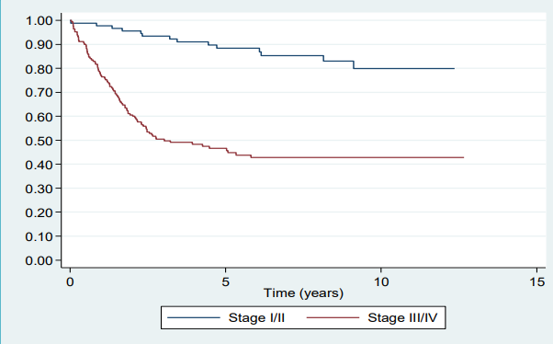
EOCRC overall survival in SWAG
Biggs et al. on behalf of SWAG-YOCC group, Colorectal Dis 2022

Slide 10
If we can diagnose at an earlier stage, survival is very good for EOCRC

Slide 11
Rationale
FIT known to have high negative predictive value (NPV): >99%
A good test for exclusion of CRC
Allows for risk stratification of referrals
BUT studies underpinning use based on adults >50 years
Little is known about diagnostic accuracy in adults <50 years
Studies small
NICE FIT only included 17 patients <50 years
Possible comparable sensitivity, specificity and NPV
Diagnostic accuracy needs to be known if application broadened to enhance early detection, i.e. stratified screening programmes

Slide 12
Aims
Determine sensitivity, specificity, PPV and NPV in symptomatic population <50 years
Develop model to identify cancer risk based on FIT value
Important concept PPV α prevalence of CRC
Sub-group analysis of aims 1 and 2 by age-band
20-29, 30-39, 40-49 years

Slide 13
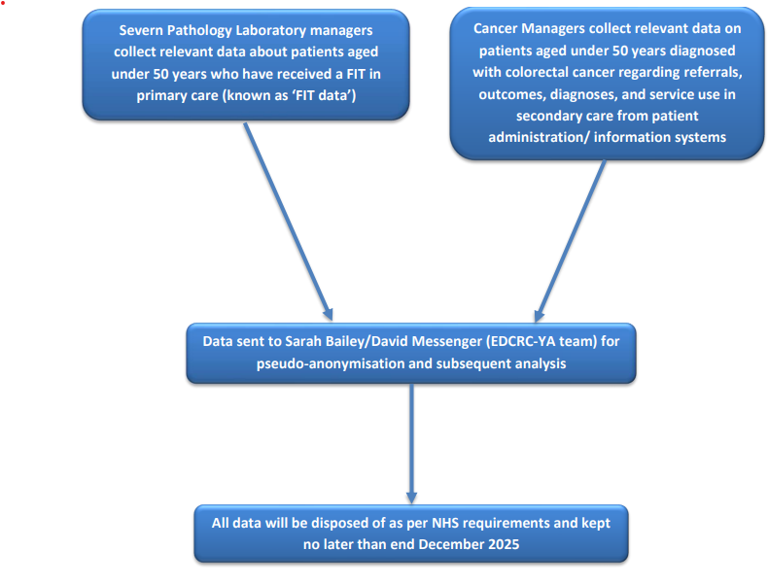
Methodology
All FIT undertaken between 01/01/2021 and 30/06/2023
All new diagnoses CRC between 01/01/2021 and 30/09/2023
Should allow for complete population coverage within SWAG

Slide 14
Progress
~41,000 FIT results have been processed
421 new diagnoses of CRC <50 years
Initial data linkage review suggest ~30% had FIT
125-130 cases for analysis
Sample size more than two times larger than previous diagnostic accuracy study of adults over 50 years conducted in SWAG
Currently in data analysis phase

Slide 15
Acknowledgements
Sarah Bailey, Associate Professor of Primary Care Diagnostics, University of Exeter
Adrian Heaps, Consultant Clinical Scientist, Severn Pathology, NBT
Allison Brixey, Laboratory Manager, Severn Pathology, NBT
Ryan Preece, Specialist Trainee in General Surgery, Severn PGME
Cancer Managers at the NHS trusts in SWAG
Rosie Edgerley, SomersetFT
George Thompson, Salisbury
Hannah Marder, Bristol
Edward Nicolle, RUH

Slide 16
Multi-Cancer Blood Test Programme (MCBTP)

Slide 17
What is it?
An in-service evaluation of a multi-cancer early detection blood test (Galleri) in the NHS
Pilot programme sponsored by NHS England
Aim is to offer 1 million tests across selected areas in England
Two-year programme running from summer 2024
Forms part of NHS Long Term plan for early cancer detection

Slide 18
What are the tests?
Cancer Signal Detection (CSD)
Detection of methylation patterns on cell-free DNA (cfDNA) released by apoptosis or necrosis of non-cancerous and tumour cells and found in peripheral circulation
Cancer Site Origin (CSO)
Further test to detect cancer origin
One or two most likely sites from possible 21 tumours
Includes colon, rectum and anal cancers
Prediction accuracy of 88%

Slide 19
Evidence base
Circulating Cell-free Genome Atlas substudy 3 (Klein et al., 2021)
99.5% specificity
Sensitivity increases with stage
Stage I: 17%, Stage IV: 90%
PATHFINDER study (Schrag et al., 2023)
Asymptomatic population
1.4% returned positive CSD
PPV of 43% and specificity 99.5%
CSO prediction accuracy of 88%

Slide 20
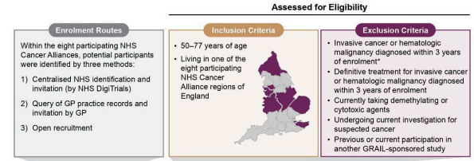
NHS-Galleri Trial
RCT of 140,000 people: August 2021 – July 2022
Primary endpoint: Incidence rate of stage III/IV cancer
Sampling deliberately skewed to areas/groups of increased deprivation

Slide 21
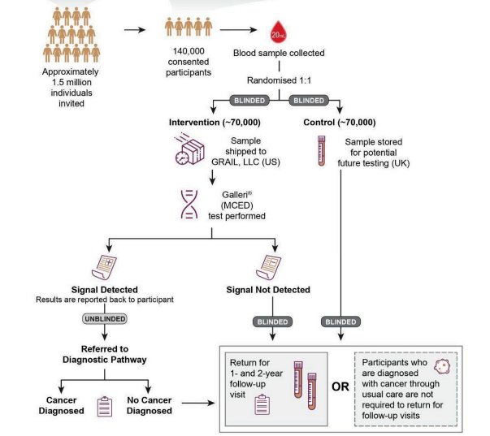
Trial pathway

Slide 22
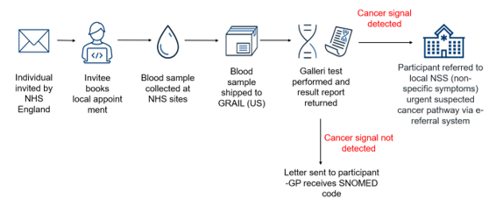
What is happening in SWAG?
Bristol, North Somerset and South Gloucestershire (BNSSG) ICB will contribute patients
I only learned of this a few weeks ago!
Patients being recruited across SWAG
Keen to know others experience/knowledge of process

Slide 23
Cancer Vaccine Launchpad (CVLP) study

Slide 24
What is it?
NHS England sponsored trial (recent NIHR approval)
Establish feasibility of pathways to enable patients to access cancer vacines
Based on mRNA technology
NHS Long Term Plan – looking for accelerated development
‘Riding the Covid vaccine wave’
BNT-122-01 is CRC trial arm

Slide 25
Patient eligibility criteria
Inclusion criteria
Patients who fulfil the following criteria are eligible to be consented into the CVLP to support the BNT-122-01 colorectal trial:
Be over the age of 18.
Have the capacity to consent to involvement in the CVLP.
Patients who are radiologically suspected high-risk stage 2 & 3 colorectal cancer that is or has been totally surgically resected as part of standard of care, either electively or as an emergency.
Post surgery and pathological assessment, they also need to fulfil the following inclusion criteria:
Are suitable for adjuvant chemotherapy (that has not yet started)
Patients who have stage II/stage III rectal cancer or stage II (high risk)/stage III colon cancer that has been totally surgically resected (R0 confirmed by pathology report). Stage II high risk colon cancer in defined at stage II disease with any of the following risk factors for reoccurrence:
T4/any N1 or N2 nodal involvement
Grade 3 / poorly differentiated
Clinical presentation with bowel obstruction or perforation
Histological signs of vascular, lymphatic or perineural invasion
Have sufficient tumour available for genomic analyses (to be assessed by local pathology once tissue sample is collected).

Slide 26
Patient eligibility criteria
Exclusion criteria
Diagnosed high microsatellite instability (MSI-H) or deficient MMR analysis (dMMR). NB- intermediate MSI is not an exclusion criterion.
Neo-adjuvant (radiotherapy or chemotherapy) prior to surgery.
Treatment with systemic immunosuppressive medication within 2 weeks prior to initiation of trial treatment or anticipation of the need for systemic immunosuppressive medication during trial treatment, with the exception of low dose steroids defined as 10mg oral prednisone (or equivalent).
Current or recent (within 28days prior to randomisation) treatment with another investigational drug.
Any known metastasis
The following additional inclusion criteria will be determined through screening at the trial site once the patient has consented into the trial:
Patients with detectable ctDNA prior to start of AdCTx
At least 5 tumour neoantigens identified in the provided tumour sample.

Slide 27
Trial Pathway
1. Patients identified by the clinical team managing their care
2. RN/HCP consents patient into CVLP, adds patient details to spreadsheet and sends to CL
3. Tissue sample taken from resection surgery
4. RN/HCP completes referral form for eligible patients, sends to trial site, copying in CL and sends tissue sample to the CPGC
5. Trial site consents patient into trial, allocates patient ID and informs CL.
6. CRC trial site to take blood sample for ctDNA testing 4-8 weeks after surgery and within 7 days prior to start of AdCTx
Key
RN - Research Nurse
CPGC - Cellular Pathology Genomic Centre
CL - NHSE clinical liaison
AdCTx – Adjuvant chemotherapy
- CVLP activity
- CRC trial site or
BioNTech activity
10. BioNTech to carry out ctDNA test/screening 1 and inform trial site of result. Trial site to inform CL.
7. CL to tell CPGC once patient has consented into the trial and reference number
8. CPGC to prepare curls & slides for screening within 5 working days
9. Curls & slides for trial patients sent to BioNTech
11. If patient is ctDNA positive, trial sites will complete screening 2 (take blood sample for vaccine manufacturing at least 14 days before last dose of AdCTx) and screening 3 (earliest 14 days after last dose of AdCTx).
12. CL to tell CPGC if patient is eligible for vaccine manufacture
14. 2nd set of curls & slides for trial patients sent to BioNTech
15. BioNTech to sequence eligible patients. Patients randomised to experiential or observational group.
13. CPGC to prepare 2nd set of curls & slides for sequencing and vaccine production within 3 working days
NHS CVLP
Cancer vaccine clinical trial

Slide 28
Current status
UHBW (BRI site) and NBT currently recruiting patients
Gloucestershire commenced recruitment?
Velindre is Cancer Vaccine delivery site
Aim is to recruit 1-2 patients per month initially
Allow pathway to become embedded

Slide 29
UHBW (BRI site) experience with Robotic Colorectal Cancer Resections

Slide 30
Summary
Two surgeons trained and undertaking procedures (DM and JS)
September 2023 – April 2024 (~6 month) period
DaVinci Xi platform
30 CRC resections in total
10 right hemicolectomies
10 high anterior resections
6 low anterior resections
2 extralevator abdominoperineal excisions
2 Hartmann’s procedures
Replacement of laparoscopic practice

Slide 31
Outcomes
Clavien Dindo ≥III (return to theatre <30 days)
2/30 (6.7%)
Colostomy necrosis & small bowel microperforations (?ischaemic)
30-day readmission
1/30 (3.3%)
Colostomy necrosis
Anastomotic leak
0/26 (0%) (!)
Wound infection
1/30 (3.3%)
Early experience suggests it is safe
Length of stay data to follow

