Slide 1
Symptomatic Faecal Immunochemistry Testing (FIT) Update
SWAG Colorectal Cancer Clinical Advisory Group Meeting 02.05.2024
Dr Adrian Heaps
Consultant Clinical Scientist

Slide 2
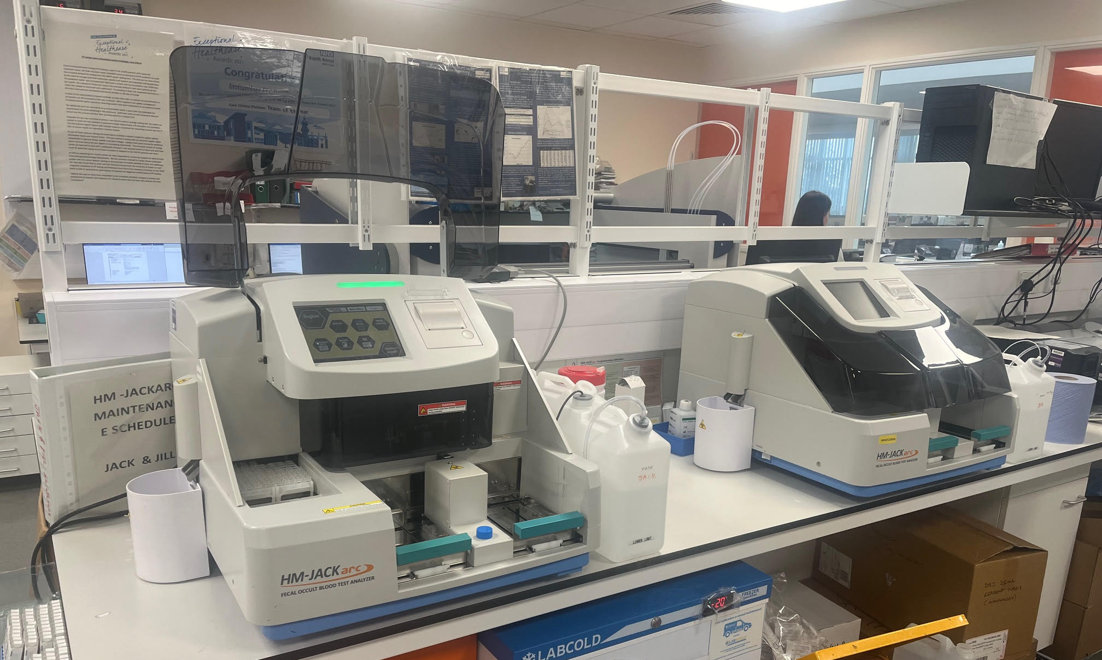
Notes:
HM-JACKarc FIT Analysers (Jack and Jill)
2

Slide 3
Summary
Symptomatic FIT for SWAG-CA region:
BSW – 48K /yr (postal requests)
BNSSG – 43K / yr (90% ICE requests)
GLOS – 28K / yr (NPEX lab links)
SOM – 24K / yr (Postal and minority NPEX)
Non-SWAG ~1K / yr (various)
99% primary care requests 1% secondary care

Slide 4
FIT workload
Notes:
From 500 tests per month in 2018 to an average of 12000 tests per month
4

Slide 5
FIT workload by requesting source

Slide 6
Positivity rate
Notes:
Current mean is 18% positivity (17.2% - 19.5%)
6

Slide 7
% testing under 50 years
Notes:
Currently ~20% of FIT requests are in the <50s
7

Slide 8
Workload by requesting criteria
New FIT criteria introduced July 2022 (BSG):
Previous criteria:
Change in bowel habit age (>40 yrs)
Iron / non-iron deficiency anaemia
Symptoms but are low risk (>18 yrs)
New criteria:
2 week wait referral
Non-site-specific symptoms
Low risk but not no risk
Notes:
New requesting criteria introduced Mid 2022
8

Slide 9
Workload by requesting criteria
Notes:
New requesting criteria introduced July 2022
9

Slide 10
Workload by requesting criteria 2023-24
Notes:
New requesting criteria introduced July 2022
10

Slide 11
Workload by requesting criteria 2023-24
Notes:
New requesting criteria introduced July 2022
11

Slide 12
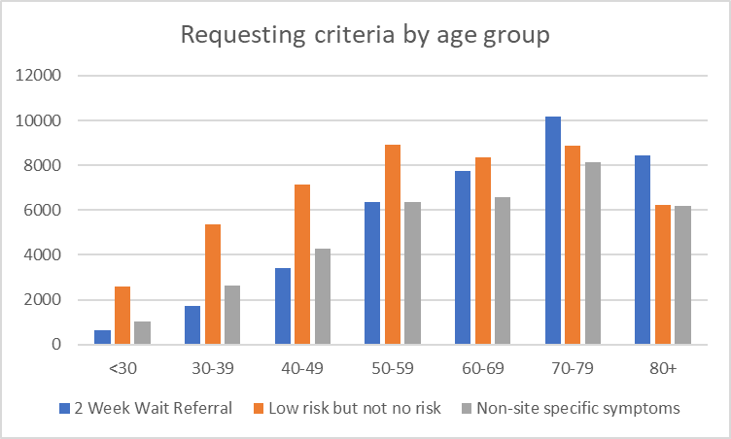
FIT requesting criteria by age group

Slide 13
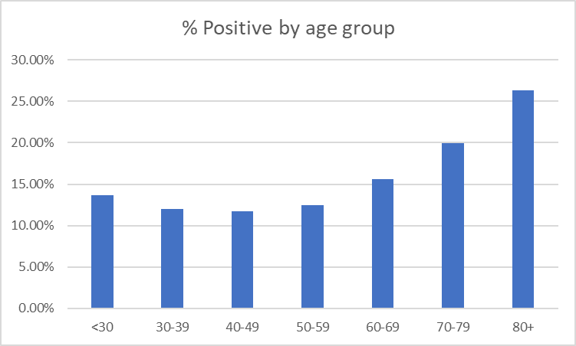
Total % positives by age group
Age | Request_Count | Positive Count | % Positive
<30 | 8835 | 1208 | 13.67%
30-39 | 20970 | 2525 | 12.04%
40-49 | 36689 | 4290 | 11.69%
50-59 | 69276 | 8622 | 12.45%
60-69 | 68499 | 10668 | 15.57%
70-79 | 84382 | 16832 | 19.95%
80+ | 63330 | 16666 | 26.32%
Grand Total | 351981 | 60811 | 17.28%
Notes:
Data since 2018
13

Slide 14
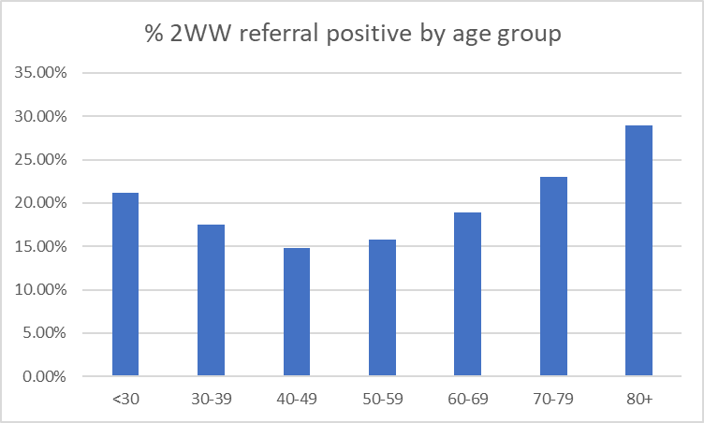
% positivity by age group: ‘2 week wait referral’ criteria
 | 2 Week Wait Referral
Age group | % Positive
<30 | 21.17%
30-39 | 17.54%
40-49 | 14.79%
50-59 | 15.74%
60-69 | 18.89%
70-79 | 23.00%
80+ | 28.95%
Notes:
2023-24
14

Slide 15
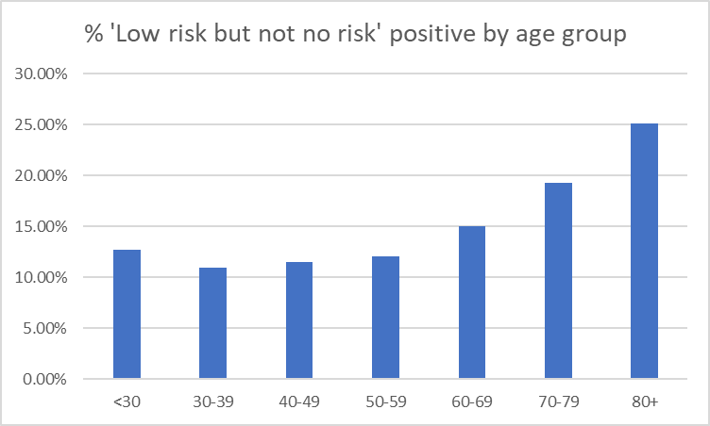
% positivity by age group: ‘Low risk but not no risk’ criteria
 | Low risk but not no risk
Age group | % Positive
<30 | 12.66%
30-39 | 10.98%
40-49 | 11.52%
50-59 | 12.07%
60-69 | 14.97%
70-79 | 19.32%
80+ | 25.08%
Notes:
2023-24
15

Slide 16
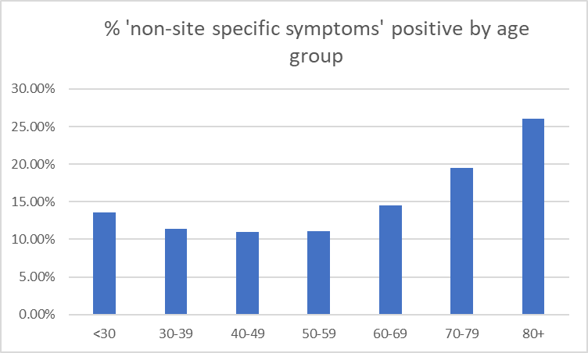
% positivity by age group: ‘non-site-specific symptoms’ criteria
 | Non-site-specific symptoms
Age group | % Positive
<30 | 13.59%
30-39 | 11.34%
40-49 | 10.96%
50-59 | 11.11%
60-69 | 14.51%
70-79 | 19.48%
80+ | 26.02%
Notes:
2023-24
16

Slide 17
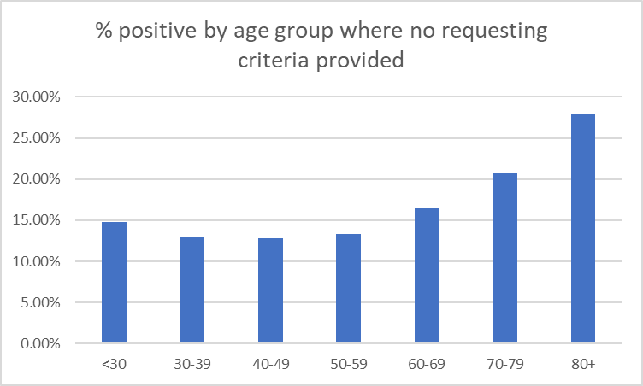
% positivity by age group: no criteria provided with request
 | No criteria provided
Age group | % Positive
<30 | 14.75%
30-39 | 12.96%
40-49 | 12.83%
50-59 | 13.29%
60-69 | 16.48%
70-79 | 20.68%
80+ | 27.88%

Slide 18
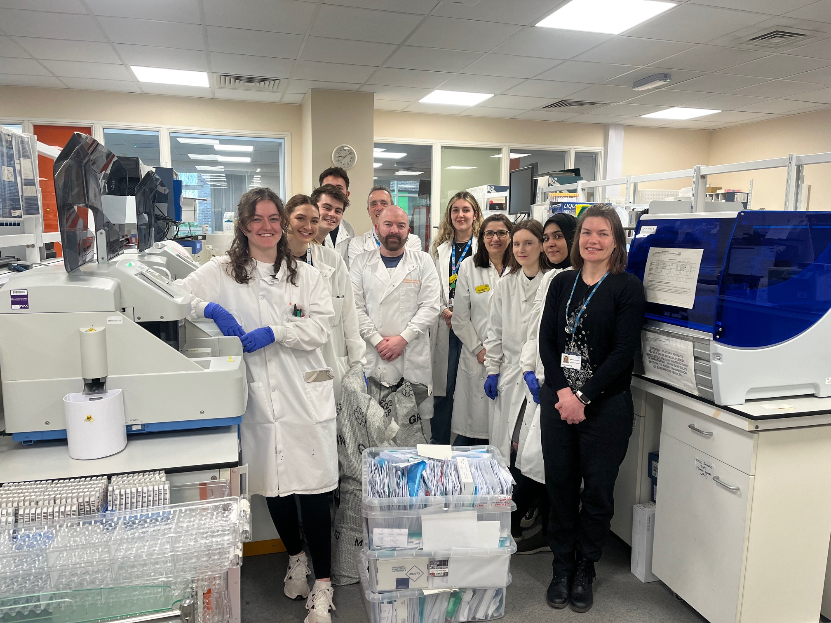
Notes:
Kathryn, Mia, Jacob, Andi, Darrell, Mike, Holly, Afsaneh, Michaela, Naba and Ellen
18

