Slide 1
SWAG Network Lung Cancer
Clinical Advisory Group
Research Update
Claire Matthews & Gareth Ayre
14/05/2024

Slide 2
National Recruitment to Lung Cancer Studies
Apr 2022 - Mar 2023
Apr 2023 - Mar 2024
Data cut 09/05/2024
Source: ODP All Portfolio

Slide 3
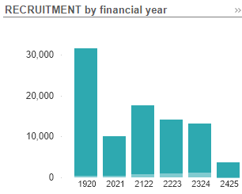
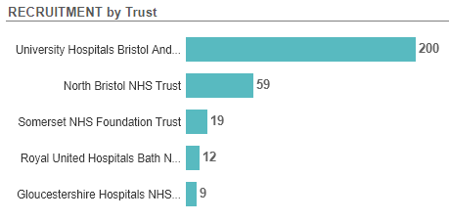
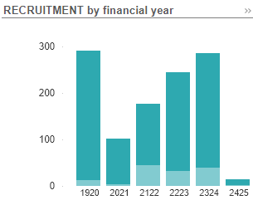
National vs Regional Recruitment to Lung Cancer Studies Apr 2019 - May 2024
National Recruitment
SWAG region Recruitment
Data cut 09/05/2024
Source: ODP All Portfolio

Slide 4
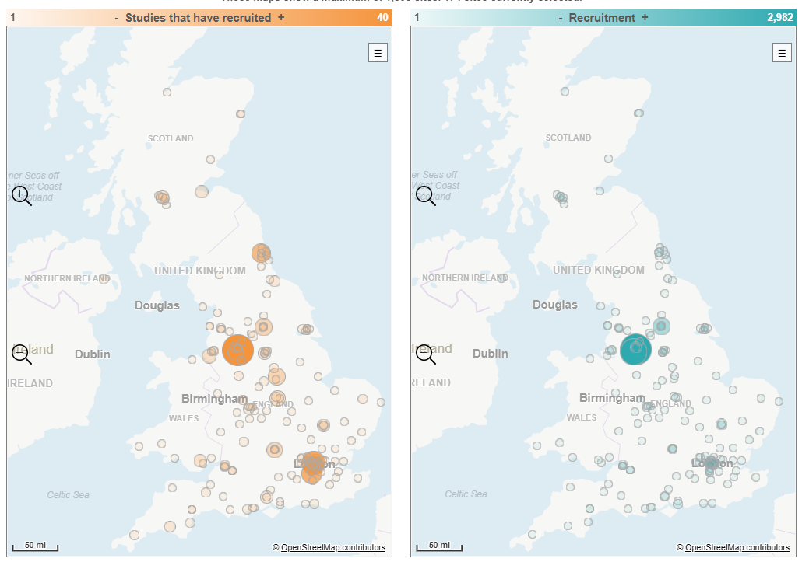

Slide 5
Study | Description | Centre
Pleural
MITOPE | Phase 1/2 of RSO-021 (thiostreopton) in malignant pleural effusion (mesothelioma or metastatic) | NBT
eVOLVE-Meso | Volrustomig (bi-valent PDL1 / CTLA4 Mab) vs carbo-pem or Ipi-Nivo in MPM | Taunton
Meso-ORIGINS | Observational study of RIsk prediction and Generation of paired benign-meso tissue samples | NBT, Taunton
mNSCLC
REFINE | Maintenance pembro dosing interval | BHOC, Taunton, Yeovil, Salisbury
Genmab | GEN1046 (bi-specific MAb – PDL1 and 4-1BB) in recurrent NSCLC | Cheltenham
KontraRASt-02 | JDQ-443 vs docetaxel in pre-treated KRAS G12C NSCLC | Salisbury
AVANZAR | Dato-Dxd-carboplatin-durvalumab vs standard chemo-pembro in mNSCLC without a driver mutation | Taunton, Cheltenham
Radiotherapy
E²-RADIatE | RWD – radiotherapy infrastructure study | Taunton

Slide 6
Study | Description | Centre
Peri-operative NSCLC
ADAURA2 | Adjuvant osimertinib in stage IA2-IA3 NSCLC with EGFR mutation | Taunton, Salisbury
Stage 3 NSCLC
PACIFIC-8 | Durvalumab +/- domvanalimab following cCRT for inoperable Stage 3 NSCLC | Cheltenham, Taunton
PACIFIC-9 | Durvalumab +/- oleclumab or monalizumab following cCRT for inoperable Stage 3 NSCLC | BHOC
Small cell
IMForte | Atezolizumab +/- lurbinectedin as maintenance treatment for ES-SCLC | Salisbury
PRIMALung | MRI surveillance +/- prophylactic cranial irradiation in SCLC | BHOC, Cheltenham
Not tumour-specfic
MITRE | Impact of microbiome on immunotherapy efficacy and toxicity | BHOC, Taunton, Bath, Yeovil, Salisbury
WAYFIND-R | Registry in patient profiled with NGS | Bristol, Taunton, Yeovil, Swindon, C&G

Slide 7
Lung Cancer Studies opened in last 12 months
CPMS ID | Short Name | Open | Closure | Sample Size Eng | Eng Recruits
57835 | NHS Cancer Vaccine Launchpad (NHS CVLP) | 17/04/2024 | 01/05/2025 | 9951 | 7
54523 | Tarlatamab with Standard of Care Chemotherapy in Relapsed Small Cell Lung Cancer | 28/03/2024 | 01/05/2025 | 9 | 0
53427 | Sotorasib versus Pembrolizumab - NSCLC | 15/03/2024 | 28/02/2026 | 22 | 0
56813 | REZILIENT2 | 08/02/2024 | 12/08/2024 | 2 | 1
56318 | CANFit: home-based exercise programme for patients with cancer | 04/12/2023 | 18/10/2024 | 660 | 0
55363 | eVOLVE-Meso | 24/11/2023 | 30/09/2025 | 40 | 10
53017 | ELEX2101-X02101 | 13/10/2023 | 01/04/2024 | 31 | 3
54864 | Lighthouse - v2, 31Mar2023 | 09/10/2023 | 21/01/2025 | 125 | 83
52009 | M18-868 | 12/07/2023 | 07/03/2027 | 13 | 2
42105 | EFC15858 | 23/06/2023 | 15/04/2024 | 4 | 0
51510 | MX39897: Registry in patients profiled with NGS | 12/05/2023 | 31/12/2026 | 100 | 62
Full list of open studies to be circulated

Slide 8
Cancer Vaccine Pathway Studies: Lung
NHS Cancer Vaccine Launchpad (NHS CVLP):
Establishing a UK Platform to collect Tumour Samples and Perform DNA/RNA Sequencing for the Development of Personalised Cancer Vaccines. Multiple sites in region
Phase 3, Two-stage, Randomized Study of ONC-392 Versus Docetaxel in Metastatic Non-Small Cell Lung Cancers that Progressed on PD-1/PD-Ll Inhibitors
Study Opened Feb 24, no recruitment recorded. No sites open in region, Torbay, RDE, So’ton closest
LuCa-MERIT-1: First-in-human, open label, Phase I dose confirmation trial evaluating the safety, tolerability and preliminary efficacy of BNT116 alone and in combinations in patients with advanced non-small cell lung cancer
Study opened Apr 24, no recruitment recorded. No sites in region, Velindre closest
Phase 1/2 Study of mRNA 4359 Administered Alone and in Combination With Immune Checkpoint Blockade in Participants with Advanced Solid Tumors (MOBILIZE Trial)
Study opened Aug 23. 8/25 recruited. No sites open in region, Torbay, RDE, So’ton closest
A Phase 1, Multicenter, Open-label, Nonrandomized, First-in-human Study of OVM-200 as a Therapeutic Vaccine in Patients with Locally Advanced or Metastatic Non Small Cell Lung Cancer, Ovarian Cancer, and Prostate Cancer
Study opened Sept 21. 8/14 recruited. No sites open in region, Torbay, RDE, Velindre, So’ton closest

Slide 9
DETERMINE
Determining Extended Therapeutic indications for Existing drugs in Rare Molecularly defined Indications using a National Evaluation platform trial
Aim:
Evaluate the efficacy of licensed targeted therapies in unlicensed indications, in rare adult, paediatric and TYA cancers with actionable genomic alterations (including common cancers with rare actionable alterations)
Identify genomic,transcriptomic and immune contextual influences on response to therapy
The ultimate aim is to transition positive findings to the NHS (Cancer Drugs Fund [CDF]) to provide new treatment options for patients with rare malignancies.
Arm 1 Alectinib
Arm 2 Atezolizumab
Arm 3 Entrectinib
Arm 4 Trastuzumab in combination with pertuzumab
Arm 5 Vemurafenib in combination with cobimetinib

Slide 10
Associate PI Scheme
https://www.nihr.ac.uk/health-and-care-professionals/career-development/associate-principal-investigator-scheme.htm
A six month in-work training opportunity, providing practical experience for healthcare professionals starting their research career. People who would not normally have the opportunity to take part in clinical research in their day to day role have the chance to experience what it means to work on and deliver a NIHR portfolio trial under the mentorship of an enthusiastic Local PI.
CIs working with a CTU can register their study on the scheme https://www.nihr.ac.uk/health-and-care-professionals/career-development/register-your-study-for-the-associate-principal-investigator-scheme.htm
REFINE-Lung A randomised open-label phIII trial of Reduced Frequency pembrolizumab immuNothErapy for first-line treatment of patients with advanced NSC lung cancer utilising a novel multi-arm frequency-response optimisation design. No APIs in the region (site: UHBW)
WAYFIND-R - microbiome as a biomarker of response and toxicity to ICIs (Sites: Bristol and Bath) 1 API in region (UHBW)
ICI Genetics No APIs in the region (sites: Musgrove, UHBW)
MITRE Microbiome Immunotherapy Toxicity and Response Evaluation (MITRE) . 2 APIs in the region (UHBW) Other sites: Yeovil, Musgrove, Salisbury, RUH

Slide 11
Principal Investigator Pipeline Programme (PIPP)
https://www.nihr.ac.uk/documents/principal-investigator-pipeline-programme-pipp/33803
A new scheme support research delivery nurses and midwives by supporting them to become Principal Investigators (PIs)
Free of charge for eligible participants
Delivered through a variety of live virtual and on-line classroom environments, combined with real world hands-on experience.
COHORT 2 key dates: Applications opened 1st March 2024
31st May 2024: Close to applications
End June 2024: Applicants notified of outcome of application
September 2024: COHORT 2 begins

Slide 12
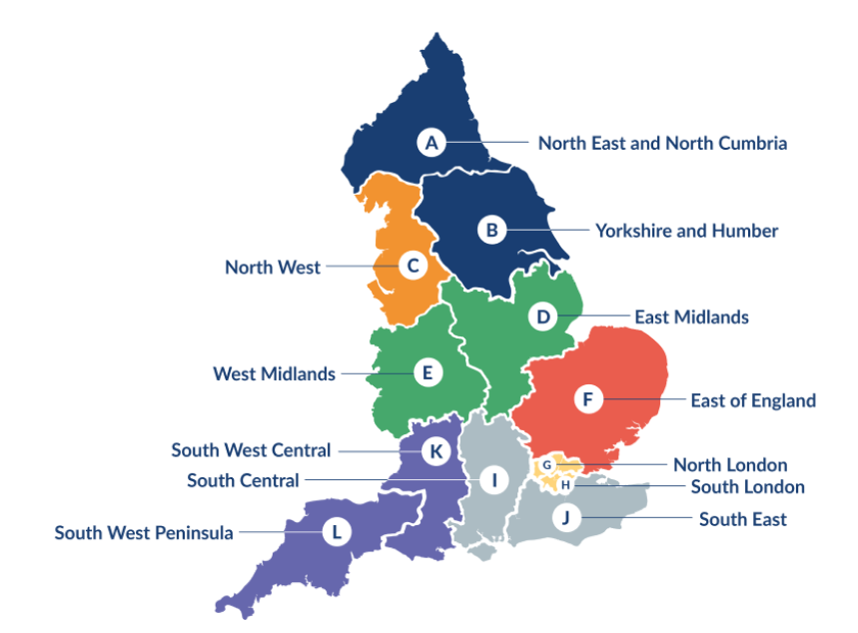
Clinical Research Network Transition to Research Delivery Network
Launching Oct 2024
The NIHR RDN has 2 primary purposes:
To support the successful delivery of high quality research, as an active partner in the research system
To increase capacity and capability of the research infrastructure for the future
SW Central
Network Director: Kyla Thomas
Operations Director: Stephen McGlynn
Strategic Development Director: Ifan Jones
We are recruiting for two new senior leadership vacancies.
RRDN Health and Care Research Director (Medical) - 0.4wte, appropriate clinical salary (e.g. Consultant) or AfC Band 8d, closes 15th May
RRDN Health and Care Research Director (Nurse, Midwife or Allied Health Professional) - 0.4wte, AfC Band 8d, closes 23rd May
You can find both of these roles on NHS Jobs

Slide 13
LCRN Contacts
Research Delivery Managers
West of England: claire.matthews@nihr.ac.uk
South West Peninsula: joannetaylor1@nhs.net
Research Portfolio Facilitator
West of England: rebecca.pienaar@nihr.ac.uk
Subspecialty Lead
Gareth Ayres

