Slide 1
The development of a digital self-management platform for people living with lung cancer
HandHeld Health - Lung Cancer App
Suriya Kirkpatrick
OxInAHR PhD Student
Advanced Research Practitioner
Chair LCNUK RIG

Slide 2
The Team
Supervisors
Professor Eila Watson
Professor Cathy Henshall
Dr Zoe Davey
Dr Peter Wright
Clinical Advisors
Dr Helen Winter
Dr Iain Phillips
Commercial/Digital Advisor
Dr Stan Windsor
Patient Representative
Janette Rawlinson
Funding
Oxford Institute for Applied health Research
Oxford Brookes Knowledge Exchange Award (£30,000)
North Bristol NHS trust
Collaborators
HedgeHog Labs
Cirenia Sketches
North Bristol NHS Trust
Oxford University Hospital Trust
The Royal Marden NHS Foundation Trust

Slide 3
Agenda
Background
Systematic review
Co-development of the HHH Lung Cancer App
What's next?
Discussion/Questions

Slide 5
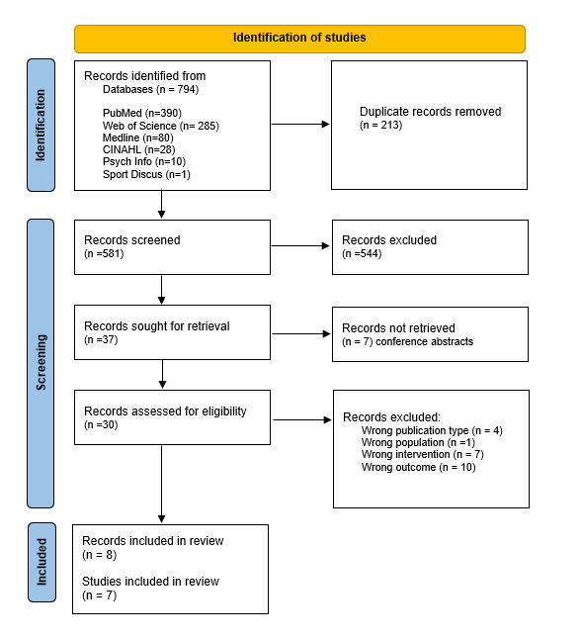
Literature Review
Aim:
To establish what mHealth and eHealth technologies have been developed to support people with lung cancer to improve or maintain physical functioning and/or impact their quality of life.
Findings:
eHealth apps are generally acceptable to people with lung cancer
Can positively impact their physical functioning and wellbeing
Limited studies that demonstrate the impact of these digital interventions over longer periods
None of the studies report on the implementation or adoption of the mobile or electronic health interventions in routine clinical practice
Need for further research in this area

Slide 7
Background
Lung cancer remains one of the most prevalent cancers globally
Approximately 48,500 new cases are diagnosed in the UK every year
Despite early diagnosis and improvements in treatment people with lung cancer are not living as long as people with other cancers
Good symptom management and improved quality of life is a priority
Current health care services have limited capacity to provide this support
One way to address this issue is to empower patients to self-manage their condition using mobile or electronic health technologies

Slide 8
So…
We are developing a new, holistic, tailored, evidence-based digital self-management platform for lung cancer survivors to:
Improve physical functioning
Enhance QoL
Improve symptom management
Derived from two other apps developed at OBU
iExhale and HHH.
Notes:
Reduce carbon footprint
Reduce pressure on NHS resources
Cross professional boundaries
Current programs limited and difficult to access

Slide 9
iExhale
Co-produced web-based app
Provides personalised recommendations for activities and how to access them
Broad range of exercises
Patient creates their own programme from recommendations - NO EXERCISE PRESCRIPTION
Allows patients to track their activity over time and view impact of activity on symptoms (breathlessness, fatigue, depression)

Slide 10
HandHeld Health
OBU startup company
Native App
Developed for COPD patients
Provides a bespoke exercise prescription including strength-based exercises for pulmonary rehab
Registered as a medical device

Slide 11
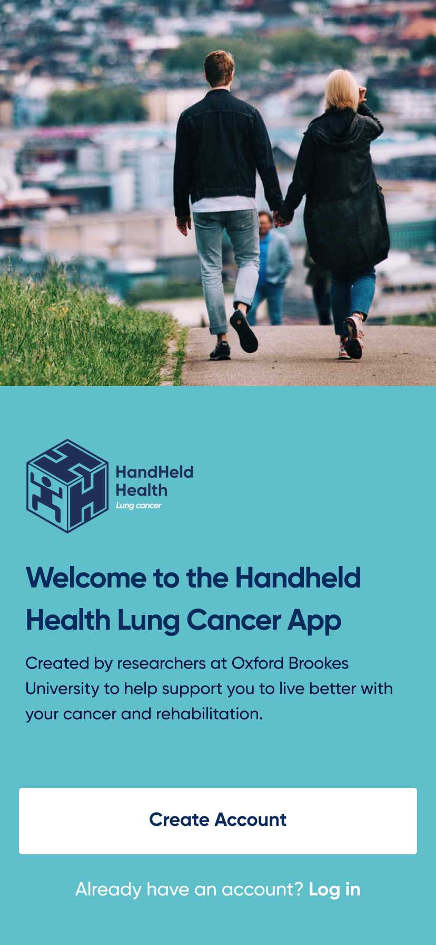
Co-Development of the HHH Lung Cancer App
Integration of the 2 Apps
+
=
Hedgehog Labs

Slide 13
Program of Work
Literature
Systematic Literature Review
App Co Development
Integrate 2 Apps
Feasibility Study
2 NHS Trusts
N= 20
Usability Study
Focus Groups
Patient and Public Involvement

Slide 14
Co-Development of the HHH Lung Cancer App
Focus Group Study
To ensure that the features and content of the new app are relevant and specific to lung cancer patients
University Ethics- 18th Sept 2023
Advertised study via social media, charities, professional networks
Qualtrics for EoI, consent and demographic data
Hosted focus groups and interviews with HCPs and separate focus groups and interviews with LCPs and carers from 16th Oct to 14th Dec 2023
Total number of participants = 27
8 focus groups and 4 interviews
Enquired about initial thoughts, perceived usefulness, content, other recommendations
Meetings recorded transcribed de identified analysed

Slide 15
Focus Group Aims
Utility of the App
What are your initial thoughts on the app in terms of its usefulness for lung cancer patients?
Do you think patients in your care would benefit from such an app? If yes, why, what elements? If no, why not?
Content
What are your thoughts on the suggested exercises prescribed for use within the app?
Are there any activities/exercises we have omitted that your patients may benefit from?
Are there any activities/exercises we should omit? Why/why not?
What do you think about the exercise instructions? Are these adequate?
Ease of Use
How easy or difficult to use does the app seem?
What do you think about the layout and presentation of the information on the screens?
What could we do to make navigating the app as simple as possible?
Is there anything else you would like to see on the app? Why/why not?

Slide 16
Focus Group Study – Results- HCP
n=15
Professional backgrounds
9- nurses
4 physiotherapists
1 dietician
1 oncologist

Slide 17
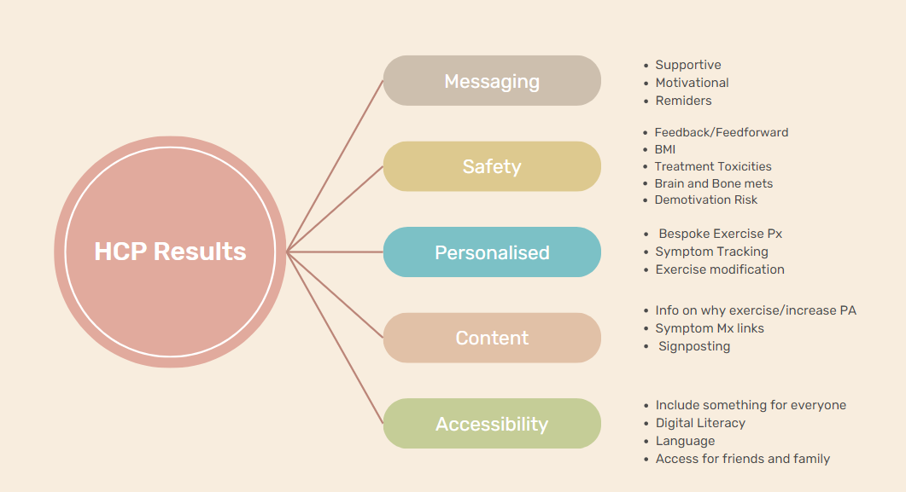

Slide 18
Focus Group Study LCP Results
n=12 (11 patients and 1 carer)
8 females, 4 males
Ethnicity – 9 white, 3 Asian
Diagnosed 2011-2023
100% NSCLC
5 completed treatment >6 months ago
6 receiving targeted therapies
Age range

Slide 19
Current unmet need
“Liked the helpful links on breathing exercise. I thought that's really good. I've never had any information on breathing or exercise before”
“Post op support was not in my local area - diff hospital, I fell through the cracks. I was also given info to take home on management post cardiac surgery”
“I've not had any guidance about exercise form my HCPs”
“I too haven't had any guidance about exercise. I don't know if they think, because I’m young, I don't need any guidance on this”
“I think because I'm in that bracket, aged 42 they don't sort of care. This time I left the hospital really with no guidance when it came to exercise, none at all.”
“I'm short of breath, weak, with pain in my knees and exhausted. Thought the only thing that I can do is play games on the tablet or watch TV.” No one discussed exercises that will help my breathing. ". “No one advised me on exercise”.
“Because of the smoking stigma I never talked about my cancer in a first-person situation”.
“If guidance was available at the outset, I would have taken it on board. Although I try to stay physical, I don’t know if I am doing enough.”

Slide 20
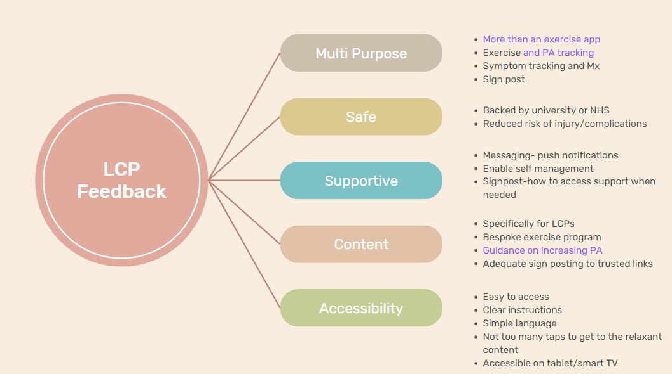

Slide 21
Co-Development of the HHH Lung cancer App
Similarities
Safety
Accessibility
Content- disease management -sign posting
Messaging – support and motivational
Differences
LCP did not raise concerns re digital literacy
HCP –feedback/feedforward
LCP – app empowering, independently influence their own outcomes – self management
LCP – multipurpose app vs HCP- don’t water it down …
Notes:
Limited budget
Goal of the app within the context of the PhD
Rich data to support further development of the app when there is further investment

Slide 22
Co-Development of the HHH Lung cancer App
Usability Study
To ensure the app works for the intended population
Amendment to university ethics – approved Dec 2023
Recruited 8 patients that took part in focus group study
Phase 1: 1-1 face to face session, participants accessed and navigated the app in a simulated environment. The researcher evaluated the participants task performance
Phase 2: Participants tested the prototype at home for 2 weeks, then attended a 1-1 semi-structured interview via Zoom to provide further feedback
Findings influence further edits of the app Beta version

Slide 24
The LungFit Study
Aim
To establish the feasibility of employing a digital platform that recommends a personalised exercise plan to improve the physical functioning and well-being of individuals with lung cancer
Inclusion Criteria
Aged ≥18 years
Confirmed diagnosis of primary lung cancer
English speaking to enable engagement with the app and complete study questionnaires
Able to provide written informed consent.
ECOG PS ≤ 1
Has access to a smart device with secure internet connection

Slide 25
Feasibility Study LungFit
Oxford & Bristol
Follow Up
Week 9
Follow up
Week 4
Follow Up
Week 12
Enrolment
n=20

Slide 26
Schedule of Events
Timepoint on study (in weeks)
Trial Procedures and Assessments | Baseline (-2/-1) | 0 | 1 | 2 | 3 | 4 | 5 | 6 | 7 | 8 | 9 | 10 | 11 | 12
Study Visits
Face to Face | X |  |  |  |  | X |  |  |  |  | X
Telephone |  | X | X | X | X |  | X | X | X | X |  |  |  | X (zoom)
Recruitment
Written Informed Consent | X
Eligibility | X
Baseline Assessments
Demographic Data | X
Disease Status and Treatment | X |  |  |  |  | X |  |  |  |  | X |  |  | X
ECOG performance status | X
Falls Risk Assessment | X |  |  |  |  | X |  |  |  |  | X
Frailty Assessment | X |  |  |  |  | X |  |  |  |  | X
Vitals signs
BP, HR, Spo2 | X |  |  |  |  | X |  |  |  |  | X
Height | X |  |  |  |  | X |  |  |  |  | X
Weight | X |  |  |  |  | X |  |  |  |  | X
Functional assessments
Grip Strength test | X |  |  |  |  | X |  |  |  |  | X
Sit to stand test | X |  |  |  |  | X |  |  |  |  | X
6 min walk test | X |  |  |  |  | X |  |  |  |  | X
Training and set up
On Boarding HHH Lung Cancer app | X |  | Start app |  |  |  |  |  |  | Delete app
App based screening questionnaire | X |  |  |  |  | X
Wearable activity tracker | X | X | X | X | X | X | X | X | X | X | X
Questionnaires
MDPQ16 | X |  |  |  |  | X |  |  |  |  | X
EORTC C30 and LC 13 | X |  |  |  |  | X |  |  |  |  | X
EQ5D-5L | X |  |  |  |  | X |  |  |  |  | X
HADS | X |  |  |  |  | X |  |  |  |  | X
FACIT | X |  |  |  |  | X |  |  |  |  | X
G-PAQ | X |  |  |  |  | X |  |  |  |  | X
QUEST 2.0 |  |  |  |  |  |  |  |  |  |  | X
Other Assessments
Safety Data |  | X | X | X | X | X | X | X | X | X | X | X | X | X
Qualitative Interview |  |  |  |  |  |  |  |  |  |  |  |  |  | X
Activity Diary |  | X | X* | X* | X* | X* | X* | X* | X* | X* | X | X | X | X (Return via post)

Slide 27
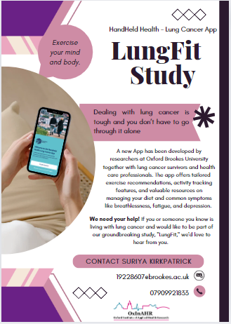

Slide 28
Thank you for listening

