Slide 1
Perioperative SACT in lUNg cancer
Dr Adam Dangoor
University Hospitals Bristol & Weston

Slide 2
1980s & 1990s
Natural history of metastatic lung cancer
10% 1-year survival
1991, SWOG (Albain et al.), 2531 patients
Cisplatin an independent predictor of survival
BUT does toxicity outweigh benefit?
Chemotherapy or best supportive care (BSC)?

Slide 3
Meta-analysis 1995
NSCLC Collaborative Group
Chemotherapy vs BSC
9387 patients
52 randomised trials
10% gain in survival at 1 year
Alkalylating agents detrimental
“…chemotherapy may have a role in treating this disease”

Slide 4
Advances in management of advanced disease
Platinum doublet increases survival by 3-5 months: OS 10.3-12.6 months
Maintenance pemetrexed in non-squamous: Added OS of 2.2 months
Osimertinib in EGFR+ve: OS 38.6 months
Alectinib in ALK fusion +ve: OS 29.1 months
Pembrolizumab immunotherapy in high PDL1 disease, up to 30% 5-year survival

Slide 5
Adjuvant chemotherapy
Around 5% benefit in overall survival
Chemotherapy effect higher in patients with better performance status

Slide 6
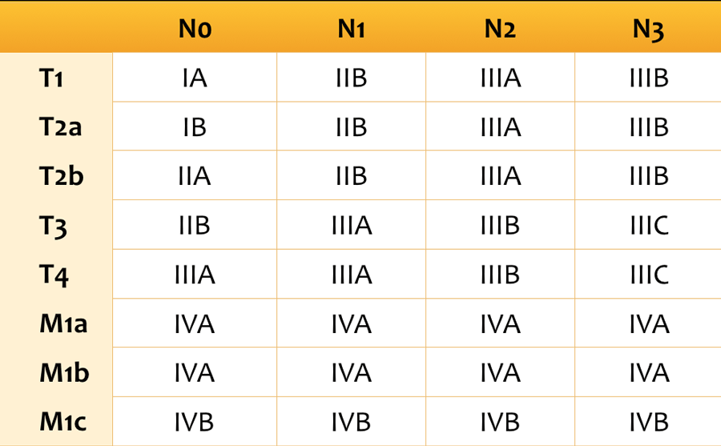
Interpretation of trials and TNM

Slide 7
For discussion…
How has treatment changed in the peri-operative setting
Optimal timing – neoadjuvant vs adjuvant
Optimal duration?
Do new treatments alter the criteria for resectability?

Slide 8
Current NICE approvals
TA761, 01/2022: Osimertinib is recommended for use within the Cancer Drugs Fund as adjuvant treatment after complete tumour resection in adults with stage IB to IIIA (now IB (>3cm) -IIIA, N2 only IIIB) non‑small‑cell lung cancer (NSCLC) whose tumours have epidermal growth factor receptor (EGFR) exon 19 deletions or exon 21 (L858R) substitution mutations. It is recommended only if:
osimertinib is stopped at 3 years, or earlier if there is disease recurrence or unacceptable toxicity
TA823, 09/2022: Atezolizumab is recommended for use within the Cancer Drugs Fund as an option for adjuvant treatment after complete tumour resection in adults with stage II to IIIA (now IIB (>5cm), IIIA, N2 only IIIB) non-small-cell lung cancer (NSCLC) whose:
tumours have the programmed cell death ligand‑1 (PD‑L1) biomarker expression on 50% or more of their tumour cells and
whose disease has not progressed after platinum-based adjuvant chemotherapy.
TA876, 03/2023: Nivolumab with chemotherapy is recommended, within its marketing authorisation, as an option for the neoadjuvant treatment of resectable (tumours at least 4 cm or node positive IIA-IIIA or N2 only IIIB) non-small-cell lung cancer (NSCLC) in adults.

Slide 9
Osimertinib (ADAURA)
3 years of adjuvant Osimertinib +/- chemo x4
5-year OS
II-IIA: 85% osimertinib vs 73% placebo
Patients receiving adjuvant chemotherapy and osimertinib had a 5-year OS of 87% vs 80% with osimertinib alone.
Questions:
Do they need chemo? Use beyond 3 years? Use ctDNA to guide treatment?
In overall trial population IB-IIIA: 88% vs 78%

Slide 10
Atezolizumab (IMPOWER 010)
Up to 4 cycles of platinum doublet chemotherapy
Overall survival only shown in those with PDL1 ≥ 50%
Hazard ratio 0.43
Need to consider the patients who might later receive targeted therapies: IO less effective, late toxicity

Slide 11
Nivolumab (CheckMate 816)

Slide 12
Nivolumab (CheckMate 816)
Median event-free survival 31.6 months vs 20.8 months
Complete response 24.0% vs 2.2%
At interim analysis hazard ratio for death 0.57 (NS)
Proportion undergoing surgery 83.2% vs 75.4%
EFS benefit by stage: IIIA 0.54 vs IB or II 0.87
PDL1: ≥ 50% (HR0.24), 1-49% (0.58), <1% (0.85)
Adjuvant chemo given in 11.9% vs 22.2%

Slide 13
Nivolumab (CheckMate 816)
In combination arm:
Surgery shorter
Fewer cancellations
Fewer pneumonectomies
Greater minimally invasive surgery

Slide 14
Additional treatment
During neoadjuvant SACT:
i) If disease progression occurs, then further immunotherapy is NOT funded IN ANY INDICATION.
ii) If no disease progression but deemed not for surgical resection, further immunotherapy is ONLY PERMITTED following a disease response of at least 6 months (duration from last Nivolumab dose to progressive disease). UNLESS stage III disease and treated with concurrent chemoradiotherapy then potentially eligible for maintenance durvalumab
Following neoadjuvant SACT and successful resection:
i) Adjuvant chemotherapy, radiotherapy or chemoradiotherapy is PERMITTED if indicated.
ii) Adjuvant immunotherapy is NOT PERMITTED.

Slide 15
Does neoadjuvant treatment redefine resectability?
In various trial of neoadjuvant chemoIO, despite selection for resectability, around 20% did not have surgery
R1/2 resections seen in up to around 7%
Advice is that we maintain current standards for resectability assessment
We do not want to take on patients for surgery who could have chemoradiotherapy + IO

Slide 16
Chemoradiotherapy (PACIFIC)
Chemoradiotherapy in stage III unresectable NSCLC
Durvalumab for 12 months if no progression after CRT
24-month OS 66.3% vs 55.6%
PFS 17.2 m vs 5.6m
Median time to death or distant mets 28.3m vs 16.2m

Slide 17
Rapid Advances in Resectable Non–Small Cell Lung Cancer - A Narrative Review. West & Kim. JAMA Oncol 2024;10 (2):249-255

Slide 18
Points to consider
Pre-treatment staging
NGS or targeted rapid tests – not just EGFR relevant
Assessment with oncologists before surgeons?
When to scan. After 2 or 3 cycles of neoadjuvant treatment?

