Slide 1
Robotic Minimally Invasive Surgery – for Colorectal Cancer Patients

Slide 2
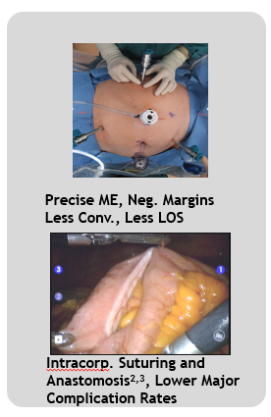
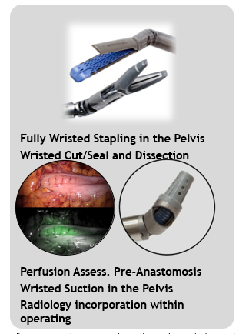
Reproducible Surgery Advancing

Slide 3
The case for change
The surgical model of care worldwide has transitioned the shift from open surgery to less invasive laparoscopic (keyhole) surgery has occurred and is now transitioning to minimally invasive Robotic Assisted Surgery (RAS) being the norm and with this, bringing significant and wide-ranging benefits.
RAS addressed many of the inherent limitations of the laparoscopic approach thus making it possible to perform complex surgical procedures that traditionally can only be attempted by specific highly trained and skilled operators.
The 2019 Royal College of Surgeons (RCS) England Future of Surgery 1 report outlined how surgery is likely to change in the NHS over the next decade with major predicted expansion in the provision of RAS.
The Topol Review exploring the impact of a digital future on the NHS came to similar conclusions.

Slide 4
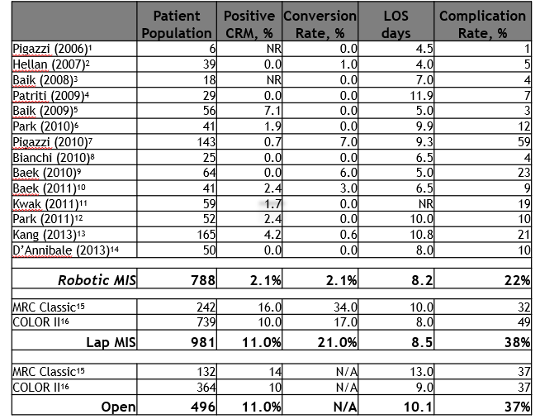
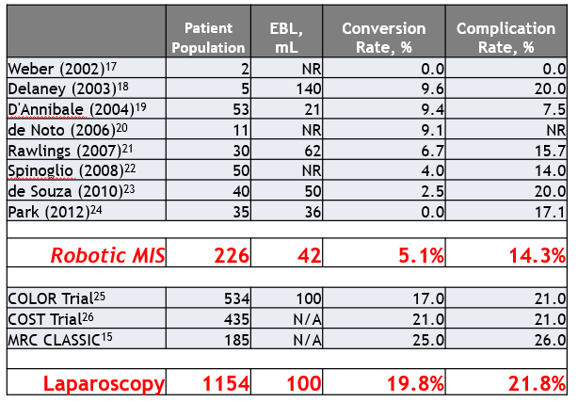
Initial Data

Slide 5
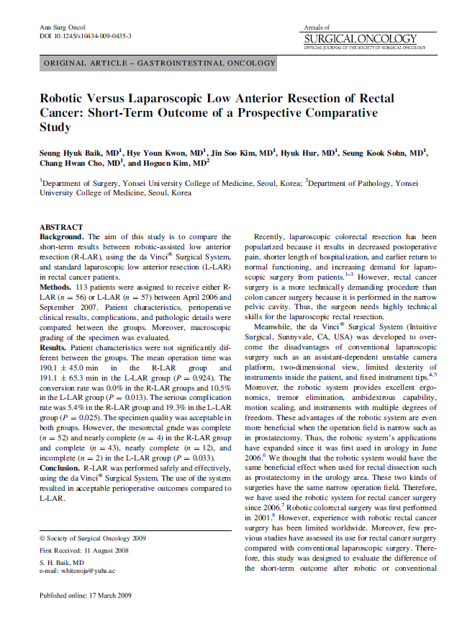
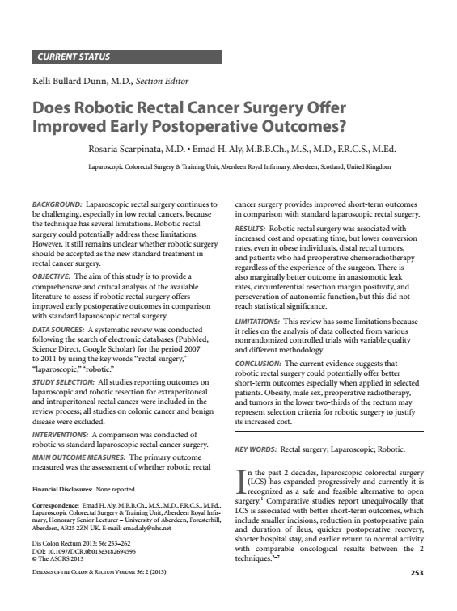
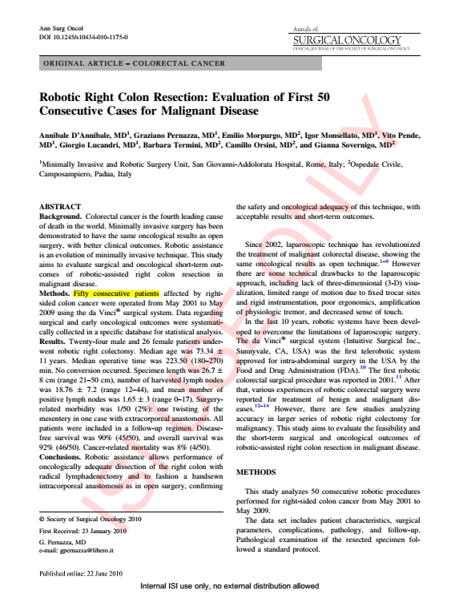
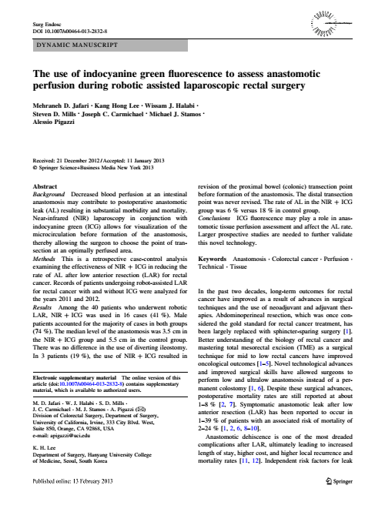
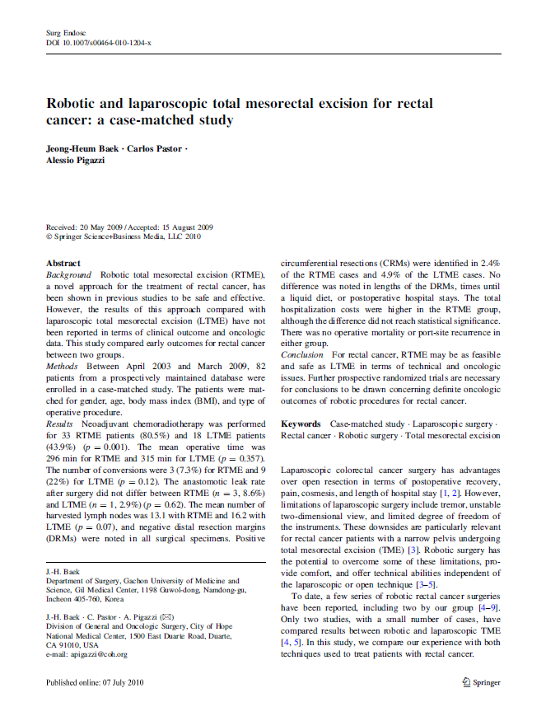
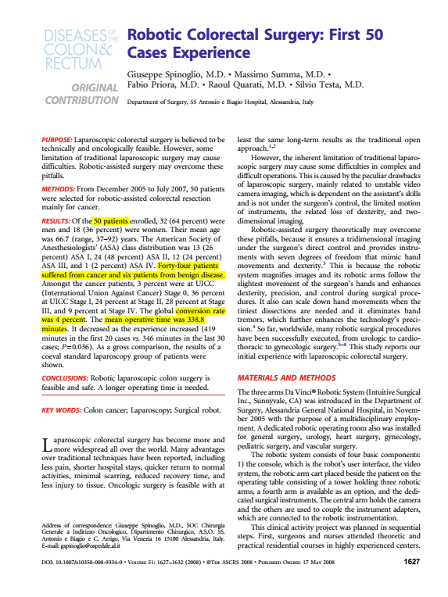
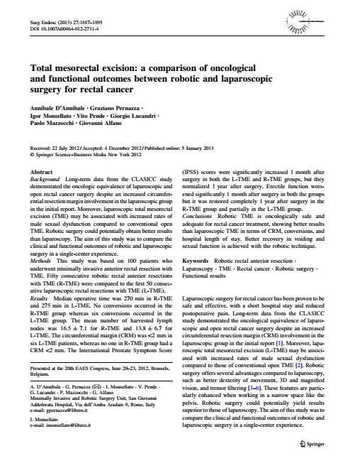
Advancing minimally invasive surgery for our Colorectal Cancer patients
Peer-Reviewed MIS Robotic Platform Colorectal Surgery Publications

Slide 6
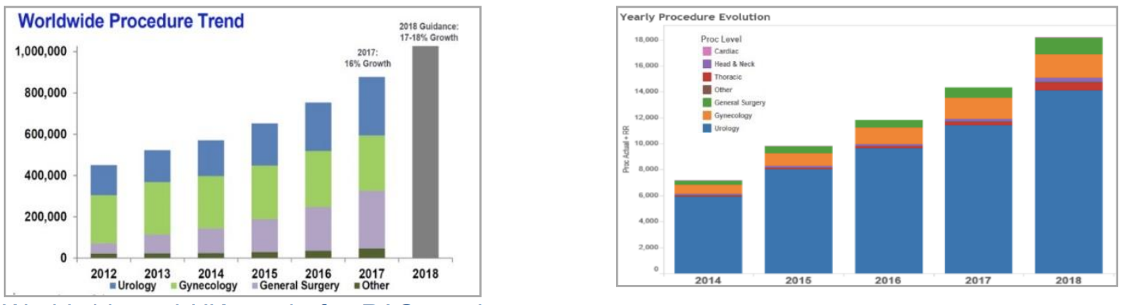
Next Steps
Worldwide and UK trend in the uptake of robotic surgery in various surgical specialities. demonstrating increasing trend in implementation of robotics
In post COVID world - complex rectal cancer surgery especially in obesity disease patients, male patients with a deep narrow pelvis and low-lying tumours are particularly challenging via the laparoscopic approach.

Slide 7
SWAG Next Steps
This trend reflects the ability to adopt the robotic approach to safely and effectively replace laparoscopic techniques as well as the use of the robotic approach to perform open procedures that are not suitable for laparoscopic approach given their complexity.

