Slide 1
Meeting of the SWAG Network Lung Cancer Clinical Advisory Group
Cellular pathology update

Slide 2
Significant increases in resection workload

Slide 3
Significant increases in resection workload
Impact:
Delay to resection report turn around (2- 4 weeks)
Reports have been not ready for patients in thoracic post op clinics
Increase in number and (?proportion) of frozen section results
MDT workload

Slide 4
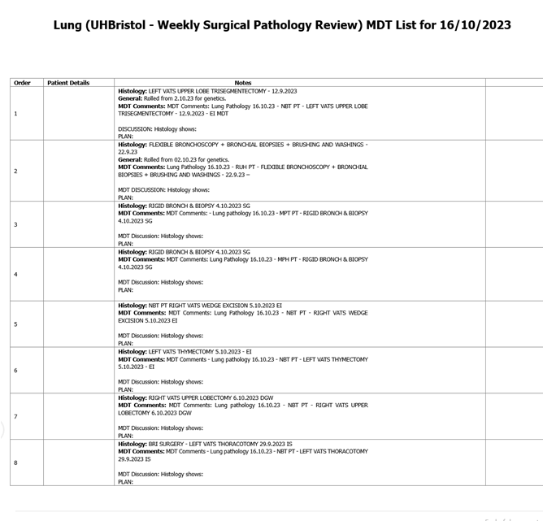

Slide 5
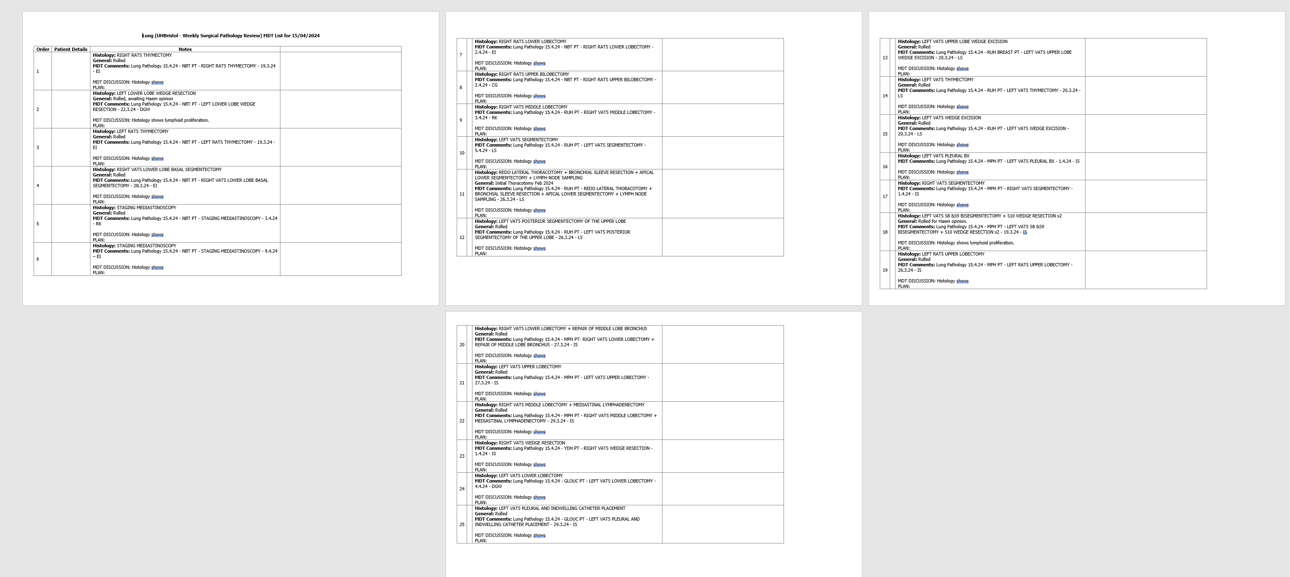

Slide 6
Significant increases in resection workload
Mitigations
Return to pT2a N1 (and above) reflex testing for lung cancer NGS panel and PDL1
Job adverts – 1 in progress, business case for further post pending
Admin support for molecular testing/chasing results

Slide 7
Increases in diagnostic biopsy/EBUS rates?
Projected 70% increase in biopsy rate across the region
Anecdotally this has not yet materialised as a significantly increased workload.

