Slide 1
Soft tissue pathology concepts for sarcoma MDT members

Slide 2
Themes from the pathology discussion
“Is it benign or malignant?” Why this a difficult question to answer in soft tissue pathology
“Is it high grade or low grade?” Why we can’t always help you out with this.
What is it? Why there isn’t always an answer.
Why we want to be specific about diagnosis, even though the treatment might not differ.

Slide 3
Carcinomas
The cells shows features that taken together, mean you can say a tumour is malignant, even without knowing what it is exactly.
Sarcoma
The way a cell looks does not always predict its behaviour.

Slide 4
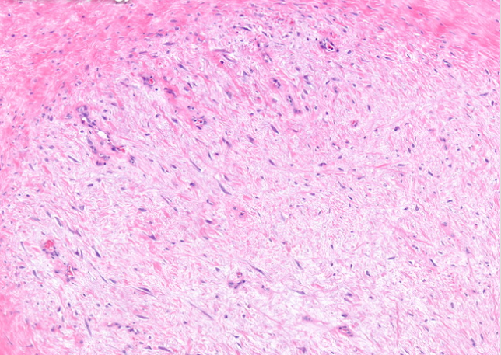
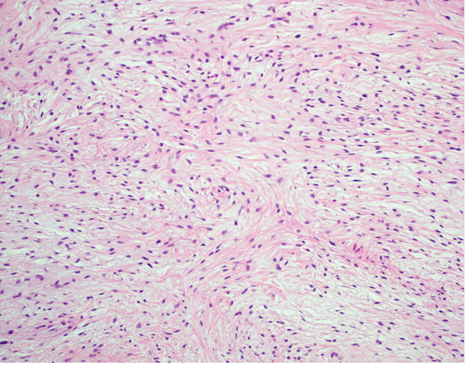
Is it benign or malignant? One is a sarcoma…

Slide 5
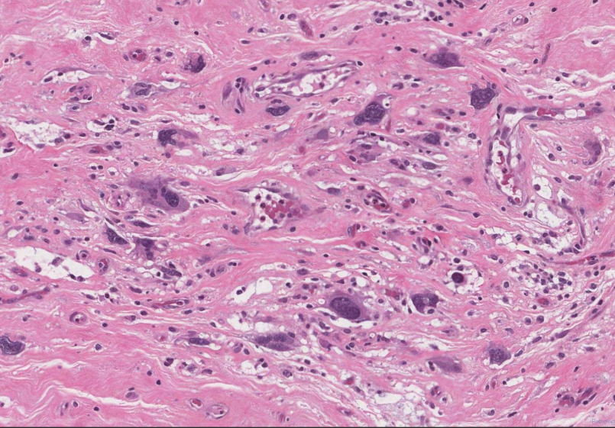
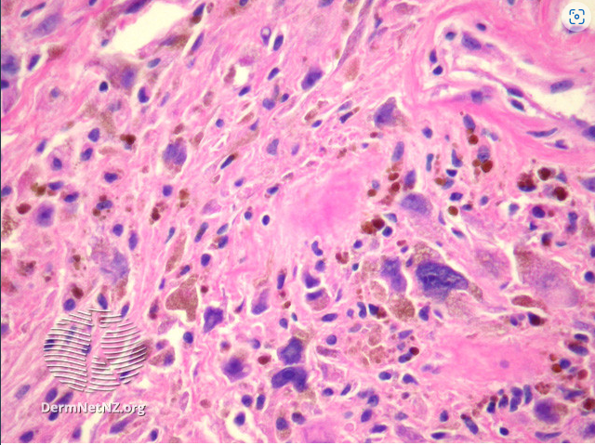
Benign or malignant? One is a sarcoma…

Slide 6
This affects the testing pathway…..
Morphology
Immunohistochemistry
Molecular testing
WAY MORE IHC AND MOLECULAR THAN ANY OTHER SPECIALTY

Slide 7
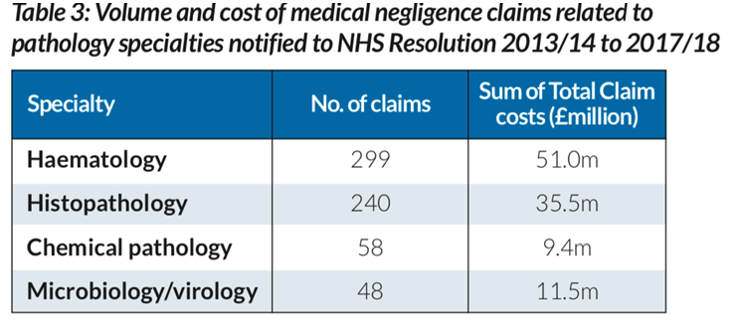
What happens if we don’t do all that extra testing…

Slide 8
Experience is key – accessing it takes more time
We compared the sarcoma unit's histopathology reports with referring reports on 349 specimens from 277 patients with suspected or proven soft tissue tumours in a one-year period. Conclusions. Diagnostic agreement was found in 256 of 349 cases (73.4%), with minor diagnostic discrepancy in 55 cases (15.7%) and major discrepancy in 38 cases (10.9%). Benign/malignant discordances accounted for only 5% of all discrepancies (5 cases). The most common discrepancies occurred in tumour classification, including diagnosis of gastrointestinal stromal tumour and leiomyosarcoma and the subtyping of spindle cell sarcomas, as well as in tumour grading that could conceivably lead to changes in clinical management.

Slide 9
Is it high grade or low grade?
GRADING IS TUMOUR SPECIFIC!
You need to know the specific tumour diagnosis before you can grade it

Slide 10
It looks generic….

Slide 11
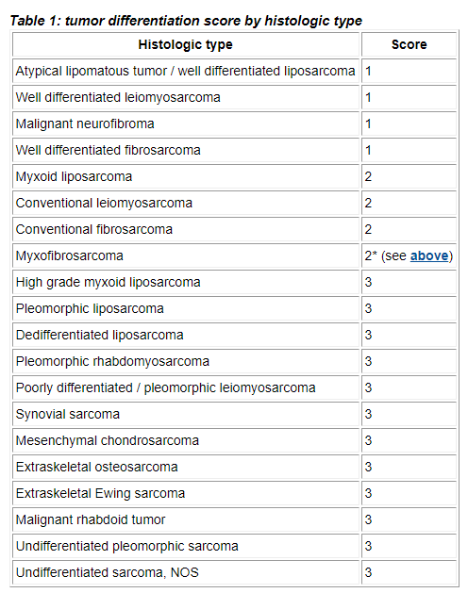

Slide 13
Uncertainty – why we can’t always be sure what it is
Tumour heterogeneity and lack of specific markers.
Unknown unknowns – in 2010, 20% of the papers in modern pathology were on soft tissue tumours.
They are not all described yet and if we confidently categorise them all, some of those will be wrong.

Slide 14
Why we want to be specific
Accurate diagnosis is integral to our professional role and credibility as a specialist soft tissue pathology unit.
There are not specific treatments for this patient group now, but it is only by being specific in diagnosis that there will be any in the future. The tumours are wildly different from each other biologically.
The prognosis of these tumours can be very specific and for personalised care, may be best managed with the specific tumour type in mind, rather than a low grade/high grade split.

Slide 15
Examples
Myxoinflammatory fibroblastic sarcoma = 1% metastasis rate, local recurrence +++
Pseudomyogenic haemangioendothelioma= 60% local recurrences (often multiple – lytic in bone, intramuscular and subcut) or develop additional nodules in the same anatomical region. Regional lymph node and distant metastases <5%, most often occurring years or decades after presentation.
Clear cell sarcoma = recurrence rates approaching 40% and pulmonary or lymph node metastasis in at least 30–50% of patients. Metastasis often occurs more than a decade after initial diagnosis. Survival rates at 5, 10, and 20 years are approximately 60%, 35%, and 10%, respectively

Slide 16
Lastly, you need this book

