Slide 1
Single Centre Experience Of Total Neoadjuvant Therapy (TNT) Compared With Long Course Chemoradiotherapy (LCCRT) Alone For Locally Advanced Rectal Cancer
Alexandra Maling
Justin Tetlow
Tom Strawson-Smith

Slide 2
Background
Locally advanced rectal cancer is a heterogeneous disease
Aims of treatment are to
Downstage to allow R0 resection
Reduce risk of local recurrence
Improve overall survival (reduce the risk of distant metastasis)
Notes:
Background to help understand relevance + outcomes
Patient with Stage 3 colorectal cancer are heterogenous population – any nodal
T1 = submucosa alone
T3 mesorectum
T4: tumour invades directly into other organs or structures and/or perforates visceral peritoneum
T4a: tumour penetrates to the surface of the visceral peritoneum
T4b: tumour directly invades or is adherent to other organs or structures
Other factors to consider when thinking about prognostic risk + risk of relapse + hence deciding treatment
EMVI (Extra-mural vascular invasion) = presence of tumour cells within blood vessels beyond the muscularis propria
Poor prognosis as = a predictor of haematogenous spread
CRM +ve if tumour or involved LN or EMVI within 1mm of mesorectal fascia
biggest single predictor of relapse

Slide 3
Treatment approach
Straight to surgery (TME)
TNT
LCCRT (45Gy in 25#)
SCRT (25Gy in 5#)
LCCRT
TNT
Low risk
Intermediate risk
High risk
Depends on prognostic factors
When to consider TNT:
1 or more high risk features:
CRM +
T3/4
Enlarged lateral LNs
N2
EMVI +
Notes:
Several options:
Need to cosndier patient factors: comorbidities, patient preference, bowel symptomsStraight to surgery, TNT, LCCRT, SCRT,
Considering options ovciously depends on many factors which I wont dwell on too much but patient and disease factors
Disease factors
Straight to surgery (TME) TME consists of the complete removal of the rectum, together with the surrounding mesorectum lymphovascular fatty tissue (mesorectum)
→ likely only if T3 and no EMVI and no ENE of +ve nodes
(Pre-op RT better than post-op RT)
TNT
The strategy of providing all treatment modalities (including CRT and chemotherapy) prior to surgery is known as TNT. The rationale behind TNT includes early systemic treatment, facilitating early targeting of micrometastatic disease better tumor regression but mainly to improve DFS through reduced distal spread
SCRT + CAPOX (RAPIDO style)
CAPOX + LCCRT (PRODIGE style)
LCCRT + CAPOX
Long Course CRT:
Long course chemoRT 45(-50)Gy/25# with concurrent capecitabine every day for 5 weeks (or 5FU)
If CRM+
Surgery at 6-8 weeks following treatment (pts are restaged prior to surgery)
Aims to reduce local recurrence and to downstage tumour.
Short Course only
Short course pre-op RT 25Gy/5# (with surgery within 6 weeks of completing RT – Stockholm 3 trial, reduced surgical complications with 6 week delay vs immediate surgery). Aims to reduce local recurrence.

Slide 4
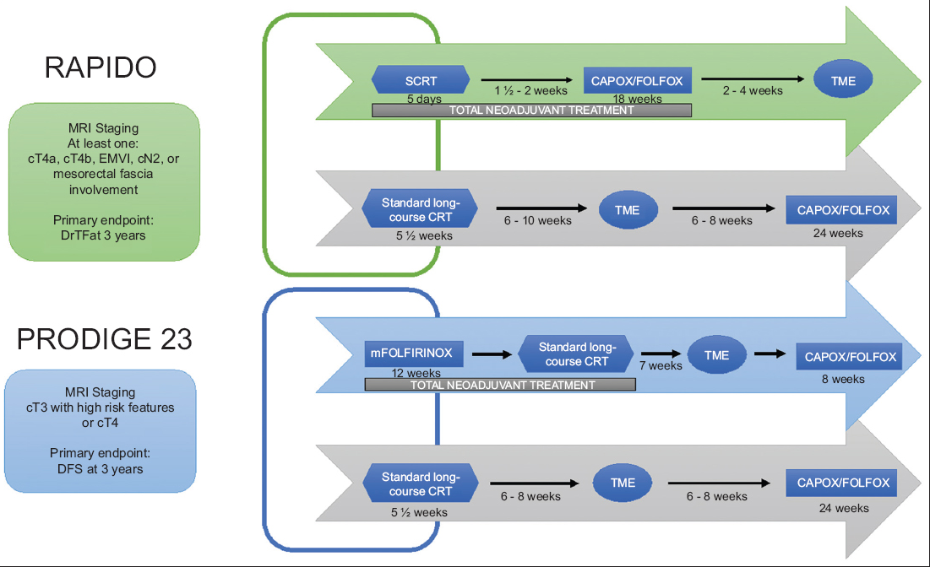
Pivotal trials
Notes:
Pulbished in 2020 + 2021
PRODIGE included anyone with stage 3 or 4
RAPIDO included high risk on pelvic MRI: T4a/b, EMVI, N2, CRM + fit for chemo
RAPIDO = SCRT – then chemo then TME vs SCRT then TME then adjuvant chemo
PRODIGE = chemo then LCCRT then TME +- adj chemo
V LCCRT tme then chemo

Slide 5
RAPIDO and PRODIGE outcomes
Notes:
RAPIDO
Look first at distant mets – 4th down TNT had LOWER rates of distant mets but HIGHER rates of locoregional failure. Overall end point
DrTF = first occurrence of locoregional failure, distant metastasis, new primary colorectal tumour, or treatment-related death LOWER primarily due to lower rates of distant mets
Suggesting that TNT might improve outcomes primarily due to mets.
facilitating early targeting of micrometastatic disease better tumor regression but mainly to improve DFS through reduced distal spread
BOTH showed– increase path CR
PRODIGE – also lower rates of fistant mets

Slide 6
Organ preservation
Treating LARC non-operatively in select patients could improve long-term functional issues resulting from complications of surgery, which could significantly improve QoL
OPRA trial
Patients with cCR or near-cCR were assigned to WW
Patients with an incomplete response and residual tumour underwent TME
No difference in 3-year DFS was found between the two groups
They concluded that WW in patients who achieve a cCR is a viable treatment strategy
Notes:
Improved path CR – leads to improved rates of organ preservation ?
The better treatment response with the TNT strategy has raised a novel question: do patients who have achieved a clinical CR (cCR) after TNT require surgery?
Intuitively, the next topic to investigate is whether removing the rectum provides any substantial benefit in patients who achieve a cCR following neoadjuvant therapy. Treating LARC non-operatively in select patients could improve long-term functional issues resulting from complications of surgery, which could significantly improve QoL and risks of surgery

Slide 7
Aim
To examine the tolerability and efficacy of TNT when compared to LCCRT in the real world
Who are we treating with LCCRT and TNT?
How did our outcomes compare to the trials?

Slide 8
Method
Data collected
DOB
PS
Comorbidities
cTNM stage
EMVI status
CRM status
Treatment regime: TNT: PRODIGE, RAPIDO, LCCRT then chemotherapy LCCRT alone SCRT alone
Radiotherapy and chemotherapy dates
Chemotherapy regime used
Chemotherapy toxicity and grade
Dose reductions
Completion of radiotherapy and chemotherapy
Date of surgery
pTNM stage
Recurrence – distal, local
Death
Pathological complete response rate
Locally advanced rectal cancer undergoing RT
Radiotherapy database
TNT or LCCRT 1/1/23 to 31/12/22 at BHOC
Data collected: treatment regime, patient characteristics, disease characteristics, safety and tolerability
Notes:
Local radiotherapy database
TNT was delivered as CAPOX for all (not FOLFIRINOX) and compare to PRODIGE (FOLFIRINOX + ADJUANT) NOONE got adjuvant chemo

Slide 9
Results – population
 | TNT (n = 41) | LCCRT (n=22)
Median Age (years) | 60 | 72
CRM+ (%) | 46 | 77
T3 (%) | 75 | 50
T4 (%) | 15 | 27
N2 (%) | 51 | 18
EMVI + (%) | 64 | 23
 | TNT Total (n = 41)
SCRT + 3m CAPOX | 32
3m CAPOX + LCCRT | 4
LCCRT + 3m CAPOX | 5
Notes:
63 Patients in total
Results at %
RAPIDO – 32, chemo then LCCRT 4, LCCRT then chemo 5 – lumped together due to small numbers
LCCRT – 22
Patient characteristics
LCCRT – older 72 vs 60
TNT – higher rates of EMVI
LCCRT – higher rates of CRM +
T4
N2 disease – TNT 51%, 18% LCCRT

Slide 10
Outcomes
 | TNT (n = 41) | LCCRT (n=22)
Completed systemic treatment (%) | 76 | 95
Completed radiotherapy (%) | 100 | 100
Complete radiological response (%) | 15 | 14
Opted for surveillance after CR (%) | 9 | 14
Pathological complete response (pCR) (%) | 27 | 5
Overall CR (CR+pCR) (%) | 36 | 19
≥ Grade 3 toxicity (%) | 34 | 9
Treatment related deaths (%) | 0 | 9
 | TNT (n=41) | LCCRT (n= 22)
Underwent surgical resection (%) | 76 | 59
Progressive disease (%) | 7 | 14
Complete radiological Response (%) | 15 | 14
Declined surgery (%) | 2 | 14
Notes:
All as a %
More patients completed planned chemo RT regime in LCCRT
CRC – similar
Higher rates opting for surveillance in LCCRT
Path CR HIGHER in TNT- defined at surgery – similar to RAPIDO + PRODIGE quoting 28%
COMPARE TO TRIALS
Despite higher rates of path CR – not much higher rates of organ preservation
Path CR RAPIDO + PRODIGE trial – both 28%
Toxicities:
34% TNT >grade 3 tox 9% LCCRT but 2 patients died in LCCRT group – IE + Ischemic bowel
2 TNT went to ICU
1 with grade 4 enteritis after 1 cycle 7/22, eventually surgery 1/23 – since PD
1 with grade 4 colitis after c3 – CR on scans, opted for WW
Path CR – 27% vs 5% (28 in trials)
TNT – 4/10
1- tox, delayed surgery, no recurrence since
2- didn’t complete treatment, had surgery, still bulky, since recurred
1 - didn’t complete treatment, had surgery, still bulky, hasn’t recurred
4 – chemo tox, CR, no recurrence since
1 – had a stroke, progresse don imaging so didn’t get surgery
Important because sometime I think if they have terrible tox they might get excellent response

Slide 11
Conclusion
Higher rates of CR in TNT
Similar rates of organ preservation in LCCRT and TNT
Higher rates of >G3 toxicity and hospital admission in TNT
Future work:
Need long term recurrence data to confirm TNT outcomes locally
Plan to re-audit in 1-2 years
Audit local WW practice and outcomes

Slide 12
Questions?

Slide 13
References
Conroy et al. Neoadjuvant chemotherapy with FOLFIRINOX and preoperative chemoradiotherapy for patients with locally advanced rectal cancer (UNICANCER-PRODIGE 23): a multicentre, randomised, open-label, phase 3 trial. 2021. https://www.thelancet.com/journals/lanonc/article/PIIS1470-2045(21)00079-6/abstract
[Garcia-Aguilar J et al. Organ Preservation in Patients With Rectal Adenocarcinoma Treated With Total Neoadjuvant Therapy. J Clin Oncol. 2022 Aug 10;40(23):2546-2556. doi: 10.1200/JCO.22.00032. Epub 2022 Apr 28. PMID: 35483010; PMCID: PMC9362876.
Bahadoer et al. Short-course radiotherapy followed by chemotherapy before total mesorectal excision (TME) versus preoperative chemoradiotherapy, TME, and optional adjuvant chemotherapy in locally advanced rectal cancer (RAPIDO): a randomised, open-label, phase 3 trial radiotherapy followed by chemotherapy . 2020. https://www.thelancet.com/journals/lanonc/article/PIIS1470-2045(20)30555-6/abstract
Affleck et al. The evolution of rectal cancer treatment: the journey to total neoadjuvant therapy and organ preservation. Annals of Gastro. 2022. http://www.annalsgastro.gr/index.php/annalsgastro/article/view/6595/5366

