Slide 1



GMSA update:
Genomic testing in prostate cancer
Matilda Bradford
Genetic Counselling Lead for Cancer, SW GMSA
Principal Genetic Counsellor, Peninsula Clinical Genetics
@SWGenomics / @SWGLH / @NHSgms

Slide 2
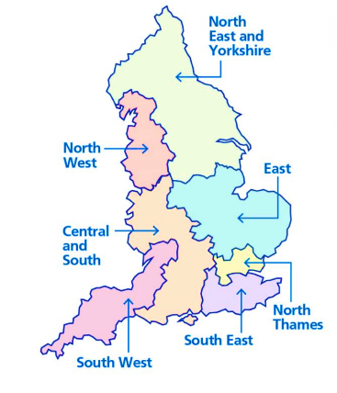
What is ‘mainstreaming’?
What it is…
National programme locally delivered
Work with both clinical genetics services to develop pathways, competencies and education delivery
CPI development
Peer to Peer support network
Tool kit approach
Supporting diagnosis at the earliest point in the pathway
Proactively direct resources where they can impact on patient care most
Adapt the way we work to make the best use of new technologies
Provide an infrastructure which supports decision making
Increasing access to safe and appropriate genomic testing
SW Genomic Laboratory Hub (SWGLH)
SW Genomic Medicine Service Alliance (SWGMSA)
What it’s not…
A replacement for the expertise in the genetics service
Notes:
Clinical Pathway Initiative

Slide 3
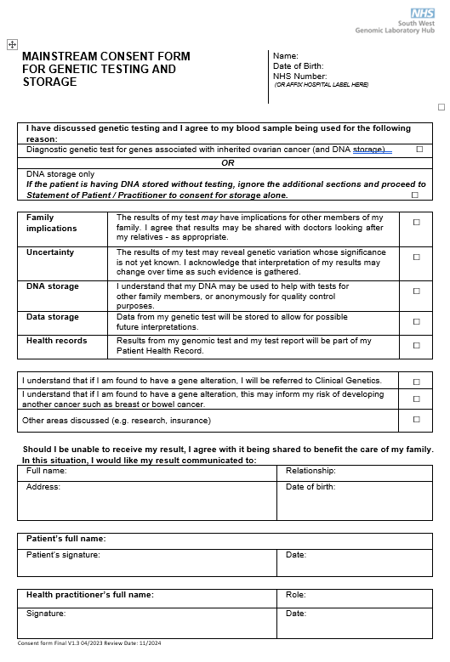
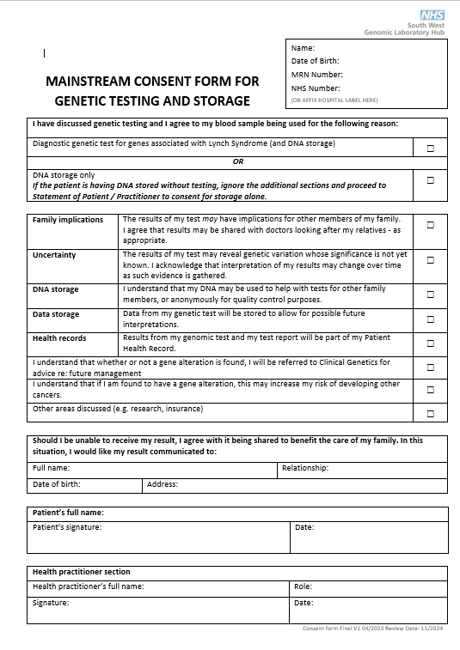
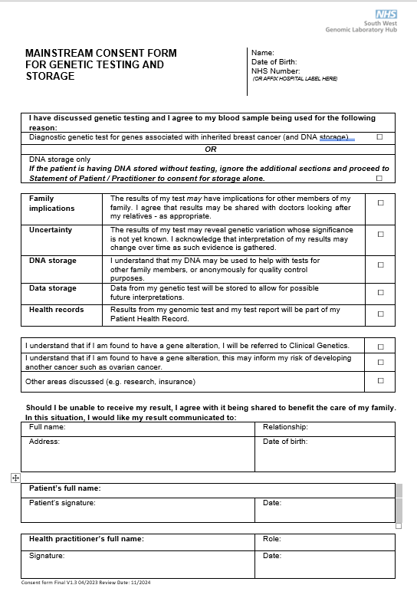
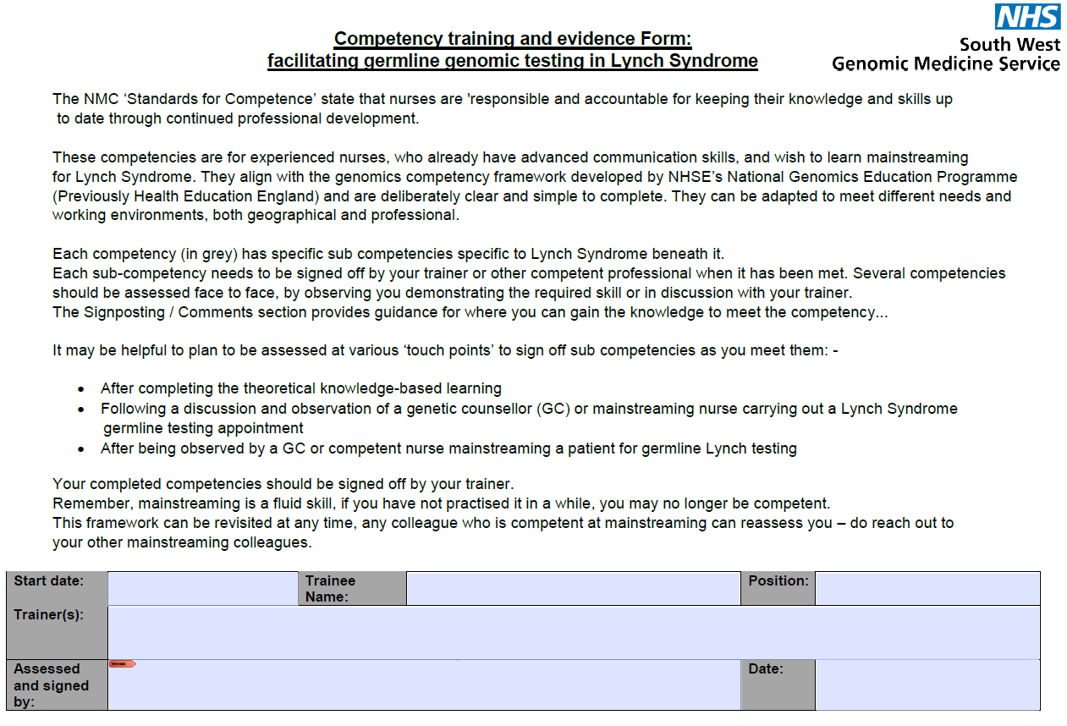
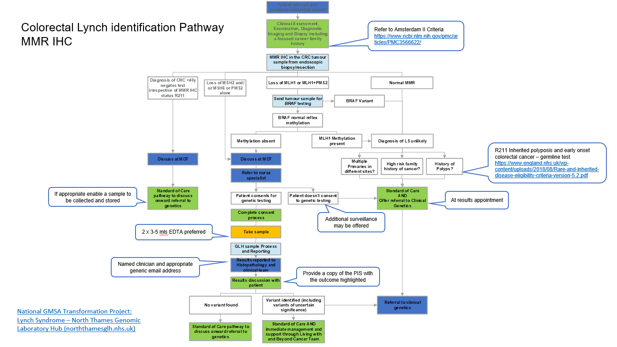
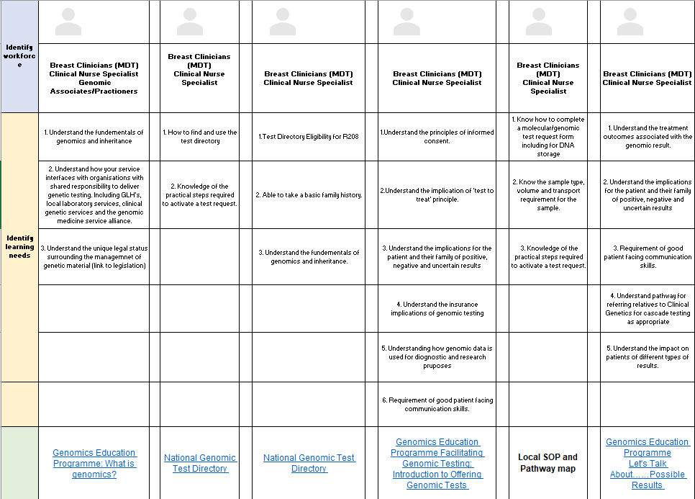
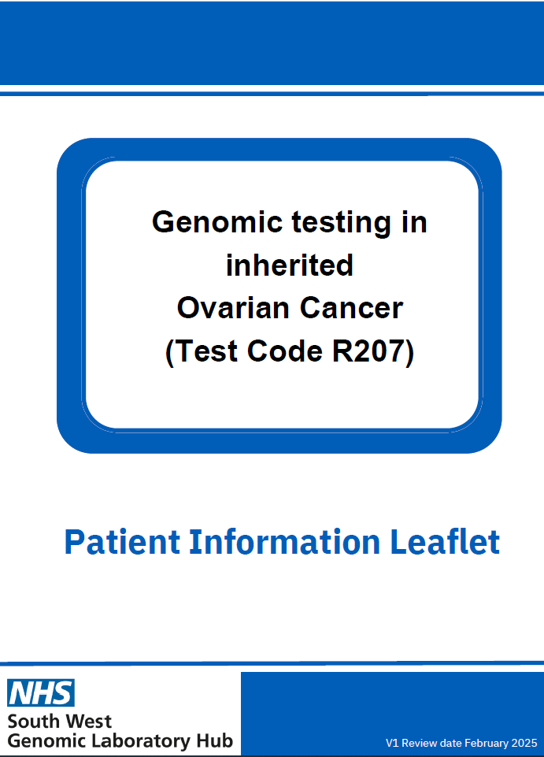
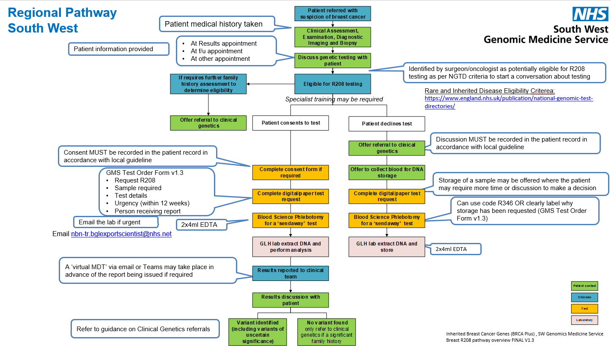
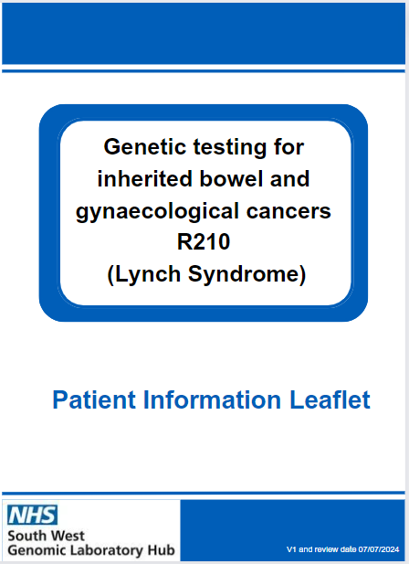
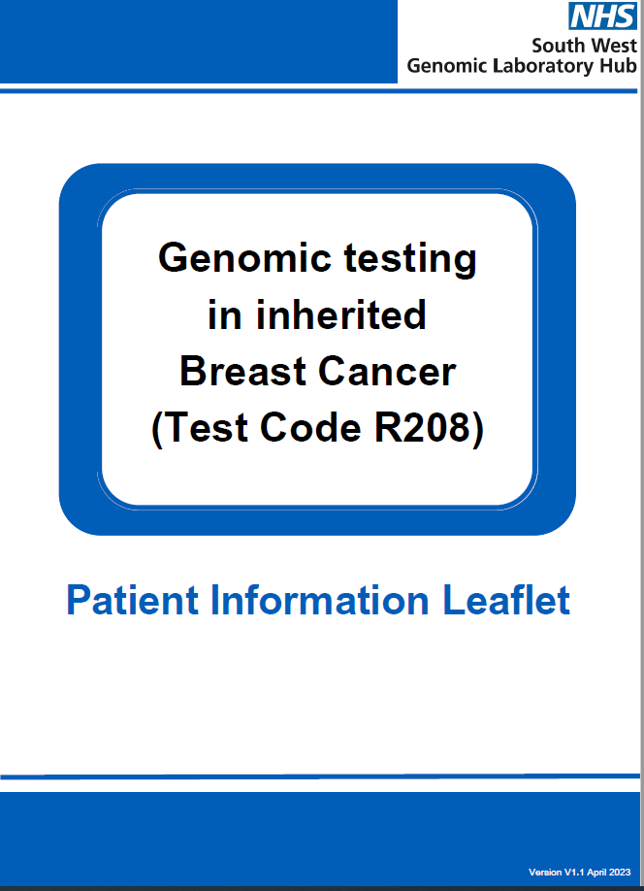
Regional approach to mainstreaming
“I feel more confident with knowing when to discuss genetic testing and how to discuss it”
Patient Consent Forms
Patient Information
Pathway Mapping: A multidisciplinary approach
Education and Training
https://www.nbt.nhs.uk/south-west-genomic-laboratory-hub/swglh-sample-test-information/swglh-inherited-cancer-testing-services

Slide 4

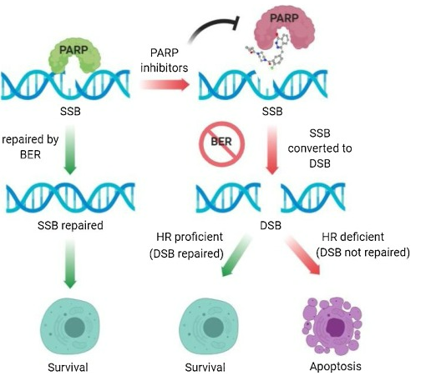
PARPi

Slide 5
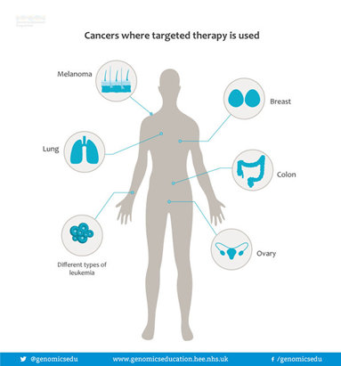
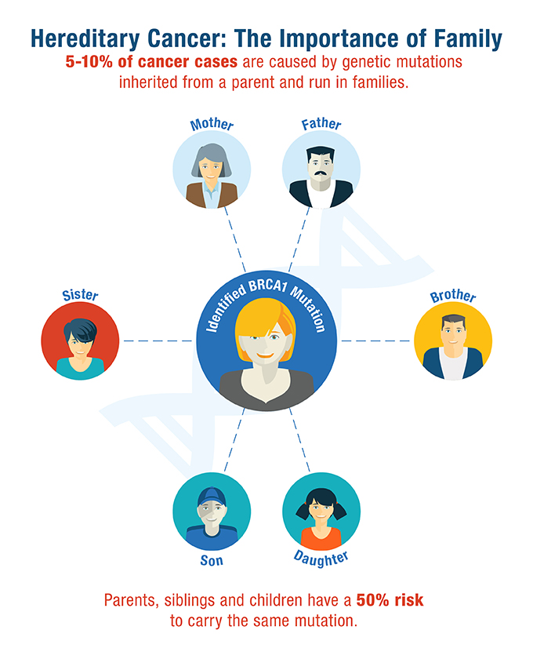
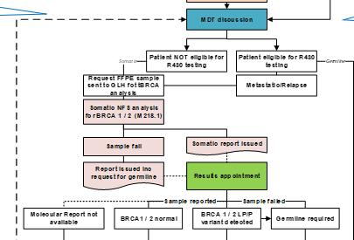
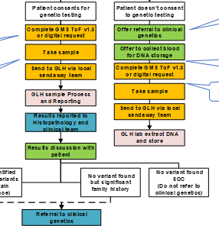
Testing in the cancer pathway
SOMATIC:
The genetic information in a specific cell, variation that occurs after conception. In the context of cancer: not inherited or heritable.
GERMLINE:
The genetic information that you are born with, and can possibly pass onto your children or share with your brothers and sisters.
Germline to support
Test to Treat
Germline to support
Test to Prevent

Slide 6
Testing Strategy Summary
For patients with a diagnosis of metastatic castration-resistant prostate cancer that are potentially eligible for Olaparib we can offer:
Purpose | When to request? | Test Code | Referral Form | Sample Type | Somatic/Germline | Genes Tested
Test to treat: Olaparib eligibility | First line (all cases) | M218.1 | Adult Solid Tumour | FFPE | Somatic | BRCA1&2 Will not currently identify CNV’s
Prevent: germline assessment | If M218.1 shows a variant | R240 | GMS Test order form | EDTA blood | Germline | Direct testing for the somatic variant in germline DNA
Workaround for failed samples | …If M218.1 fails | R444.2 | GMS Test order form | EDTA blood | Germline | BRCA1&2 Will not identify variants that have arisen somatically
Prevent: germline assessment | For patients diagnosed with prostate cancer <50yrs, metastatic prostate cancer <60yrs, strong family history (refer to eligibility Rare Disease criteria Document). | R430 | GMS Test order form | EDTA blood | Germline | BRCA1, BRCA2, MLH1, MSH2, MSH6, ATM, PALB2, CHEK2.

Slide 7
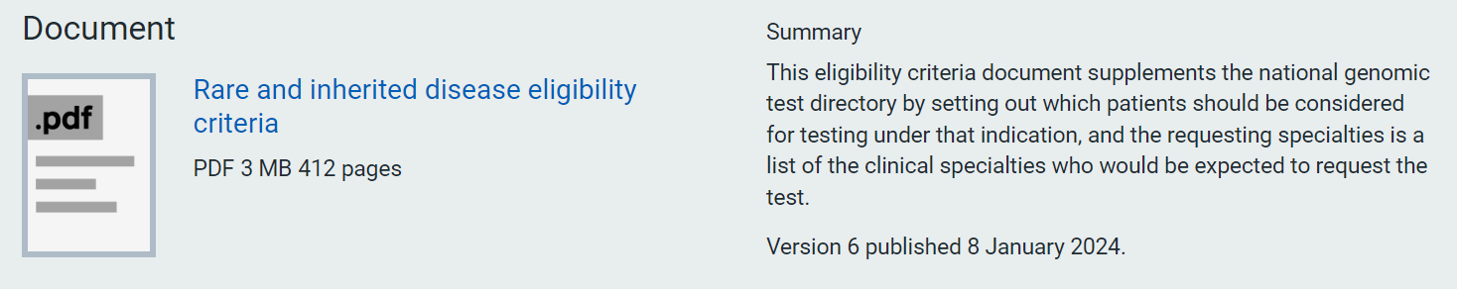
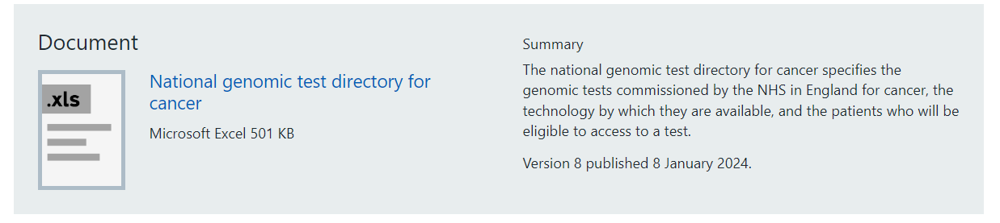
Which test?
Following tumour testing.
Mainstreaming colleagues can request germline based on NGTD eligibility criteria, independent of somatic investigations.
National Genomic Test Directory
https://www.england.nhs.uk/publication/national-genomic-test-directories/
Notes:
Replace with slide on figures for testing in region

Slide 8
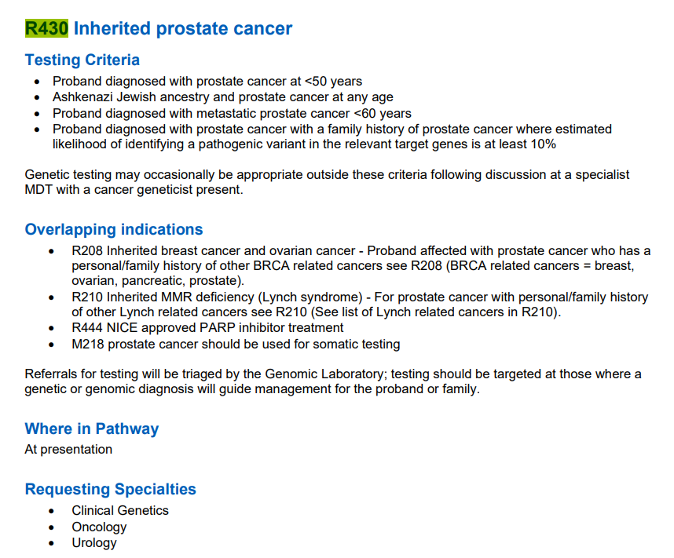
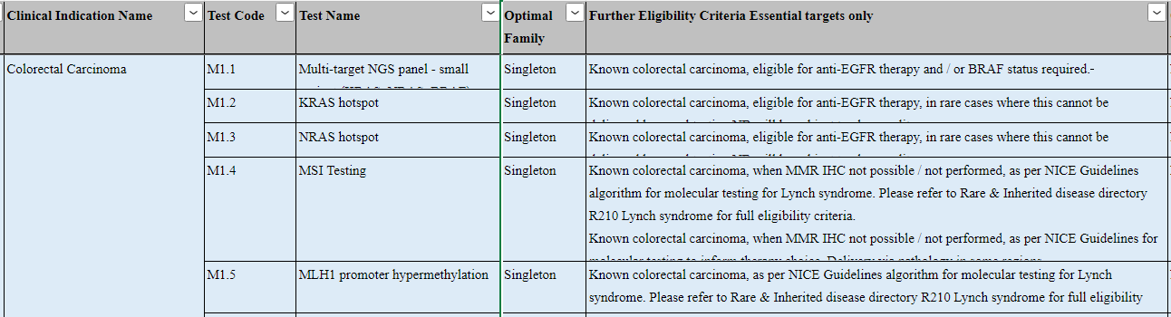
Using the NGTD
https://www.england.nhs.uk/publication/national-genomic-test-directories/
Notes:
Replace with slide on figures for testing in region

Slide 9
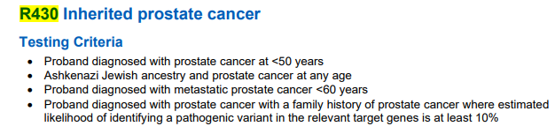
Straight to MDT discussion
Relevant family history taken at triage
MRI and Biopsy could be same day or separate appointments
by phone/in clinic – include genomic next steps in patient discussion
Requesting managed by MDM
Patient identified metastatic
Family history Yes/No
Metastatic/molecular status
Request activate tissue request AND blood (MDT co-Ordinator/ CNS) (document for lead nurse)
Results reported to histopathology and clinical team
R444 Germline required where M218 failed. No family history required
R430 Germline required where strong family history
Discussion MUST be recorded in the patient record in accordance with local guideline
Storage of a sample may be offered where the patient may require more time or discussion to make a decision
Test to Treat complete for second line treatment as required
(R240 confirmatory testing not required)
Can use code R346 OR clearly label why storage has been requested (GMS Test Order Form v1.3)
GMS Test Order Form v1.3
Request R444
Sample required
Test details
2x4ml EDTA
2x4ml EDTA
Suggested pathways:R444Test to Treat in Prostate
Email nbn-tr.bglexportscientist@nhs.net
Rare and Inherited Disease Eligibility Criterea:
https://www.england.nhs.uk/publication/national-genomic-test-directories/

Slide 10
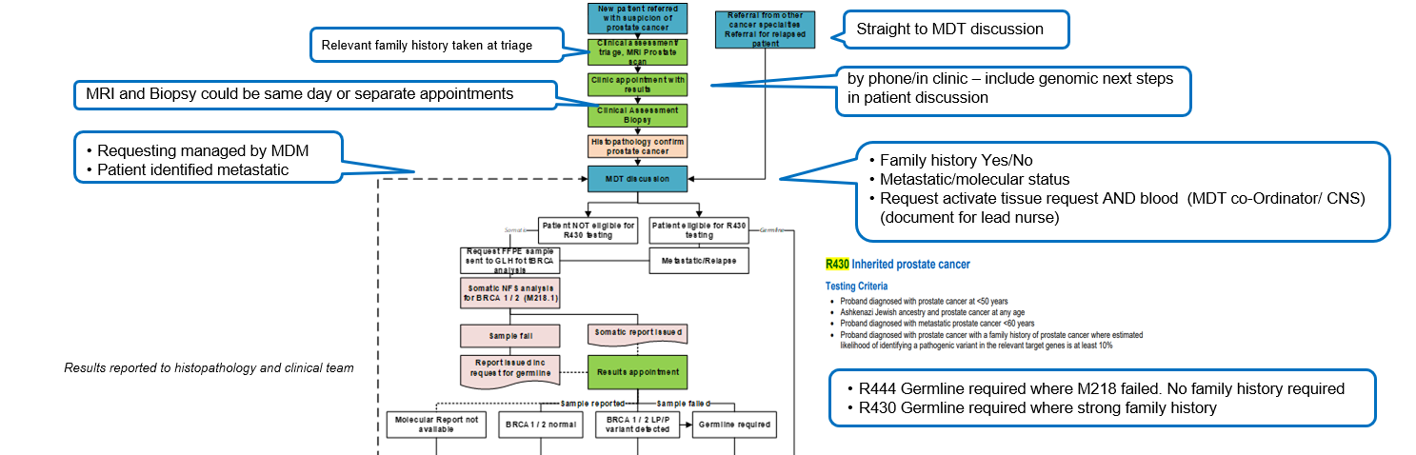

Slide 11
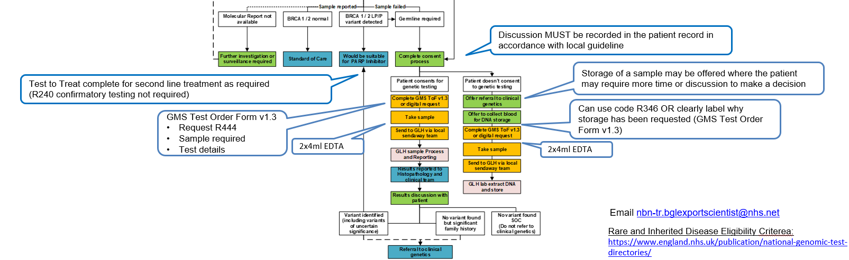
ALL patients with a germline BRCA1/2 variant (pathogenic or VUS), or an unexplained family history should be referred to the Clinical Genetics Service

Slide 12

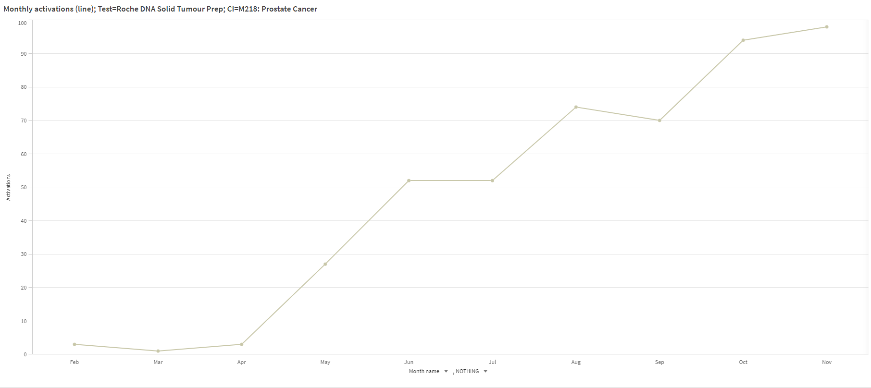
Samples Received to Date (2023)
100
NICE
~100 patients a month for M218 somatic prostate testing
Failure rate is ~12%
Received ~ 4/month for R444 (mostly Torbay)
Received ~3 /month for R430
Patients (n)
0
FEB MAR APR MAY JUN JUL AUG SEP OCT NOV
  Graph of Sample increase for M218 – somatic prostate

Slide 13





Getting the right support
https://www.england.nhs.uk/publication/national-genomic-test-directories/
Unsure what test you need to request?
Contact the lab!
nbn-tr.swglhcancer@nhs.net
rduh.exetergenomicslaboratory@nhs.net
Complex case or further advice needed?
Contact CG!
rduh.pcgreferrals@nhs.net
uhb-tr.clinicalgeneticsuhb@nhs.net
Unsure what paperwork to complete?
Contact us!
GNP
rduh.swgenomicpractitioner@nhs.net

Slide 14
Additional contacts
nbn-tr.swglhcancer@nhs.net
  Cancer genetics team at Bristol Genomics lab, checked daily by Duty Scientist (solid tumour and germline)
Ruth.cleaver@nhs.net
  Consultant Clinical Geneticist and Cancer Lead SW GMSA
Matildabradford@nhs.net
  Genetic Counselling Lead SW GMSA
F.mcdermott@nhs.net
  Colorectal Surgeon & Cancer Lead, SW GMSA
Tracie.miles@nhs.net
  Nursing and midwifery lead, SW GMSA

