Slide 1
National Cancer Programme Deliverables
National Cancer Programme – Operational Performance Deliverables
Run specific projects addressing; i) mitigating known seasonal challenges; ii) rolling out the MDT streamlining guidance; iii) safety netting for abnormal radiology and pathology; and iv) treatment waiting times for radiotherapy.
National Cancer Programme – Priority Pathway Deliverables
Lead a project with secondary care partners to implement risk stratification tools, such as Predict/ Cambridge Prognostic Groups, to reduce unnecessary progression to biopsy and/or progression to treatment regimens.
Complete the implementation of nurse-led LATP biopsy services in providers delivering prostate pathways.
Work with providers in tiering where Urology has been identified as a priority pathway and those with lower than 60% FDS performance on the USC Urology/prostate pathway to complete a baseline pathway analyser of 30 patients, investigate and identify challenges, agree recommendations and next steps for improvement. This should include a focus on the wider Urology pathway beyond Prostate cancer, with a particular focus on bladder cancer pathways where there are significant and growing challenges. Priority should be given to tier 1 providers in Q1, with other tiered providers prioritised for action by end Q2.
Support and hold providers to account for delivery of improvement plans, including repeating pathway analysis at 6 months post baseline to evaluate impact of action/ recovery plan.
National Cancer Programme – Treatment Variation Deliverables
Implement national priority recommendations from clinical audit/GIRFT reports to reduce variation in treatment:
Prostate: >75% of men receiving radical treatment for high-risk/locally advanced prostate cancer

Slide 2
National Cancer Programme Deliverables
SW Prostate Group and SWAG Clinical Advisory Group alignment of work plans Q4 23.24 for inclusion in SWAG CA 24.25 plan
Contribute to development and adopt use of prognostic predictive tools for referral and triage
Design and complete an Audit of Prostate staging practices: prostatE caNcer stagInG iMAging (ENIGMA) audit
Fund, utilise pathway and practice intelligence with further develop the SW Prostate dashboard
Understand and investigate variation in radical treatment decision making with a view to achieving >75% of men receiving radical treatment for high-risk/locally advanced prostate cancer across SWAG providers
Support innovations Ai programme: Deontics and Lucida
Roll out Nurse led LATP biopsy where not currently optimised and review opportunity for NBT training accreditation
Support the development of Urology Investigation Units
Identify Bladder pathway improvement priorities
Improvement in Core quality
Since these discussions conversations with the National Cancer Programme have clarified the expectations requirements regarding MDT streamlining and there is an expectation of development of Standards of Care

Slide 3
SW Prostate Dashboard: Fund, utilise pathway and practice intelligence with further develop the SW Prostate dashboard
An extension of the current Prostate dashboard, this will include ensuring access and maintaining the data freshness. There is also the need to refresh the data sharing agreements.
As above, with the following enhancements to the dashboard
The addition of patient demographic data incl ethnicity and deprivation
The automatic download of data from the SCR to the Dashboard (maybe up to 70% )
Ingestion of the PYE score of likelihood of cancer into the Prostate dashboard.
Continuation of the dashboard until 31st March 2025 and enhancements specified above £22,584
SOP refreshed and circulated to updated contacts
QA undertaken and circulated

Slide 4
SW Prostate Dashboard: Fund, utilise pathway and practice intelligence with further develop the SW Prostate dashboard
1.1: Top 10 incomplete data field for SW Prostate Dashboard for year 2022, 2021 and 2020:
 | Top 1 | Top 2 | Top 3 | Top 4 | Top 5 | Top 6 | Top 7 | Top 8 | Top 9 | Top 10
All | PIRADS Score | Likert Score | Index Lesion Diameter | MRI strength | N Stage | T Stage | Syst Cores | Targ Cores | Unspec Cores | Left Max Length
2022 | PIRADS Score | Index Lesion Diameter | Likert Score | MRI strength | N stage | T Stage | Syst Cores | Targ Cores | Unspec Cores | Left Max Length
2021 | PIRADS Score | Likert Score | MRI strength | Index Lesion Diameter | N stage | Syst Cores | Targ Cores | Unspec Cores | T Stage | R Max Length
2020 | MRI strength | PIRADS Score | Left max length | Likert Score | Index Lesion Diameter | SNS Max. Length | SNS Cores Inv. | Left GS | N Stage | Overall Core Inv.

Slide 5
SW Prostate Dashboard: Fund, utilise pathway and practice intelligence with further develop the SW Prostate dashboard
1.2: Top 5 missing data by providers within SWAG for year 2022:
2022 | Bath | Bristol | Gloucester | Salisbury | Swindon | Taunton | Weston
Top 1 | MRI Strength | Likert Score | No data | PIRADS Score | PIRADS Score | Sys Cores | Index Lesion Diameter
Top 2 | PIRADS Score | Index Lesion Diameter | No data | Index Lesion Diameter | N Stage | Targ Cores | Likert Score
Top 3 | Index Lesion Diameter | PIRADS Score | No data | Right GS | T Stage | Unspec Cores | PIRADS Score
Top 4 | SNS Max. Length | N Stage | No data | Left Max. Length | Targ. Max. Length | MRI Strength | Left Cores Inv.
Top 5 | Likert Score | T Stage | No data | Left GS | Targ. Cores Inv. | SNS Max. Length | Left GS
Gloucestershire urology navigator onboarded with CM support

Slide 6
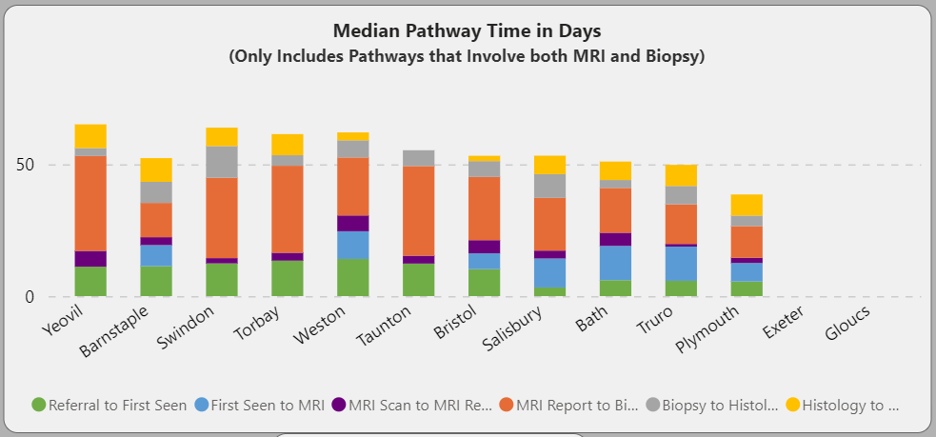
SW Prostate Dashboard: Fund, utilise pathway and practice intelligence with further develop the SW Prostate dashboard: NCP Deliverable Pathway analyser capability
Notes:
Tier Q1 etc

Slide 7
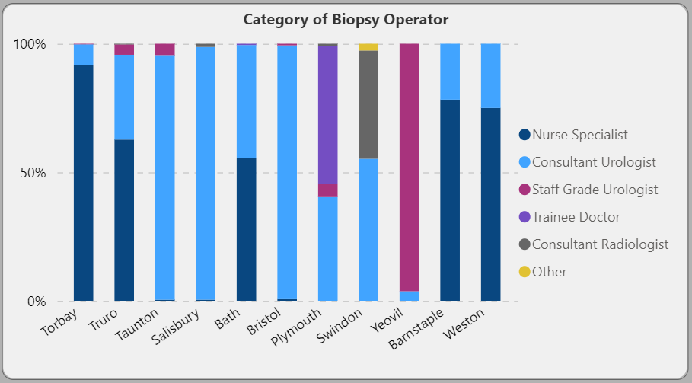
SW Prostate Dashboard: Fund, utilise pathway and practice intelligence with further develop the SW Prostate dashboard: NCP Deliverable Pathway analyser capability
Notes:
Tier Q1 etc

Slide 8
Treatment Variation: NPCA
‘Investigate why men with high-risk/locally advanced disease are not considered for radical treatment’
Numerator: number of patients having radical prostatectomy, radiotherapy, or brachytherapy within 12 months of diagnosis​
Denominator: number of men with high-risk/locally advanced* prostate cancer​

Slide 9
Urology CAG – National Cancer Programme
23.24 Treatment Variation workstream
Providers NPCA | %
England | 69% (2023)
Gloucestershire | 72% (2023)
North Bristol Trust | 65% (2023)
Royal United Bath | 68% (2019)
Salisbury | 61% (2023)
Taunton | 76% (2021)
Yeovil | 65% (2023)
 |  | Metric | Apr-23 | May-23 | Jun-23 | Jul-23 | Aug-23 | Sep-23 | Oct-23 | Nov-23 | Dec-23
NBT | Treatments: Reduce variation in treatment across the pathway - Prostate | Investigate why men with high-risk/locally advanced disease are not considered for radical treatment |  |  |  | 66.70% | 40% | 50% | 50% | 61% | 44%
SFT |  |  |  |  |  | 7/8 88% | 6/8 75% | 6/8 75% | 6/20 30% | 6/14 43% | 9/11 82%
RUH* Data has not been clinically validated |  |  | 60.0% 9/15 | 64.2% 9/14 | 43.8% 7/16 | 42.9% 9/21 | 36.8% 7/19 | 36.4% 8/22 | 23% 3/13 | 53% 19/36 | 57% 17/30
 |  |  | N -3 D – 35 9% | N -4 D – 35 11% | N -2 D – 22 10% | N - 1 D – 27 4% | N - 2 D – 29 7% | N - 3 D – 27 11% | N – 6 D – 14 43% | N – 1 D – 34 3% | N – 1 D – 14 7%
GHFT |  |  | N -3 D - 35 | N -4 D - 35 | N -2 D - 22 | N - 1 D - 27 | N - 2 D - 29 | N - 3 D - 27
Notes:
? How meaningful – final 23.24 quarter figures in Q1 24.25 – how is it sensible to manage this data and review

Slide 10
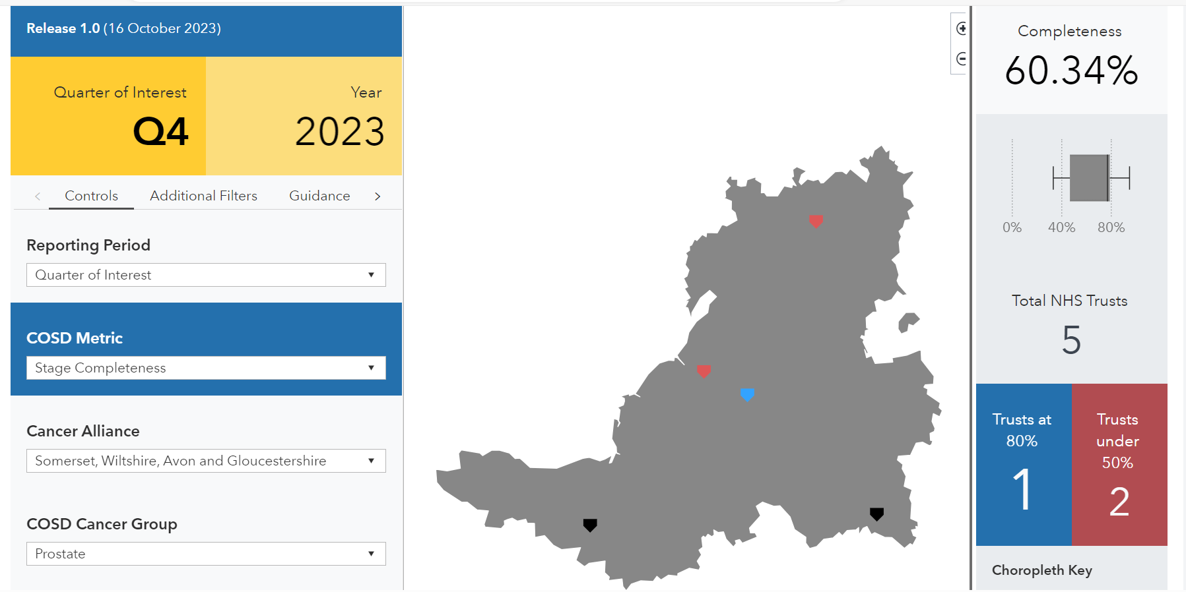
National Cancer Programme Focus for Urology 24.25: COSD

Slide 11
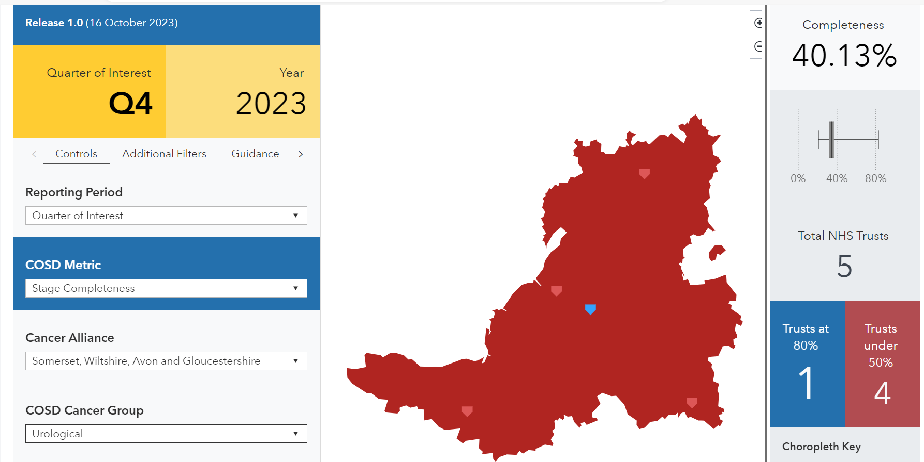
National Cancer Programme Focus for Urology 24.25 (COSD)

Slide 12
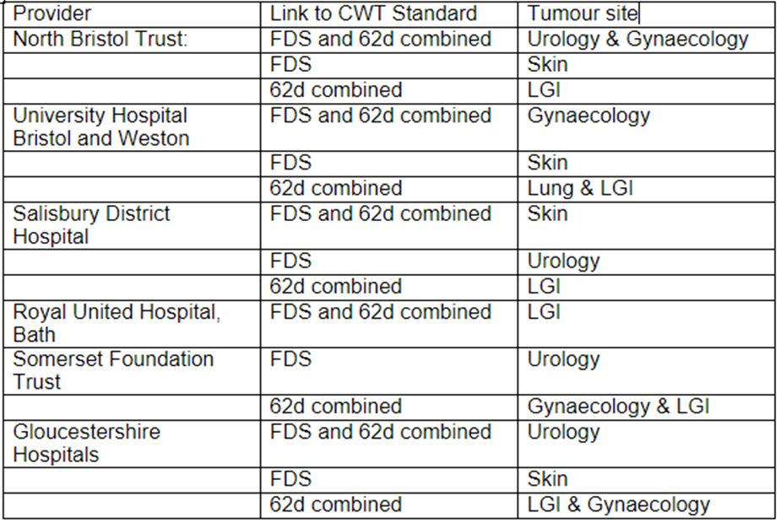
SWAG CA and Provider Performance Improvement plans
Notes:
Focus on intelligence (pathway analysis, D&C modelling) / PTL management (escalation protocols, navigation, tracking) / Productivity e.g triage, STT, N/S led LATP, capacity (workforce: MRI CTU LATP RALP histopath) and partnerships (Primary care / diagnostics re dedicated or alignment)
Full pathway NBT and GHFT
FDS: SFT and SDHFT

Slide 13
National Cancer Programme Focus for Urology 24.25 Improvement plans
Provider | Plans | Provider | Plans
SFT | Improvement oversight Front door: Standardise triage LATP demand:capacity N/S LATP CDC opportunities | GHFT | Insights: deep dive and SW Dashboard Workforce: Additional LATP (328) and flexi (504) capacity MDT clinics UIU
SDHFT | Insights (pathway analysis & D:C) LATP, OPA, TURBT & TULA capacity N/S LATP Diagnostic TATs | NBT | Introduce STT and reduce Diagnostic TATs TBC LATP capacity 3T scanner / UIU?

Slide 14
National Cancer Programme Focus for Urology 24.25 Investment
Provider | Initiative
NBT | Pathology enhanced rates
 | Improvement Clinical Leadership (Pathology and Radiology)
 | Band 7 Urology CNS 1wte
GHFT | Urology Band 3 1 wte MDT coordination
 | Same day biopsy pilot (pathology uplift B3-7)
 | 7 sessions per week Flexi cystoscopy
SFT | Cancer Faster diagnosis front door –admin, project management, CNS triage
 | 1.5PA Radiology reporting – bladder pathway improvement
Provider | Initiative
RUH | Additional 500 haematuria USS
 | Cystoscopy scopes
 | Surgical care practitioner (increase consultant OPA clinic capacity)
 | Prostate theatre or LATP WLIs
SDHFT | Prostate Cancer Nurse practitioner to support triage and LATP
 | 0.5 WTE Consultant Surgeon Fixed term
UHBW | Uro-oncology specialty Doctor 10PAs
c860k investment in pathway transformation and performance improvement

Slide 15
Cancer alliance comms
5th June 2024

Slide 16
Innovation event
Dr Netty Kinsella RN, MSc. PhD
Dr Kinsella is a Uro-Oncology Nurse Consultant at The Royal Marsden NHS Foundation Trust. She'll be sharing The Royal Marsden, London’s pilot project reducing the time to prostate cancer diagnosis.
Jaimin Bhatt
Jaimin is a Consultant Urological and Robotic Surgeon at Queen Elizabeth University Hospital, NHS Greater Glasgow and Clyde, Glasgow. He'll be sharing Queen Elizabeth University Hospital, Glasgow’s, personalised pathways work 'Filters and Cascades'.
Rachel Baker-Green and Arbaaz Allybux
Rachel Baker-Green is a Metastatic Renal Cancer Clinical Nurse Specialist and her colleague Arbaaz Allybux are from Leeds Teaching Hospitals NHS Trust. They'll be sharing insights into making the pathway more efficient and how they are engaging men from Black communities.
26th July
Faster Diagnosis Pathway Innovations
12pm-1.30pm
Register

Slide 17
PROSTATE CANCER UK EARLY DIAGNOSIS WEBINAR
Register now for FREE!
When: 24th July
12pm to 1pm
Where: Online
Speaker: Dr Sam Merriel
Learn the high-risk demographics for prostate cancer.
Assess (& reassess) need for PSA blood testing.
Explain the recent changes in the diagnostic pathway.
Understand the key health inequalities/inequities in prostate cancer.
Learn the latest PCN DES requirements.
Identify where to signpost patients for more information.

