Slide 1
Patient Experience - 03/06/24-26/06/24
IQVIA Patient feedback Hub
Neuro-Oncology CNS feedback form
Bristol Haematology Oncology Centre
Suzanne Waldon-Smith 16/07/24

Slide 2
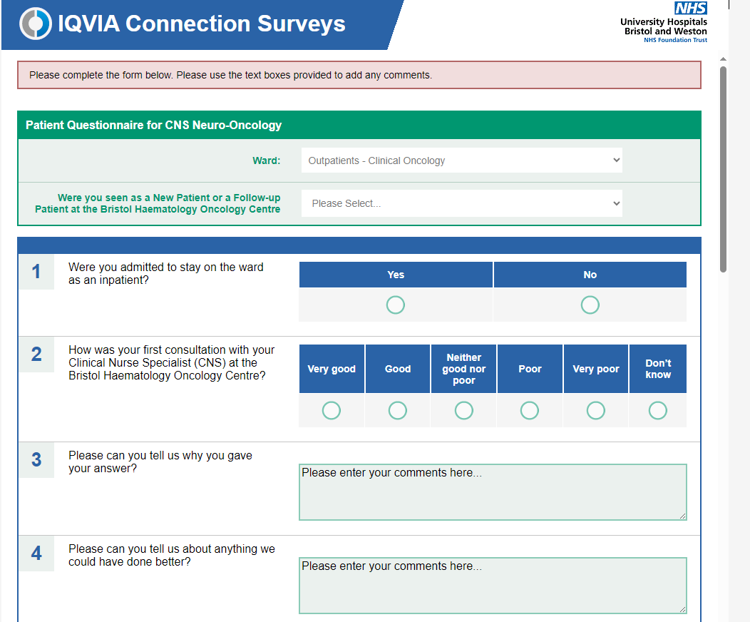

Slide 3
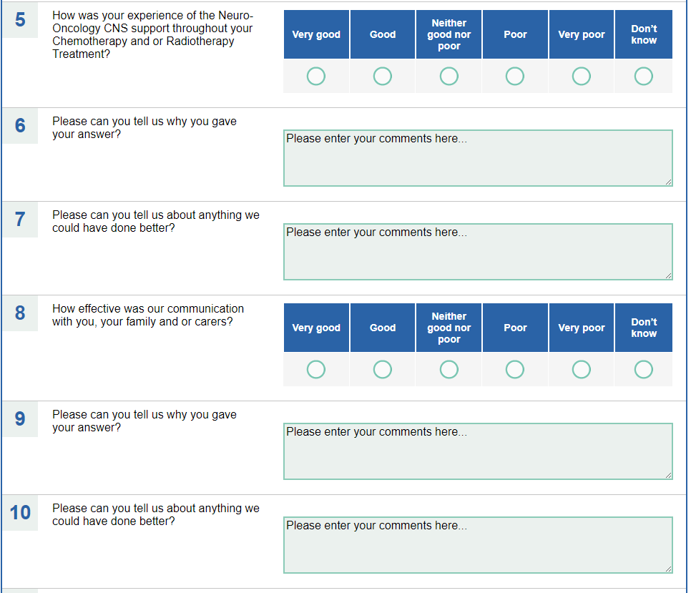

Slide 4
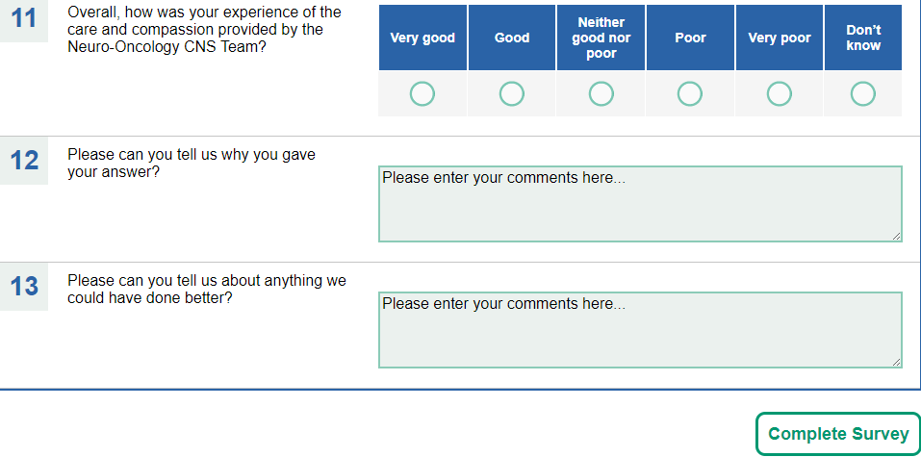

Slide 5
Here are the completion links for the survey and I have attached the QR code.
Web - https://www.oc-meridian.com/uhbristol/survey/PatientQuestionnaireforCNSNeuroOncology QR Code - https://www.oc-meridian.com/uhbristol/completion/custom/default.aspx?slid=489&did=
Paper - https://www.oc-meridian.com/uhbristol/completion/custom/default.aspx?slid=490&did=
Link sent to patients at the end of the patients chemoradiotherapy/radiotherapy

Slide 6
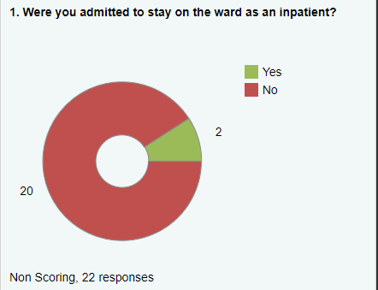
Notes:
Response analysis

Slide 7
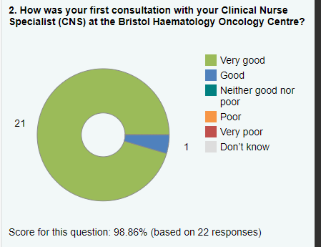

Slide 8
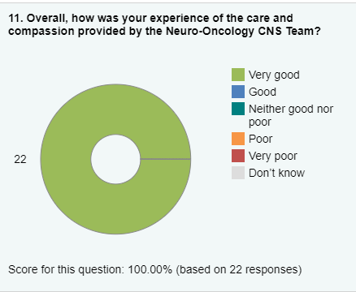

Slide 9
Overall Themes of Feedback
Always Supportive and patient
Informative and patient
All the staff were very attentive and Caring people
Nothing could be improved
I really don’t think anyone could improve the care provided by the staff
The nurses were very empathetic
Extremely positive
The professionalism, humanism, humbleness, kindness and generosity of the Oncology team makes me grateful to all the team. Thankyou NHS

