Slide 1
Hope in Fatigue Development of non-pharmacological interventions for fatigue management in primary brain tumour.
Rachael
Simms-Moore, MSc.
PGR researcher College of Health, Science and Society.
Contact
24/06/2024
5 minutes
Notes:
Good afternoon everyone,
my name is Rachael Simms- Moore,
I have a masters degree in Psychology and am currently working on Developing non-pharmacological interventions for fatigue management in primary brain tumour.
I am going to share an update on what I have been getting up to and I hope you find It interesting.

Slide 2
Fatigue in Primary Brain Tumour
Fatigue significantly reduces quality of life, limiting the ability to work, socialise or engage in activities ⁽¹⁾.
Non-Pharmacological Interventions
Patients express a preference for non-pharmacological interventions ⁽²⁾
but there are no standard options available ⁽³⁾.
Cancer Research UK, (2019). Survival. Retrieved 14/12/2022 from https://www.cancerresearchuk.org/about-cancer/brain-tumours/survival
Louis, D. N., Ohgaki, H., Wiestler, O. D., Cavenee, W. K., Burger, P. C., Jouvet, A., Scheithauer, B. W., & Kleihues, P. (2007). The 2007 WHO
Higginson. (2004). Fatigue in Cancer (Vol. 1). Oxford University Press.
Notes:
First a quick bit of background:
Fatigue is a key debilitating symptom for patients with a primary brain tumour (PBT).
The fatigue experienced can be physical, psychological and/or emotional
It significantly reduces quality of life, limiting the ability to work, socialise or engage in activities.
Patients have expressed a preference for non-pharmacological (non – drug) interventions. There are no standard options available.

Slide 3
The Research Process
Patient and Public Involvement and Engagement (PPIE)
Scoping Review
Patient and Healthcare professional Interviews
Intervention Co-Design
Proof of concept study
Feasibility
study
Behavioral Change
Tailored
Delivery
Holistic
Notes:
So how am I going to address this issue?
Well as you can see, my PhD is divided into 5 key stages.
Patient and public involvement crucial throughout, and I shall go into more detail on how I have engaged patients on the next slide.
The stage of the PhD I shall soon be moving into is intervention co-design, which focuses on:
Behavioural change.
Individual tailoring.
Holistic design.
Delivery methods.
Currently I am analysing interviews and writing up a scoping review to inform this intervention design stage.

Slide 4
Patient Research Partner (PRP) Involvement
Patient Research Partners are individuals diagnosed with the same medical condition or experience of a symptom of treatment being researched.
Their roles are crucial in offering a patient's perspective on the design and implementation of research.
They provide feedback on research findings and advocate for the needs of patients.
They may help in spreading research results to patient communities, often in association with relevant charity organisations.
They give feedback on interview questions or patient-facing documents, contributing their unique perspectives.
PRP 1 | PRP 2 | PRP 3 | PRP 4*
Male | Female | Male | Female
18-25 | 25-35 | 35-50 | 50+
White | White | Asian | White
Grade 1 | Grade 1 | Grade 4 | Grade 4
Surgery | Surgery | Surgery Chemotherapy Radiotherapy | Surgery Chemotherapy Radiotherapy
*PRP has withdrawn due to illness progression.
Recruitment is ongoing for a fourth PRP.
Notes:
Now Patient Research Partners are individuals sharing the studied medical condition or have experience of the condition.
They serve a crucial role in research design and implementation.
==
I have been working with four partners since the beginning of this research. However, sadly as is the nature of the research, one of my PRPs has had to withdraw due to their tumour progression and entering hospice.
==
My PRPs have varied tumor grades, ages, treatment journeys, ethnic backgrounds, and gender mix, meaning they have contributed diverse perspectives on my research.
Including sharing their personal experiences they have also provided feedback on key documents, participated in pilot interviews and at every stage advocate for patient needs.
They have also been assisting in disseminating results to patient communities, two of my PRPs have already been collaborating with charities previously and so have been a vital link.

Slide 5
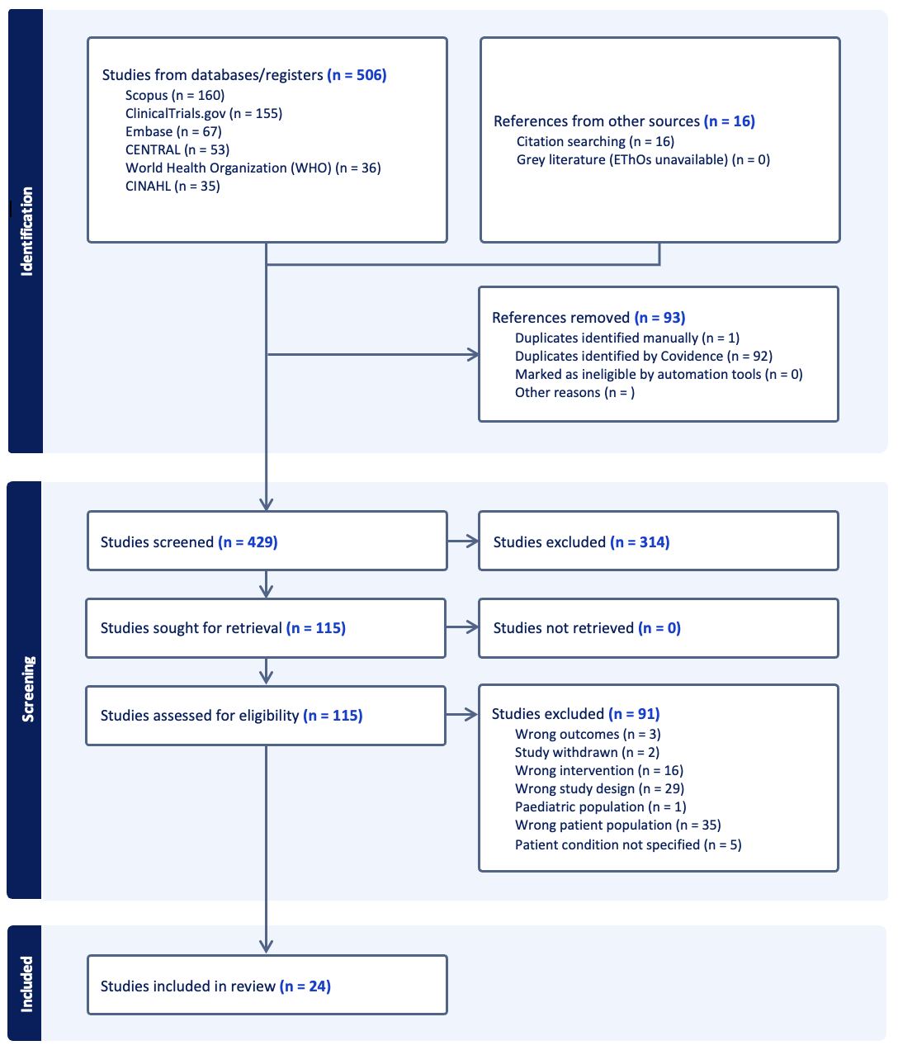
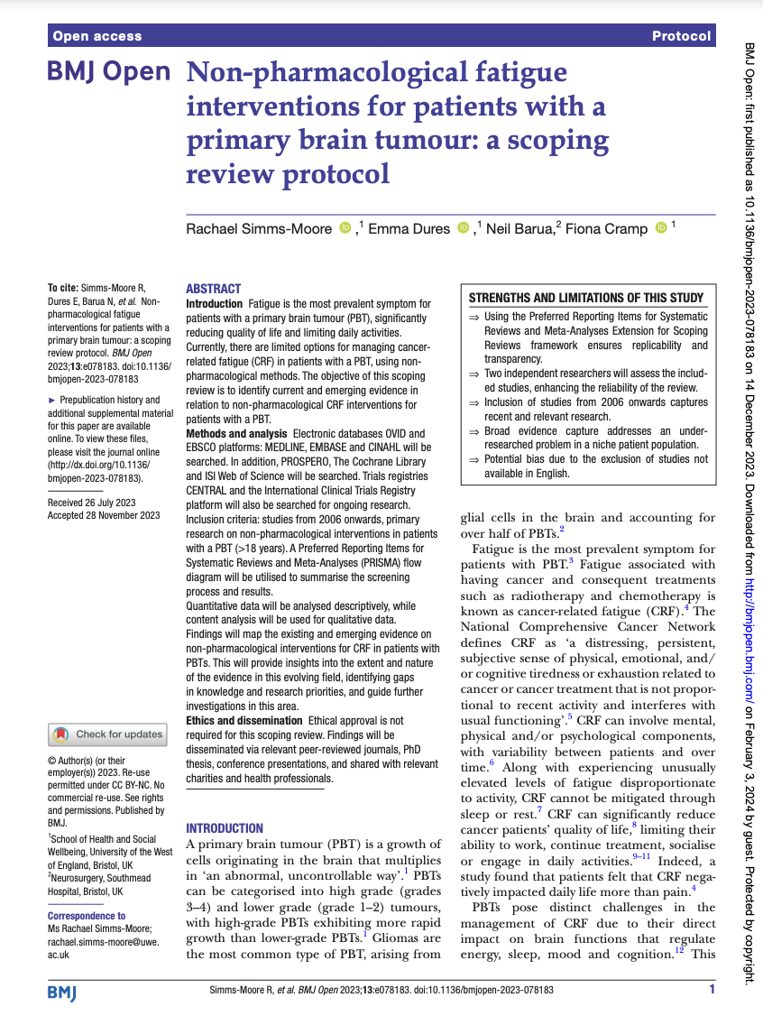
Scoping review
Protocol published in the BMJ Open, Dec 2023.
Figure: PRISMA Flow diagram showing study selection process
Working alongside an independent reviewer for the study selection screening process.
This scoping review will map the current available literature.
Notes:
The first stage of this research was looking at the literature. Mapping literature to see what is currently available is essential for intervention design.
Therefore, I am currently conducting a scoping review for this research.
Our Protocol was published in BMJ Open in December of last year.
==
I have included a PRISMA flow chart here just showing the study selection process, the searches resulted in 522 studies and once duplicates were removed 429 of these were screened by myself and a second independent reviewer.
The rounds of screening resulted in 24 papers to be included for the review.
I have completed data extraction and am now on the Final stage of analysis and write up, I hope to have this completed and a paper ready for publication later this summer. Fingers crossed!

Slide 6
Initial scoping review findings
The 24 studies included were conducted across 10 countries;
Brazil (n=1), Canada (n=3), Denmark (n=2), France (n=1), Netherlands (n=4), Republic of Korea (n=1), Spain (n=1), Switzerland (n=2), United Kingdom (n=3), United States of America (n=6).
68% of study designs were RCTs;
The studies fell into four categories of intervention;
RCT (n=17)
Cohort study (n=3)
Non-randomised experimental study (n=3)
Prospective single-arm intervention trial (n=1)
Case series (n=1)
Cross sectional study (n=1)
Exercise/ Physical activity (n=12)
Cognitive/ behavioural (n=8)
Dietary (n=1)
Comprehensive/Multidisciplinary (n=3)
Data extraction is complete, analysis is in progress. I am aiming to complete this in the coming months and submit the full review paper to the BMJ open for publication later this year.
Notes:
Although I have not completed the write up yet I have popped a few points on here from the review.
The 24 studies were conducted across 10 countries.
68% of these studies were Randomised controlled trials
And the studies fell into roughly four categories of intervention, Exercise, behavioural, dietary and multidisciplinary.

Slide 7
Patient and Healthcare Professional Interviews
Study Aims
Understand experiences of fatigue in Primary Brain tumour from patient and Healthcare Professional perspectives.
Explore experiences of fatigue self-management, strategies, and interventions.
Explore ideas for fatigue support.
Methods
A qualitative approach.
Recruited patient participants from brain tumour charities.
Recruited Healthcare Professionals from Professional networks, charities and organisations.
A topic guide for each group was developed with input from patient research partners, the supervision team and literature.
Semi-structured interviews via video call or face-face at the University were conducted according to participant convenience.
Notes:
Meanwhile, alongside the scoping review, over the last few months I have conducted 24 semi structured interviews with patients and heathcare professionals. With all but one opting for video call.
==
Through these interviews I aim to Understand the experiences of fatigue from both patient and Healthcare professional perspectives.
Specifically exploring fatigue self-management strategies. The results from these interviews will also help inform intervention design.

Slide 8
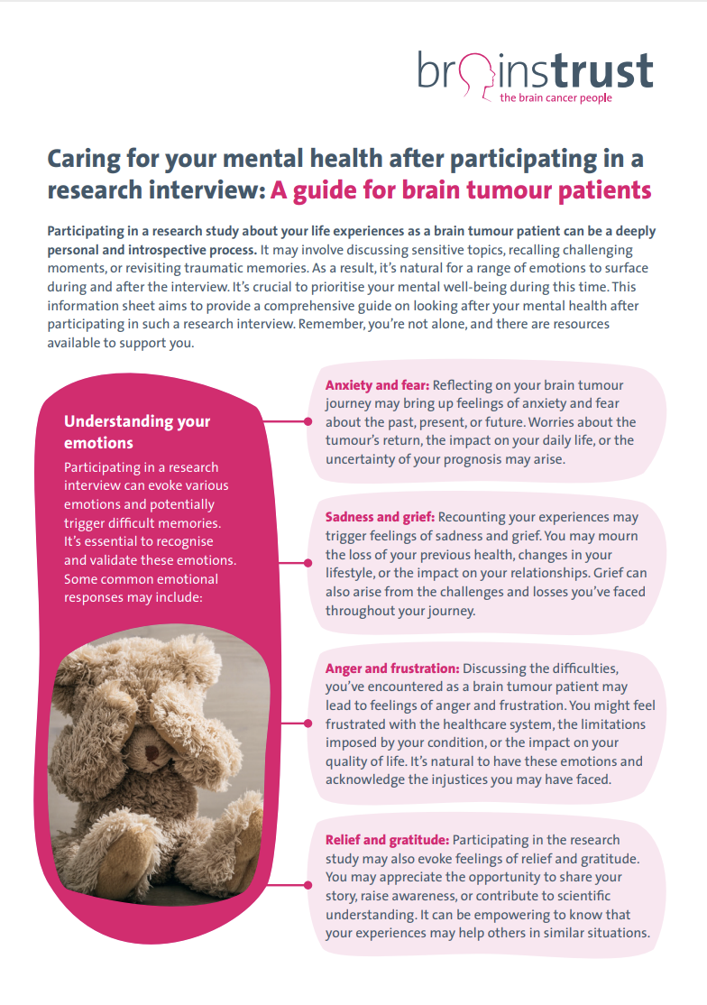
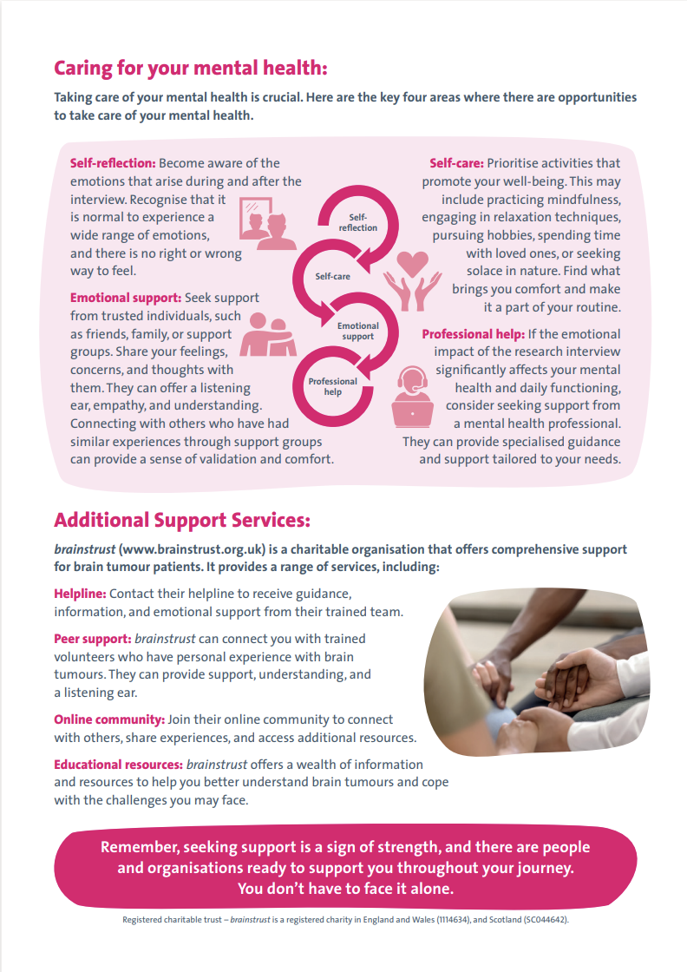
Study ethics
Ethical Approval: Securing approval from the University of the West of England Research Ethics Committee ensures ethical standards are met.
Informed Consent: Prior to participation, informed consent will be gained from all participants. This involves providing clear, comprehensive information about the study's purpose, procedures, potential risks, and benefits, ensuring participants fully understand their involvement and rights. Consent forms will be used to document this agreement, reinforcing participants' autonomy and the ethical foundation of the research.
Participant Well-being: Detailed risk management strategies are in place for pre, during, and post-interview scenarios, emphasizing participant safety and comfort.
Data Confidentiality: Adherence to general data protection regulations (GDPR) and specific data handling procedures protect participant privacy and ensure data security.
Insider Researcher Disclosure: The researcher's disclosure of their personal history as a former brain tumour patient is ethically considered to build rapport and trust, with measures to avoid bias and maintain professional integrity.
Notes:
Ethical approval for both patients and healthcare professionals has been gained via UWE.
As this is not NHS ethics I recruited via charities, social media and professional networks.
==
To keep participant wellbeing at the forefront of this study we created an aftercare sheet for participants that was given to them after their interview.
This included signposting to revelant brain tumour charities for advice and support both practically and emotionally.
It also had some strategies for managing difficult emotions that may come up after the interview. With this aftercar sheet we also had permission from brains trust charity to include their fatigue booklet. This pack was was very well received by the participants.
==
We also made the decision while designing this study that I would disclose my history as a former brain tumour patient myself. This was done in the information sheet which all participants received in their pre-interview information as a brief line that the researcher has a personal history as a patient hence their interest in the research. We believed it would enable rapport to be built and trust, particularly as my personal story has already been published and is readily available online.

Slide 9
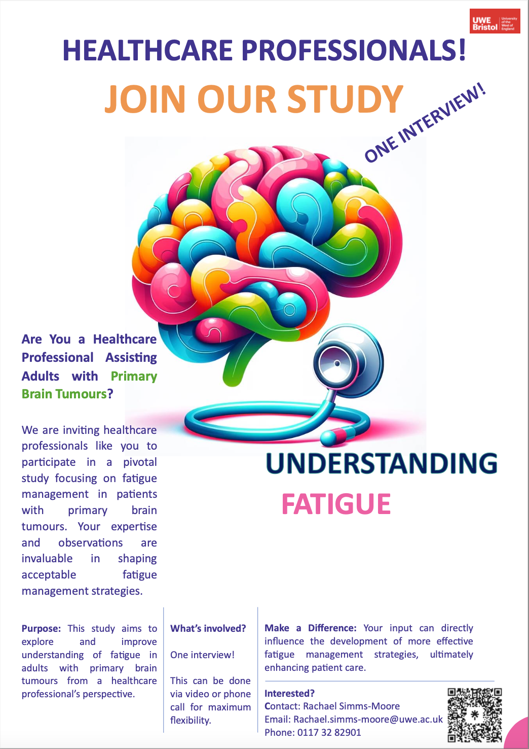
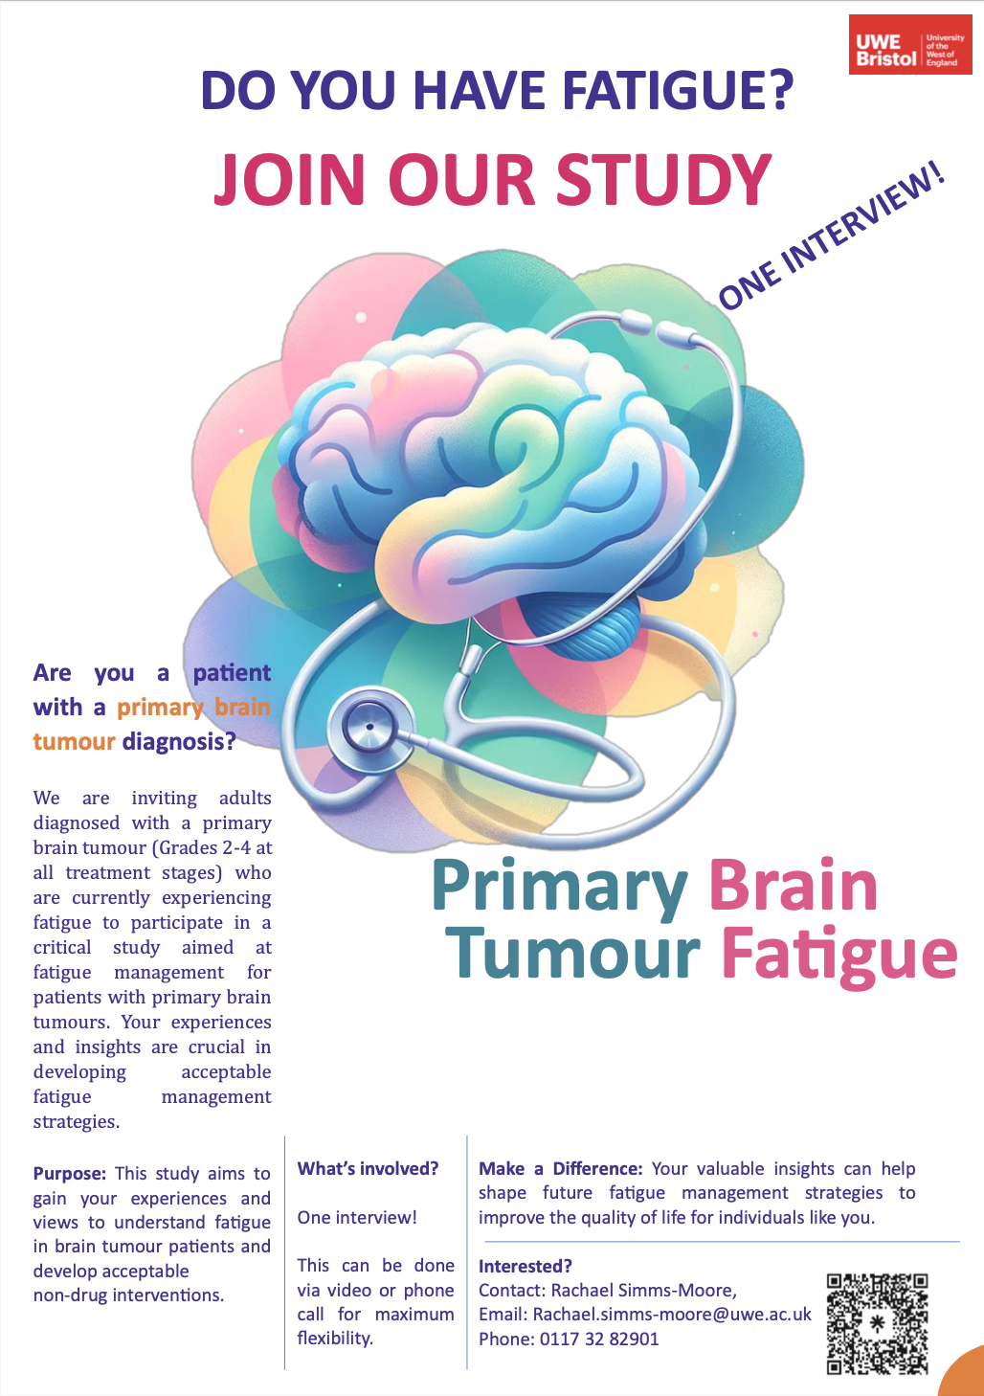
Study recruitment
Study recruitment materials reviewed by patient research partners.
Recruitment via charities and social media.
Notes:
I have been working with many UK brain tumour charities to recruit participants from both the larger well-known charities and smaller more specialised charities.
==
The posters for recruitment were designed with feedback from my patient research partner team to try to ensure accessibility and clarity of message.
They liked the bright colours saying that they makie the posters more hopeful and upbeat despite the topic.
They also all commented on the image of the stethoscope being important as fatigue is hidden and the stethoscope indicates it is a real condition and issue.
==
We faced two main challenges inrecruitment for this study,
One was trying to recruit a wider range of professions, including surgeons and other medical staff.
==
A further challenge of this study across both groups has been the recruitment of and therefore under representation of Black, Asian and Mixed ethnicity participants.
After the first wave of recruitment yielded a 100% white cohort I met with the CEO of Black in Cancer, Signoury Bell a PhD at Cambridge for advice.
She kindly helped me with some ideas for a new recruitment approach and a new poster design to be distributed by her charity and the charity CancerBlack Care.
Although we made great efforts in this second recruitment drive we once again were only able to get white participants for this study.
==
I have however taken away some valuable learning points from that meeting and hopefully these are some points that I can pick up later in this research!

Slide 10
Who was Interviewed?
13 Patients with Primary Brain Tumours
Ages: 26-68, Range: 42.0, Mean: 46.7, SD:11.4
Gender: Female 61.5%, Male 38.5%
Years since diagnosis: 1-14,
Range:13.1, Mean:5.0, SD: 4.1
Primary brain tumour types:
Anaplastic astrocytoma grade 3
Astrocytoma grades 2, 3, 4
Glioblastoma multiforme grade 4
Glioma grade 2
Meningioma grade 2
Oligodendroglioma grade 2
Pontine Glioma grade 3
Notes:
So who was interviewed? I interviewed 13 patients with primary brain tumours.
61% were female with a mean age of 46.7.
Patients interviewed have been living with a brain tumour for between 1 and 14 years.
The mean average of living with a brain tumour was 5 years since diagnosis.
==
On this slide are a series of numbers and statistics. But it is important to remember what sits behind them, and that is individuals who are truly struggling with their day to day lives. This is why this research is important.

Slide 11
Who was Interviewed?
11 Healthcare Professionals
Age: 26-58, Range: 32.0, Mean: 46.7, SD: 9.1
Gender: Female 100%
Years of experience: 2.5-30.0,
Range: 27.5, Mean:10.2, SD: 8.2
Profession:
Nursing:
Advanced Clinical practitioner
Clinical nurse specialist
Rare cancer nurse
Allied Health Professionals:
Occupational Therapist (n=5)
Physiotherapist
Radiographer
Psychology:
Clinical Psychologist
Notes:
As for the 11 Health care professionals, 100% were female with a mean age of 46.7 and a mean of 27.5 years of experience working with patients with brain tumours.
3 main types of profession were interviewed in this study: nursing, Allied Health professionals and Psychology.
==
I have recently completed the interviews and am now in the process of checking the transcriptions for accuracy and anonymising all content before then deleting the audio and video recordings.
As I clean each transcript I import them into Nvivo where I have began coding as the first step in a thematic analysis.
==
Although coding is still ongoing I have included a few emerging themes with some anonymised quotes which I shall share with you now.

Slide 12
Emerging Themes
Theme 1: Understanding Fatigue
Decreased motivation and lack of energy
Definition of Fatigue
Lack of standard information
“They're just too exhausted to try anything”
Harriot, Healthcare Professional
Theme 3: Coping Mechanisms and Strategies
Self-Management Techniques
Support Systems
Effective vs. Ineffective Strategies
Time of intervention delivery inconsistencies
“I think there's a point if I've been outside and I've been in the fresh air for even if it's 20 minutes in during the day, that does help me feel fresher”
Norman, Patient
Theme 2: Experience and Impact of Fatigue
Fluctuation Over Time
Physical Impact
Emotional and Cognitive Impact
“Fatigue is catastrophic”
Jackie, Healthcare Professional
“My son will say can we go outside and have a kick around.
And half of those times, I have to say I'm really sorry mate. I can't. I haven’t, I just haven't got the energy"
Dexter, Patient
Theme 4: Support Systems and Their Role
Family and Friends
Healthcare and Charitable Support
Future Planning
Health care professional silos
Postcode lottery
“We have a neuro-psychologist, but, well there’s quite a bit of a wait for that and it's a bit of a post code lottery as well”
Harriot, Healthcare Professional
Notes:
Currently I am coding all interviews from patients and healthcare professionals together as there are many thematic commonalities between both groups.
==
Theme 1 is understanding fatigue.
There appears to be a lack of a definition of fatigue, this was in both healthcare professionals and patients, with both unsure what was causing the fatigue or if it was even caused by the tumour or lifestyle. This lack of definition is interesting as the understanding of it can influence how the healthcare professional instructs the patient and how the patient self manages their fatigue. i.e do they believe it is physical or psychological.
==
Theme 2 is the experience and impact of fatigue itself.
Although there was no agreement on what causes the fatigue, there was clear agreement on the significant and damaging impact of fatigue across many aspects of life and that it appears to fluctuate over time.
==
Theme 3 is coping mechanisms and strategies
The types of strategies/interventions suggested to patients varied between HCPs and between patients. There is also an interesting disagreement emerging regarding the preferred timing and location of intervention delivery between patients and health care professionals. With Healthcare professionals wanting interventions to be in person at hospital and fatigue information delivered later in the patient journey with patients preferring at home online interventions and information on fatigue delivered much earlier.
==
The final emerging theme for now is support systems and their roles in fatigue management.
Patients varied between having a great deal of family support or none at all. This was similar in terms of support from the NHS, patients varied from no aftercare for fatigue or signposting etc or lots of support at specialised fatigue units. This was also expressed by healthcare professionals who depending on their location felt they could offer lots of support or very little. Many professionals felt siloed and unaware of what other healthcare professionals were offering patents this was between teams and hospitals/ trusts.
Charities were frequently credited by both patients and healthcare professionals as essential.
==
Just to note that again these are emerging themes and I expect some changes as I continue coding, but I hope this has given you a flavour of what shall be coming.

Slide 13
Next Steps!
Interview data analysis Scoping review completion
Intervention development
Proof of Concept
Feasibility
Notes:
And just to close,
The next steps for my research completing this study and a scoping review which is ongoing both of which will inform the Intervention development stage where an intervention will be co designed with patients and healthcare professionals.
Subsequently a proof of concept and feasibility study will be conducted in the future.
I look forward to updating you all once I have some new findings to share!
Thank you

