Slide 1
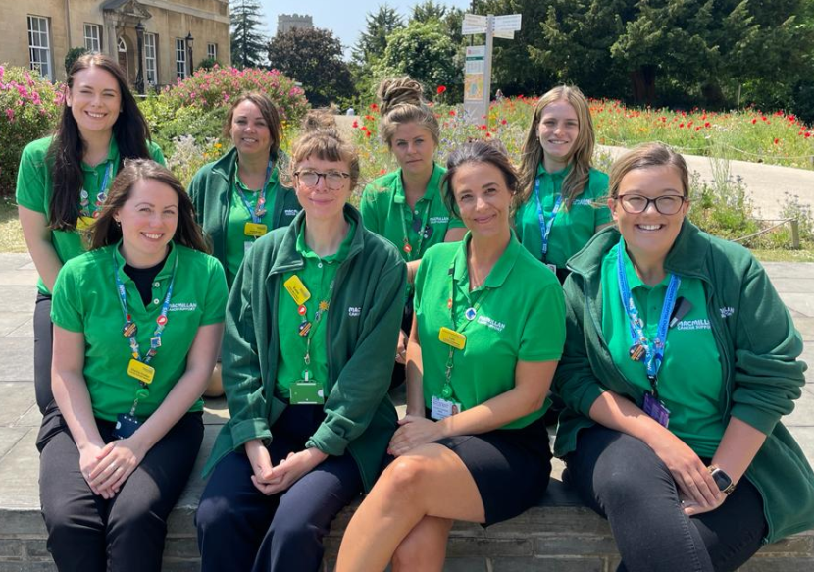
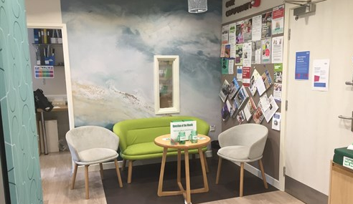
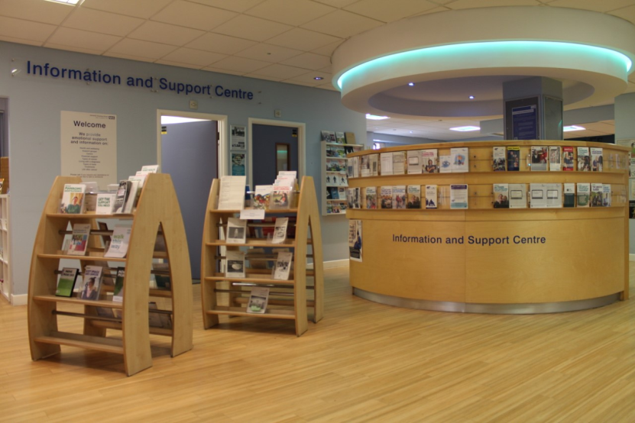
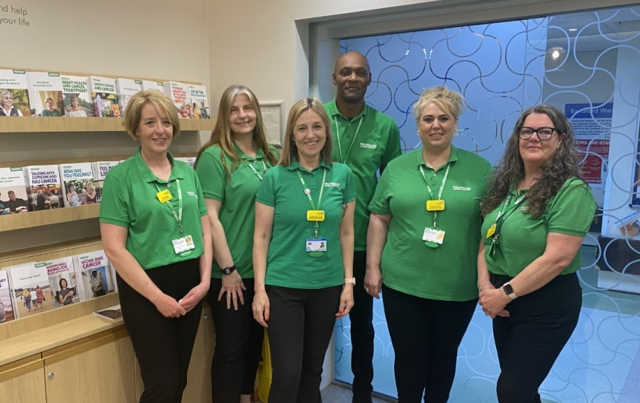
Personalised Care & Support team

Slide 2
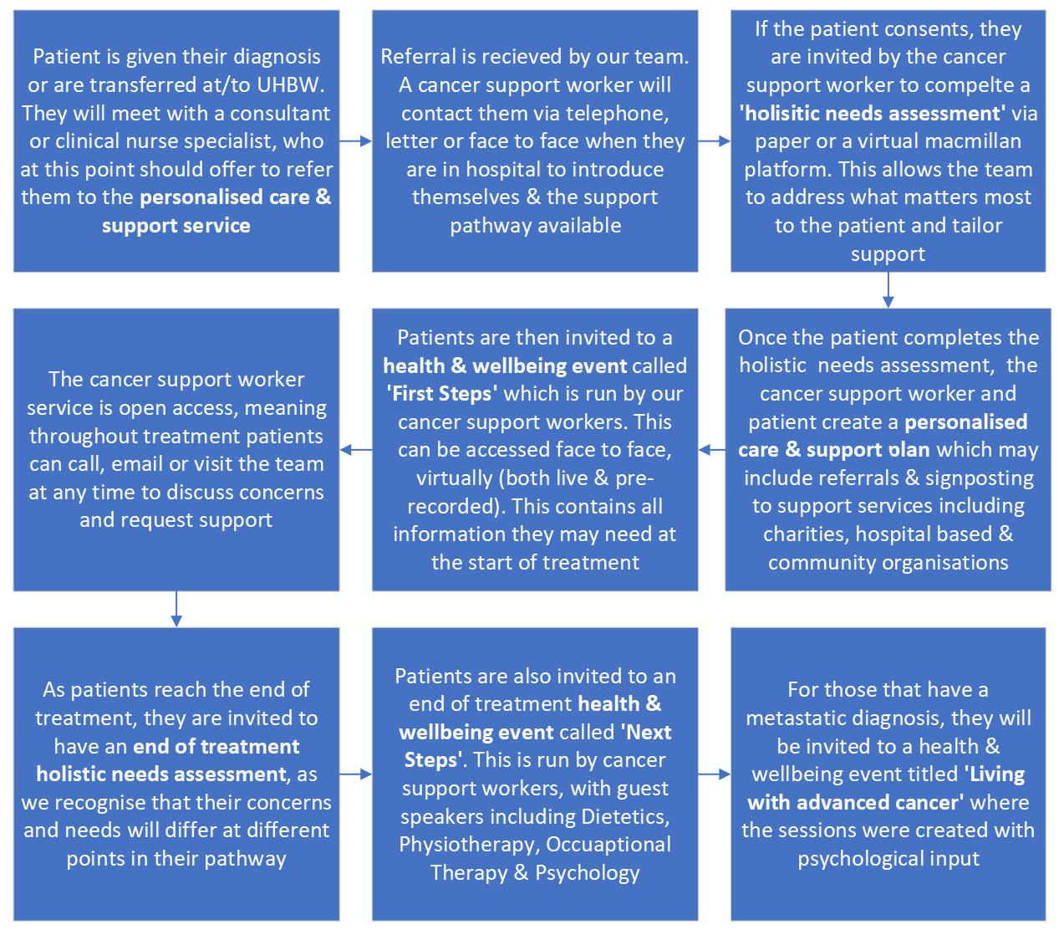
Notes:
This is a rough overview of the personalised care & support service pathway. Whilst this represents someone entering our service at the beginning of their cancer journey, people can access us at any time and will be supported appropriately.

Slide 3
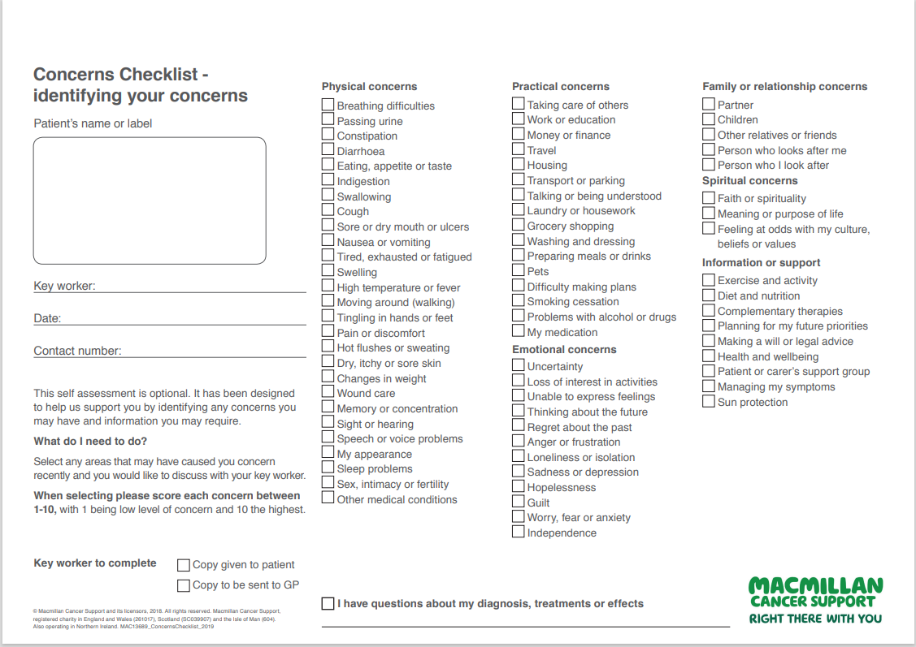
Notes:
For those that are not familiar with the concerns checklist our service reviews with patients, I wanted to highlight just how extensive this support is.
Preparing meals/drinks: Meals on wheels, Wiltshire foods
Washing and dressing: Care connect
Isolated/patient carers support group: Refer to.. Bristol & Bath Myeloma UK support group or Bristol/WSM Haematology Support Group, local support groups include You Tree, trust psychological support

Slide 4
Treatment Summaries
Completed by clinical teams, with a copy being shared with both the patient & GP
Lymphoma:
Host an end of treatment/patient initiated follow up clinic .
Here they see patients who have completed IV chemo or those who meet the criteria for PIFU.
The patient completes an HNA and brings it with them which guides the appointment and we discuss the risk of relapse and late effects and how the patient can manage the associated risks.
CNS then completes a treatment summary/clinic letter and the patient ends up with a health plan which addresses ongoing issues and late effects.
Notes:
I wanted to share an example of how this mode of support is delivered within Lymphoma

Slide 5
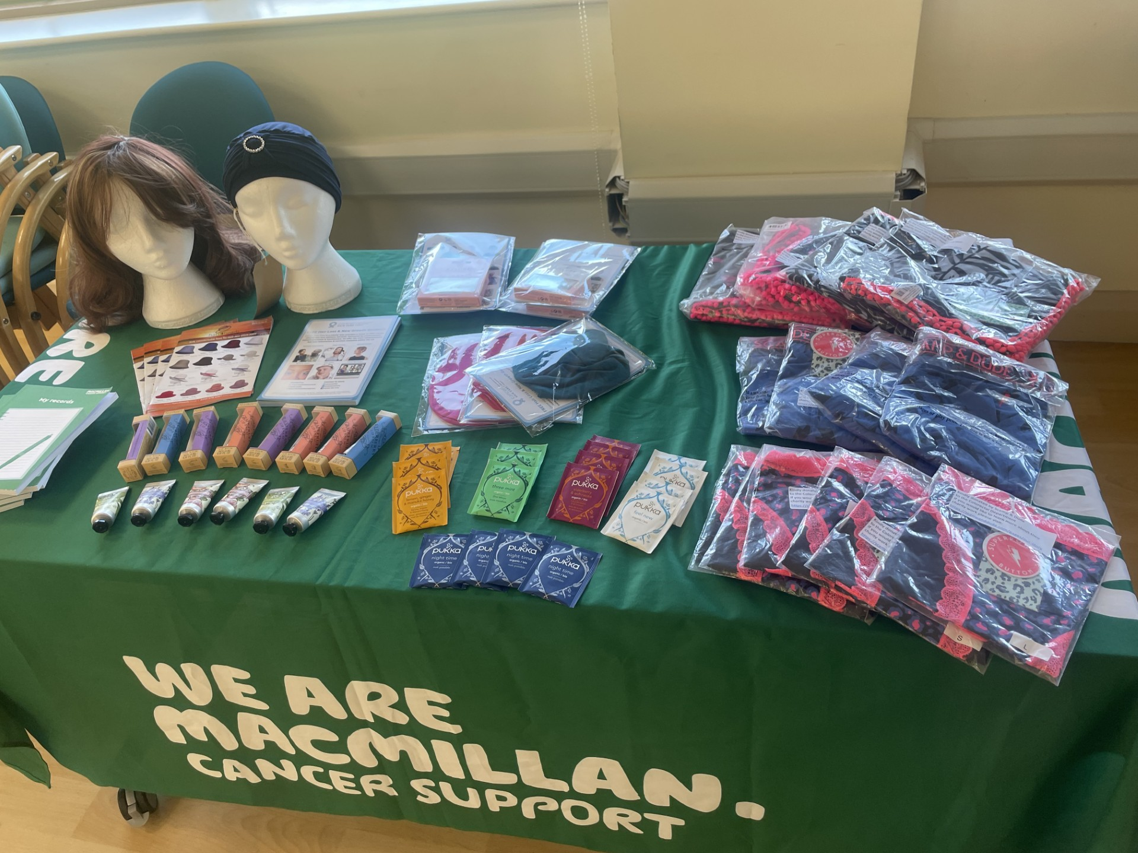
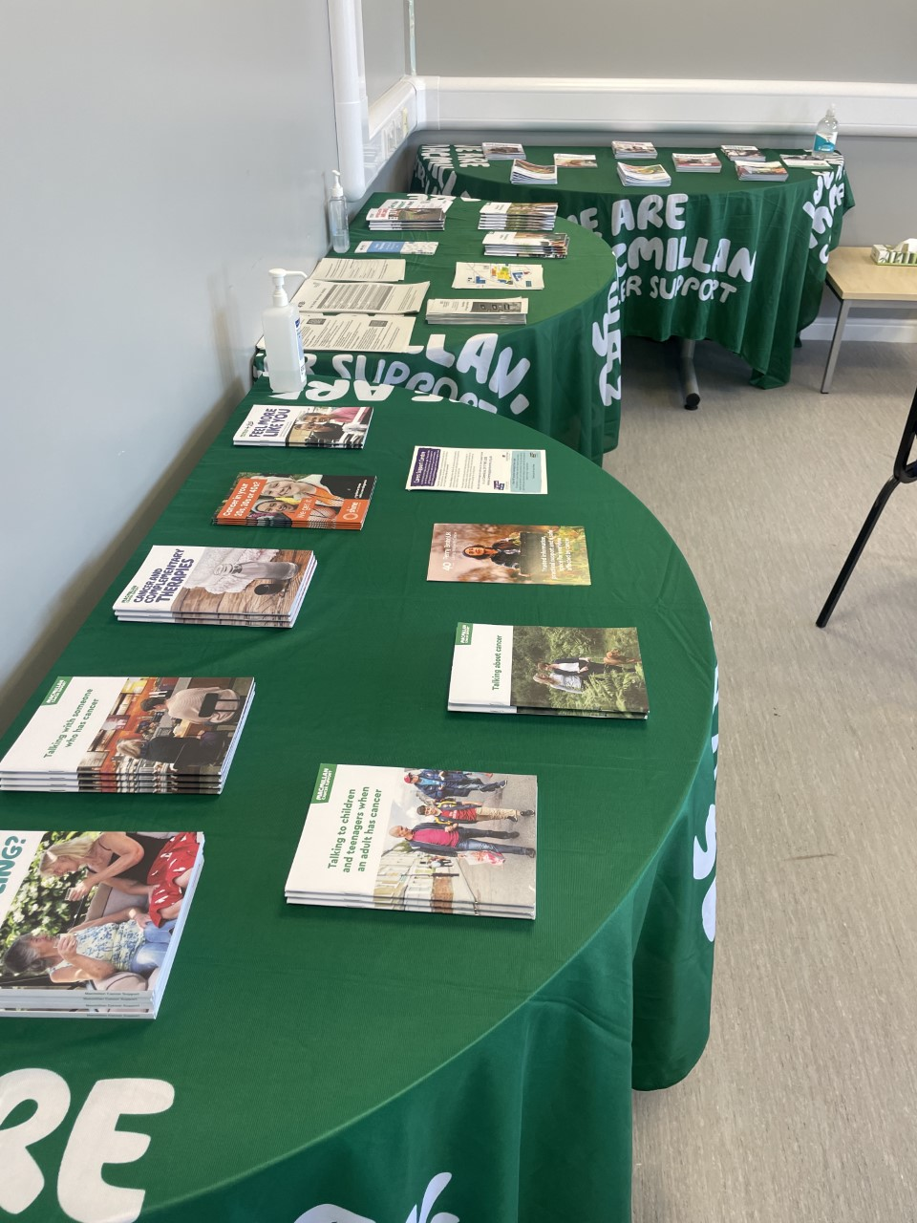
Health & Wellbeing Events
For patients newly diagnosed with cancer
For patients reaching the end of treatment
For patients with an advanced cancer diagnosis
Notes:
In a blend of face to face and virtual delivery, we offer the above events to patients
First Steps: Ran & coordinated by CSWs
Next Steps: Coordinated by CSWs with guest speakers from – dietetics, OT, Psychology
Living with advanced cancer: Coordinated by CSWs with Guest Speakers

Slide 6
Our Information & Support centres
Focus on self-empowerment and recognising the impact of changes to appearance:
Referral to our UHBW Wig service where appropriate.
Pre-Loved wigs
Hats, scarves and headwear for sale.
Headwear demonstrations to increase confidence in use
Head shaving clinic
Free look good feel better make up workshops.
Practical support:
Waterproof PICC Covers and various items for sale.
Blue Badge applications.
Help to apply for financial support.
Help to access free prescriptions.
List of travel insurance brokers.
Emotional support:
Details of support groups.
Support for carers.
A listening ear service.
Booklets and leaflets for you to take away.
Information on specific cancers.
Booklets on Planning ahead.
Support after cancer treatment.
Coffee mornings
Promotional pop up stands:
Scar therapy
Service pop up across the hospital & different wards
Cancer awareness campaigns
Community engagement to reach those who do not visit the hospital
Lifestyle specific support:
Local exercise classes and activity DVD
Advice on healthy eating and recipes
Notes:
Our cancer information & support centres act as a hub for our personalised care & support service. With one in the entrance to Bristol Haematology & Oncology Centre and the other on the first floor of Weston General Hospital, we provide an open, safe, physical presence where anyone affected by, or living with cancer can come and access support. Our cancer support workers rotate through this service, with support of the centre & service managers.
As part of our service, we encourage all new oncology members of staff to visit their closest centre. We present at the health care support worker induction day, have been included in the doctors induction & cancer nurse specialists also visit and spend time with the centre and support workers. This allows collaborative working across all departments within the oncology pathway.
We understand that many people living with and affected by cancer, will not access support offered through a hospital and therefore our focus for the coming year is on going to where these people are. As a result of this, our community engagement recently has included:
Community engagement
Monthly appearance at the local support group to our hospital
Promotion of our services within targeted communities
Pop up stand at the local Healthy Living centre
Pop up stand at the Clevedon flower show – over 30 contacts made
Promotion at local social clubs
Presentation to BNSSG Practice nurses promoting our services and providing information
Plans to target resources in GP practices

Slide 7
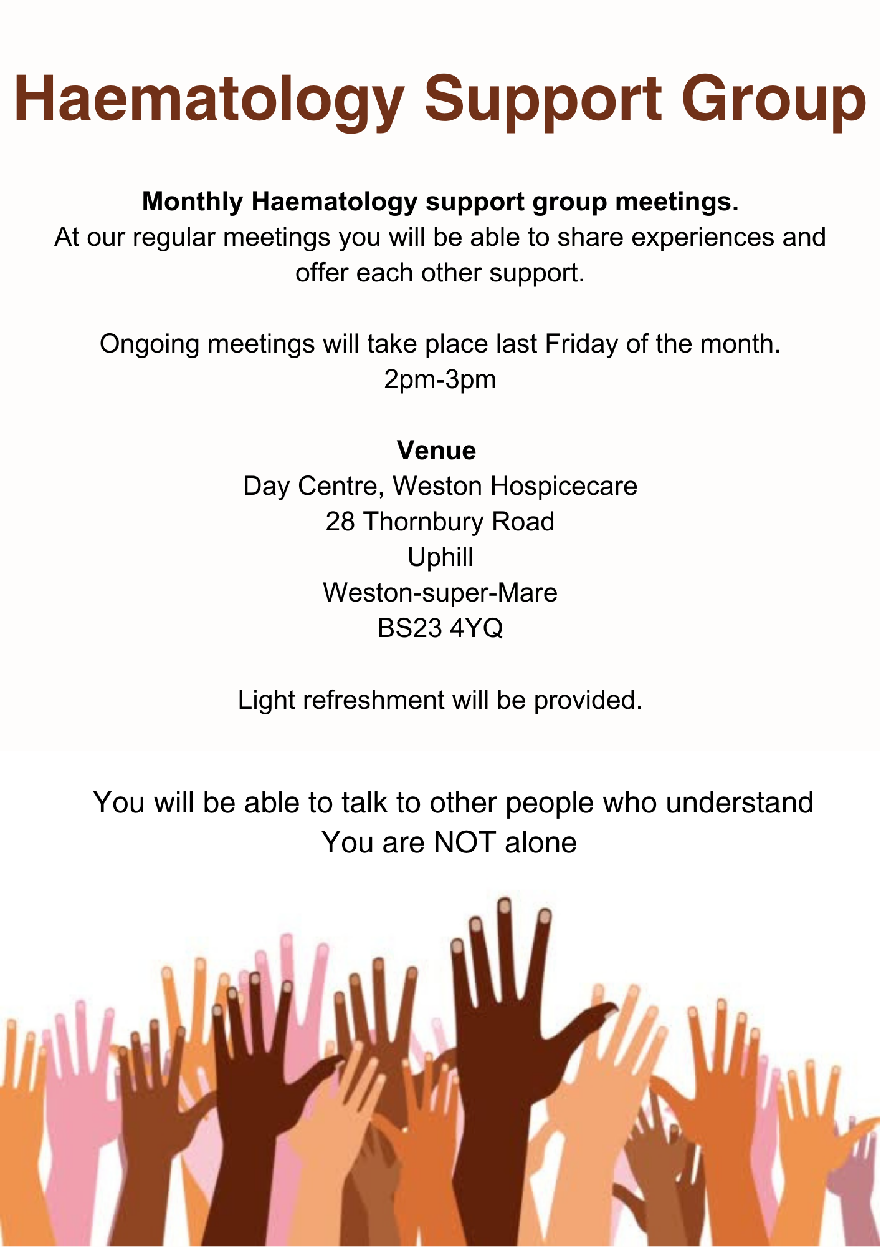
Notes:
Group co-created by CNS & Support workers for patients local to Weston Super Mare.
Some feedback:
‘The patients who come have been really supportive of one another. They mostly talk about their experiences of the treatments, bone marrow biopsies, what support helped managing fatigue, low moods etc’ The support worker voiced how successful it is as its quite nice to talk about how to get that support. We talk about exercise at different levels, appetite and changes in taste, what sorts of things help. I usually take some booklets and leave them on the table so they can also look through them or take them. Although its only an hour a month its surprising how much they get out of it’

Slide 8
Finances
Previous Macmillan research has shown that four out of five people with cancer are, on average, £570 a month worse off because of their diagnosis
In 2023, money & finances were ranked in the top 10 concerns from our UHBW HNA assessments every month.
Feedback: "this is my last winter and now I have the energy voucher I am going to put my heating on for the first time in 6 years"
Notes:
Every patient diagnosed with cancer should be referred to the Macmillan CAB service. They can complete a full assessment of an individuals finances, and ensure they access all support available to them. This is an external service, that comes into our hospital to support.
Means tested Grants
Benefit entitlements – there are many types, some related to a cancer diagnosis, some solely based on your financial situation
Blue badge applications (not just because of a diagnosis)
Extremely powerful feedback from our patient in Bristol

Slide 9
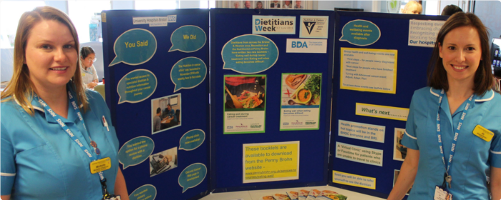
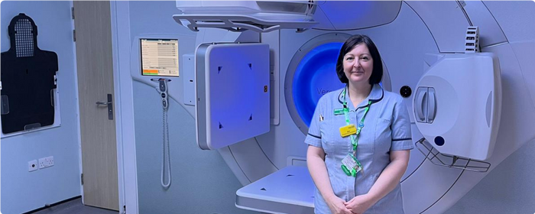
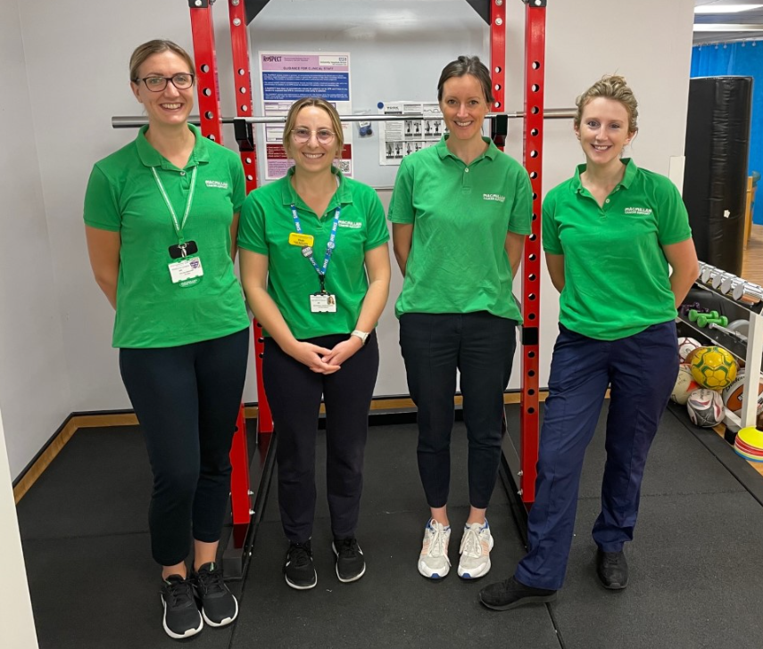
Other support services
Notes:
Other Macmillan services within UHBW include..
Macmillan therapy team - The support workers can refer to the Macmillan Treatment Therapy if patients have issues such as fatigue, musculoskeletal problems, breathlessness or physical activity concerns. Dedicated team of physiotherapists & occupational therapists can assess & support them appropriately.
Dieticians – Service accepts referrals for both inpatients & outpatients. Their support may include dietary alterations, the provision of supplement drinks or liquid tube feeds when someone is unable to eat food safely or in sufficient quantity.
Psychology – All support workers have psychological skills training, however we are able to refer to the Psychology department who offer 1:1 support, new family & supporters service to ensure they’re supported which has been extremely successful
Late effects – Macmillan funded pilot service for patients 6 months post radiotherapy experiencing any side effects. Appointment includes initial assessment by Zoe our LE radiographer, and this has been transformative for many of our patients.
Carers Liaison service – support for those who have caring responsibilities and become patients themselves, or those who care for our patients.

Slide 10
Case Study
76 year old female
Patient’s treatment plan was for Radiotherapy, due to the cost of traveling to Bristol daily, the patient refused
After discussion with the Cancer Support Worker patient accepted referral to the Macmillan CAB Advisor
Macmillan grant for £350 arranged
Transport with local company, Weston Wheels was arranged by CSW and patient accepted Radiotherapy

Slide 11
Case Studies
Case Study
75 year old female
Patient reported in their HNA they struggling with worry about change of appearance, specifically hair loss and skin changes.
Their hair was thinning so able to arrange a wig referral to the UHBW Wig service, so they had the wig ready for when starting chemotherapy
Referred to Look Good Feel Better. Charity run sessions based in the hospital delivered by qualified beauticians. Given free make up pack and advice on skin care. This is also a support group for women
Patient referred to Time for You at Weston Hospicecare – This is a day of total relaxation at the Wellbeing Centre

