Slide 1







SWAG Cancer Patient Experience
NCPES Result 2022
LCNs and SWAG Transformation Project Manager
SWAG Oesophago-gastric CAG 8/12/23
Elli Hanman LCN GHFT

Slide 2

NCPES Introduction:
Annual survey, 12th iteration of the survey
First undertaken in 2010
Commissioned and managed by NHS England
Picker is responsible for the technical design, implementation and survey analysis
Aim and Objectives:
To monitor national progress on experience of cancer care
To provide information to drive local quality improvements
To assist commissioners and providers of cancer care
To inform the work of the various charities and stakeholder groups supporting patients
The questionnaire was reviewed in 2021 to reflect changes to cancer services and commitment to cancer care. (NHS Long Term Plan)

Slide 3
Methodology:
Mixed methods
Who were included?
  NHS patients with cancer diagnosis
  All adult (aged 16 or over)
  Discharged from an NHS trust after an inpatient episode or day case attendance for cancer related treatment
  Experience of cancer related treatment in the months of April, May and June 2022
Questionnaires: by post, online option or phone (interpreters)
Comparability:
  2021 and 2022

Slide 4
Understanding the results:
Case-mix adjustment:
  Adjusted scores: understand how an Alliance is performing given their patient population (Factors: gender, age, ethnicity, deprivation, cancer type)
  Unadjusted data: show the actual patients' responses
Case-mix adjusted data and expected ranges: understand whether the results are significantly higher or lower than national results
Scoring methodology:
  61 questions were scored - directly to patient experience
  Q59 was scored based rating on a scale of 0 to 10
Suppression rules: Data is suppressed for two reasons: rid of unreliable results based on very small number, preventing individuals from being identifiable.

Slide 5
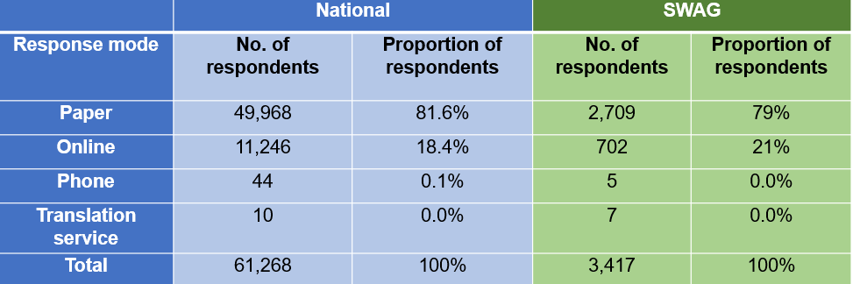
Results:
  Response Rate:
  National: 53% (133 Trusts| 61,268 responses) 55% in 2021
  SWAG: 58% (6 Trusts| 3,417 responses) 59% in 2021
  Trusts:
    Gloucester: 61%
    North Bristol: 61%
    Salisbury: 63%
    Somerset: 64%
    Royal United Bath: 61%
    United Hospital Bristol & Weston: 51%
Mode of response:

Slide 6
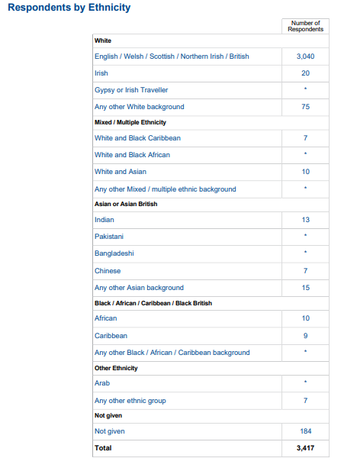
Responses by Patient characteristics:
Responses by Ethnicity:
 | National |  | SWAG
Ethnicity | No. of respondents | % of responses | No. of respondents | % of responses
White | 53,849 | 87.9% | 3,135 | 91.8%
Asian | 1,618 | 2.6% | 25 | 0.7%
Black | 1,009 | 1.6% | 26 | 0.8%
Mixed | 539 | 0.9% | 17 | 0.5%
Other | 338 | 0.6% | 7 | 0.2%
Not given | 3,915 | 6.4% | 184 | 6%
Total | 61,268 | 100% | 3,417 | 100%
Patient Characteristics:
By Gender
sexual orientation
Age
IMD quintile
long term conditions
different tumour groups
cancer types were reported.
By other characteristics
Further analysis

Slide 7
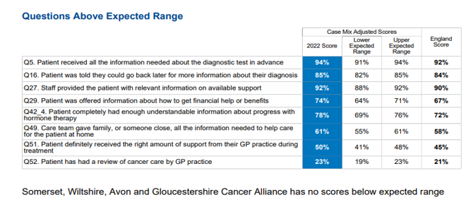

SWAG results:
Overall Experience within SWAG:
Captured by Q59 using scale 0-10 from very poor to very good.
SWAG Cancer Alliance scored at 8.9 (same as the England score) from 9.0 in 2021
Questions Above and Below Expected Range:
No question scored below Expected range
Q58 showed that SWAG is within the lower of the range.
This finding is consistent with last year

Slide 8
SWAG results (cont.):
Questions that scored less than previous year: Diagnostic, Care Planning, Hospital Care
Questions that scored higher than previous year: Q12 (finding out that you had cancer), Q22 (Deciding on the best treatment), Q52 (Patient has had a review of cancer care by GP practice)
The scores in the comparability tables, offered an indication of direction of changes, year on year, provide a signal in areas for continuous improvement and evidence for assurance in progress.

Slide 9
SWAG results: Upper GI CAG
Key areas for results:
Support from your GP practice
Diagnostic Tests
Finding our you had cancer
Support from a main contact person
Deciding on the best treatment
Care planning
Support from hospital staff
Hospital Care
Your treatment
Immediate and long term side effects
Support while at home
Care from your GP practice
Living with and beyond cancer
Your overall NHS care
Approx 50 % of results were higher than the “all cancers” combined score
Highest scores noted in, “Hospital care” and” Your Treatment” sections of the survey
Lowest scores notes in the “Finding out that you had cancer” and “Deciding on the best treatment” sections

Slide 10
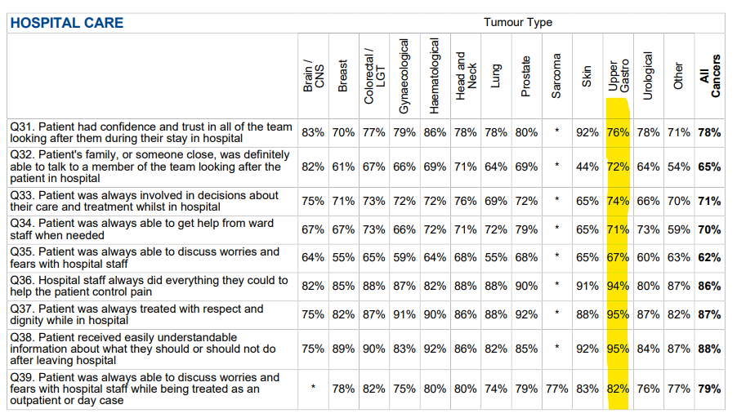
SWAG results: Upper GI CAG

Slide 11
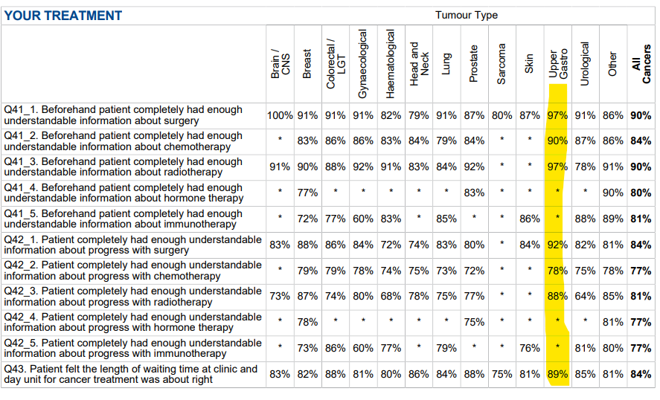
SWAG results: Upper GI CAG

Slide 12
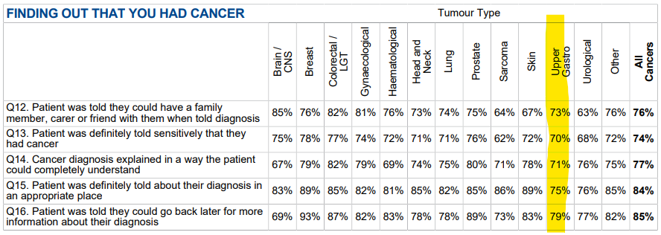
SWAG results: Upper GI CAG

Slide 13
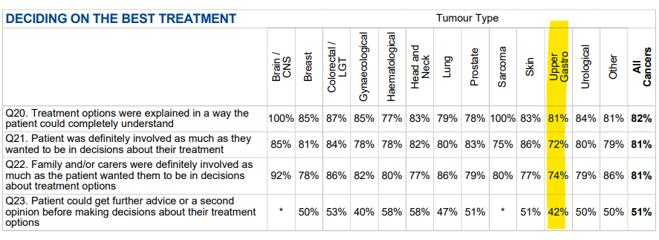
SWAG results: Upper GI CAG

Slide 14
SWAG results: Upper GI CAG
Each Trust will be disseminating tumour site results and free text comments
SWAG tumour site results should be used in conjunction to pick identify themes and produce improvement plans.
NCPES results should not be the single measure of patients experience.

Slide 15
Next Steps:
Share and disseminate NCPES 2022 findings to Board, CAGs, Delivery groups and various forums
Continue to develop a SWAG CPES dashboard to enable further data analysis
  Gain insights into patient experiences at more granular level
  Highlight areas of challenges associated with health inequalities
Identify common themes of challenges and good practices across SWAG, trusts and primary care
Agree recommendation for improvement plans and opportunity for collaboration
Further embed and expand access to PCS
Triangulation with ongoing QoL survey results
Consider various strategies for increasing survey uptake for the next NCEPS in 2023

Slide 16
Thank you!

