Slide 1
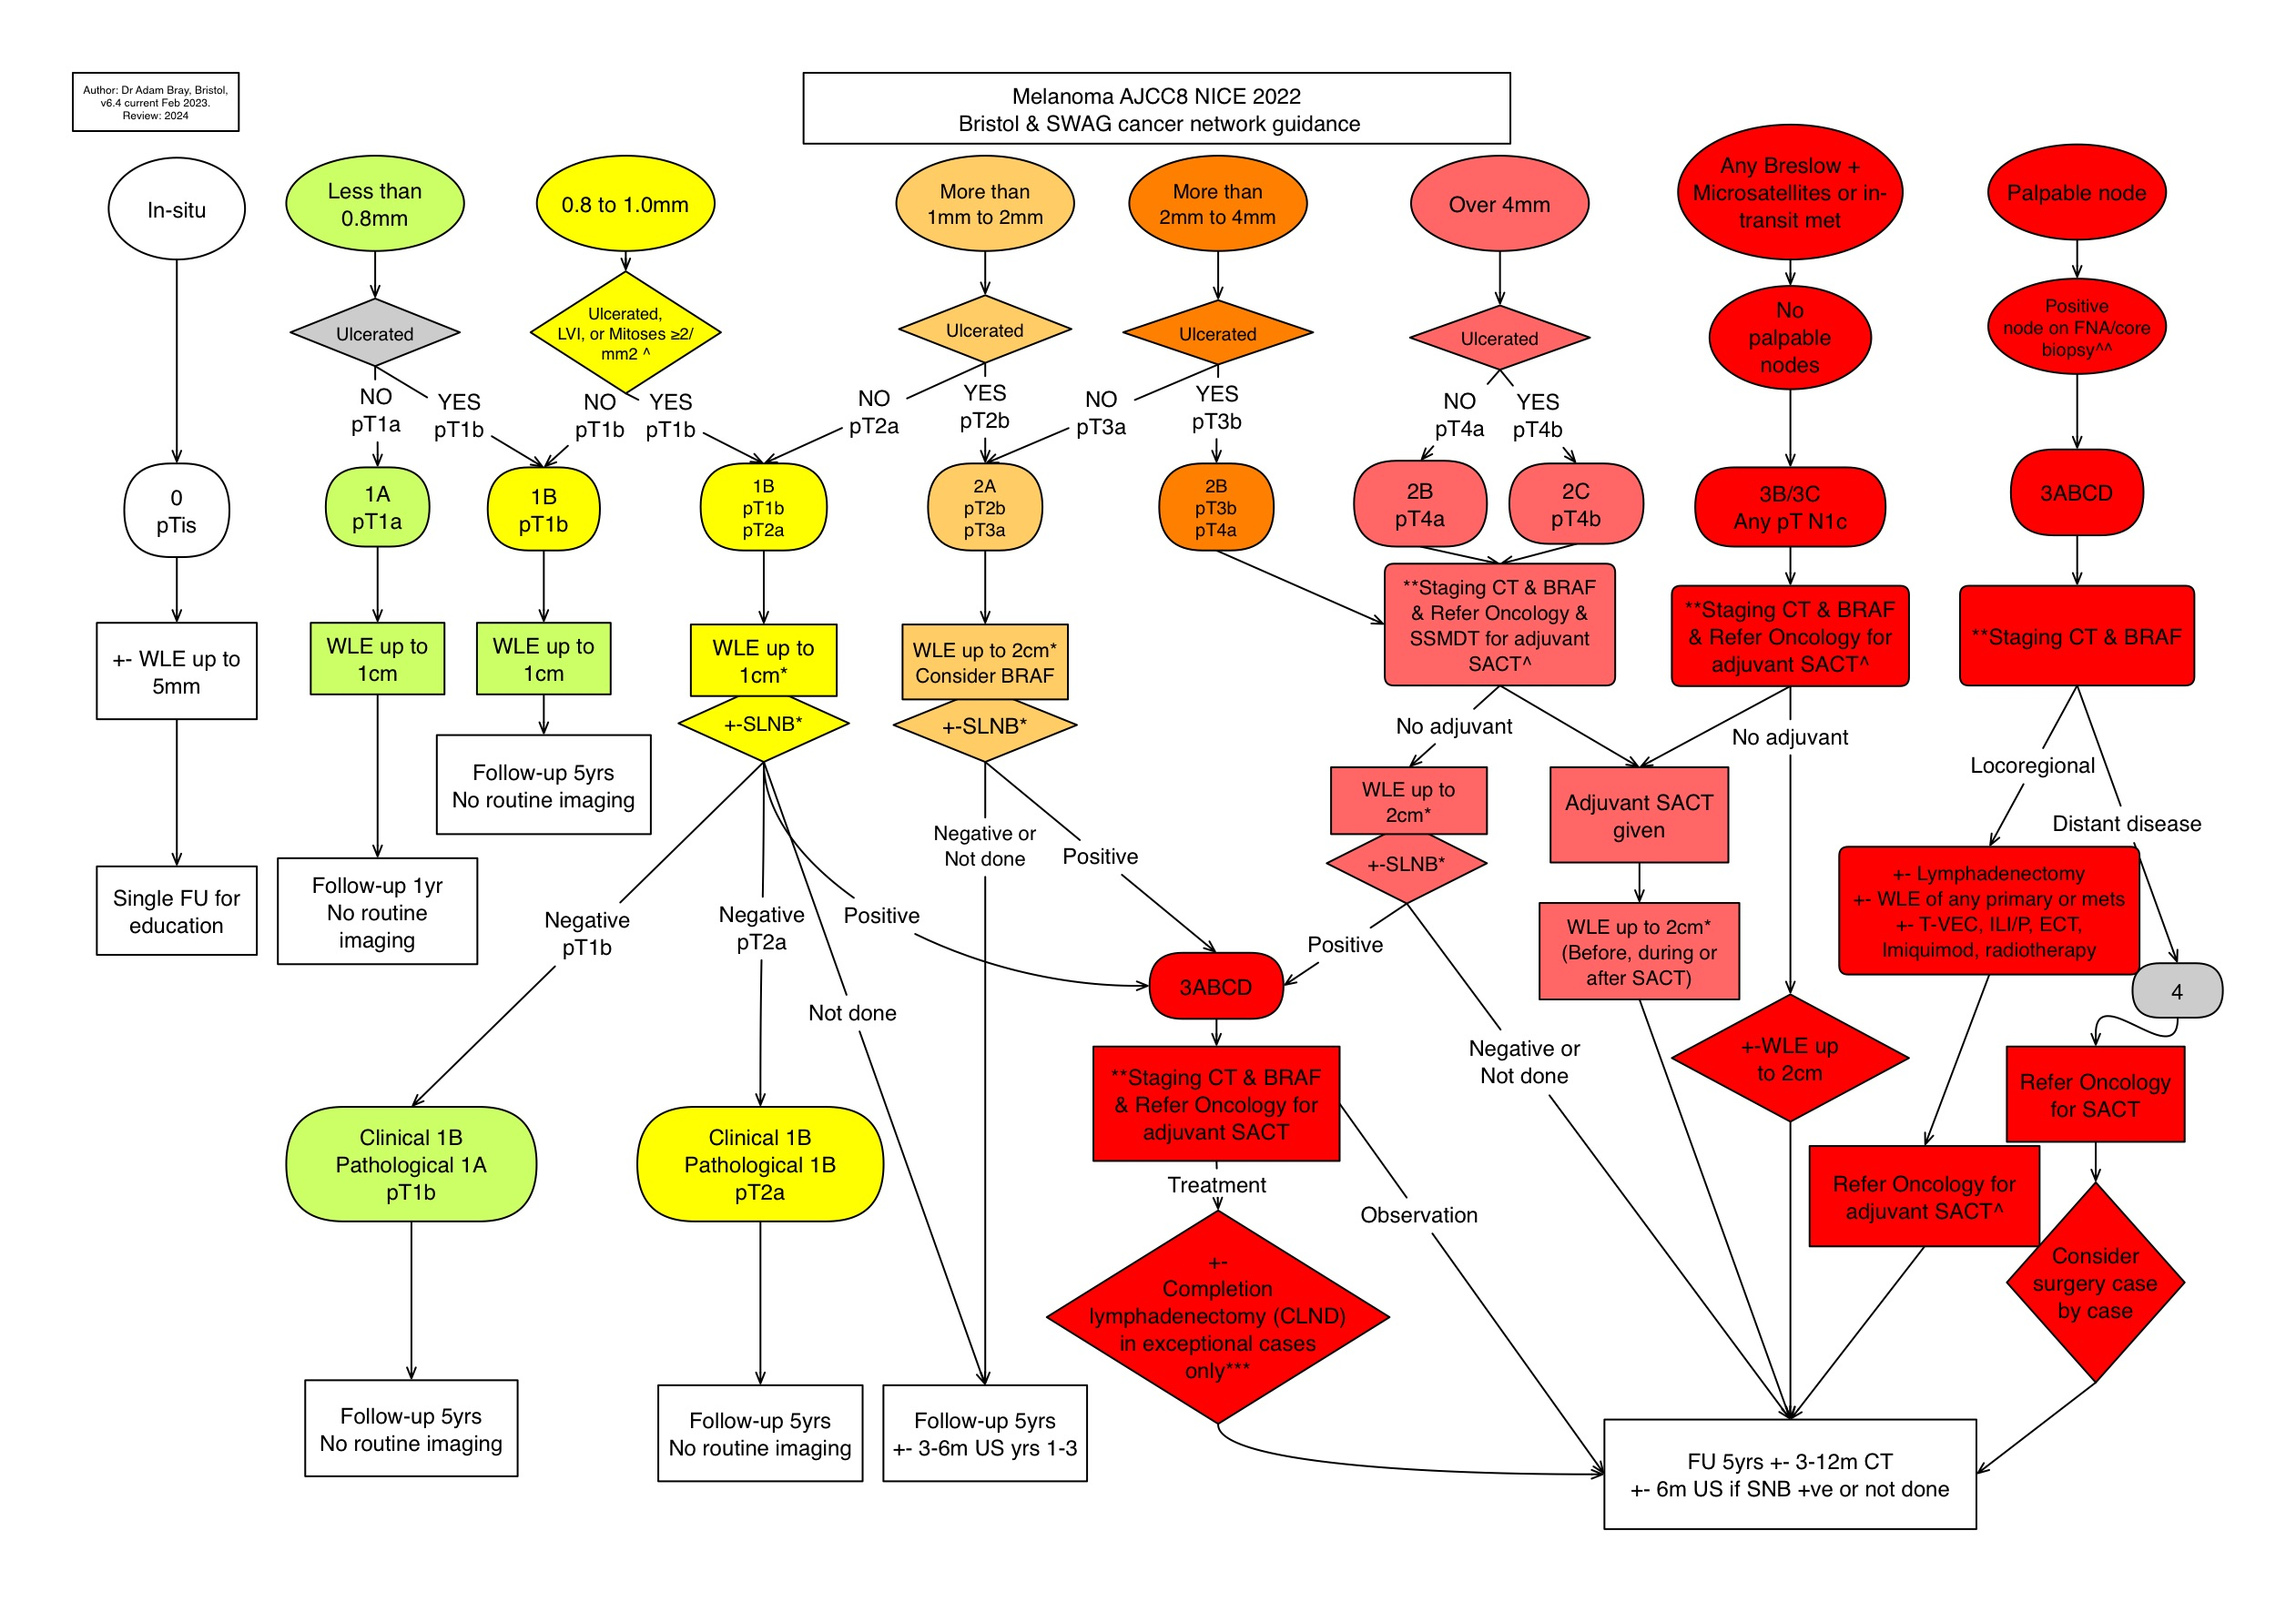
CURRENT

Slide 2
Bristol & SWAG Cancer Network Guidance - Melanoma AJCC8 NICE 2022 – Flowchart notes – v6.5 May 2023
 | Melanoma patients not currently having adjuvant therapy - by overall stage
Year of FU | 1A or 0 with regression* |  | 1B SNB negative or not eligible |  | 1B Eligible but SNB not done |  | 2A SNB negative |  | 2A SNB not done |  | 2B or 2C¹ SNB negative |  | 2B or 2C SNB not done |  | 3ABC SNB +ve |  | 3ABC SNB not done |  | 3D or resected 4
1 | 6m | No scans | 6m | No scans | 6m | US | 6m | No scans | 6m | US | 3m | 6m CT | 3m | CT/US alt. visits | 3m | CT/US alt. visits | 3m | CT alt. visits | 3m | CT
2 |  |  | 12m |  | 12m | US | 6m |  | 6m | US | 3m | 6m CT | 3m | CT/US alt. visits | 3m | CT/US alt. visits | 3m | CT alt. visits | 3m | CT
3 |  |  | 12m |  | 12m | US | 12m |  | 12m | US | 6m | 6m CT | 6m | CT & US each visit | 3m | CT/US alt. visits | 3m | CT alt. visits | 3m | CT
4 |  |  | 12m |  | 12m |  | 12m |  | 12m |  | 12m | 6m CT | 12m | CT | 6m | CT alt. visits | 6m | CT alt. visits | 6m | CT
5 |  |  | 12m |  | 12m |  | 12m |  | 12m |  | 12m | 6m CT | 12m | CT | 6m | CT alt. visits | 6m | CT alt. visits | 6m | CT
*local variation
Personalise FU as needed for all patients, but especially for those:
- on adjuvant therapy
- with unresectable stage 3 or 4
- with increased risk of further primary melanomas (e.g. atypical mole syndrome, multiple melanomas, melanoma in first degree relatives or other familial cancer syndrome)
- frail or with limited life expectancy for other reasons
NB FU start date is date of diagnosis, i.e. usually the date patient given results.
¹FU for 2C negative SNB is not mentioned in NICE guideline

Slide 3
Bristol & SWAG Cancer Network Melanoma AJCC8 Nice 2022 – Flowchart notes – v6.3 [new advice highlighted]
*SLNB/SSMDT
SLNB done with WLE. Refer to SSMDT if patient would consider SLNB & fit for GA, or needs plastic surgery for WLE, or consideration for adjuvant SACT.
^Lymphovascular invasion
^See separate node protocol
^ADJUVANT SYSTEMIC ANTI-CANCER THERAPY (SACT)
All stage 2B/2C and 3B/3C diagnosed by primary excision or SNB are now eligible.
Patients eligible on primary excision criteria may still be offered SNB for prognostic reasons. This must be carried out within 6 weeks of primary excision to allow time for adjuvant SACT to be started within 3 months if SNB negative. If SNB cannot be completed within 6 weeks, refer direct to oncology first.
Staging scans and BRAF are required, but do not wait for results before referral to oncology.
AGE/FITNESS/COMORBIDITIES
The benefits of SLNB and adjuvant SACT reduce with increasing age and frailty. Elderly patients or others with reduced physiological reserves are more vulnerable if experiencing the serious potential side effects of SACT. Patients with life expectancy less than 5 years need careful consideration of the risks and benefits. An average patient of approximately age 80 might be an appropriate guide, but there is no absolute upper age limit. Baseline CT for prognostic staging may be helpful even if ongoing scans are unlikely to lead to a change of management.
***CRITERIA FOR CONSIDERING CLND AFTER +VE SLNB
a) Extra capsular spread, b) >3 involved sentinel nodes. c) Dewar criteria (multifocal or extensive)
AND
Unsuitable for adjuvant therapy (either due to medical co-morbidities, or geographical constraints limit access to follow-up)
OR
Head/neck melanoma
**CT PROTOCOL
Contrast CT head, thorax, abdo, pelvis & closest regional lymph node basin i.e.
Head & upper torso: ADD NECK
Leg & lower torso: ADD UPPER THIGHS
Repeat pre-adjuvant treatment if scans >2 months old
ROUTINE FU ULTRASOUND (US) & CT:
US scans and additional CT should now be considered as part of routine follow-up as per the accompanying table e.g. where high risk of recurrence or metastasis, or eligible for SNB but not done.
Whether to offer the full recommended schedule will be tailored to local capacity and individual patient’s wishes/suitability.
**OTHER IMAGING OPTIONS:
US+- FNA/core: localisation or node assessment
PET: where CT equivocal, prior to major local resection, mets with unknown primary, trial use
MRI: where CT insufficient for soft tissue e.g. pre neck dissection or alternative to
CT for age <25, pregnancy, or for brain if mitoses >5, or scalp primary

