Slide 1
Enhanced and Advanced Practice in Skin Cancer Service
Mihaela Savu
November 2024 (SWAG)

Slide 2
Aim of this presentation:
To bring more clarity to the enhanced and advanced practice level based on Health Education England (HEE/ NHSE) and British Dermatological Nursing Group (BDNG) documents
Governance requirements
How to relate this to skin cancer in a real-world practice
Share my experience in this matter
Thanks to Julie Reeve Associate Director of Advanced Practice, Consultant Nurse Emergency Medicine

Slide 3
Background
History of Enhanced and Advanced roles
  Terminology is new, concept isn’t
  Inconsistency around planning
  Variable training
  Variable terminology / meanings / rigour
Recent Changes
  Increased focus on multi-skilled / MDT workforce in NHSE Plans
  Health Education England – Multi-Professional AP Framework (2017)
  The Principles of Enhanced Level Practice (2022)

Slide 4
Definitions (HEE):
Enhanced: Advanced:
Enhanced Clinical Practitioners are qualified health and social care professionals who are working at an enhanced level of practice with specific knowledge and skills in a field of expertise. They manage a discrete aspects of a patient’s care within their current level of practice, which will be particular to a specific context, be it a client group, a skill set or an organisational context………
(Health Education England 2021)
Advanced clinical practice is delivered by experienced, registered health and care practitioners. It is a level of practice characterised by a high degree of autonomy and complex decision making. This is underpinned by a master’s level award or equivalent that encompasses the four pillars of clinical practice, leadership and management, education and research, with demonstration of core capabilities and area specific clinical competence…
(Health Education England 2017)
Mihaela Savu

Slide 5
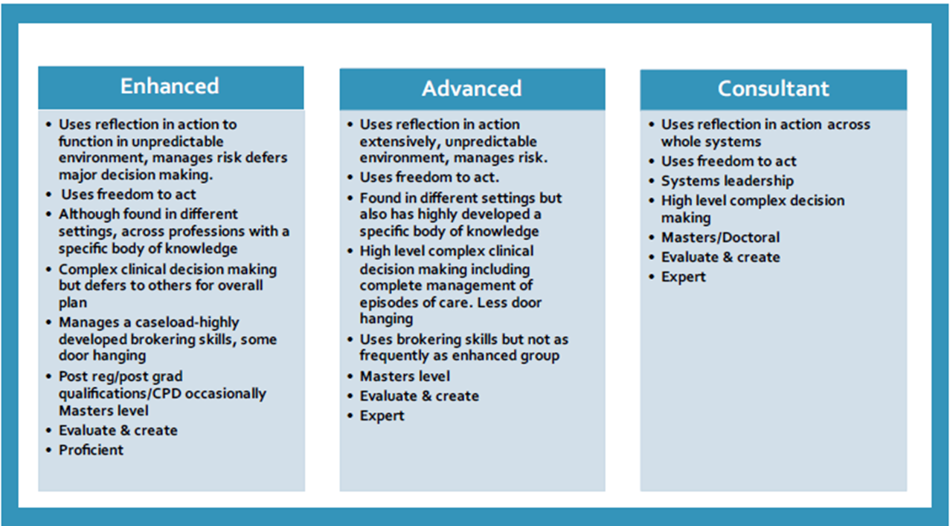
Health Education England 2022
Real world level of practice:

Slide 6
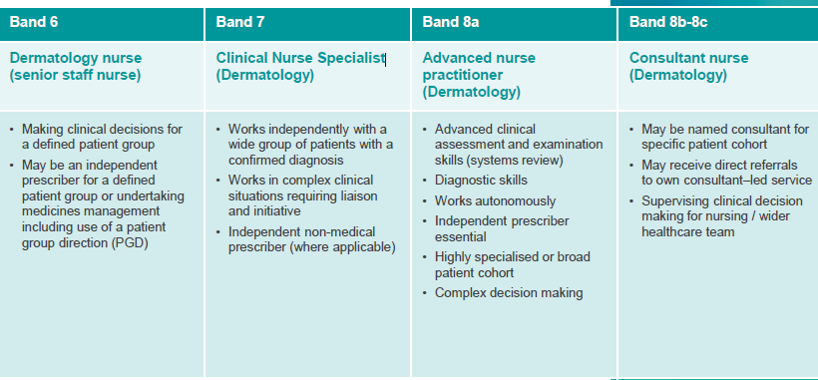
BDNG (role descriptors, March 2023):
Clinical
Not anymore

Slide 7
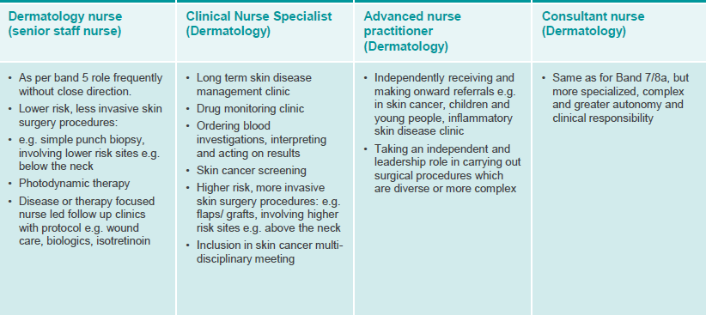
BDNG (role descriptors, March 2023):
Examples of clinical practice:
Mihaela Savu

Slide 8
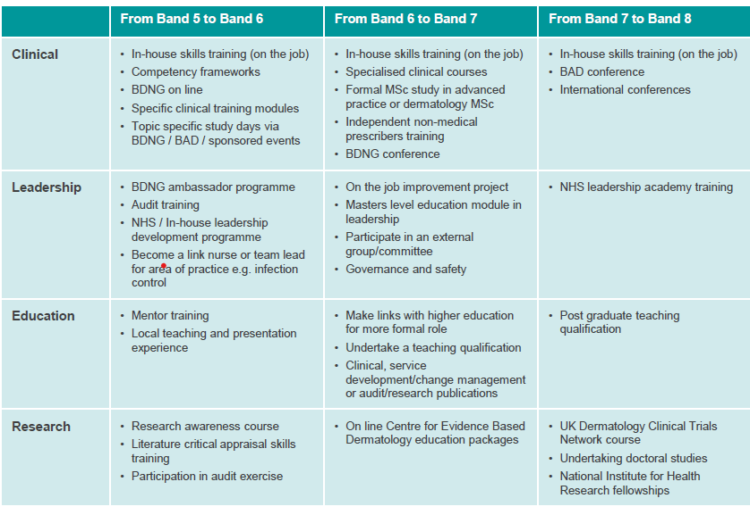
Educational development (BDNG)

Slide 9
Transition to Advanced Practice
Understand the service needs – EP, AP, Consultant?
Need to streamline career pathways
Need to optimise use of CPD funds
Where appropriate to ensure that modules map into the Advanced Practice pathways to enable optimised progression if applicable

Slide 10
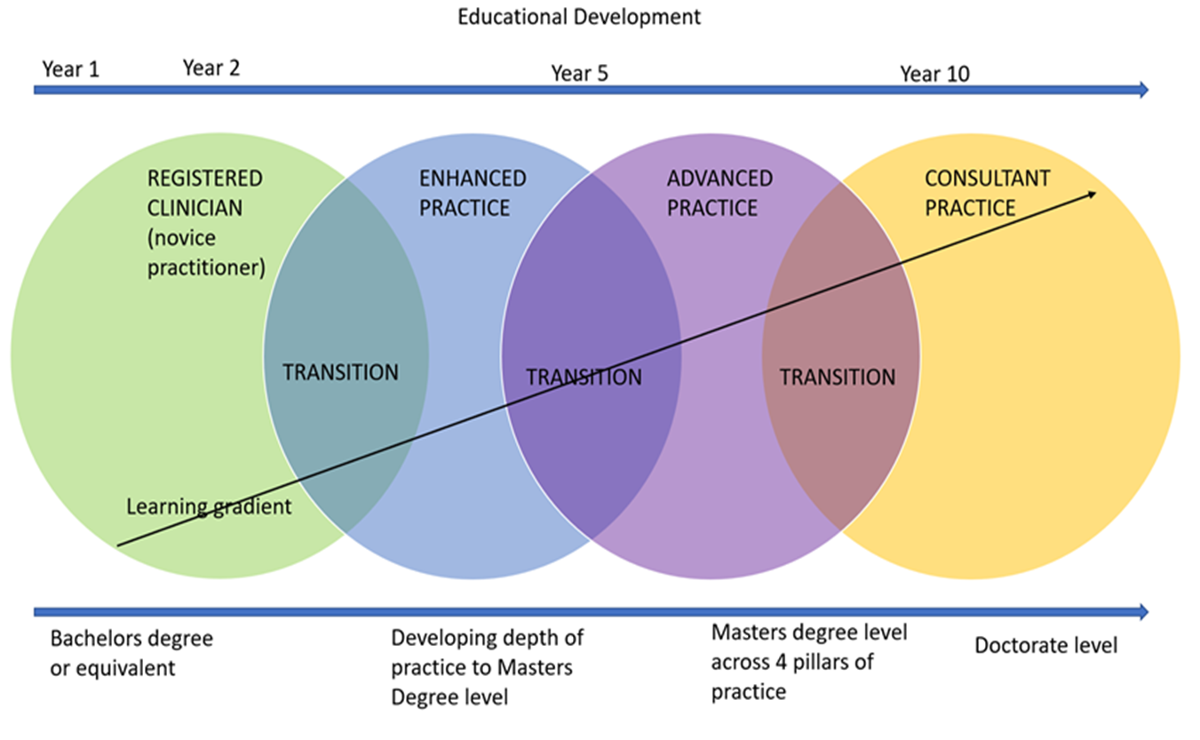
Educational development (HEE)

Slide 11
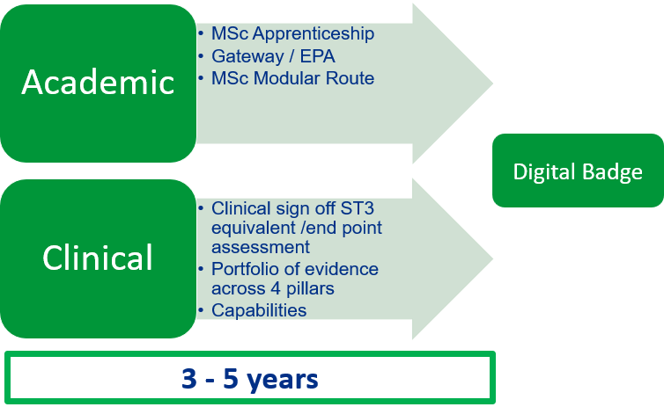
Training Pathway
Enhanced Advanced
The educational level of enhanced practice professionals is post qualification.
This might range from post registration or post qualification certificates, diplomas or professional development courses through to Master’s level qualifications, some may hold PhDs
Enhanced level practice is a precursor or preparation for advanced level practice, equally it can be a destination career level where people want to stay.
Enhanced level practice is vital to functioning of complex health and social care

Slide 12
E-portfolio route requirements
NHSE
In AP role (8A)
Job description
Job plan
Academic perspective:
-Clinical Examination –systems review
-Independent Prescriber- if needed

Slide 13
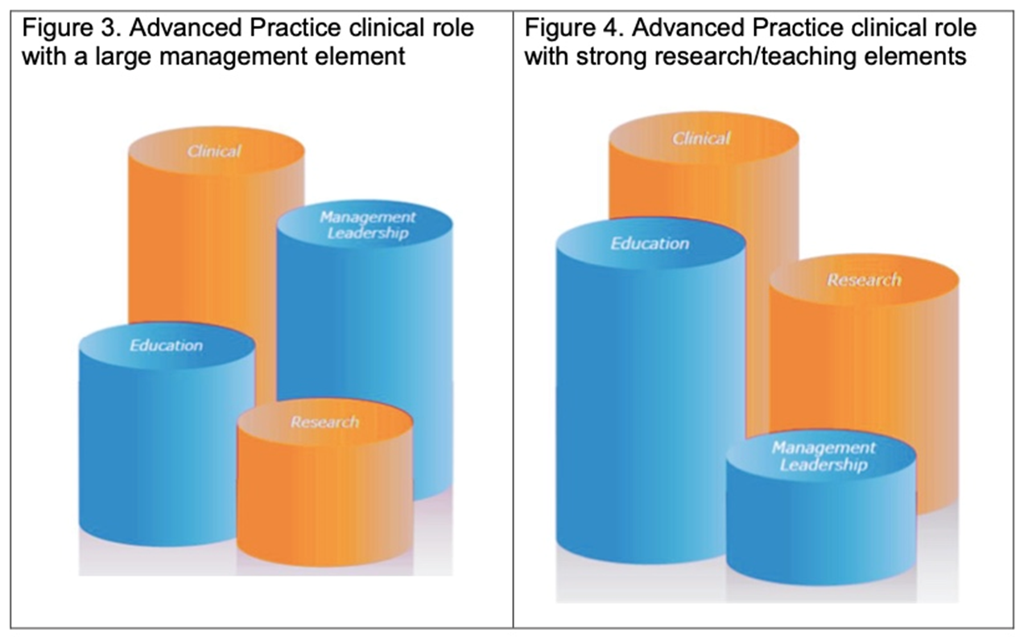

What it is…
Enhanced Advanced –the four pillars
Describes a level of practice, beyond being competent.
Complexity of work beyond newly registered and post-preceptorship registrants.
Typically rooted in ‘base’ profession
Clinically-focused roles
Complex work and manage day to day risk, including risks on behalf of, or with patients
Enhanced level practice includes freedom to act. Practice is autonomous within professional scope of practice
On the continuum of Novice to Expert (Dreyfus 2004) enhanced practice would be more aligned to being proficient than being competent.
Due to experience the ‘clinical’ pillar can be similar that of advanced practice

Slide 14
Pillars of Practice - enhanced
Very strong clinical pillar
Other 3 pillars of advanced practice, are not formally required for the role – not reflected in a job plan
  Mentoring/ supervision
  Developing team
  Audit
Involvement in teaching and audit etc but do not tend to lead on curriculum etc
Portfolio of evidence demonstrating capabilities
Roles include:
Clinical Nurse Specialists (?)
Emergency Nurse Practitioners
Specialist (?) Physiotherapists

Slide 15
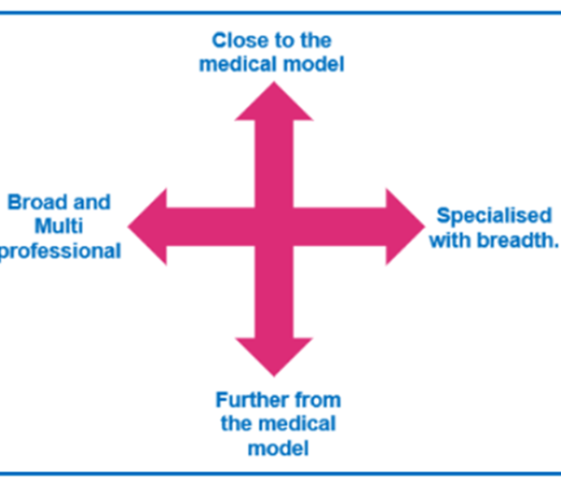
Advanced Practice in skin cancer

Slide 16
What is not…
Enhanced Advanced
A job title
Or a Synonym for a sphere of practice (ie it is not the equivalent of “specialist”)
Workers have specialist knowledge across all levels of practice
Specialist knowledge is articulated across all levels of complexity so there was a consensus not to use “specialist” as a level of practice
Not a Doctor or Medical Consultant
Not a service manager
Not a Clinical Lead

Slide 17
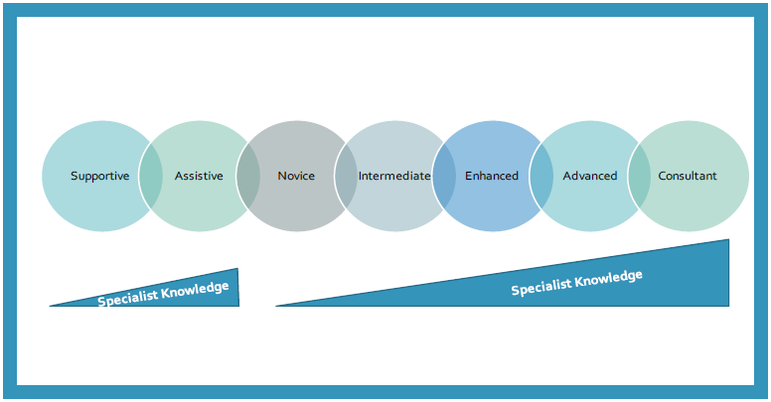
Specialist Knowledge

Slide 18
Competencies:
BDNG Skin Cancer competencies (2013)
Dermatological Nursing- A practical Guide on career pathway (2023)
Not clear guidance for enhanced and advanced level of practice -level 2 – enhanced?
-level 3 – advanced?
Needs to be updated
No Curriculum specific for Advanced Practice
Clinical supervisor to sign off those

Slide 19
Governance Requirements for Enhanced & Advanced Practice roles
Supervision is essential
  Minimum requirements in advanced roles
Capability sign off
  Advanced level - 38 national standards
  Local core capabilities
All evidenced in a portfolio
Job description to reflect the level of practice accurately
Job Plan to include activities related to all four pillars for AP
?To standardise the titles for enhanced practice

Slide 20

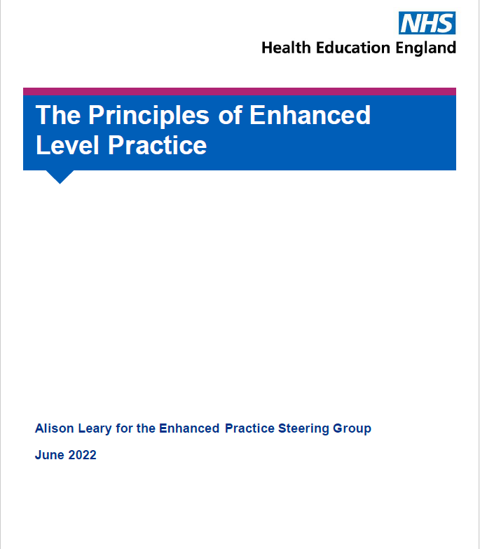



Slide 21
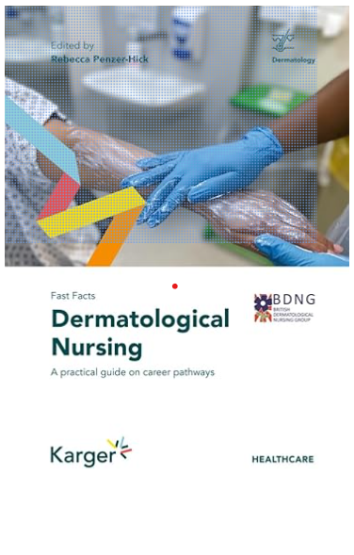

BDNG
Supportive Documents

Slide 22
Governance Requirements for Enhanced & Advanced Practice roles
FEAP
Faculty of Enhanced and Advanced Practice

