Slide 1
Ablation Therapy of Colorectal Metastases - Current Status and Future Directions
Huw Roach
Consultant Radiologist UHBW

Slide 2
Disclosures
No disclosures / conflicts of interest

Slide 3
Topics to Cover
Ablation within liver directed therapies
Current use and outcomes
Future directions

Slide 4
Liver Directed Therapies
Hepatic resection
Thermal ablation
SABR/SBRT
SIRT
(Electroporation)
(Histotripsy)
Influence of systemic treatments

Slide 5
Which to Use?
Hepatic resection
Thermal ablation
SABR/SBRT
SIRT
(Electroporation)
(Histotripsy)
Influence of systemic treatments

Slide 6
Which to use?
Hepatic resection gold standard
Pathological confirmation, R0 status
Up to 45% 5 yr survival

Slide 7
Which to use?
Other techniques if resection not feasible
Differing delivery, limitations, complications etc
No pathological confirmation of margin

Slide 8
How to assess?
What metrics to measure?
Treatments often combined
Influence of systemic therapies

Slide 9
Ablation vs Resection
NEW-COMET, HELARC due 2026

Slide 10
Ablation vs Resection
Small lesions ≤ 3cm
≤5 / 10 lesions (MAVERRIC / COLLISION)
Consider technical limitations

Slide 11
Headlines
COLLISION:
295 patients
29 month f/u
Ablation non inferior in OS
No statistical difference in local or distant PFS
Lower mortality, complications, LOS

Slide 12
Headlines
MAVERRIC:
98 patients in ablation arm
Median f/u 51 months
Median tumour size 16mm
Similar 3 yr OS (78% vs 76%)
Higher retreatments (48% vs 27%)
LTP 17% in 1 year
Lower complication rate (10% vs 30%)

Slide 13
MW ablation

Slide 14
Logistics
All referrals via MDT
Usually day case, some intra-operative
Majority under USS guidance, some CT
USS during open / laparoscopic surgery

Slide 15
Margins
≥ 5mm margin*
Influence of adjacent structures
“Clear” margin less influence for CRLM vs HCC*
*Liu C-H et al. Eur Radiol (2010) 20: 877–885

Slide 16
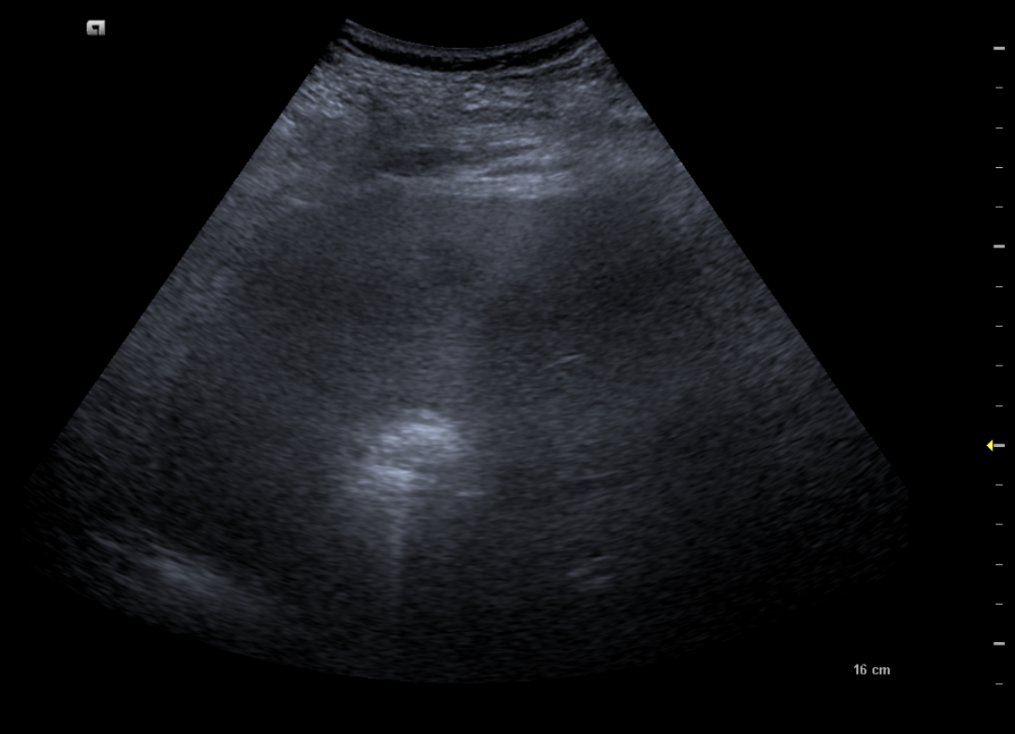

Slide 17
Post Ablation Follow Up
CT vs MRI
F/u scans at 6 weeks, 3 months, 6 months, 12 months

Slide 18
Post ablation

Slide 19
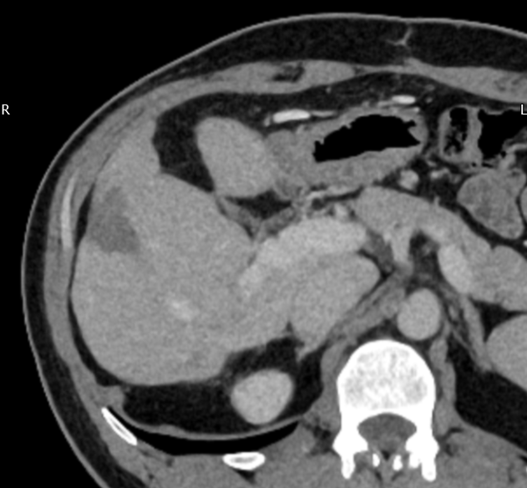
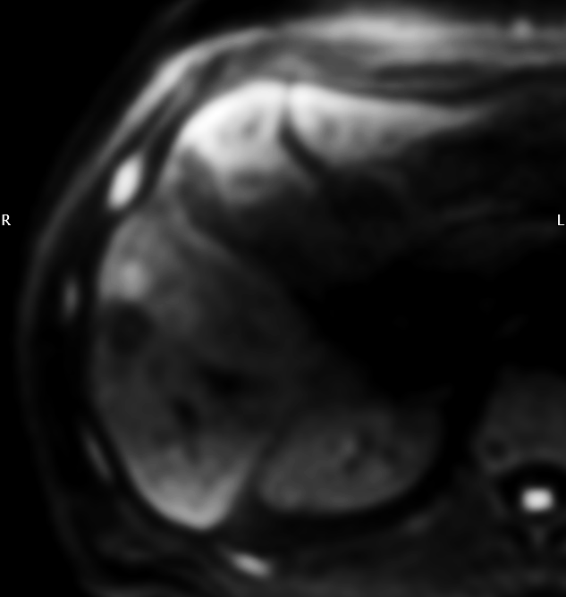
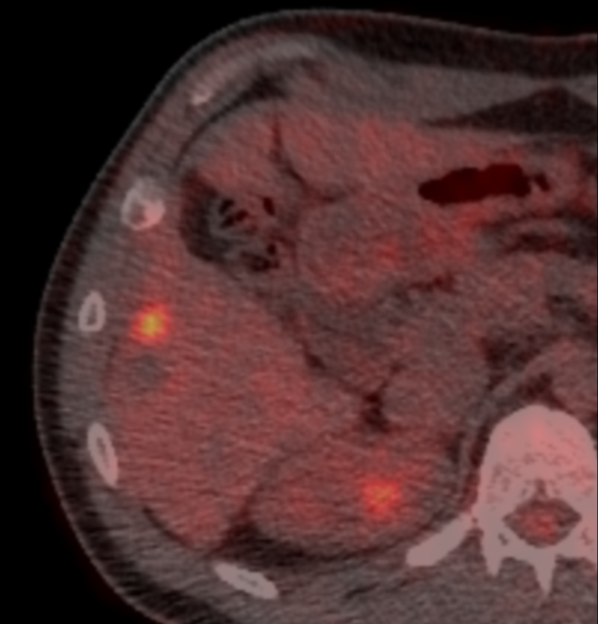
LTP / LTR

Slide 20
My experience
Reviewed 2016-23
28 patients with CRLM, 29 episodes
-13 percutaneous
-16 operative (14 open, 2 lap)
45 ablations, 44 with follow-up

Slide 21
My experience
42/44 lesions (95%) technical success
LTP 20/44 lesions (45%), 14/28 patients (50%)
All LTP within 8 months (range1.5 – 8 months)
Median time to LTP ≈ 4 months

Slide 22
My experience
Operative LTP 8/29 lesions (28%)
Percutaneous LTP 11/15 lesions (73%)
(inverse of HCC experience - LTP < 30%)

Slide 23
My experience
1 yr survival 93% (26/28)
(operative 100%, perc 83%)
3 yr survival 33% (5/15)
(operative 37.5%, perc 29%)
5 yr survival 22% (2/9)
(operative 20%, perc 25%)

Slide 24
Why LTP rate?
Operator?
Technique?
Machine?
Patient selection?
Disease?
Lesion?
All of the above?

Slide 25
Why LTP rate?
Operator?
Technique?
Machine?
Patient selection?
Disease?
Lesion?
All of the above?
cf HCC, operative
?bigger / bolder

Slide 26
Why LTP rate?
Operator?
Technique?
Machine?
Patient selection?
Disease?
Lesion?
All of the above?
63% previous liver directed therapy
50% extrahepatic disease
75% patients new mets at time of LTP

Slide 27
Why LTP rate?
Operator?
Technique?
Machine?
Patient selection?
Disease?
Lesion?
All of the above?
44% >3cm (first ablation)
“clear” margin not reliable prognostic
operative lesions smaller?

Slide 28
Future Directions
Ablation valid as adjunct to resection
Increase / decrease frontline role of ablation?
- recent trial evidence
- resources
- local outcomes
- patient selection
- other options available

Slide 29
Future Directions
CT vs USS, software solutions
More aggressive?
F/u strategy CT vs MRI
Other modalities eg cryo, electroporation

Slide 30
Take Home Points
Thermal Ablation for CRLM established and versatile technique
Need careful consideration of its future role
Complementary part of multimodality strategy

Slide 31
Thank You
Huw.Roach@UHBW.nhs.uk

