Slide 1


Skin CAG update - teledermatology
13 Nov 2024
An update on developments within SWAG
Chris Ashdown, Senior Project Manager
Connecting and Empowering the Delivery of Cancer Care Across SWAG Communities

Slide 2
Contents:
1. Summary of updates by system (BNSSG, Somerset, Glos, BSW)
2. Background – the national requirement and NHSE proposed priorities for 2025/26
3. Options appraisal and returns in BSW
4. BSW Project Delivery Group
5. Actions and oversight for the CAG
Connecting and Empowering the Delivery of Cancer Care Across SWAG Communities

Slide 3
Background
The NHS England cancer programme planning pack 2024-25 states that we should complete the rollout of teledermatology where this is still outstanding, across all USC skin pathway providers by June 2024, with services commissioned as business usual by March 2025. Their roadmap provides further guidance as does GIRFT's recommendations on using such technology to address workforce challenges​
​
Further details around this include direct work with primary care, development and training, commissioner and provider engagement, project and programme support, use of pathway analysers to inform pathway improvement; and reporting and evaluation.​
​
Connecting and Empowering the Delivery of Cancer Care Across SWAG Communities

Slide 4
National planning priorities 2025-26
Proposals from the national programme for teledermatology focus on service change and development
Complete and optimise rollout in Q1
identify providers with >50% USC telederm to ensure plans for rollout in place
All remaining services live by Q1 with all applicable services to reach at least 50% rollout by Q2
Local exclusion criteria to align with BAD telederm guidance
ensure providers are aware of telederm pricing guidance and HRG codes by Q1
ensure primary care models have had sufficient image-taking training and direct to courses where available
train healthcare staff in image review to reduce variation in onward F2F f/up
Address rising referral rates, reduce inappropriate referrals and ensure rates are aligned to cancer conversion rates by Q4
review variation in local referral rates and cancer conversion by Q1
review 2WW vs FDS referral data to assess if current rising trends are true or due to more rapid removal of pts from the pathway
complete a joint project with primary care on signs and symptoms
develop GP education modules/guides
assess use of A&G services to ensure clear understanding of the differences between A&G and USC pathways
assess use of triage to refer pts appropriately to plastics rather than derm (eg large facial lesions)
pilot BCC clinics in providers?
Expand opportunities for nursing roles by Q4
identify existing training courses for nurse review of images, minor ops, punch biopsy and share details on course registration
include nurse roles for skin cancer as part of national Workforce Team nursing fund proposals
Connecting and Empowering the Delivery of Cancer Care Across SWAG Communities

Slide 5

What do we already have in SWAG? (1/ 2)
Primary care dermoscopy well-established with training and provision of scopes. This remains the main model supplemented by hubs for USC-referred patients at Gloucester and Cheltenham along the lines of the UH Plymouth model launched Jan 2023. Evaluation last year noted that 100% referrals went through this model with 42% re-routed from USC including low risk BCCs going direct to surgery. The report highlighted 37% of referrals were triaged either back to GP, straight to surgery (low risk BCC), or to an urgent or routine dermatology appointment (non-cancer). This created additional cancer clinic capacity but put additional pressure on the non-cancer dermatology service requiring a shift of resource.​
​
Whilst saving consultant time, additional hospital-based imaging appointments were made with most patients having to attend one of the sites twice (imaging then a further acute appointment at a non-cancer or cancer clinic). The model only discharged 7.5% back to the GP though this may be due to the existing primary care dermoscopy showing increased quality at the pre-referral stage. ​
​
With better quality imaging coming with referrals, the number of imaging appointments required would reduce. This together with increased diversion to ENT/max-fax and expansion of BCC clinics would enhance the model's benefits. Use of AI as a clinical assessment device could also reduce review times. The pilot has been extended to take account of these changes and further evaluation proposed.​
Connecting and Empowering the Delivery of Cancer Care Across SWAG Communities

Slide 6


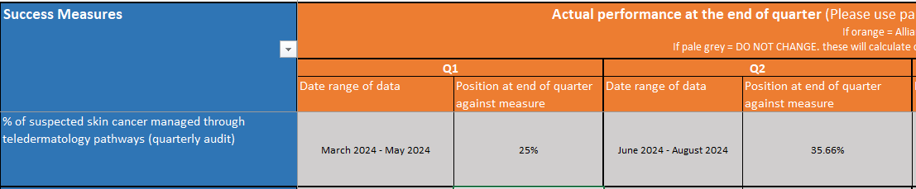
What do we already have in SWAG? (2/2)
Primary care hubs are in place with an image capture service launched in January this year at Taunton for USC referrals with Yeovil on board in September. An AI pilot with Skin Analytics launched in June but currently only one clinic/ week – early data suggests c20% patients were discharged via AI triage albeit a small sample so far. AI has been recently extended to Yeovil launching in October. A&G using Cinapsis is in place but needs to extend to USC referrals though training is in place via medical illustrators from UHBW to improve image quality​
Participating PCN sites have been capturing dermoscopic images of skin lesions in HCA-run clinics ahead of referral to UHBW or NBT. 11 PCNs from BNSSG's 20 PCNs are now participating. This is working well and a 24-week pilot report has detailed results, lessons learned, and costs for equipment, training and workforce.
Connecting and Empowering the Delivery of Cancer Care Across SWAG Communities
Notes:
Somerset – repatriation USC skin service
Significant recruitment has helped cope with demand - 4 new doctors, 4 additional nurses, 9 HCAs & 18 GPwERs (county-wide)
- Medical Illustration Service launched at MPH in Jan’24, YDH September and a Skin Analytics AI pilot began in June’24 to triage fast-track patients
- New GPwER Intermediate Service launched in Oct’24 as part of our new Clinical Model for Dermatology (Wave 1, 6 people) who’ve seen 1,953 patients and carried out 199 procedures
- Cinapsis “Advice & Referral” system for GPs launched in May’24; to date 3,630 requests triaged, within 3 days, with 47% advice back to the GP and 17% referred into Secondary Care

Slide 7
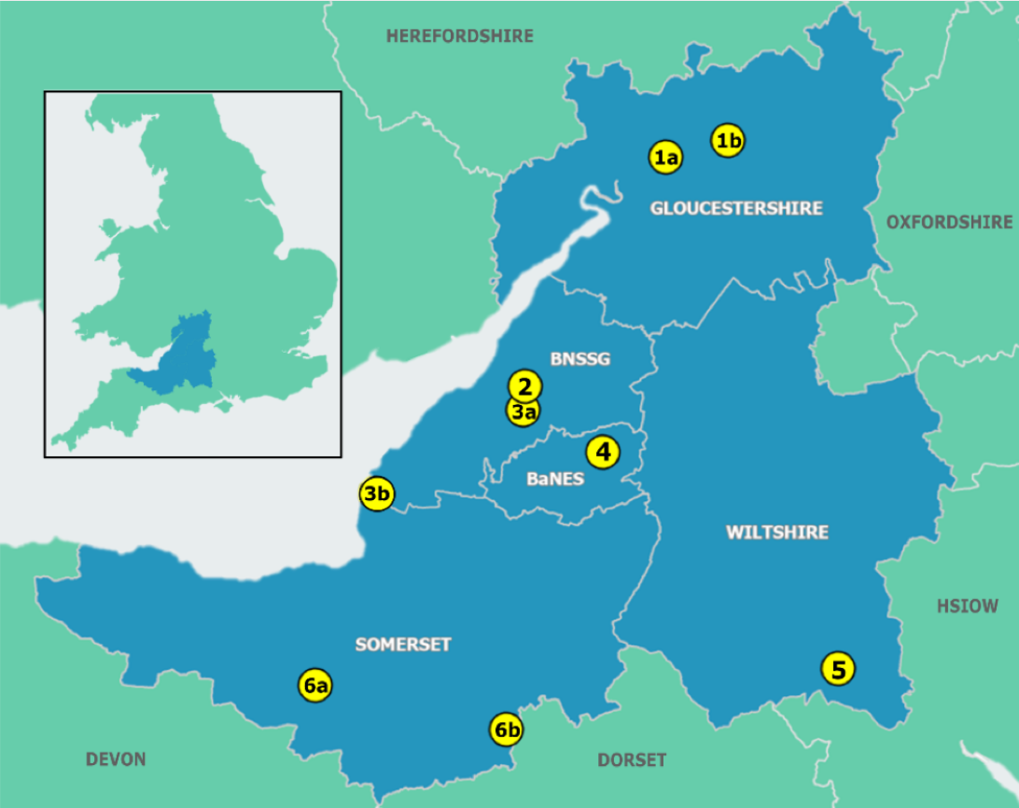
SWAG CA geographic coverage
BSW covers a large area with a dispersed geography.
We need to consider how teledermatology services will serve communities where the nearest specialist service is some distance away.
7
7
Connecting and Empowering the Delivery of Cancer Care Across SWAG Communities

Slide 8
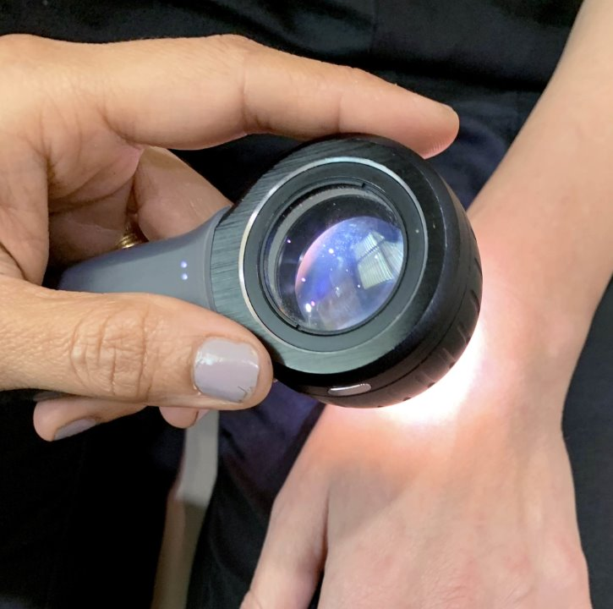
BSW tele-dermatology
Options appraisal – the results
Connecting and Empowering the Delivery of Cancer Care Across SWAG Communities

Slide 9
Summary of poll returns
We set out four options and 15 respondents opted as follows
Primary care (single practice or PCN hubs) - Five
Community care (Community Diagnostic Centres or large hubs/community hospitals) - Four
Acute-based (hospital-based site close to specialty) - None
Hybrid model (a blend of primary, community and acute settings) - Six
The clear steer reflects the thrust of the Darzi report on the NHS and a move towards a primary/ community-based model though comments caution against expecting primary care hubs to be flexible and of the right scale. Patient experience of acute appointments is often poor – parking, traffic, unreliability of public transport – making a 'closer to home' option important
A primary care option using local expertise and a locally negotiated contract together with a pre-referral option was suggested. However, concerns over image quality and sporadic use of equipment was raised and a community hub taking images at scale using trained individuals could mitigate this. Issues around booking admin for primary care and sustainability of funding for a hub model were raised. The GP would still be accountable for the referral and the history that would be included with it.
Different experiences with Cinapsis are set forward. Quality of Cinapsis images into Salisbury seen as poor or sometimes non-existent whereas Bath, who aren't using it for USC referrals, report very high quality.
Referrals for 'barn door' melanoma-type or high-risk SCC lesions should still be available for direct management by specialist services which may not require images.
Connecting and Empowering the Delivery of Cancer Care Across SWAG Communities

Slide 10
Issues/ actions for CAG
To note the national and regional position around teledermatology and rollout
To be aware of further widening of service pilots and the necessary evaluation to ensure services are sustainable into the future
To support the governance structure whereby the four systems in SWAG are accountable for oversight and delivery of teledermatology services throughout the region
To offer a network of clinical support, mentoring and sharing of best practice across your services including all health professionals (consultants, CNSs, medical illustrators, GPs, physician associates, healthcare assistants) to continually improve image quality, patient experience and flows through the USC pathway
To continue to support safe and effective development of AI triage as evidence progresses
Connecting and Empowering the Delivery of Cancer Care Across SWAG Communities
Notes:
How can CAG support / support / accommodate developments in this burgeoning service

Slide 11
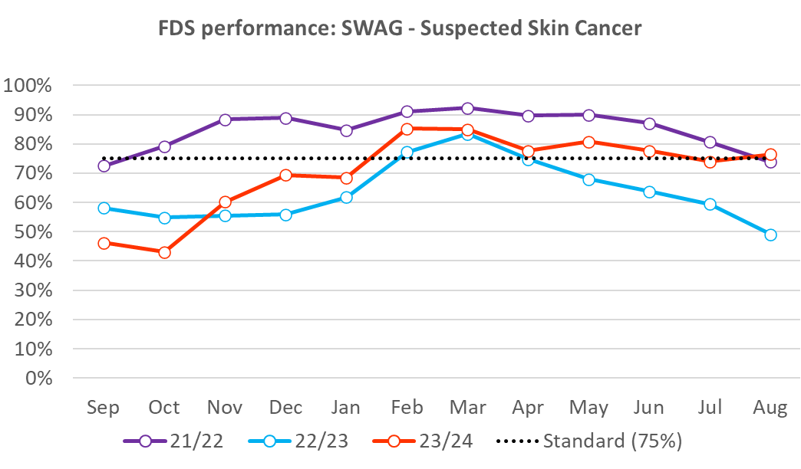
Patient pathway performance
Targeted improvement plans at all challenged providers for sustainable transformation including teledermatology with funding allocated
  PTL governance / insights / productivity / capacity / partnerships
Provider, SWAG and regional funded short term pro-active and recovery WLIs OPAs and surgery
Improved seasonal resilience 24/25 but remains underlying vulnerability and dependency
Connecting and Empowering the Delivery of Cancer Care Across SWAG Communities

