Slide 1
Colorectal liver metastases: Oncological management and future perspectives
Dr Yasmin Odding
Consultant Clinical Oncologist

Slide 2
Contents
Background
MDT decision making
Role of systemic treatment
in resectable CRLM
in unresectable CRLM
Role of liver transplant
Molecular profiling
Notes:
I’ve steered clear of ablative therapies as Huw will discuss

Slide 3
Background
25% patients with CRC will develop CRLM
5yr OS survival R0 resected CRLM ~20-45% (vs. ~10% unresected CRLM)
Recent studies aimed at improving outcomes

Slide 4
MDT decision making
Tumour specific factors
Synchronous vs metachronous disease
Location of primary
Molecular profile of disease plus other key prognostic information i.e CEA
Resectability of CRLM
Patient specific factors
Age
Co-morbidity (pre-hab)
Patient wishes
Notes:
In this talk, I’ll aim to take you through relvevant key research that aids us as the MDT in decision making

Slide 5
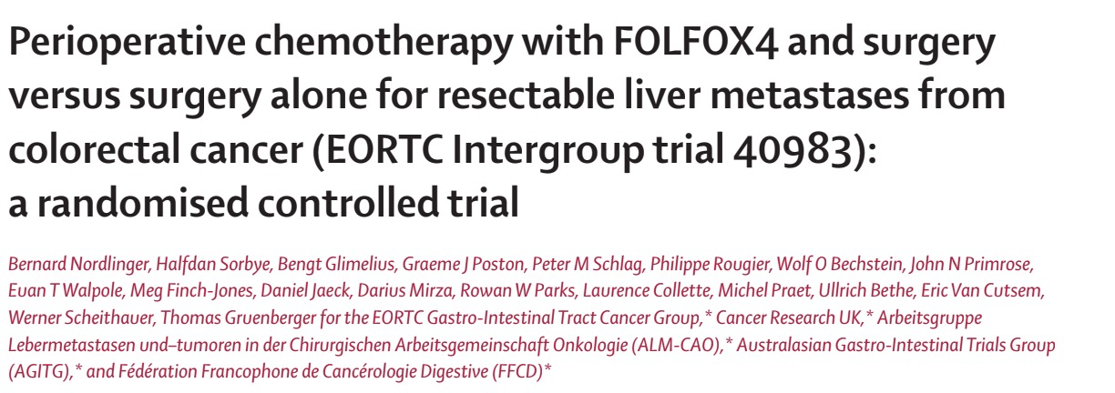
Upfront resectable disease
Key trial: EPOC Study
Notes:
Firstly, upfront resectable liver disease.
The pivotal trial in the perioperative setting was the EPOC study phase 3 RCT compared perioperative FOLFOX and surgery against surgery alone in 364 patients with liver-limited, resectable disease CRLM.
Primary e.p 3 yr PFS

Slide 6
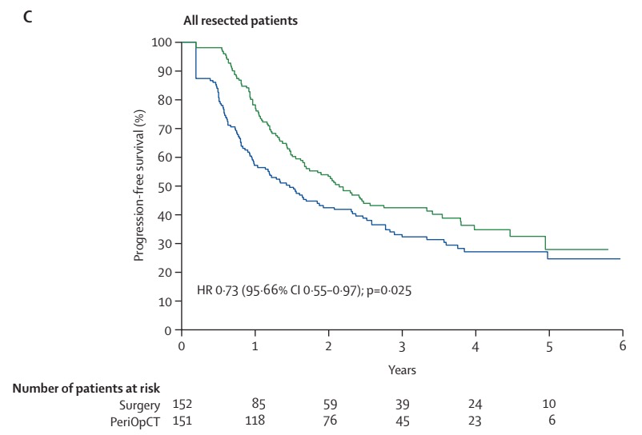
Upfront resectable disease
Key trial: EPOC Study
Notes:
As can be seen, the 3 yr PFS with peri-op chemo was 42% vs 33% in surgery only.
Following this study, perioperative chemotherapy was adopted as an acceptable standard of care for patients with resectable CRLM in UK.
However, at median follow-up of 8.5 years, no statistical difference in OS could be determined and 5-year OS rates were also similar 52% in peri-op ct arm vs 48%; in surg alone.
But the sample size was underpowered to demonstrate an OS improvement,
Benefit of this peri-op approach is widely recognized;
- biology, micromets, tumour shrinkage it provides a ‘test of biology’
Pitfalls in that tumours can progress on SACT, systemic treatment can cause hepatic tox, deconditioning and also issue of DCLM on chemo.
Number of nomograms have been created, predominantly in the East to try and risk stratify patients and differentiate those who could go straight to surgery but further research needed and peri-op remains SOC

Slide 7
Choice of SACT in resectable disease
Key trial: New EPOC Study
Notes:
In terms of choice of SACT in resectable disease, the long term results from the new EPOC study have been published.
This phase 3 study was looking at the KRAS wt population with resectable CRLM and patients received per-operative doublet chemotherapy with out without the addition of cetuximab which is an anti eGFR. Relevant here is that Addition of cetux has shown an OS benefit in some metastatic studies with inoperate disease.

Slide 8
Choice of SACT in resectable disease
Key trial: New EPOC Study
Notes:
As can be seen here, patients assigned to the investigational arm, so with cetuximab experienced significantly reduced PFS and OS so this really has been practice changing. (Median OS investigation arm was 55m vs 81m)

Slide 9
Unresectable disease
Key trial: CAIRO5
Notes:
In terms of unresectable disease, PFS data from CAIRO5 has recently been published, the OS data not yet mature.
Big phase 3 RCT across 47 centres in Netherlands and Belgium

Slide 10
Unresectable disease
Key trial: CAIRO5
Previously untreated unresected CRLM
Right sided
/RASm/BRAFV600Em
Doublet +Bev
Triplet+Bev
Left sided +RAS+BRAFwt
Doublet +Bev
Doublet + Pani
Notes:
Trial design was complex, but essentially there was prospective use of mutational status and sidedness to make decisions and treatment randomized accordingly.
521 patients included in final analysis and an expert panel reviewed imaging 2 monthly to assess for resectability. Of note, the concordance between expert panel members on resectability was only 66%

Slide 11
Unresectable disease
Key trial: CAIRO5
Notes:
In terms of results, after a median follow-up of 51.1 months in the group who were right sided, RAS or BRAF mutation positive arm, triplet chemotherapy plus bevacizumab resulted in a significant increase in median PFS seen here, RR and complete local treatment rate compared to doublet chemotherapy plus bevacizumab.
No difference in terms of PFS was observed in patients with left-sided tumours without RAS or BRAFV600E mutations (10.8 and 10.4). Addition of eGFRi did increase RR, but this didn’t translate to increase in local treatment rate and that was at the expense of toxicity in the doublet and panitumumab arm.
The rate of conversion to secondary resection according to the expert panel was higher than I thought it would be. 57% in arm A, 64% in arm B, 73% in arm C, and 75% in arm D.
Is this practice changing? More likely to use triplet in the right sided and mutation positive cohort but have to be fit!

Slide 12
Unresectable disease – liver transplant
Key trial: TRANSMET
Notes:
Moving on to the unresectable cohort who remain unresectable despite SACT, transmet bold study published in September this year conducted by a French group.
Inclusion criteria were patients with confirmed unresectable liver only disease, curative resection primary, at least SD on recent imaging, <3L CT. Included synchronous and metachronous disease, BRAFmutations exluded.
Of note, median age in study was 45

Slide 13
Unresectable disease – liver transplant
Key trial: TRANSMET
Notes:
157 patinets recruited and submitted by specialised centres to the indepnedant expert committee, interesting 40% of those submitted were deemed ineligible .
Patients then randomized to LT + C vs C alone and those patients here were eneterd on to waiting list with very short window between final cycle chemo and surgery. Those patients receiving LT received tailored immunosuppression post transplant and post op chemo wheras the other arm just had continuation of chemo.
38 patients transplanted
Priority of LT was equivalent to end stage liver disease with a high MELD up to 35.
Primary EP OS

Slide 14
Unresectable disease – liver transplant
Key trial: TRANSMET
Median follow-up 59 months
Notes:
mFU 59.3 m, ITT population, 5 yr OS 57% in LT vs 13% in C only, results more favourable in the per protocol analysis
G3 SAE similar both arms (80 vs 83%) but 3 re-transplants were untaken, 1 of whom dies for multi-organ failure post op/

Slide 15
Unresectable disease – liver transplant
UKCoMET
Notes:
On the back of this, fixed term working group set up by NHS transplant liver advisory group & based upon data that outcomes similar to transplanted HCC patients and it’s been recommended as an established treatment in international consensus guidelines by the HPB association.
LT for this cohort is running as a pilot by service evaluation in all 7 transplant centres in UK, they estimate 20-30 transplants taking place during the 2 year pilot with median time to transplant 3m from listing.

Slide 16
Unresectable disease – liver transplant
UKCoMET
Unresectable liver only disease with resection of primary
PS 0/1 and acceptable blood parameters
Radiological sustained 30% response (RECIST) for 2 years on CT
Any PD during this 2 year period – LT de-listing & clock re-set
Notes:
Key inclusion criteria here are (GO THROUGH)
Unlike TRANSMET study, less favorable molecular profiles not excluded.
Patients who have had previously resected liver disease are excluded.
Mandated locally diagnostic laparoscopy if high risk features of primary.
Here, referreal directly to transplant centre and only in cases of uncertainy are refered to national expert panel so not as standard– argument as to whether all cases should be reviewed by expert panel??
National registry maintained with oncological outcomes and QOL outcomes with futility defined as <60% 1 year OS
Is this practice changing? Small numbers but as oncologists from historic trial data, we have largely adopted an intermittent treatment strategy for majority of patients so stopping metastatic treatment at 3-6 months then re-initiating only at progression in order to try and maintain QOL, but perhaps now we need to think about continuous chemo for a small cohort of our patients.

Slide 17
Molecular profiling
Key trial
Notes:
I wanted to touch on this interesting cohort study which included 853 patients who underwent surgery for CRLM and was looking at the association of mutational status with outcome. Here, data on the cancer molecular profile was recorded and association with DFS and OS was recorded.

Slide 18
Molecular profiling
Key trial
Notes:
Here we can see kalpan meier estimates of OS.
At median FU of 28m, 44% of patients with BRAF v600e m had died and we can clearly see from this light blue line that this group have worse OS following liver resection.
Small number of BRAF non v-600E mutations and so no conclusions can be drawn, but outcomes similar to wtBRAF gentotypes so the dark blue line.
Is this practice changing? Probably on it’s own, no but it forms part of the story when making treatment decisions for our patinets

Slide 19
Conclusions
Complex group of patients
Patient factors are key
Good MDT working is critical
Notes:
Complex group – various tumour factors at play, nuanced treatment decisions
Exciting data, but patient factors are key. In our ‘real world’ patient cohort, patients are rarely PS0/1 and without co-morbities and often can be deconditioned at baseline or as a result of NA treatment, so all needs to be taken into account
Good MDT working critical

Slide 20
Unresectable disease
FOLFOXIRI+Bev FOLFOX + Bev
Resection rate 61% (R0=49%) 49% (23% R0)
RR 81% 62%
Notes:
There have been several recent studies on unresctable CRLM. The OLIVIA study was a phase II in Western Europe whereby patients with unresectable liver disease were randomized to triplet CT + Bev vs doublet CT +Bev. The primary end point here was resection rate
G3 tox was higher in the triplet + Bev arm but toxicity was expected and largely managegable

