Slide 1
Endovascular management of hepatocellular carcinoma
Michael Bonnici-Mallia
Consultant Interventional Radiologist
Notes:
Good evening all and thank you Hedi and Jamie for the kind invitation to speak.
Today I will be discussing the endovascular options we have to offer in the treatment of HCC.

Slide 2
Introduction
Transarterial chemoembolisation (TACE)
Augmentation of Ablation
Selective Internal Radiation Therapy (SIRT)
Notes:
I’ll be covering TACE, how endovascular techniques can augment our ablation practice and finally touch on SIRT.

Slide 3
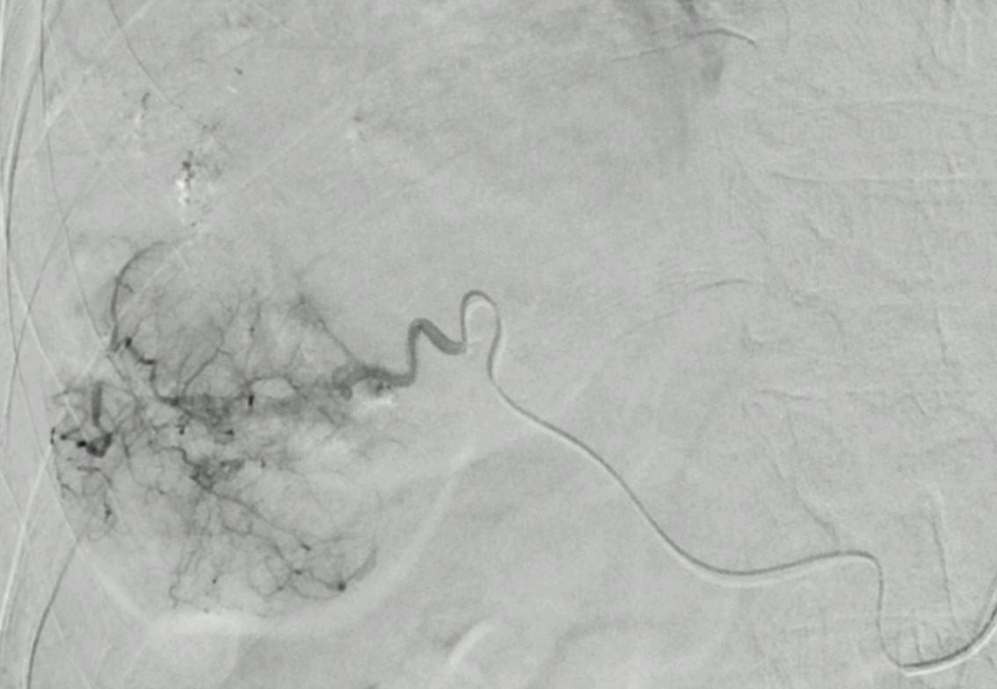
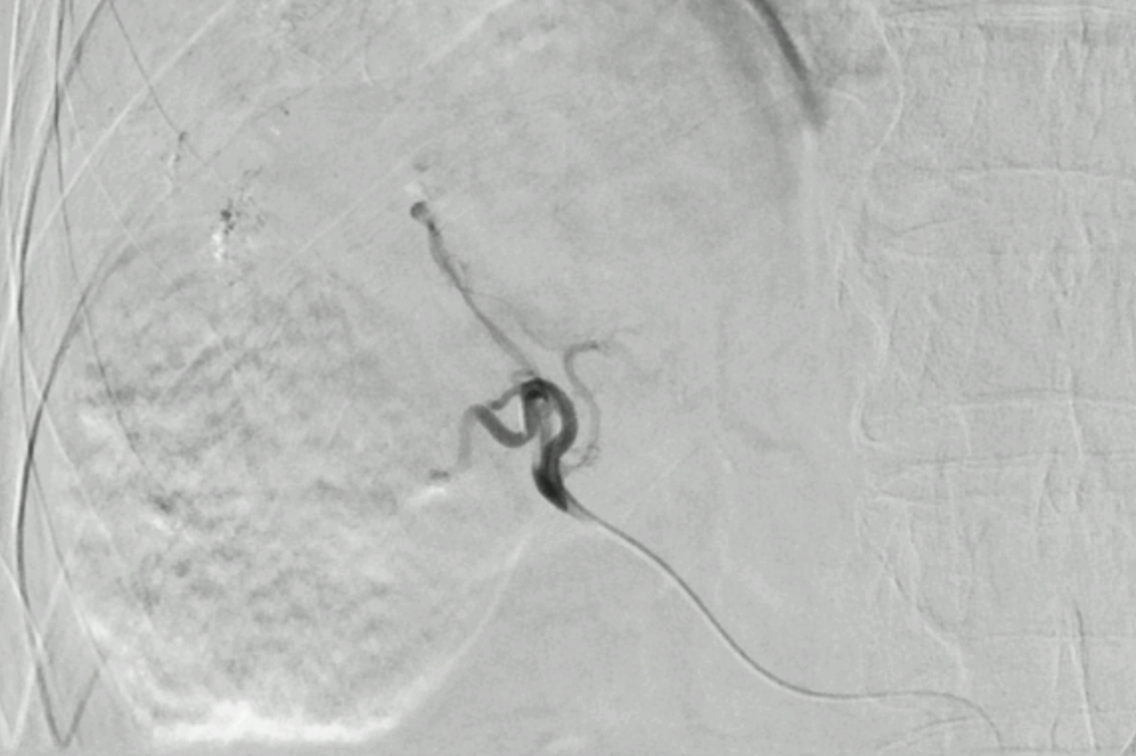
Transarterial Chemoembolisation (TACE)
Notes:
We’re all mostly familiar with TACE. It’s been around since the 1970’s. It involves placement of a catheter inside a hepatic artery branch supplying a tumour and injecting an embolic agent, with the intention to starve the tumour of it’s blood supply and cause pathological necrosis.

Slide 4
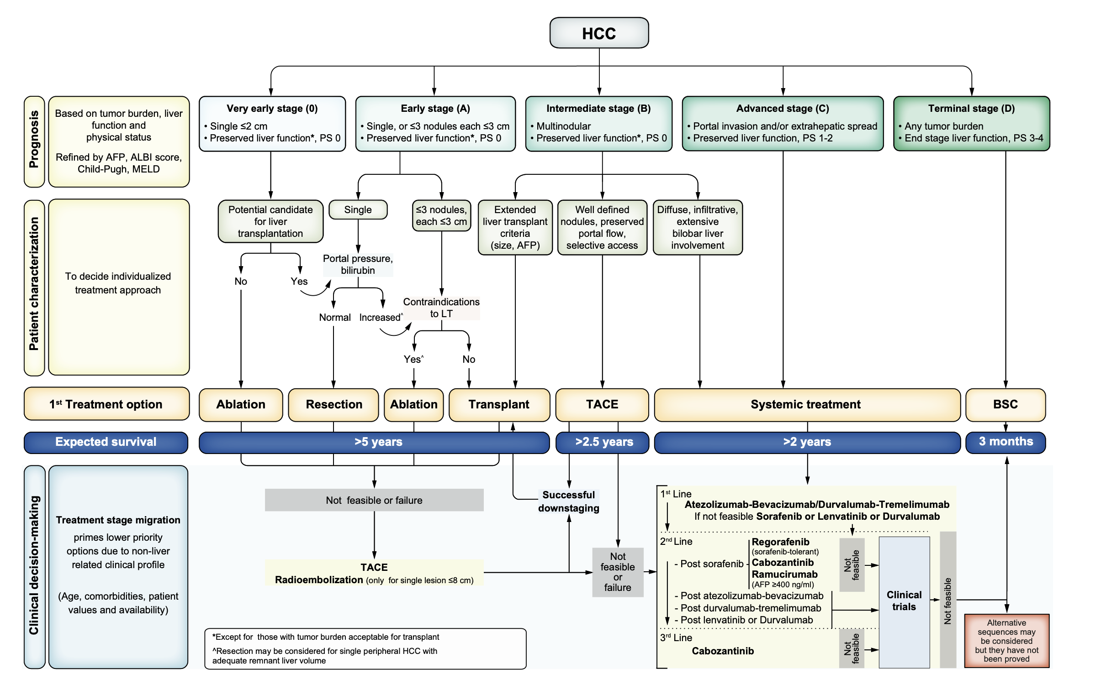

Slide 5
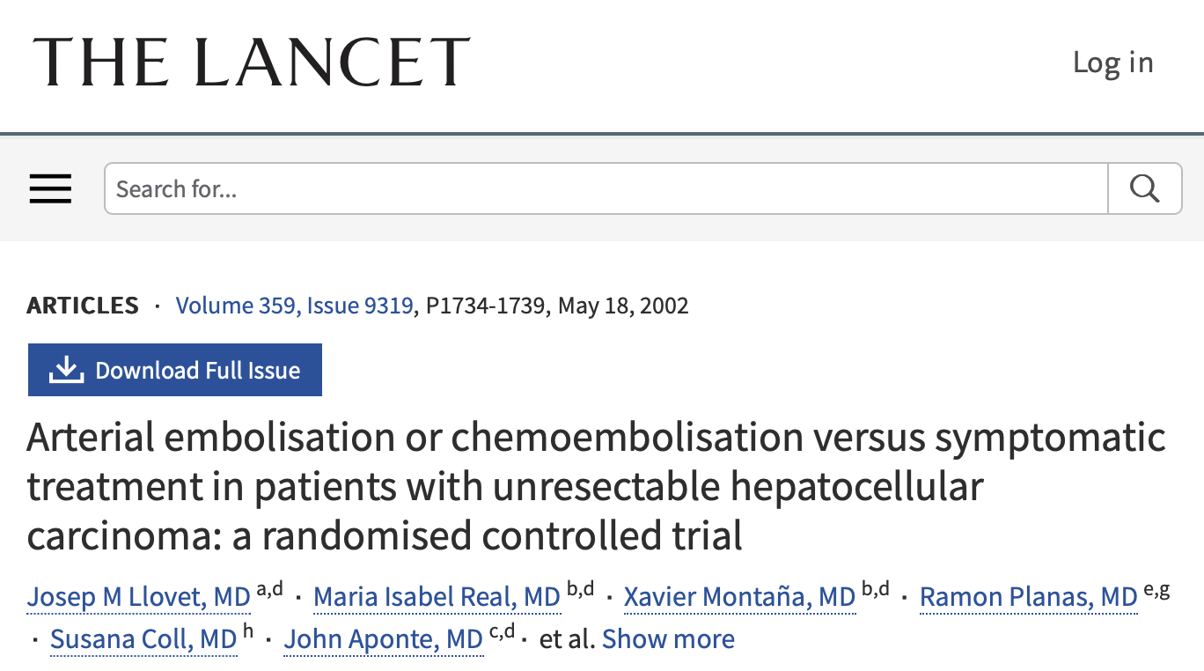
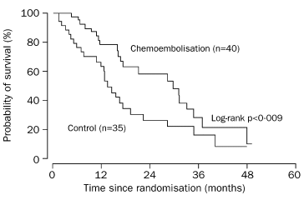
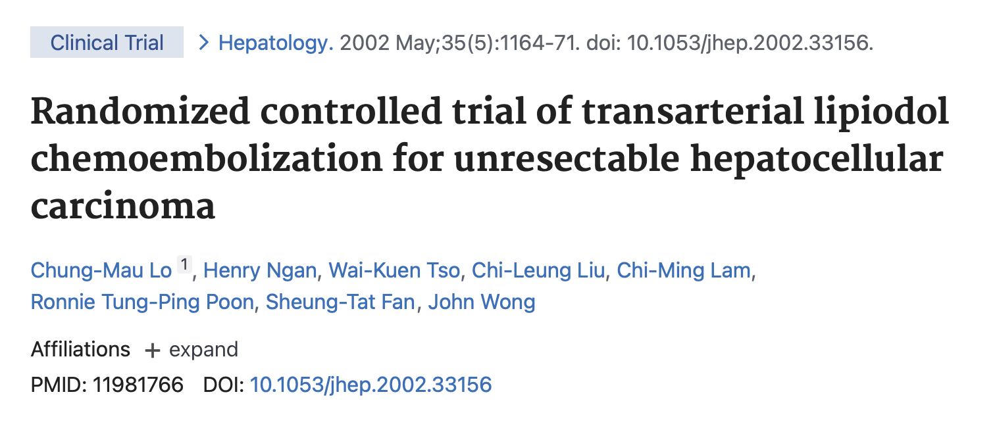
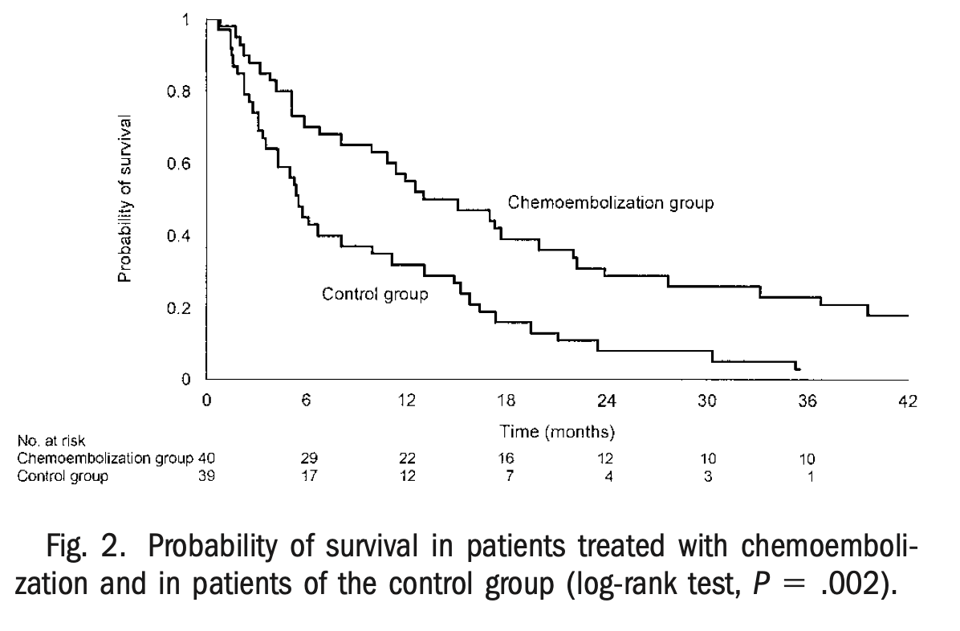
TACE: Evidence base

Slide 6
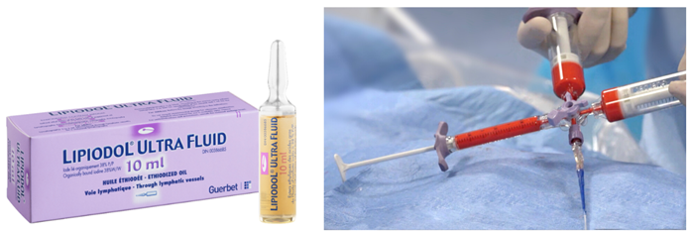
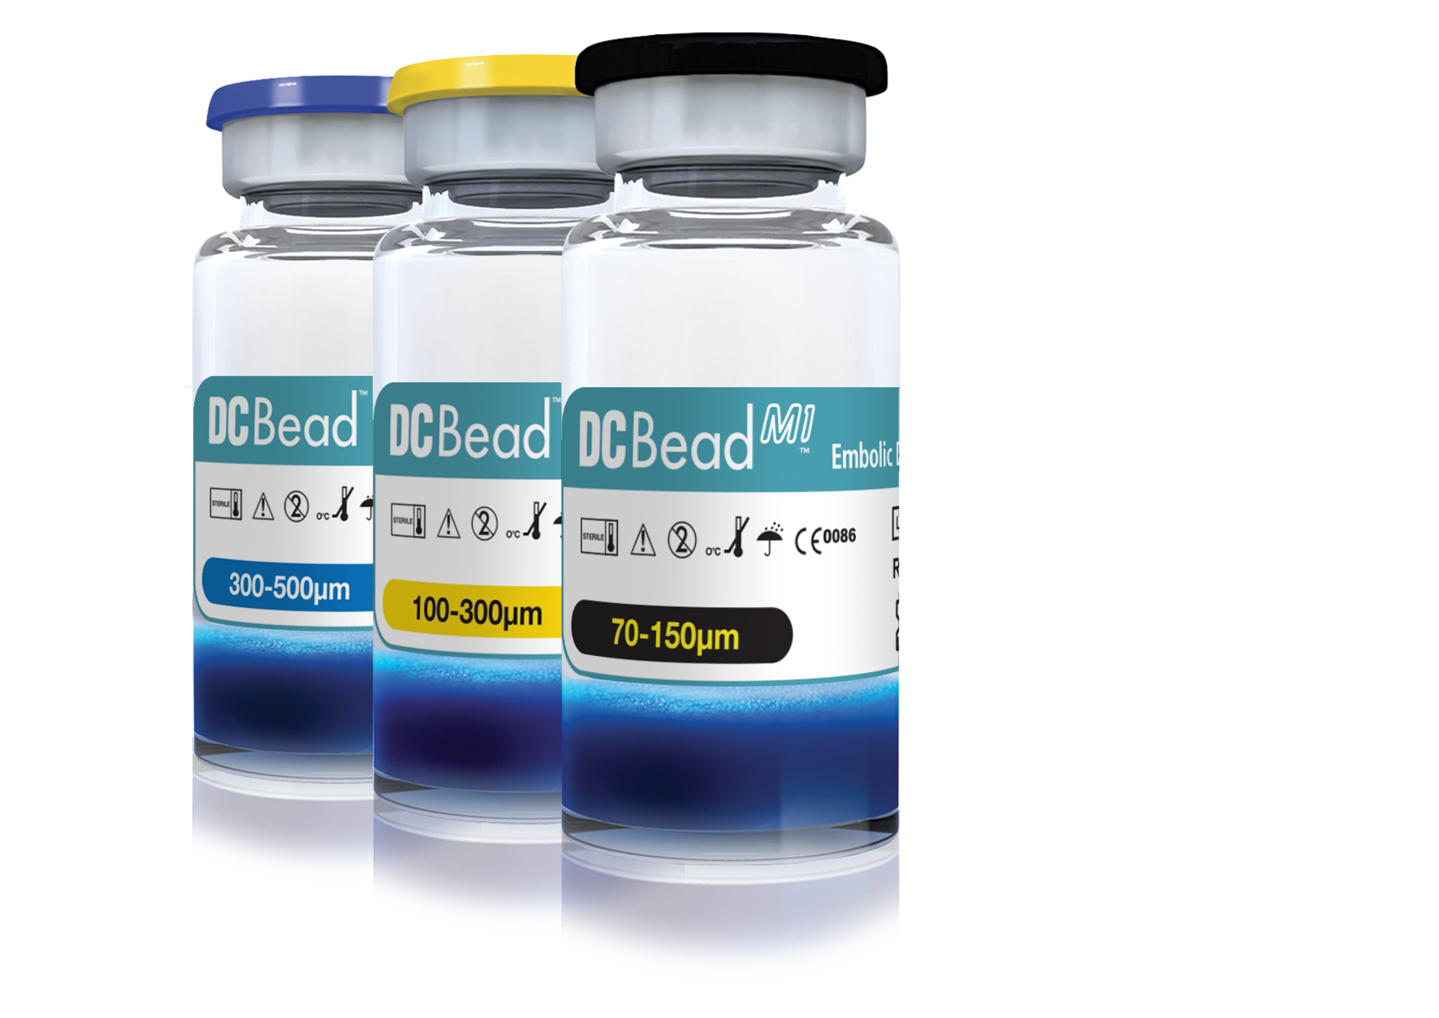
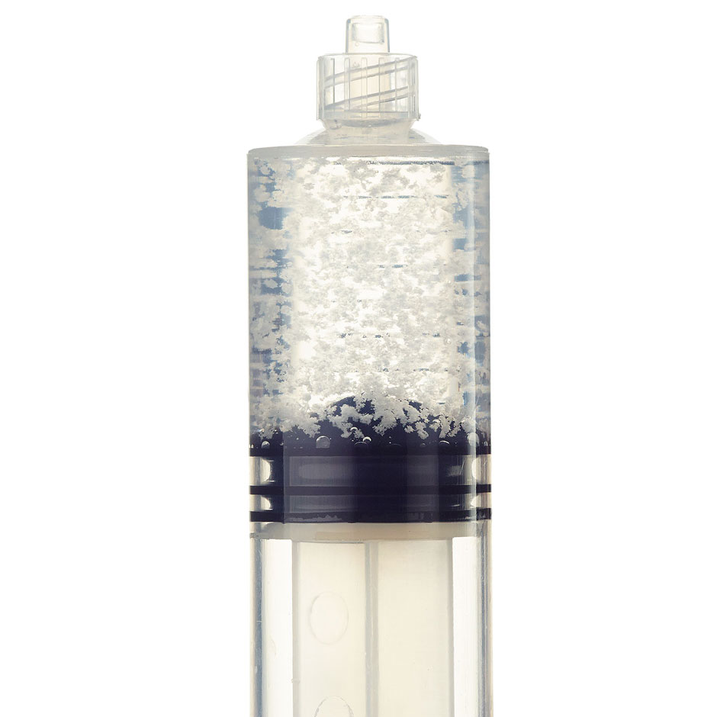
TACE: Methods
Conventional TACE (cTACE)
Bland Embolisation (TAE)
Drug-Eluting Beads (DEB) TACE
Notes:
- Bland embolisation can be performed when chemotherapy may be contraindicated.
- A few centres choose to perform bland embolisation as a primary form of embolisation, citing the ischaemic effect of the embolisation as the primary cause of pathological necrosis.
- That being said the weight of evidence remains behind cTACE and DEB TACE.

Slide 7
cTACE vs DEB-TACE
PRECISION V (2010) - DEB superior to cTACE in toxicity/local control.
PRECISION ITALIA (2014) - cTACE equally as effective when performed selectively
JIVROSG-1302 PRESIDENT (2020) - Selective TACE better local tumour control than DEB (Higher post embolisation syndrome)
Notes:
So which is better?There was a shift to DEB TACE following PRECISION V

Slide 8
TACE: Outcomes
Sieghart et al. Journal of Hepatology (2015)
Notes:
WE have seen an improvement in outcomes and OS over the years, which probably in part explained by better patient selection.
BCLC is spectrum of disease including low volume unilobar disease all the way to large volume Bilobar disease

Slide 9
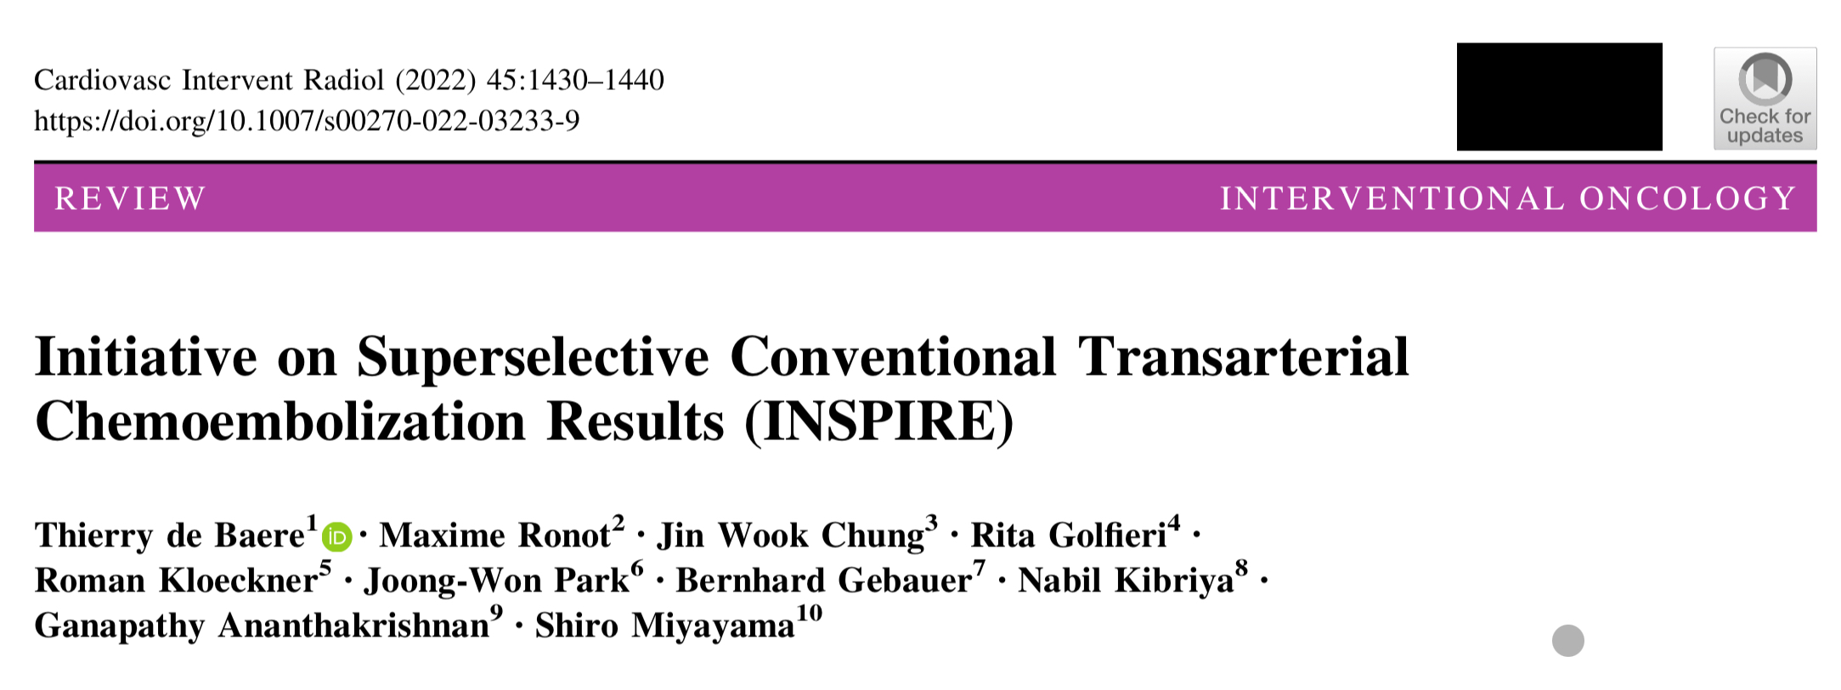
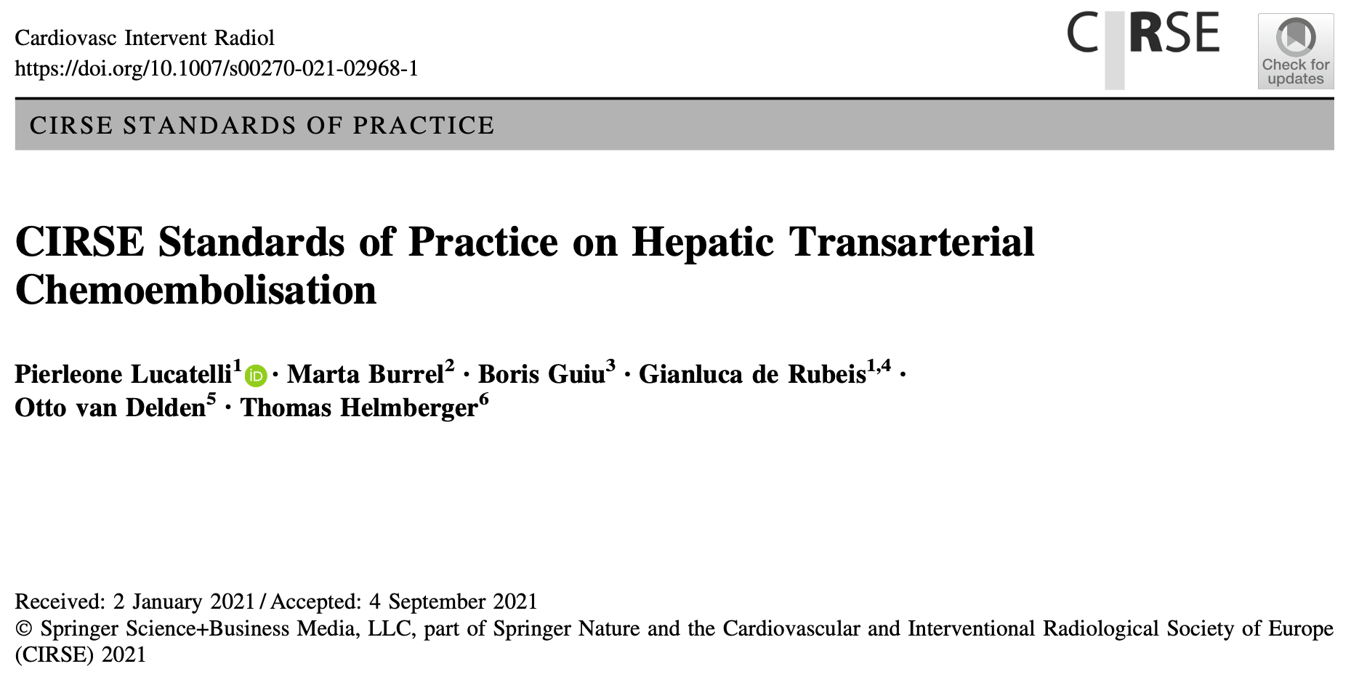
TACE: Standardisation
Notes:
That being said historically outcomes have been variable because of the lack of standardisation of the technique.
Set of technical recommendations which act as a framework for practice

Slide 10
TACE: Cone Beam CT

Slide 11
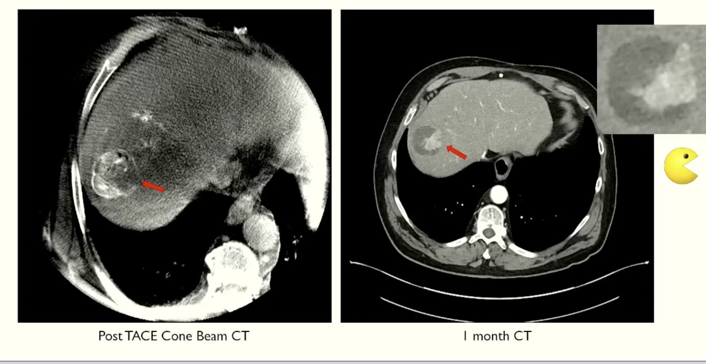
TACE: Cone Beam CT
Courtesy of Dr P Littler, Newcastle

Slide 12
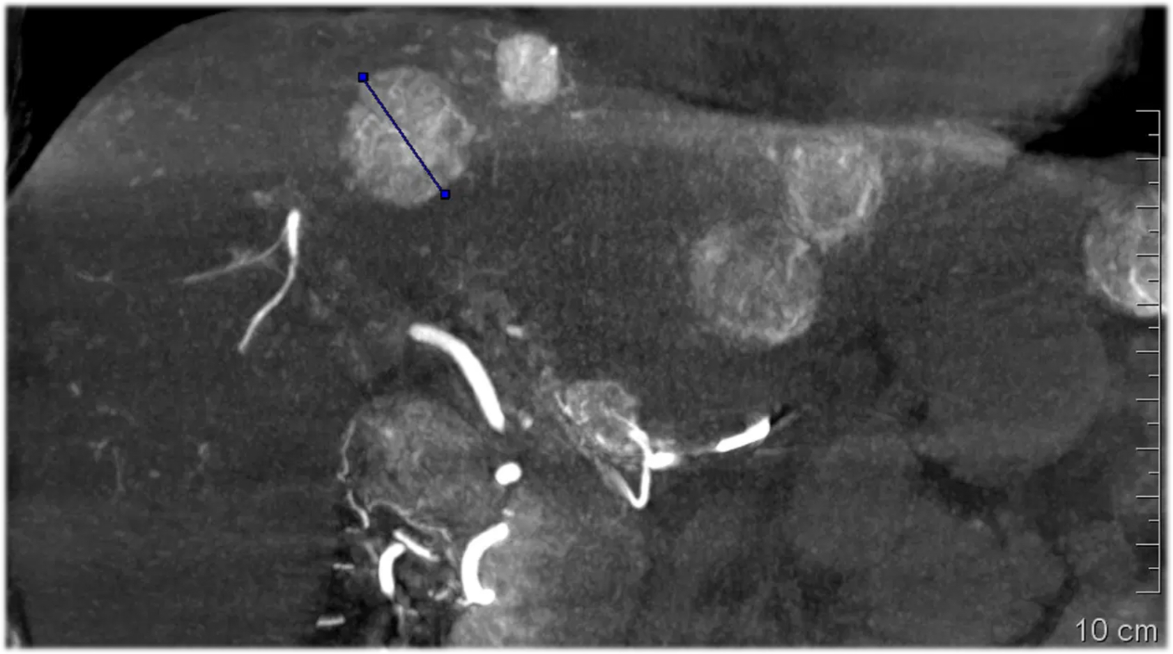
TACE: Embolisation Guidance

Slide 13
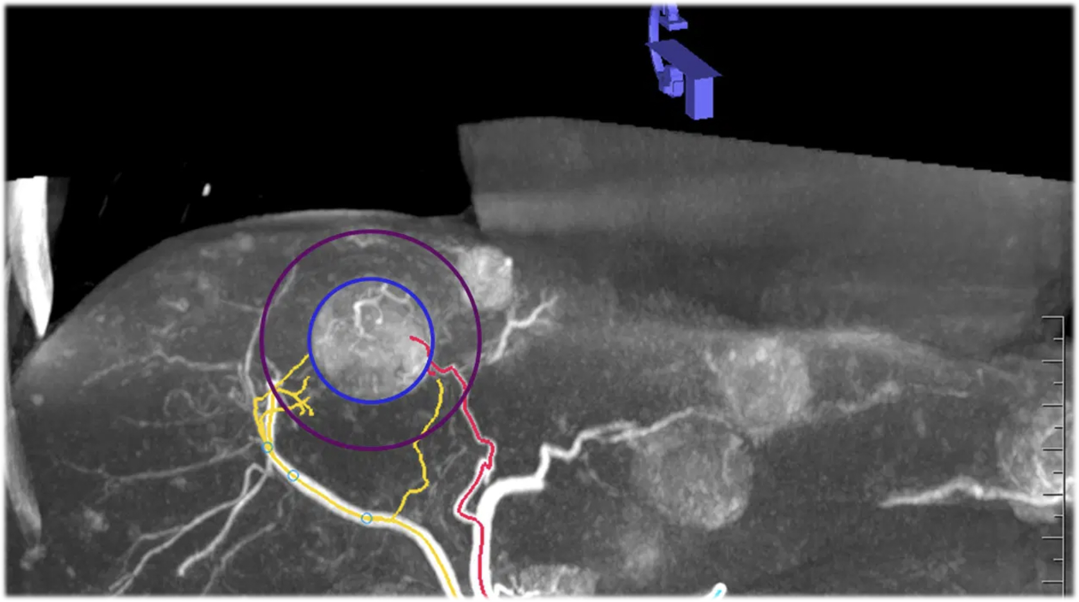
TACE: Embolisation Guidance

Slide 14
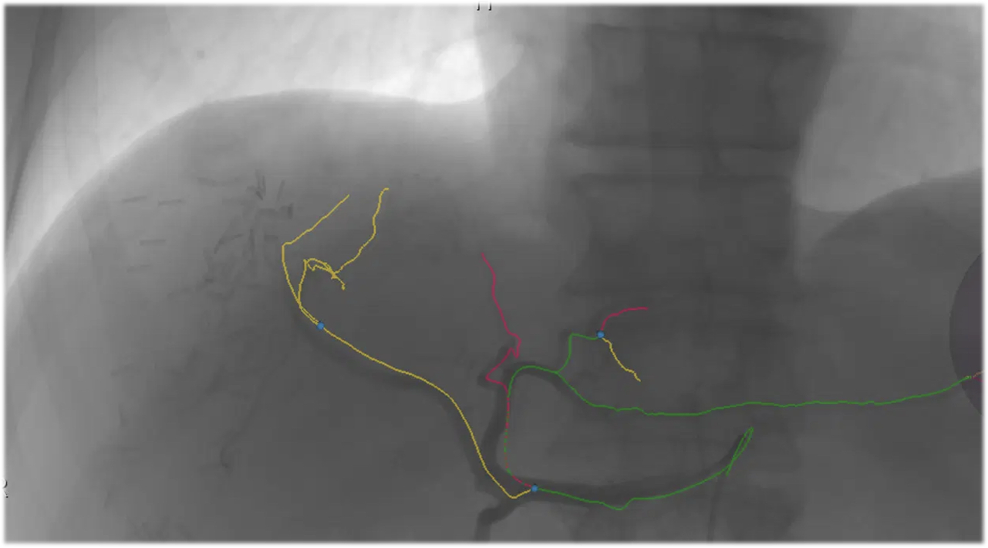
TACE: Embolisation Guidance

Slide 15
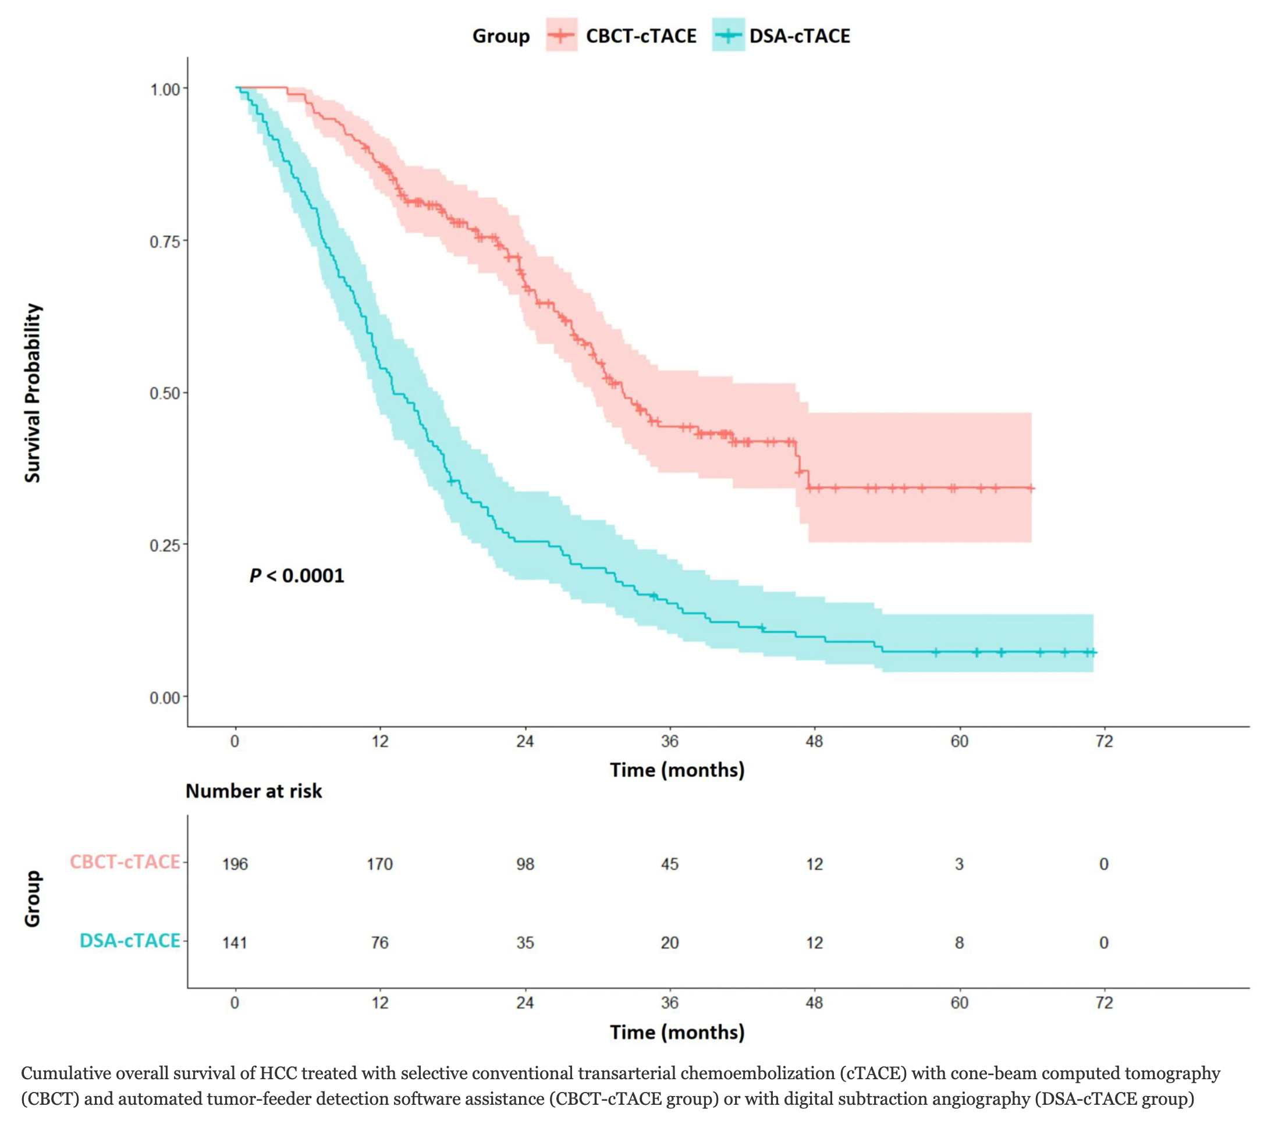
TACE: Embolisation Guidance

Slide 16
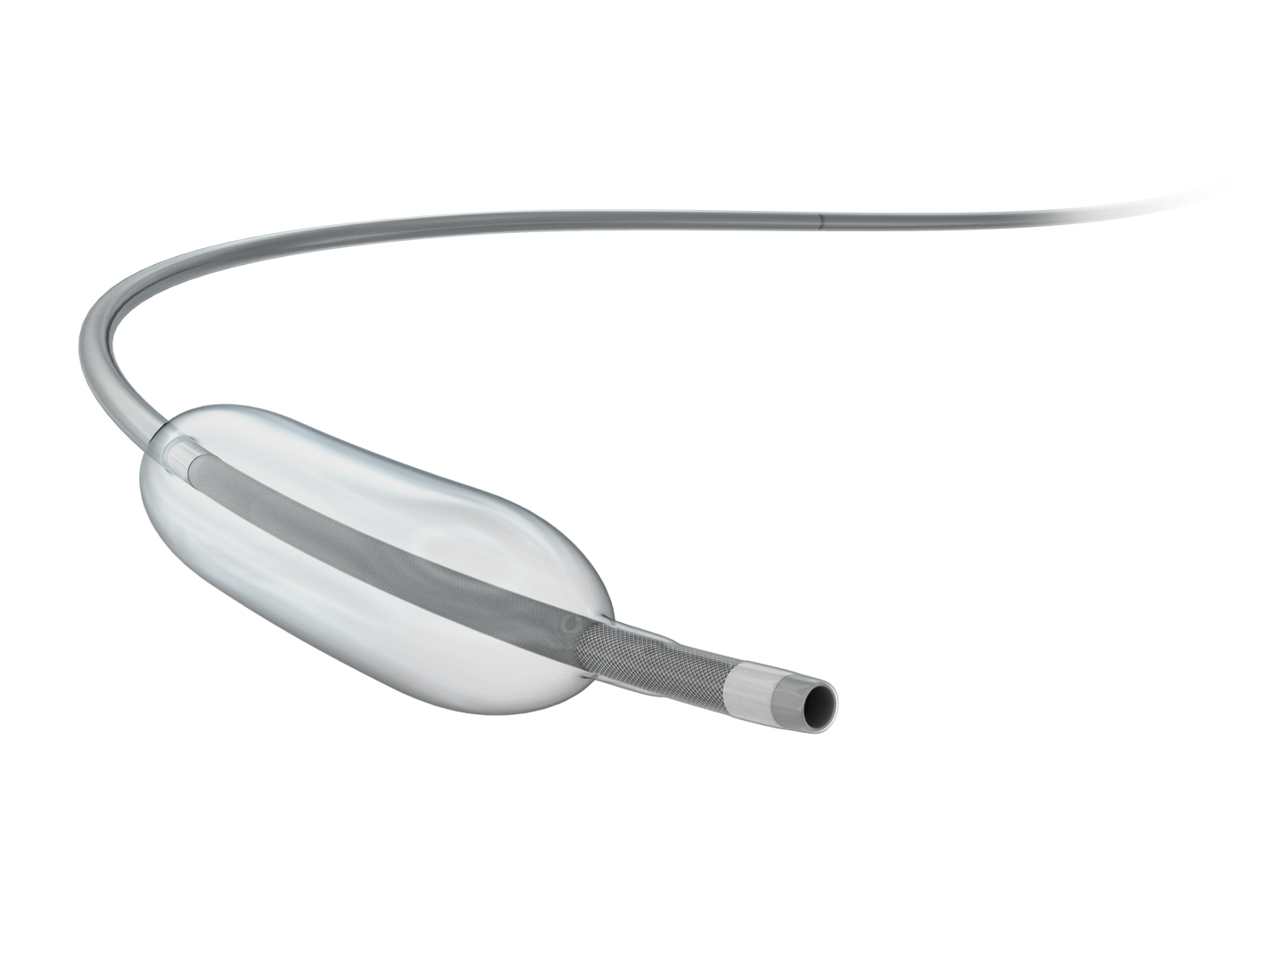
TACE: Balloon TACE
Notes:
Balloon occlusion microcatheter
Pressure gradient which redirects surrounding flow into the tumour - concentrating the embolic agent, minimising non target embolisation
We have data from our European colleagues showing B-TACE outperforms standard TACE and may represent the next generation of therapy
One centre in the UK, small numbers

Slide 17
DSM-TACE: Drug-Eluting Starch Microspheres
Notes:
Resorbed within 2 hours
Poorer liver function and patients with portal vein thrombosis

Slide 18
Ablation: Transcatheter CT Hepatic Angiography
Notes:
How can endovascular methods augment our ablation practice?
Not a new technique - first described for diagnostic imaging by the MD Anderson group in the 70s
Repurposed for ablation by the Amsterdam group in the late 2010s.
Key part of the COLLISION trial

Slide 19
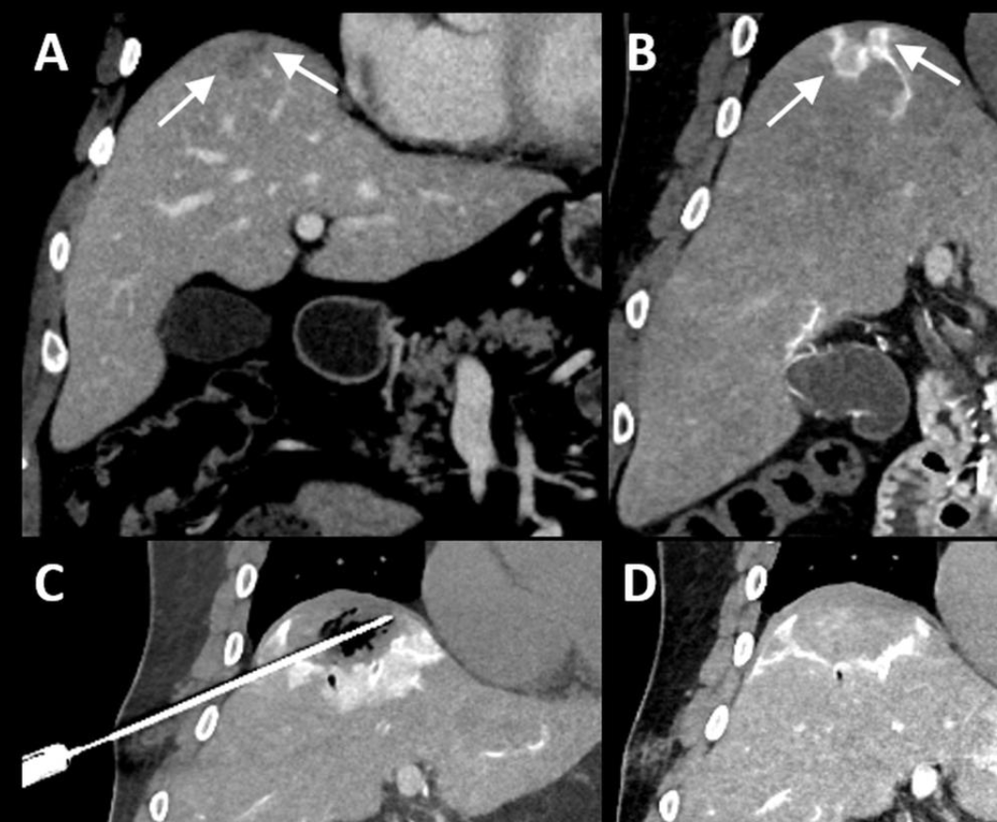
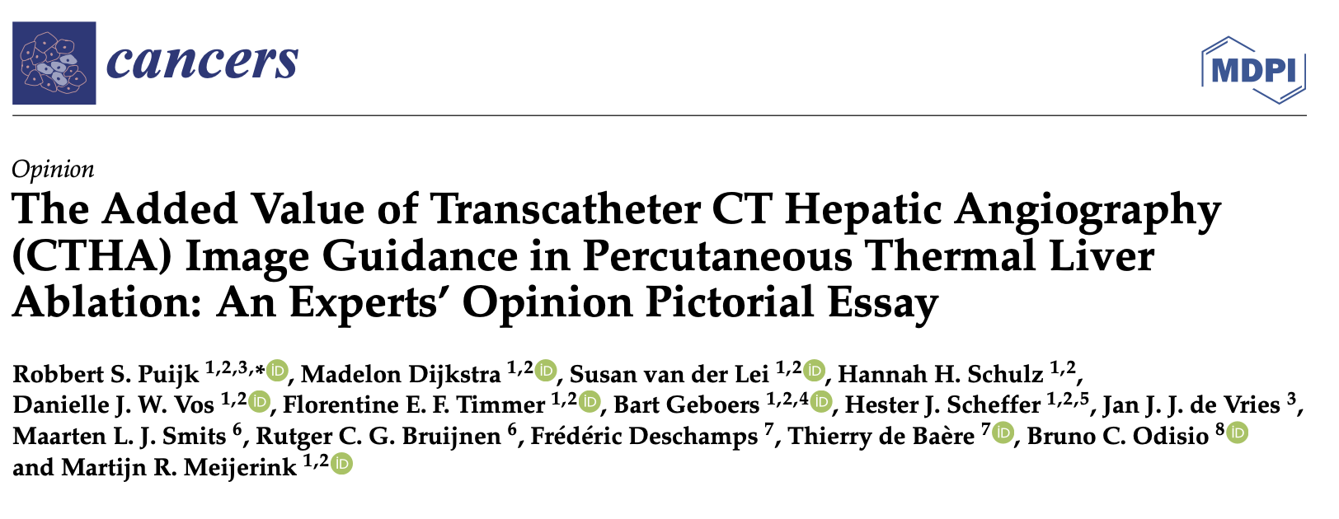
Ablation: Transcatheter CT Hepatic Angiography
Notes:
This is standard of care in the Netherlands who are at the forefront of ablation practice

Slide 20
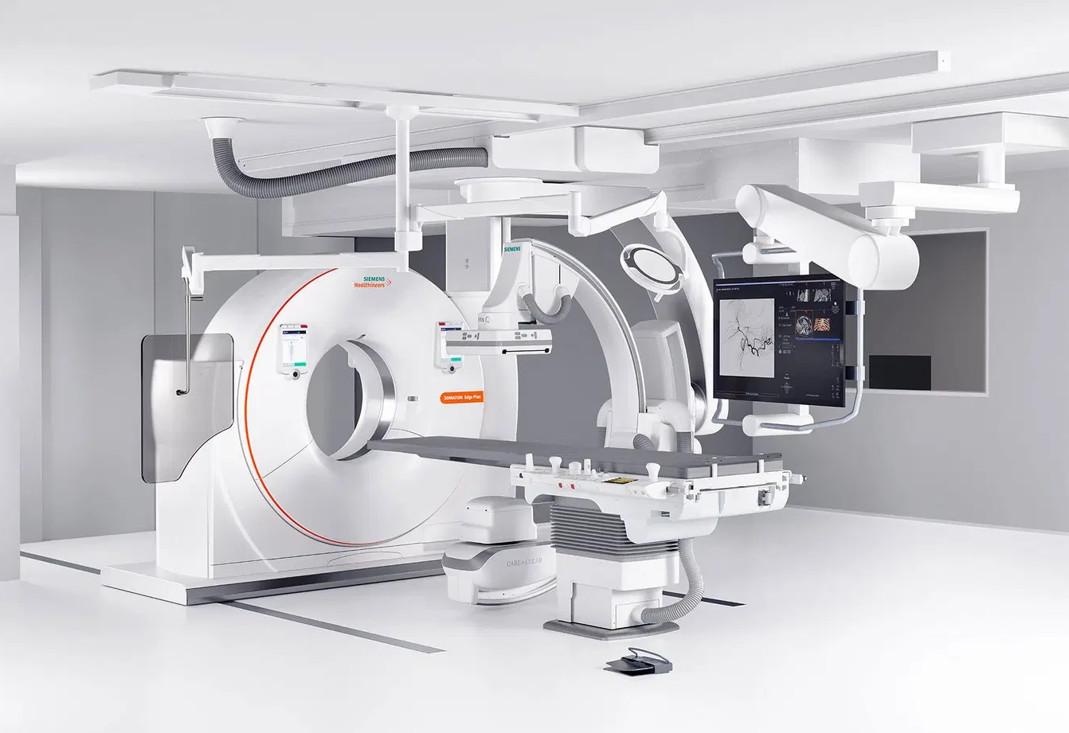
Ablation: Transcatheter CT Hepatic Angiography
Complex workflow
Need for specialty equipment
Notes:
We are bound to see CT-angio suites becoming the norm in well established interventional oncology units

Slide 21
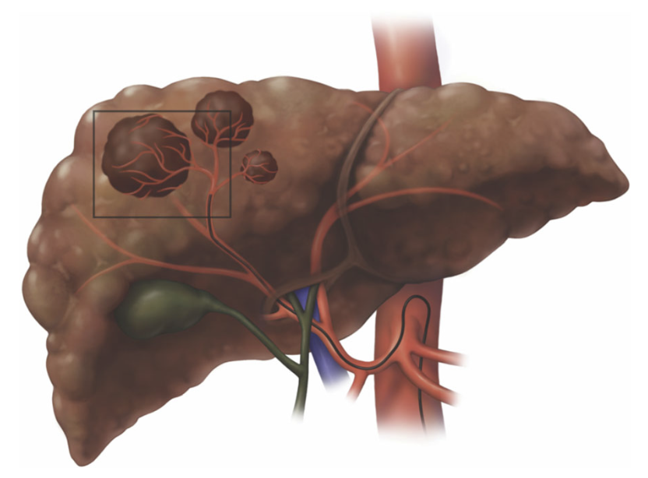
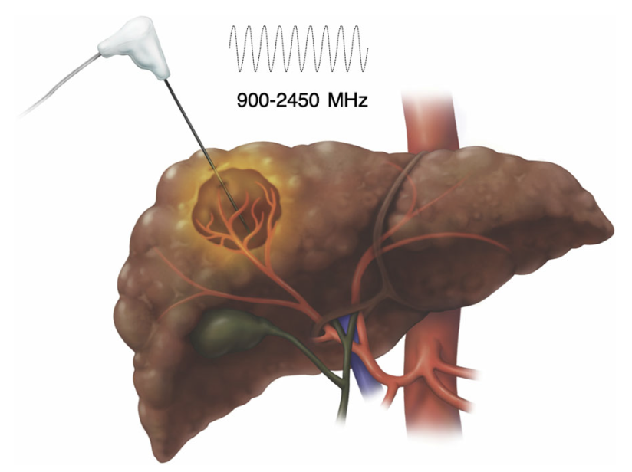
Combination therapy: TACE & Ablation
Voizard et al. Insights into Imaging (2019)
Rationale:
Pre-ablation TACE expands ablation zone by minimising heat sink effect.
Lipiodol tumour staining
Notes:
Widely practiced in most institutions treating HCC despite not being formally included in BCLC guidelines
Wealth of data correlating safety margins with recurrence - TACE expands the ablation margin

Slide 22
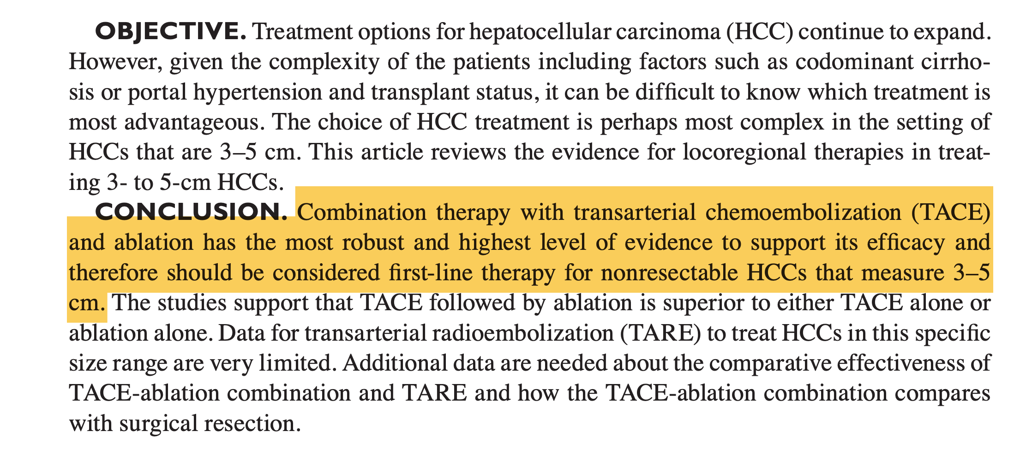
Combination therapy: TACE & Ablation
Notes:
Wealth of data correlating safety margins with recurrence - TACE expands the ablation margin
Rationale: expand ablation zone by minimising heat sink effect. Lipiodol stains the tumour improving visibility during ablation
Is commonly performed despite not being formally included in BCLC guidelines

Slide 23
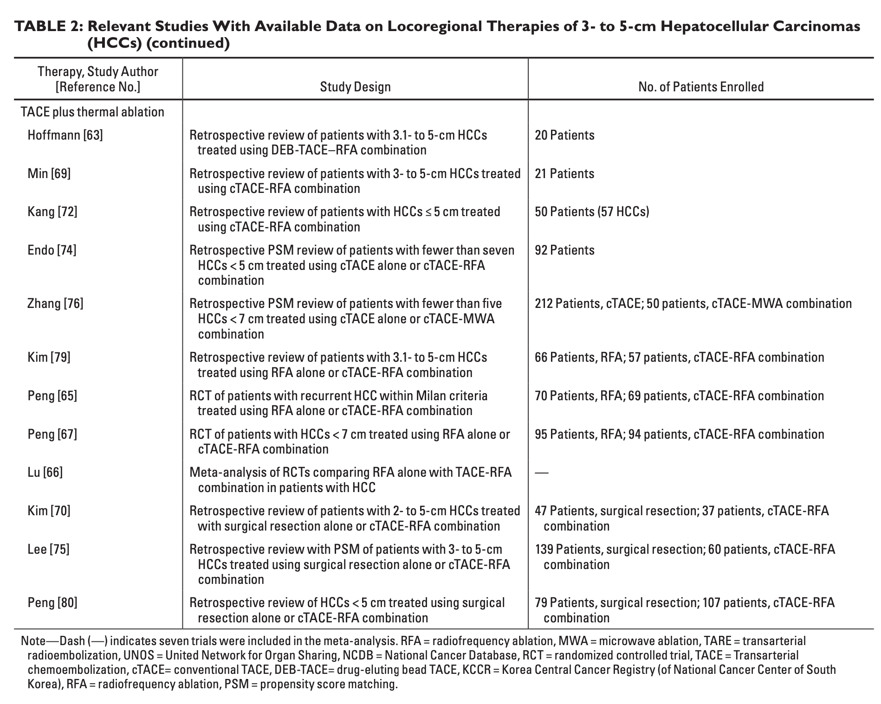

Slide 24
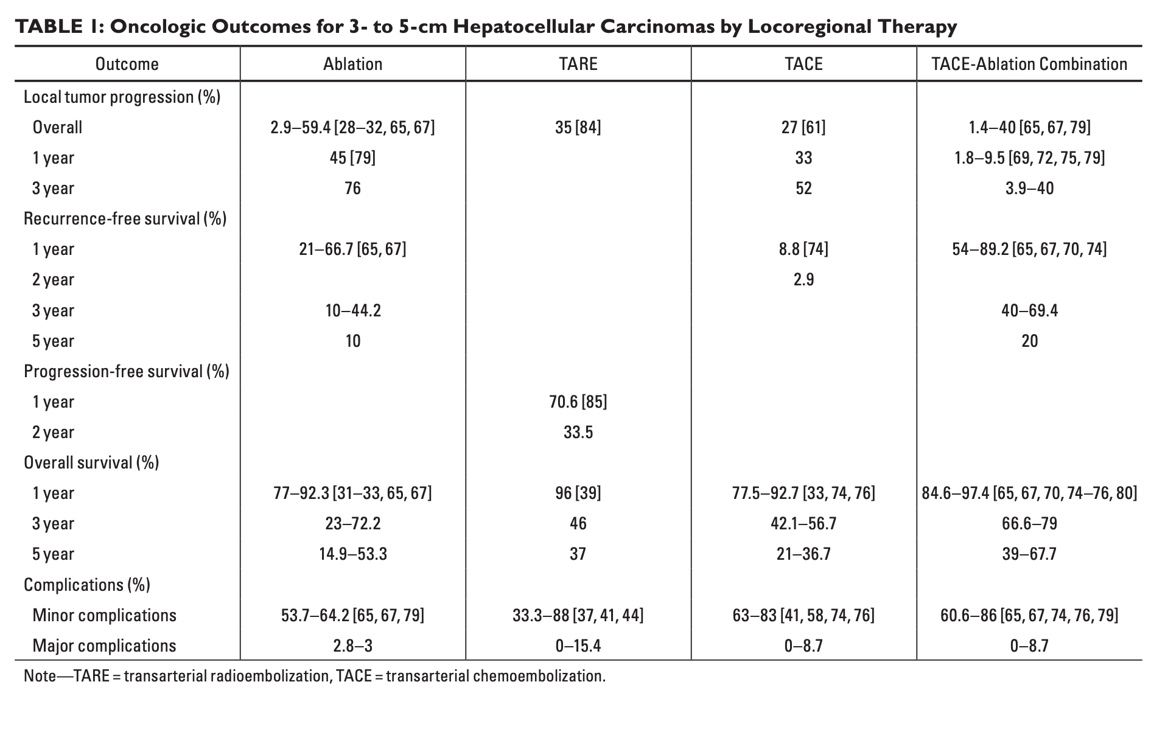

Slide 25
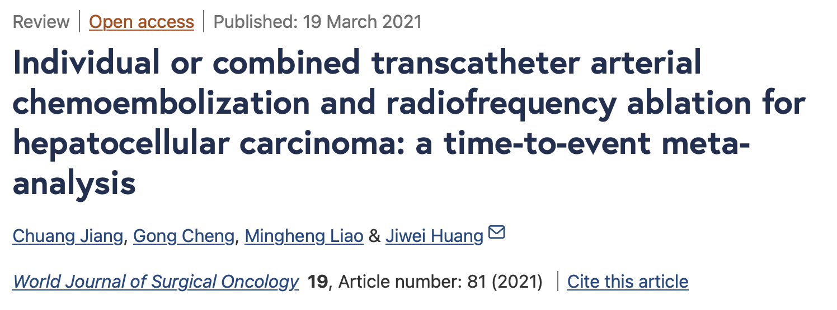
Combination therapy: TACE & Ablation
21 studies, 3413 patients
TACE combined with ablation better OS (p <0.001) and RFS (p <0.001) than TACE alone
Subgroup analysis of tumours >3cm favouring combination therapy

Slide 26
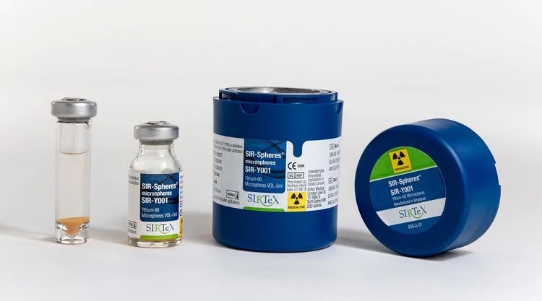
Selective Internal Radiation Therapy (SIRT)
Intra-arterial delivery of resin/glass spheres embedded with a radioisotope (Y90/Ho166)
Half life 64.2 hours
Mean tissue penetration of 2.4mm - 90% deposited within 5mm.
Notes:
Brachytherapy
Y90 is a pure Beta emitter
Half life 64.2 hours - majority of energy is deposited within 3 weeks
Mean tissue penetration of 2.4mm - 90% deposited within 5mm.

Slide 27
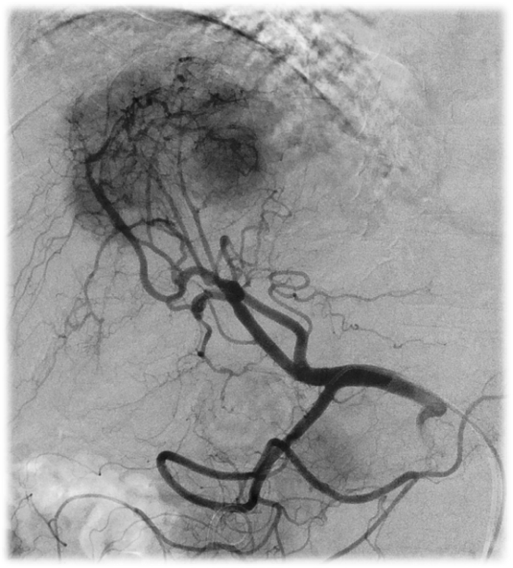
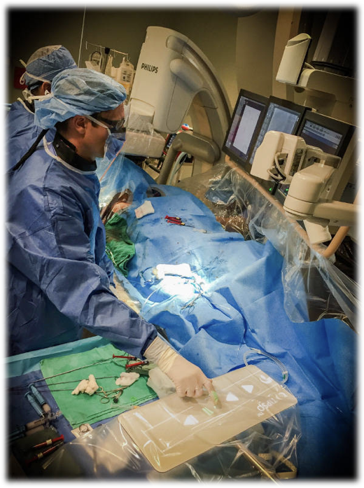
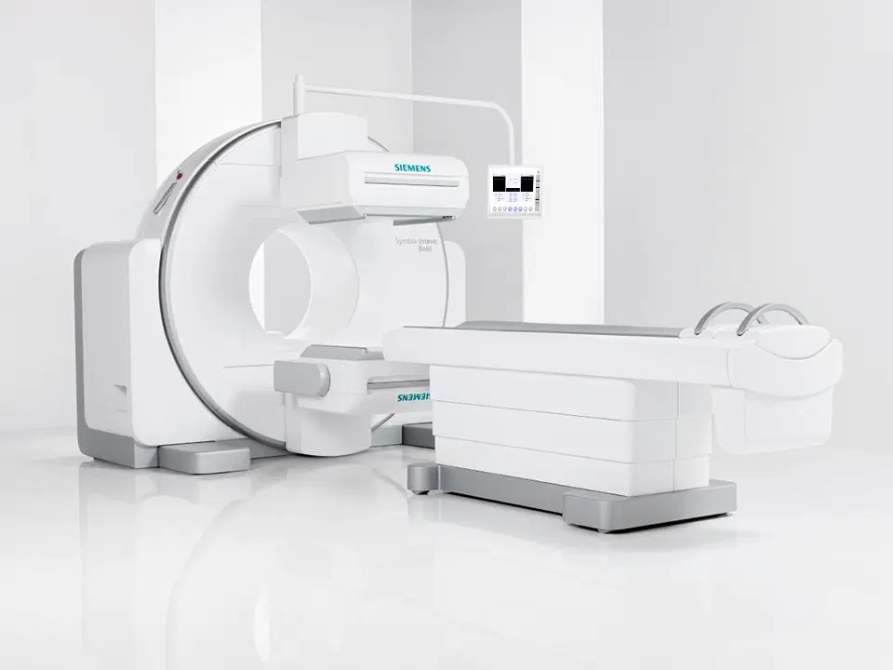
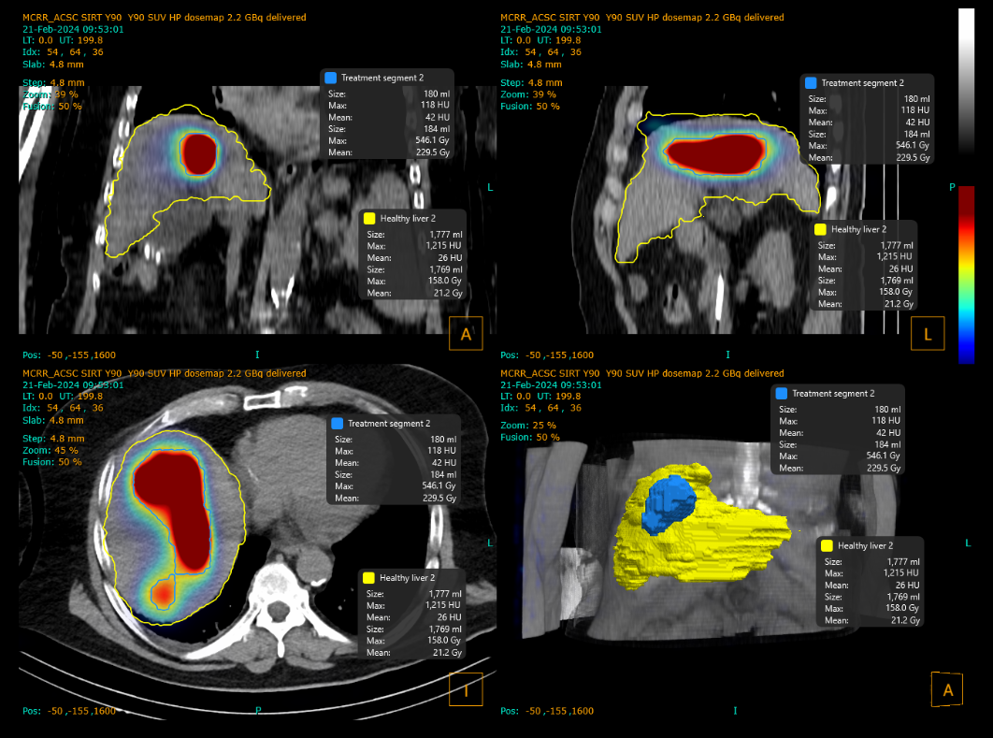
SIRT: Protocol
Workup
Treatment
Map arterial anatomy
Injection of Tc99m-MAA
SPECT-CT
Shunt fraction
Dosimetry calculations
Delivery of Y90

Slide 28
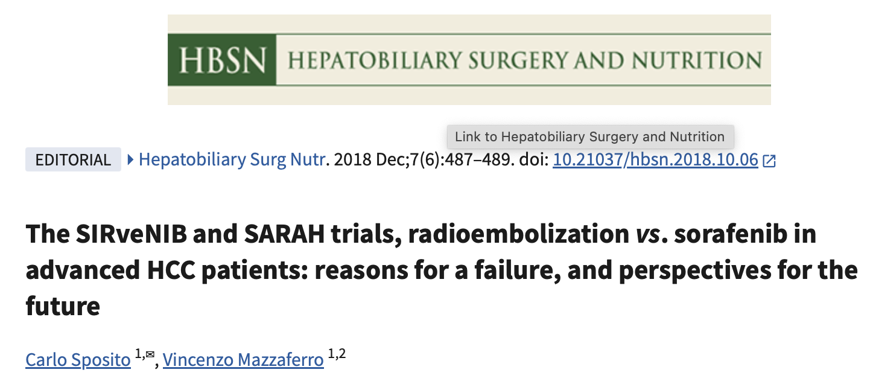
SIRT: Evidence base
SARAH (2017) & SIRveNIB (2018) - SIRT vs Sorafenib. No significant difference in OS. SIRT better tolerated
Notes:
SIRT had a shaky start
Of course Sorafenib is no longer standard of care with Atezolizumab/Bevacizumab
SORAMIC and SIRFLOX- combination therapy

Slide 29
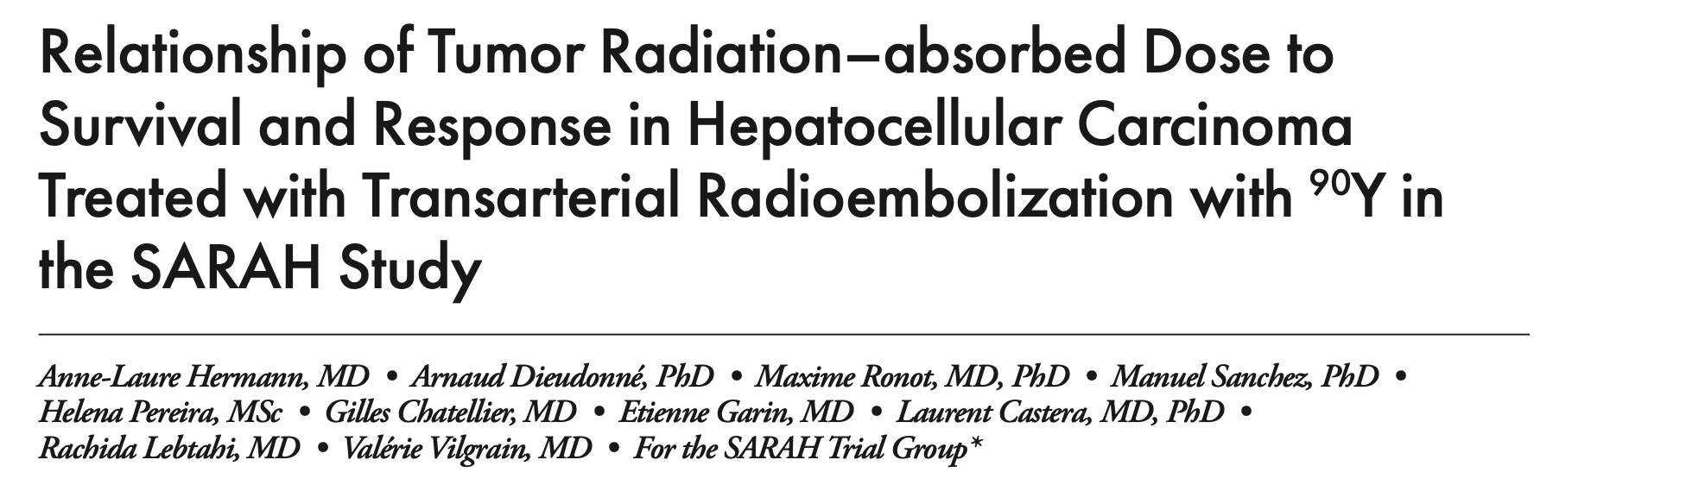
SIRT: Dose-response relationship

Slide 30
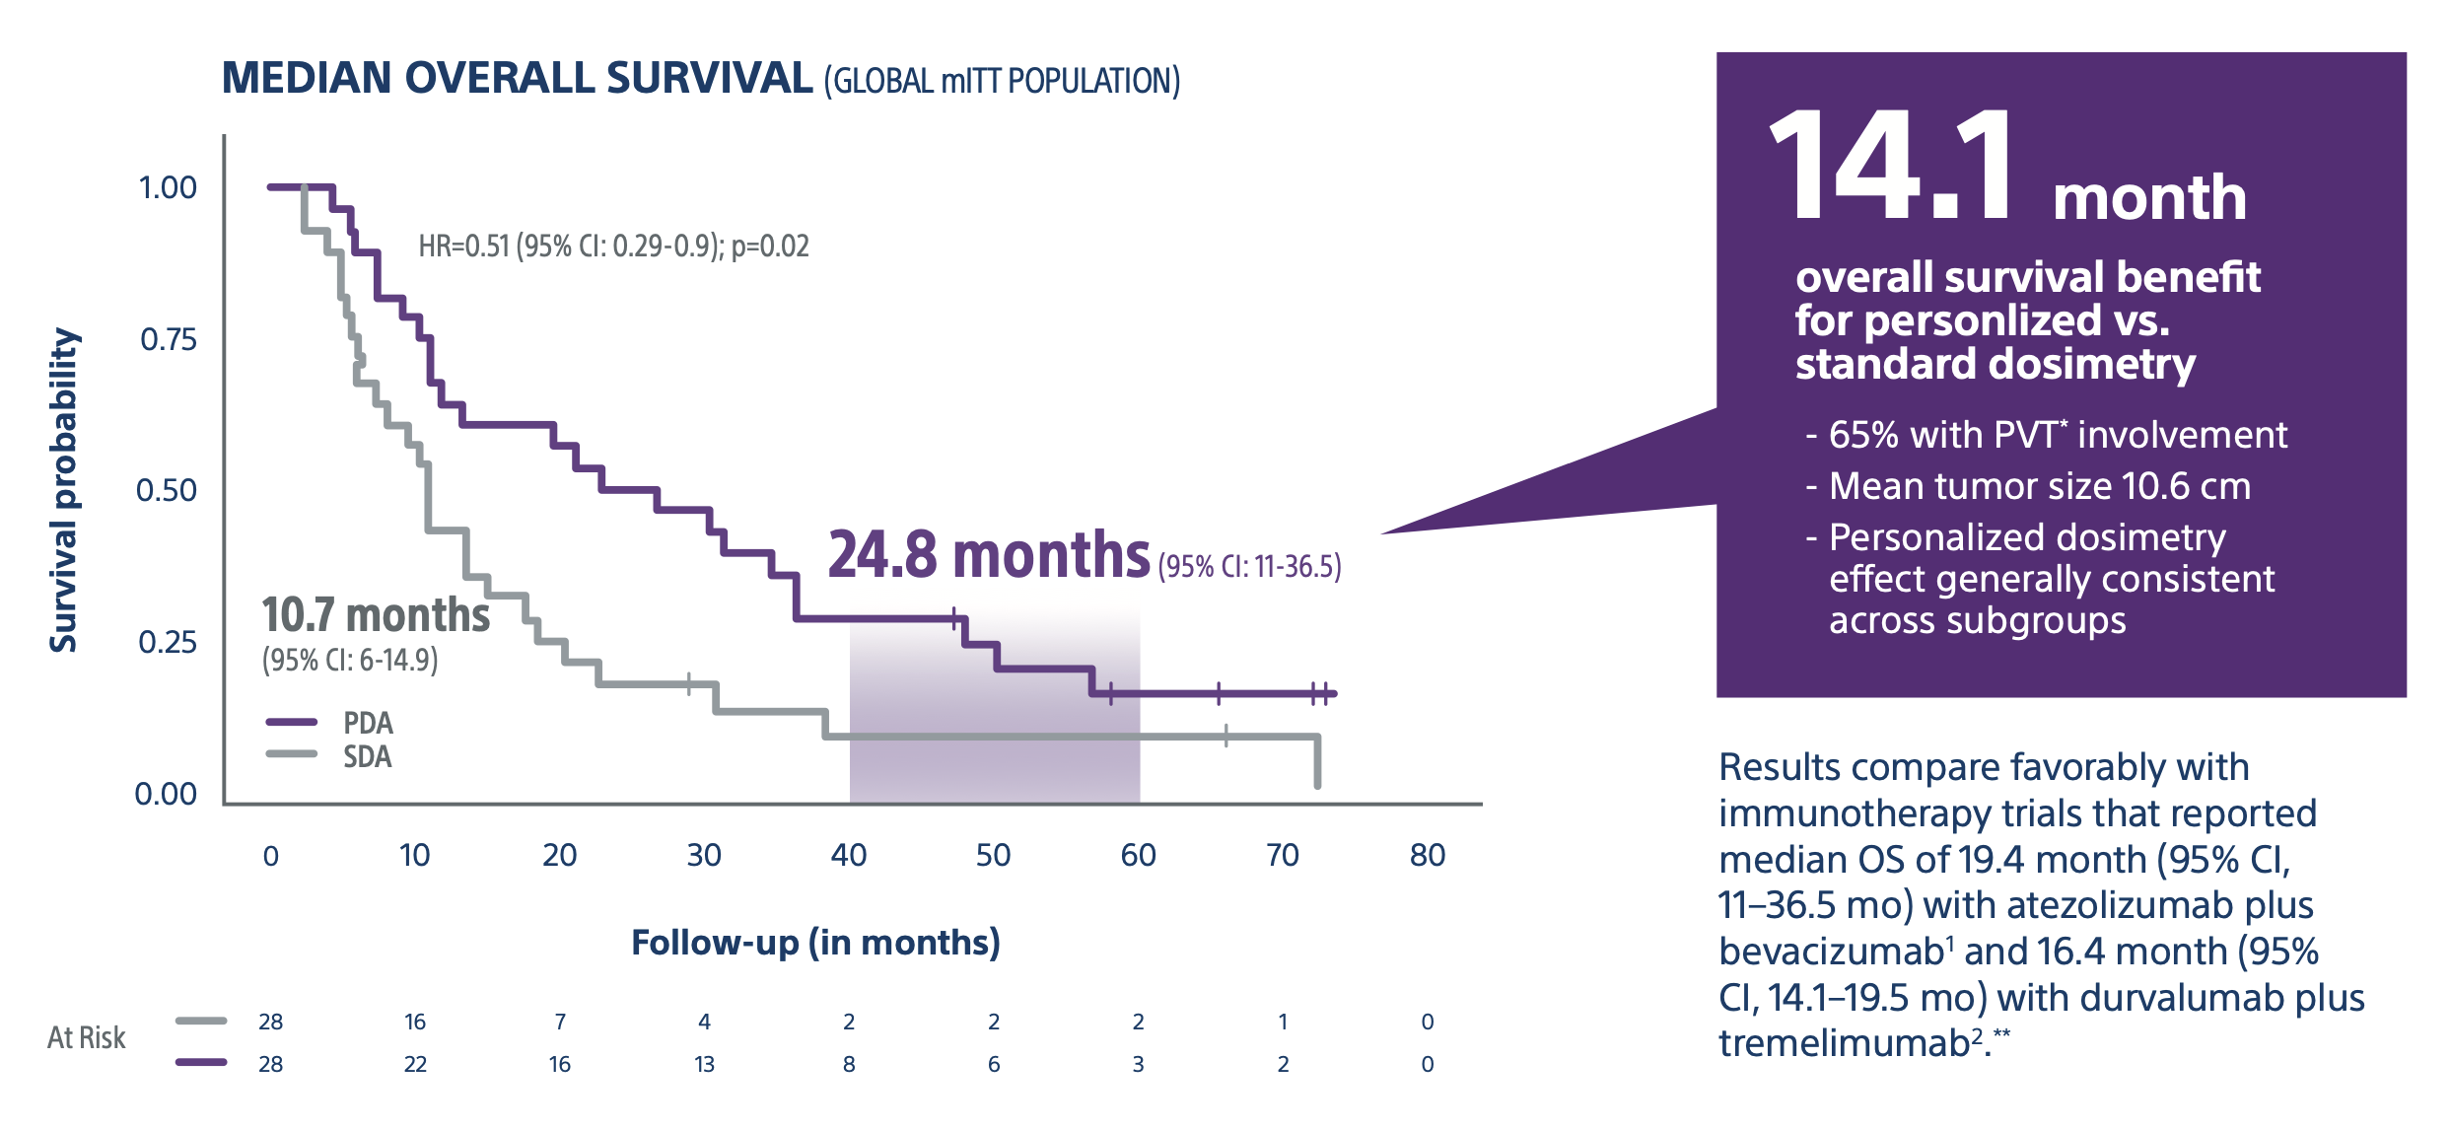
SIRT: Standard vs Personalised Dosimetry
Notes:
Higher dose correlates with higher rates of complete pathological necrosis
Personalised dosimetry is now standard of care across all SIRT sites
An update to Dosisphere was published this year showing sustained response in OS at 5 years

Slide 31
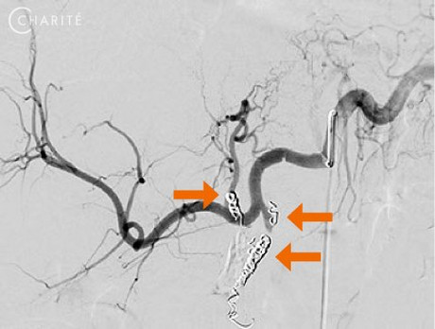
SIRT: Treatment Strategy
Notes:
What else has changed, other than dosimetry?
Radiation segmentectomy - now in the realms of curative SIRT

Slide 32
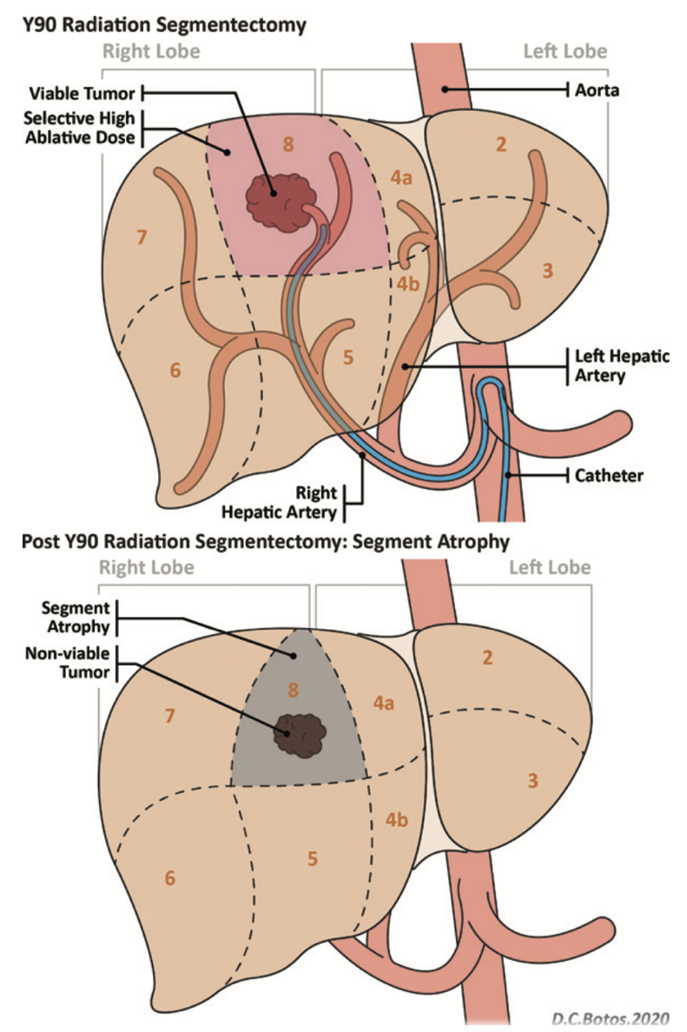
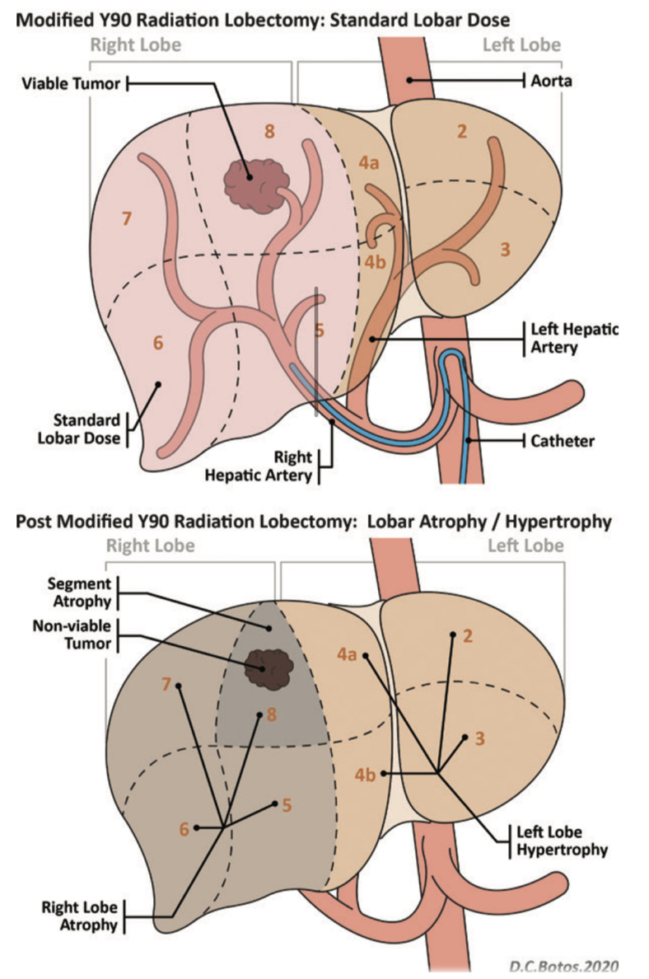
SIRT: Treatment Strategy
Lewandowski et al. Radiographics (2021)
Notes:
Radiation segmentectomy - now in the realms of curative SIRT
Lobectomy - increase the number of patients who can undergo curative resection

Slide 33
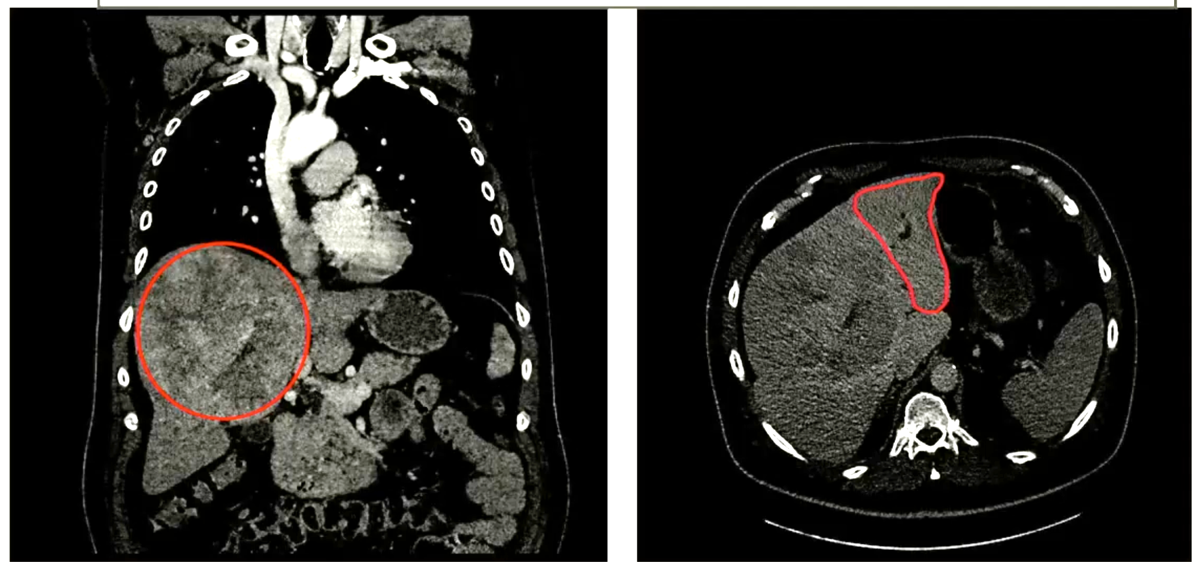
SIRT: Treatment Strategy
Courtesy of Dr P Littler, Newcastle
Notes:
Radiation segmentectomy - now in the realms of curative SIRT
Lobectomy - increase the number of patients who can undergo curative resection

Slide 34
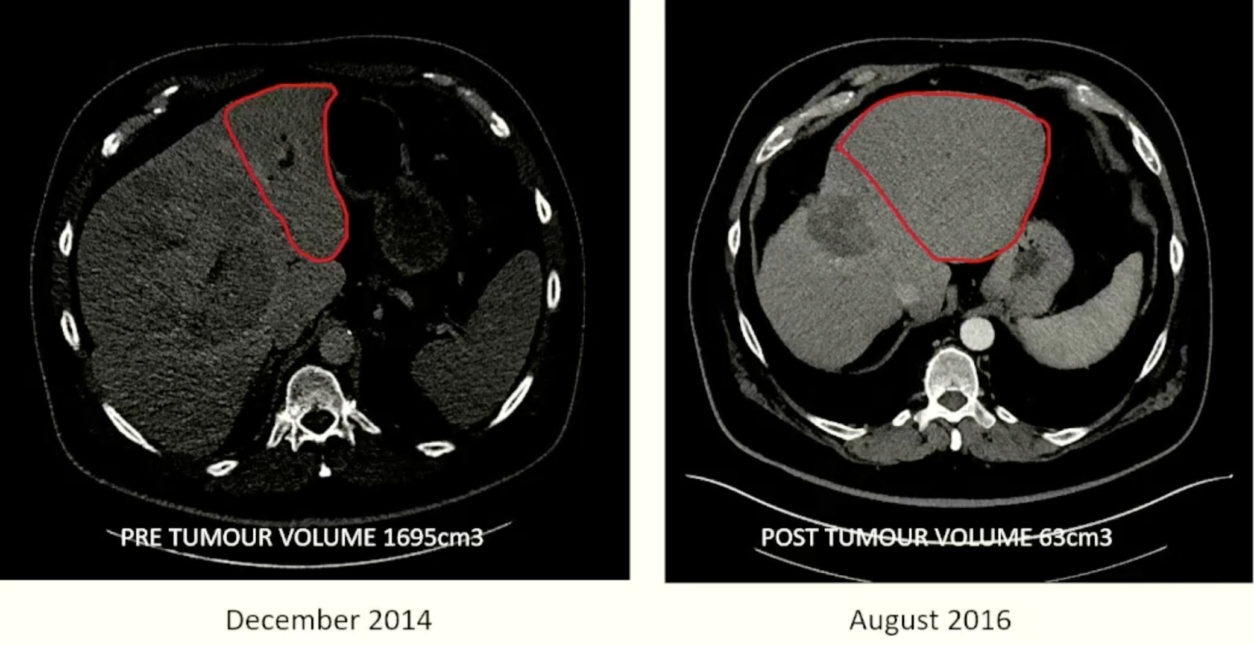
SIRT: Treatment Strategy
Courtesy of Dr P Littler, Newcastle
Notes:
Radiation segmentectomy - now in the realms of curative SIRT
Lobectomy - increase the number of patients who can undergo curative resection

Slide 35
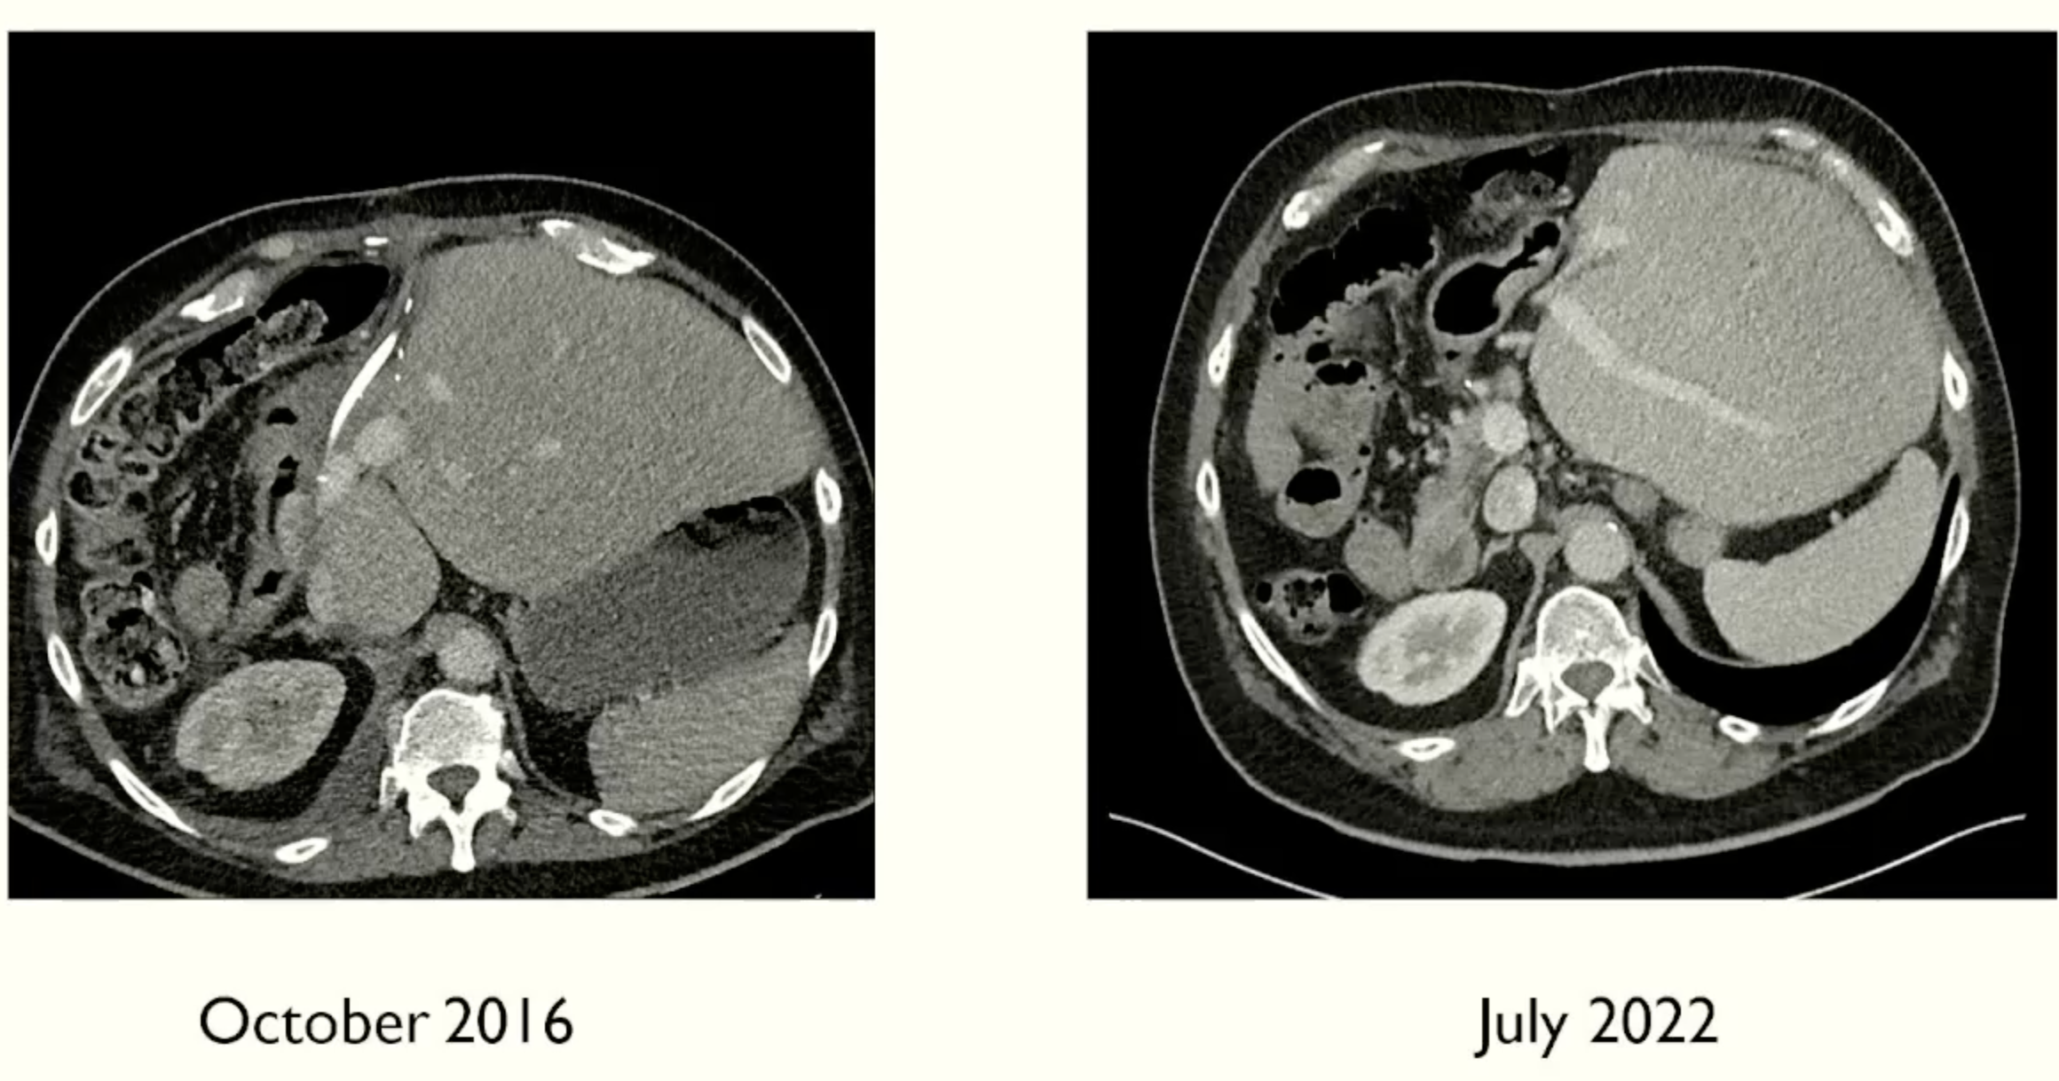
SIRT: Treatment Strategy
Courtesy of Dr P Littler, Newcastle
Notes:
Radiation segmentectomy - now in the realms of curative SIRT
Lobectomy - increase the number of patients who can undergo curative resection

Slide 36
SIRT: Selection Criteria
NICE approval for Y90 SIRT in 2021
Unresectable HCC in adults
Child Pugh A, Good performance status
Inappropriate for conventional transarterial therapies
Notes:
SIRT previously used in England through compassionate schemes

Slide 37
SIRT: Post-treatment SPECT-CT

Slide 38
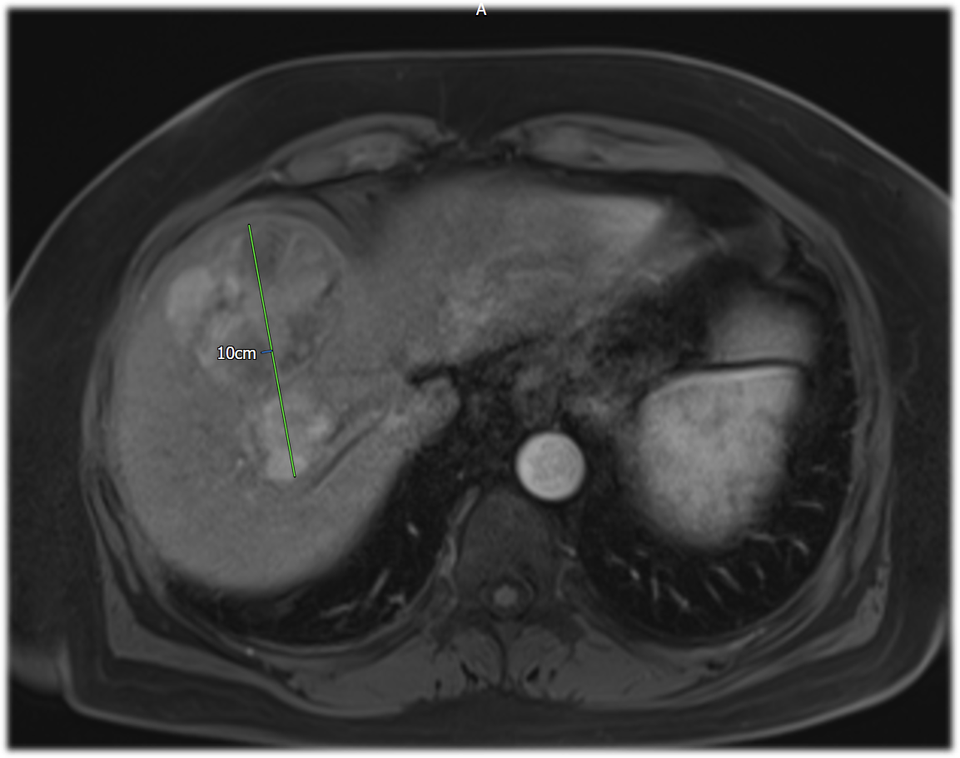
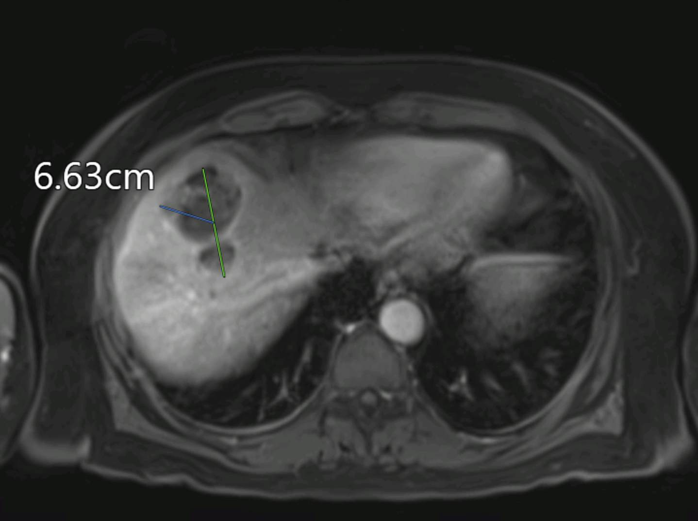
SIRT: Outcomes
Notes:
Cavitation, reduction in size and devascularisation
The best response is seen after 6 months

Slide 39
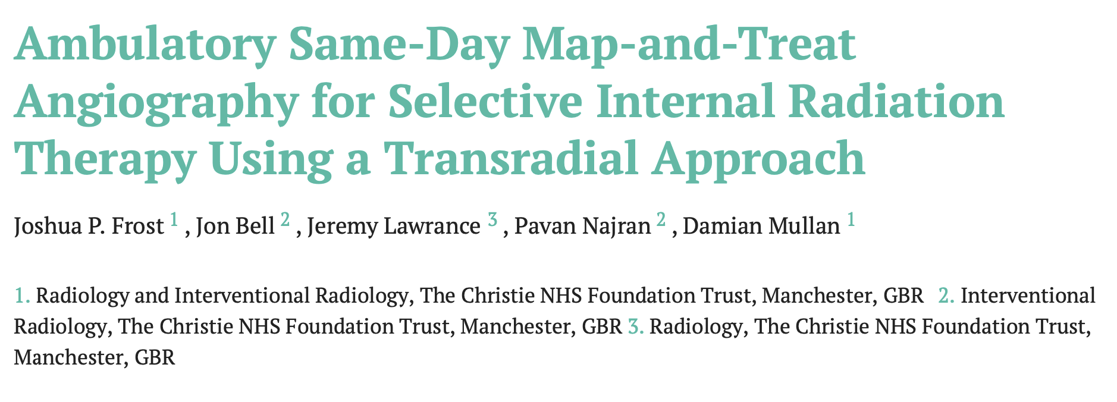
SIRT: Future Directions

Slide 40
Summary
Standardisation of intra-arterial therapies is key
Novel intra-arterial devices and embolic agents
Combination locoregional therapy carries a high level of evidence
Personalised dosimetry in SIRT
Notes:
Personalised dosimetry, along with maturation of treatment strategies has revolutionised SIRT, and we are likely to see more of in the coming years.

Slide 41
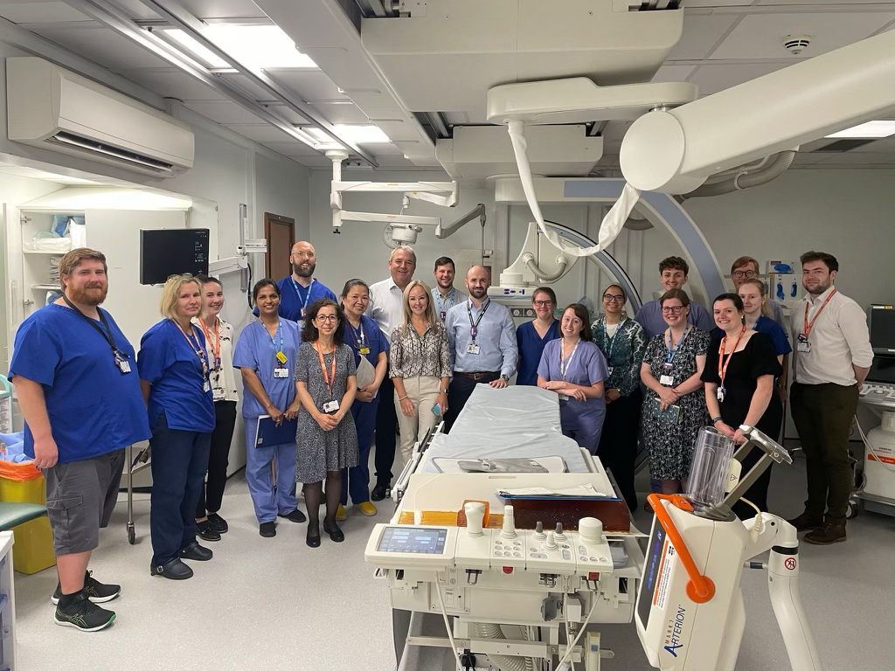
Notes:
And finally my thanks go to every member of the team in IR, nuclear medicine and medical physics.
SIRT has many moving parts and would not be possible without every single individual. Thank you

