Slide 1
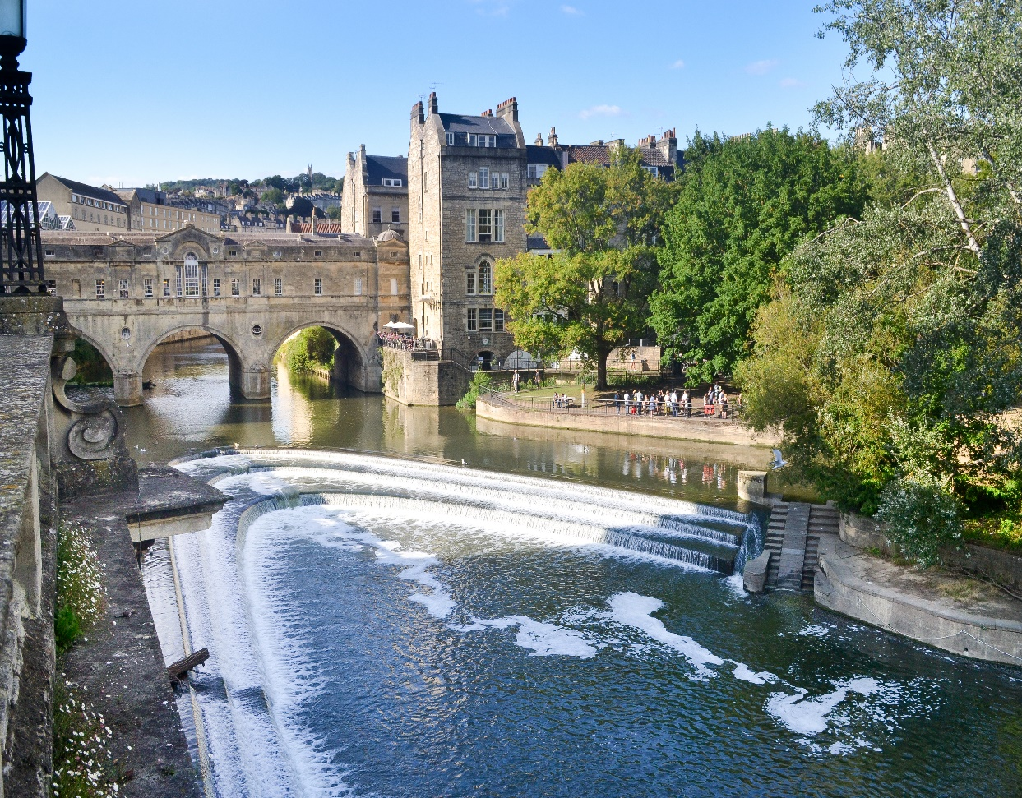

HELP CUP programme with Roche
Tania Tillett – Medical Oncologist

Slide 2
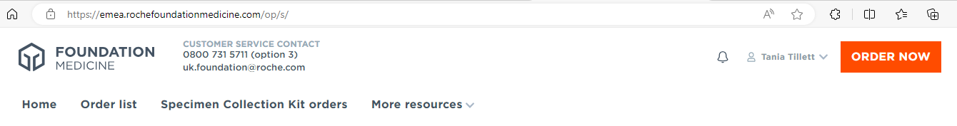
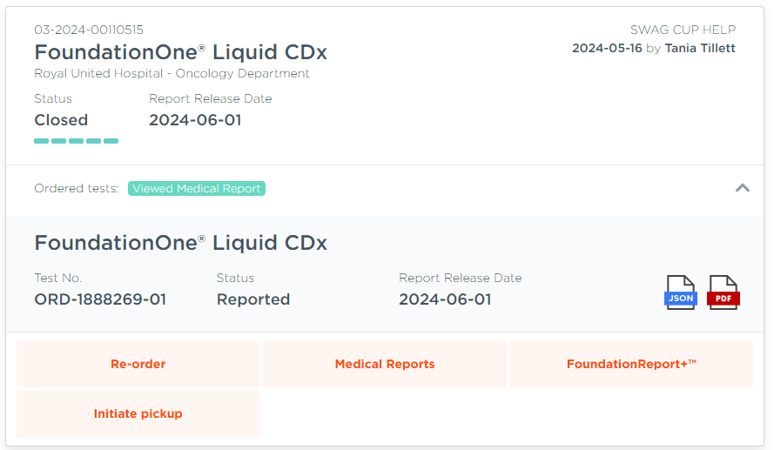
HELP programme CUP
http://www.foundationmedicine.co.uk/

Slide 3
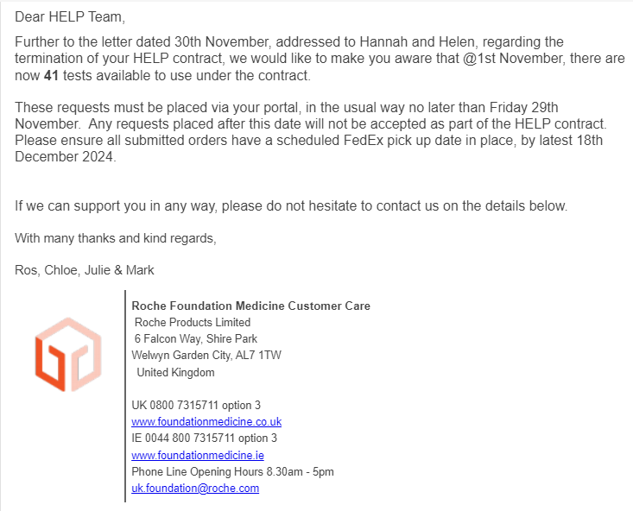

Slide 4
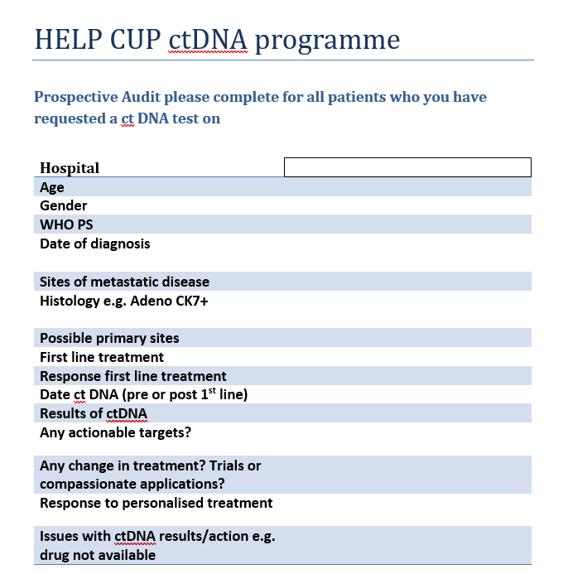
Complete audit form

