Slide 1

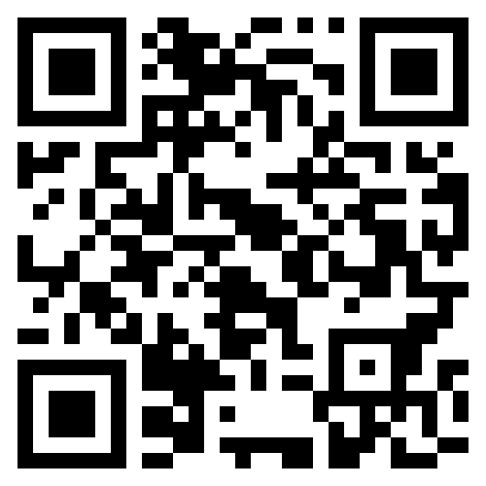




IOCN and Vumedi Collaboration
The IOCN is delighted to announce a new collaboration with Vumedi.
With 800,000 registered users and 65,000 contributed videos, Vumedi is the world’s largest video education platform for physicians and HCPs. Vumedi’s mission is to help clinicians make optimal patient care decisions through comprehensive video education from a variety of trustworthy institutions and practitioners.
Sign up for free at https://www.vumedi.com/ to access our webinar recordings
Visit our IOCN dedicated page here
While we strive to ensure all webinars are recorded and available for later viewing, we strongly advise attending sessions live whenever possible. Due to potential technical issues or IT limitations, we cannot guarantee that recordings will be successful or accessible after the event. Thank you for your understanding. Information and discussion is the opinion of the panel members and is correct at the date of recording.
www.ioclinicalnetwork.co.uk
Supporting Those Receiving Immunotherapy by Supporting Those Delivering it
P.00

