Slide 1
Non-invasive testing for clinically significant portal hypertension: Is this the end for endoscopy?
Dr Gau Appanna
South-West HPB Scientific Meeting
Friday 22nd November 2024

Slide 2
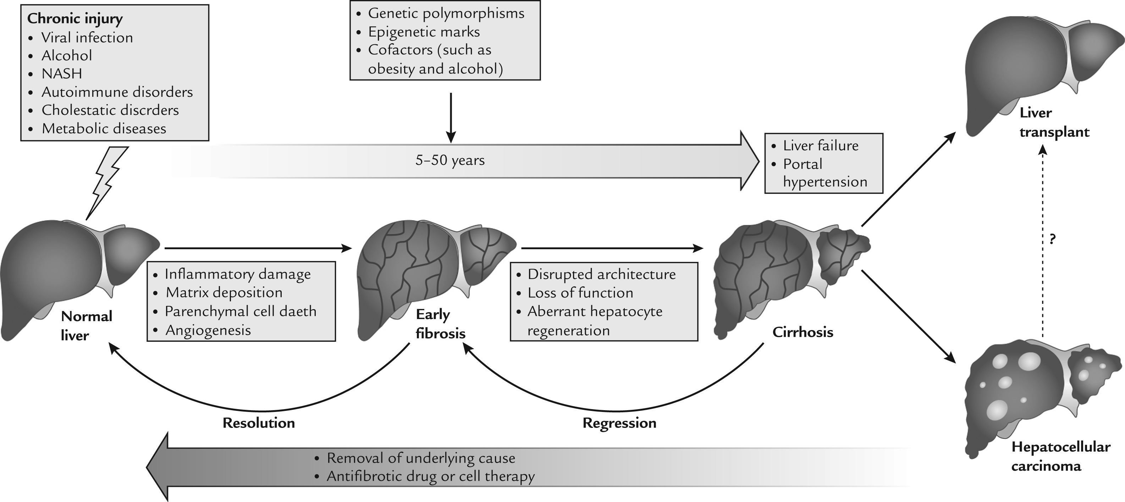
Portal hypertension
In the natural history of chronic liver diseases, development of portal hypertension is the earliest complication, with clinically significant portal hypertension (CSPH) being the key driver of increased risk of hepatic decompensation
Muir et al. Clinial Therapeutics (2015)

Slide 3
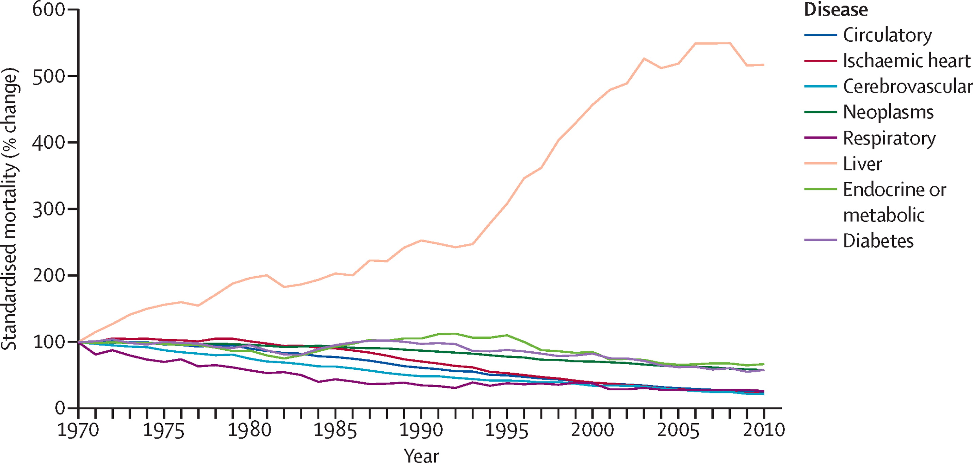
The burden of liver disease
Williams et al. Lancet (2024)

Slide 4
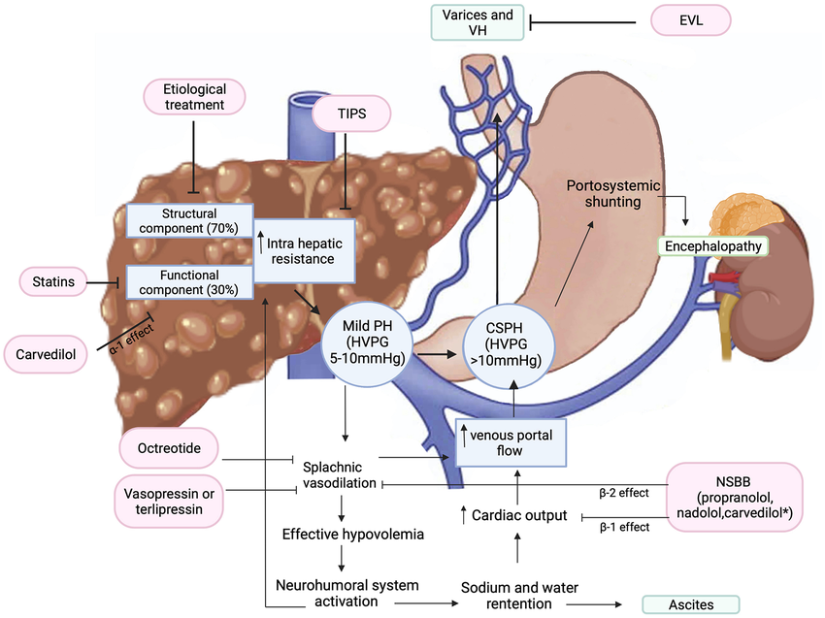
Pathophysiology of Portal Hypertension
Increased intrahepatic resistance due to fibrosis.
Splanchnic vasodilation and increased portal blood flow.
Role of CSPH in predicting:
Oesophageal varices.
Risk of bleeding and mortality.

Slide 5
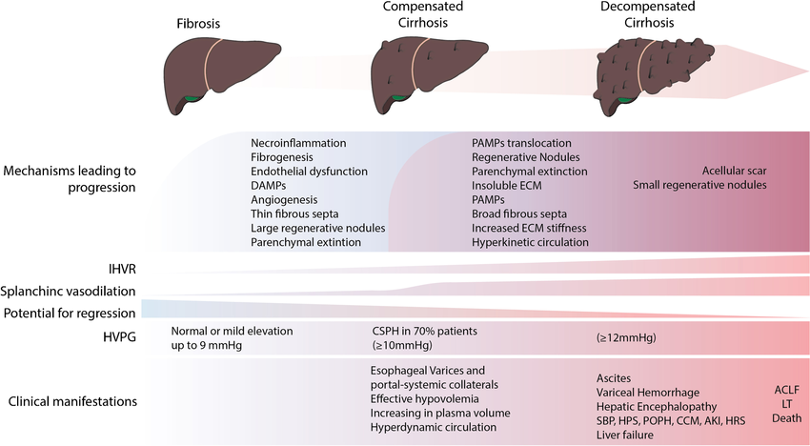
Cirrhosis and Portal Hypertension
Felli et al. Current Hepatology Reports (2023)

Slide 6
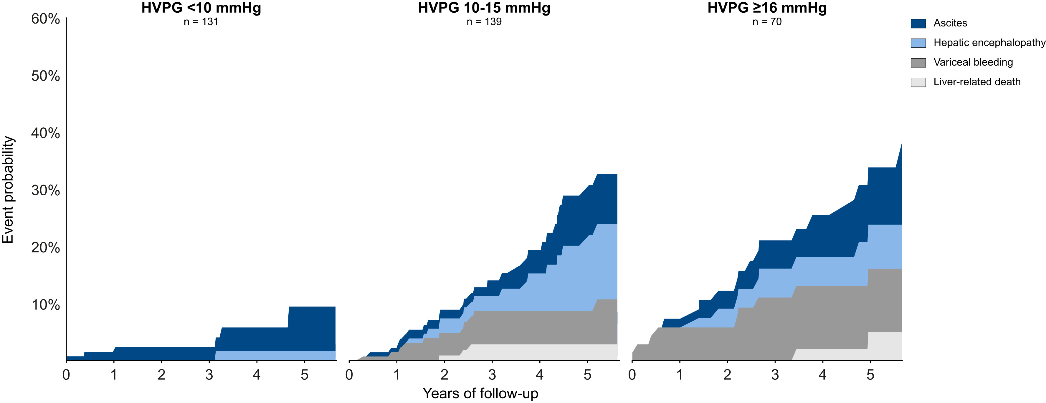
Why is this important in cirrhosis?
Paternostro et al. J Hepatology (2024)

Slide 7
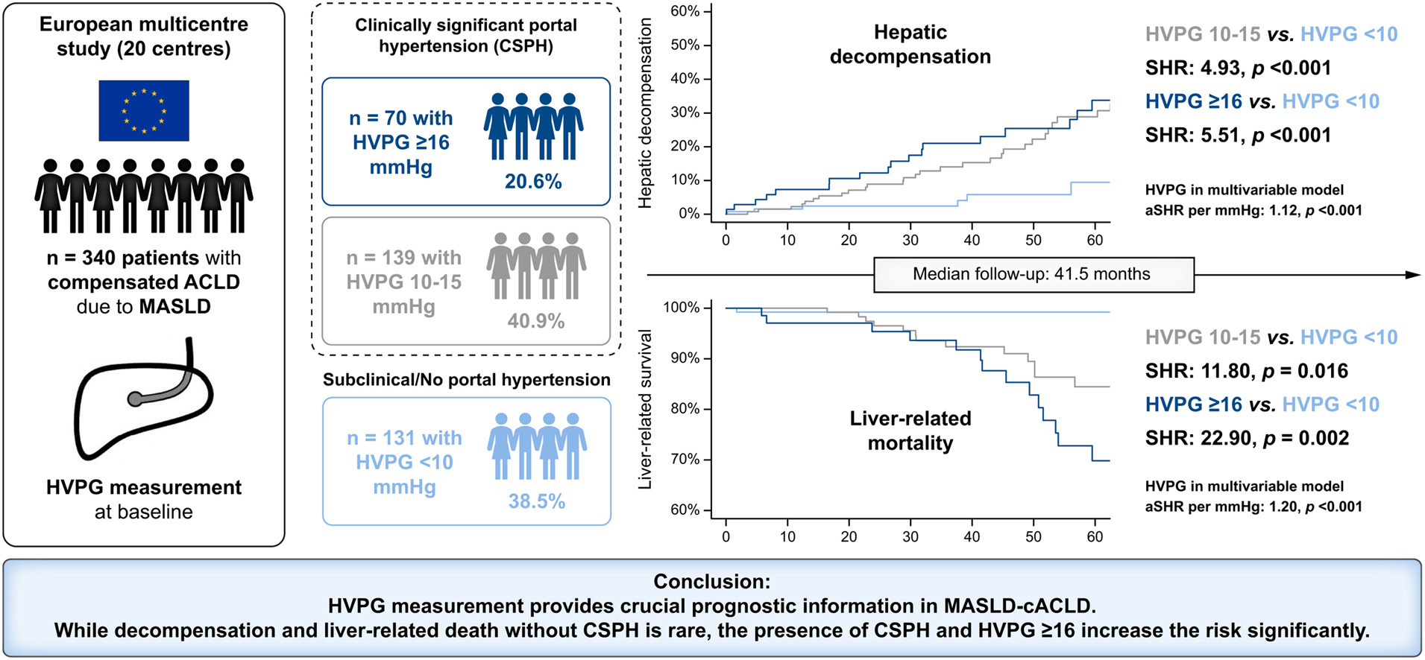
Why is this important in cirrhosis?
Paternostro et al. J Hepatology (2024)

Slide 8
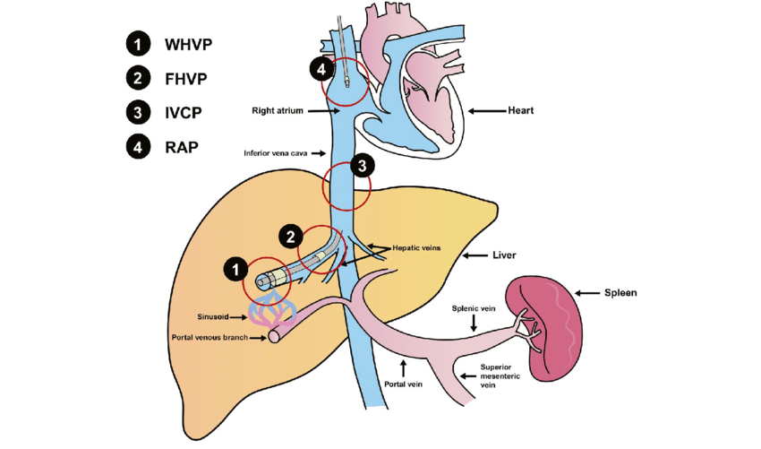
Current Methods for Assessing CSPH
→ Invasive methods:
- HVPG: Accurate but requires catheterisation and expertise.
Endoscopy: Used for variceal screening but resource-intensive.
→ Limitations:
Risk of complications.
Limited accessibility in low-resource settings.
Patient reluctance due to discomfort.

Slide 9
Key Points
Portal hypertension (PH) is a major complication of chronic liver disease.
Clinically significant portal hypertension (CSPH) increases the risk of variceal bleeding and hepatic decompensation.
Impact on other treatments: surgery
Gold standard: Hepatic venous pressure gradient (HVPG) measurement and endoscopy.
Problem: Invasiveness, cost, and patient discomfort.
We therefore need better ways of addressing this.

Slide 10
Non-Invasive Testing Methods
Imaging techniques:
Doppler ultrasound: Portal vein flow and congestion index.
Elastography (FibroScan®): Liver stiffness measurement (LSM).
MRI: Collateral circulation and hemodynamics.
Biomarkers:
Platelet count, spleen diameter, and serum markers.
Examples: AST-to-platelet ratio index (APRI), Fibrosis-4 index (FIB-4).
Composite models:
Baveno VI criteria: Platelets >150 × 10^9/L and LSM <20 kPa.
Expanded Baveno VI: Recent adaptations improving sensitivity.

Slide 11
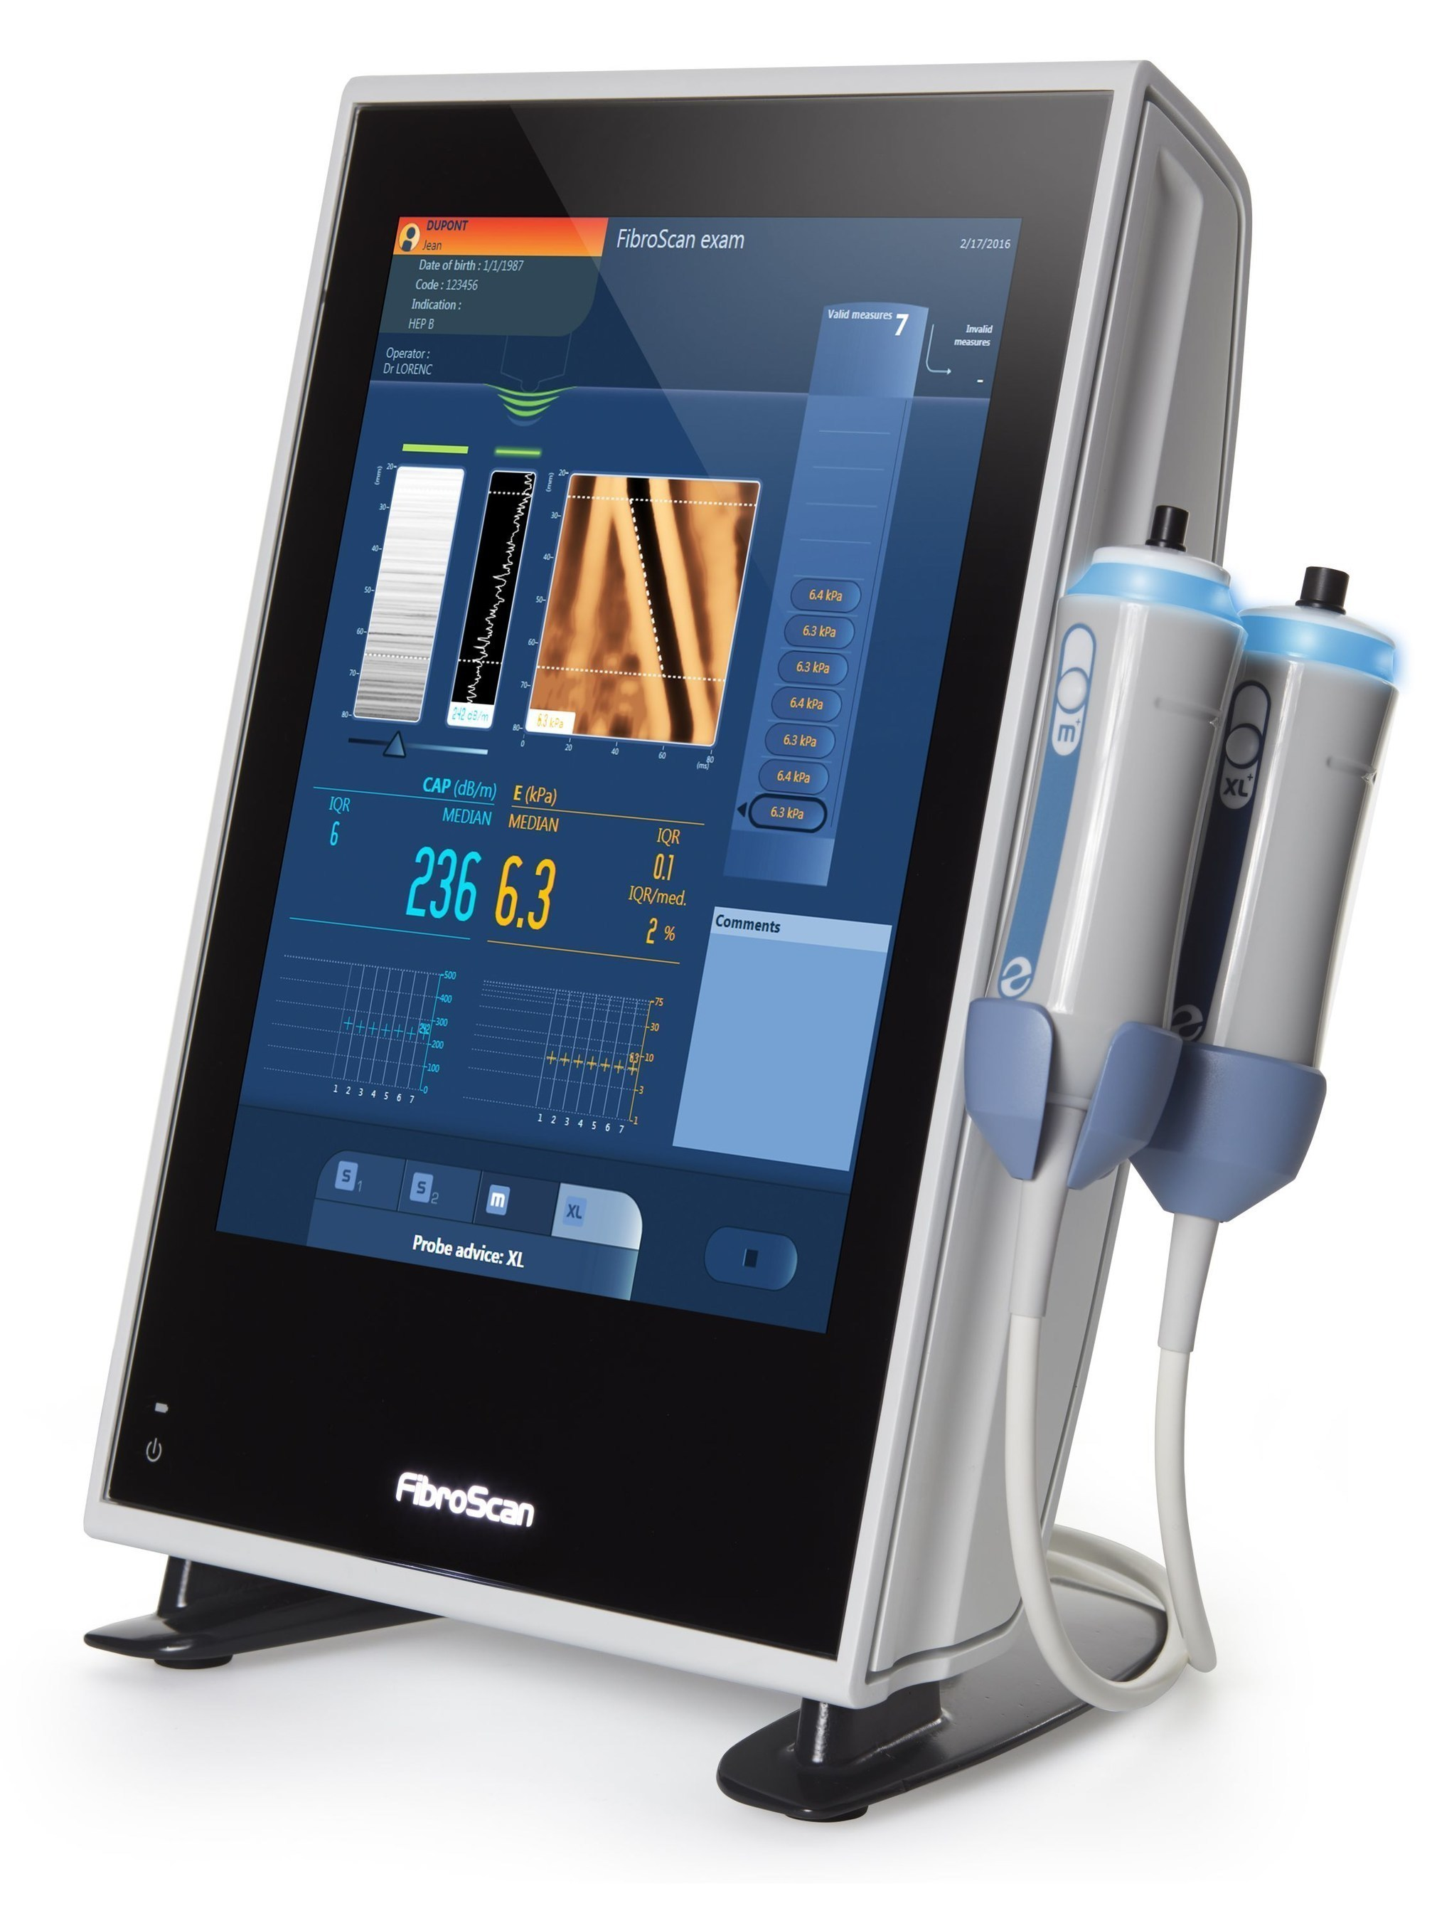
Elastography as a Game-Changer!
LSM correlates well with CSPH thresholds (e.g., LSM >25 kPa indicates high CSPH risk).
Advantages:
Non-invasive.
Easily repeatable.
High negative predictive value for varices needing treatment (VNT).

Slide 12
Biomarkers and Composite Models
APRI and FIB-4: Widely used for liver fibrosis, now applied to CSPH.
Limitations:
Overlap in cut-offs for severe vs. mild disease.
Affected by other comorbidities (e.g., thrombocytopenia from other causes).

Slide 13
Evidence Supporting Non-Invasive Methods
Meta-analysis of studies comparing elastography to HVPG and endoscopy:
Sensitivity and specificity for LSM in identifying CSPH.
Expanded Baveno VI criteria:
Reduced unnecessary endoscopies by up to 40%.

Slide 14
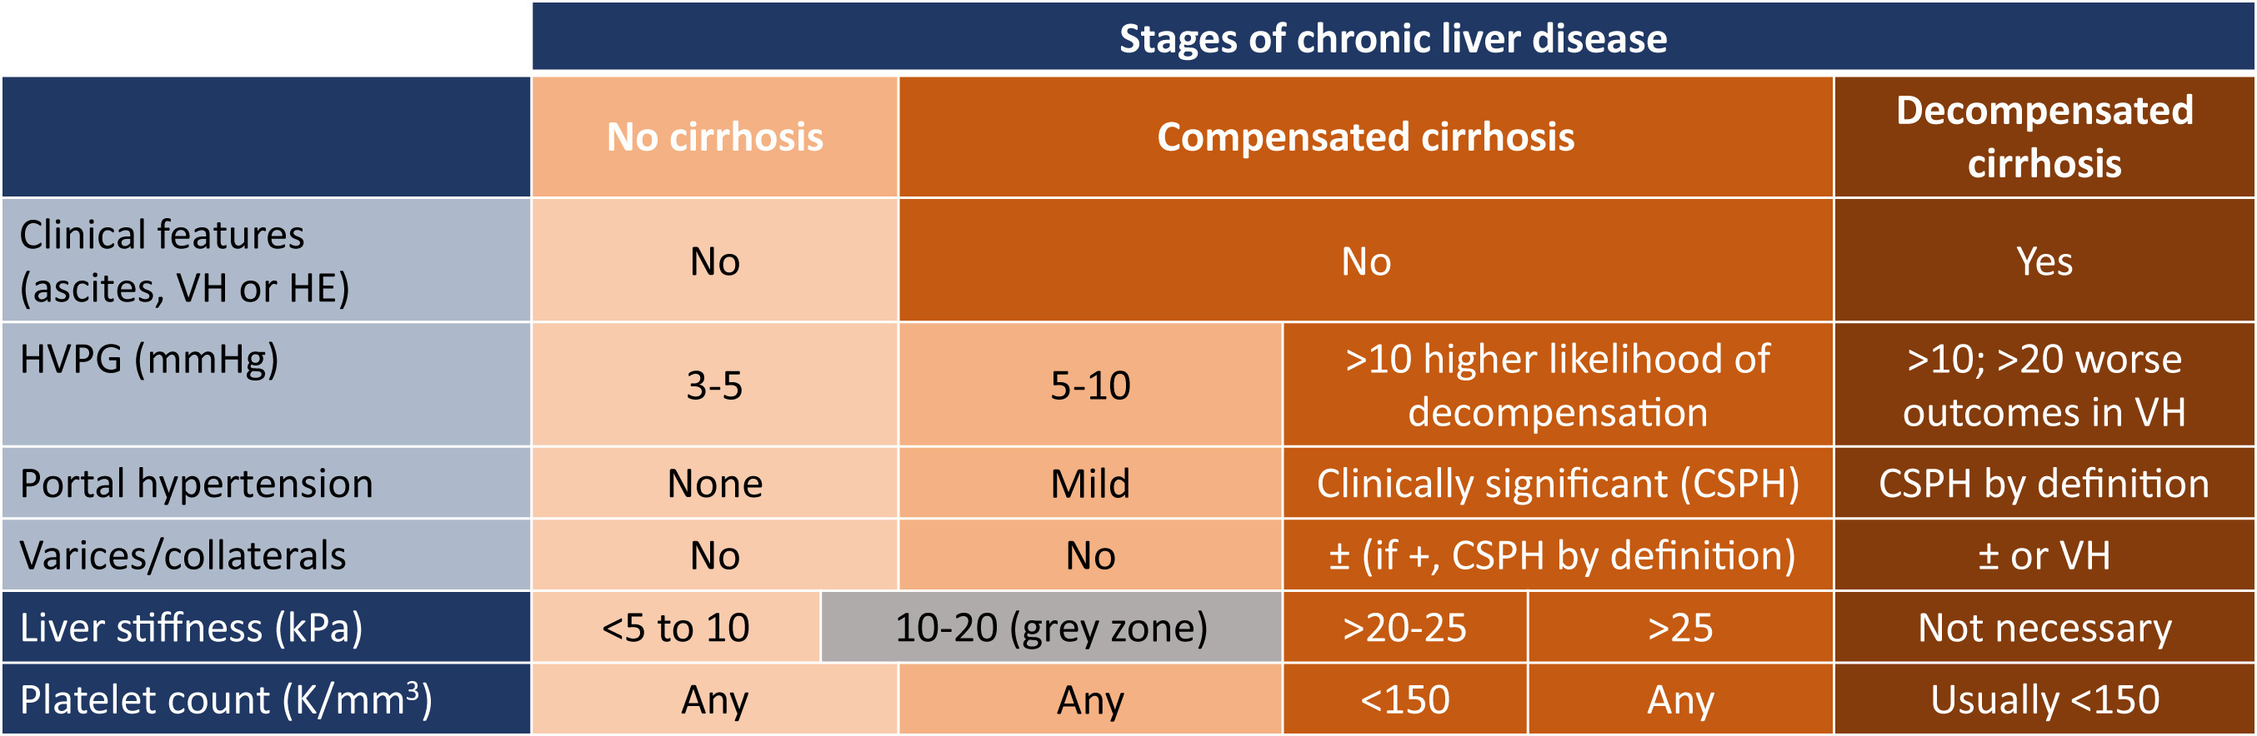
Evidence through Baveno VI
Garcia-Tsao, Abraldes. Gastroenterology (2021)

Slide 15
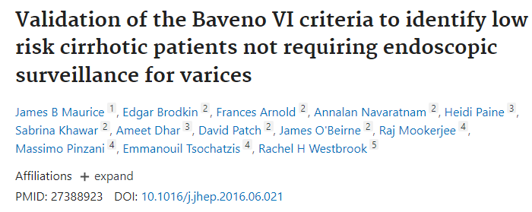
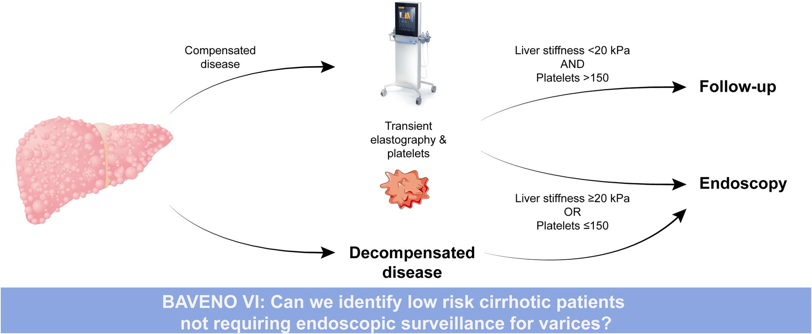
Validation of Baveno VI
Baveno VI criteria performed well correctly identifying 98% of patients who could safely avoid endoscopy

Slide 16
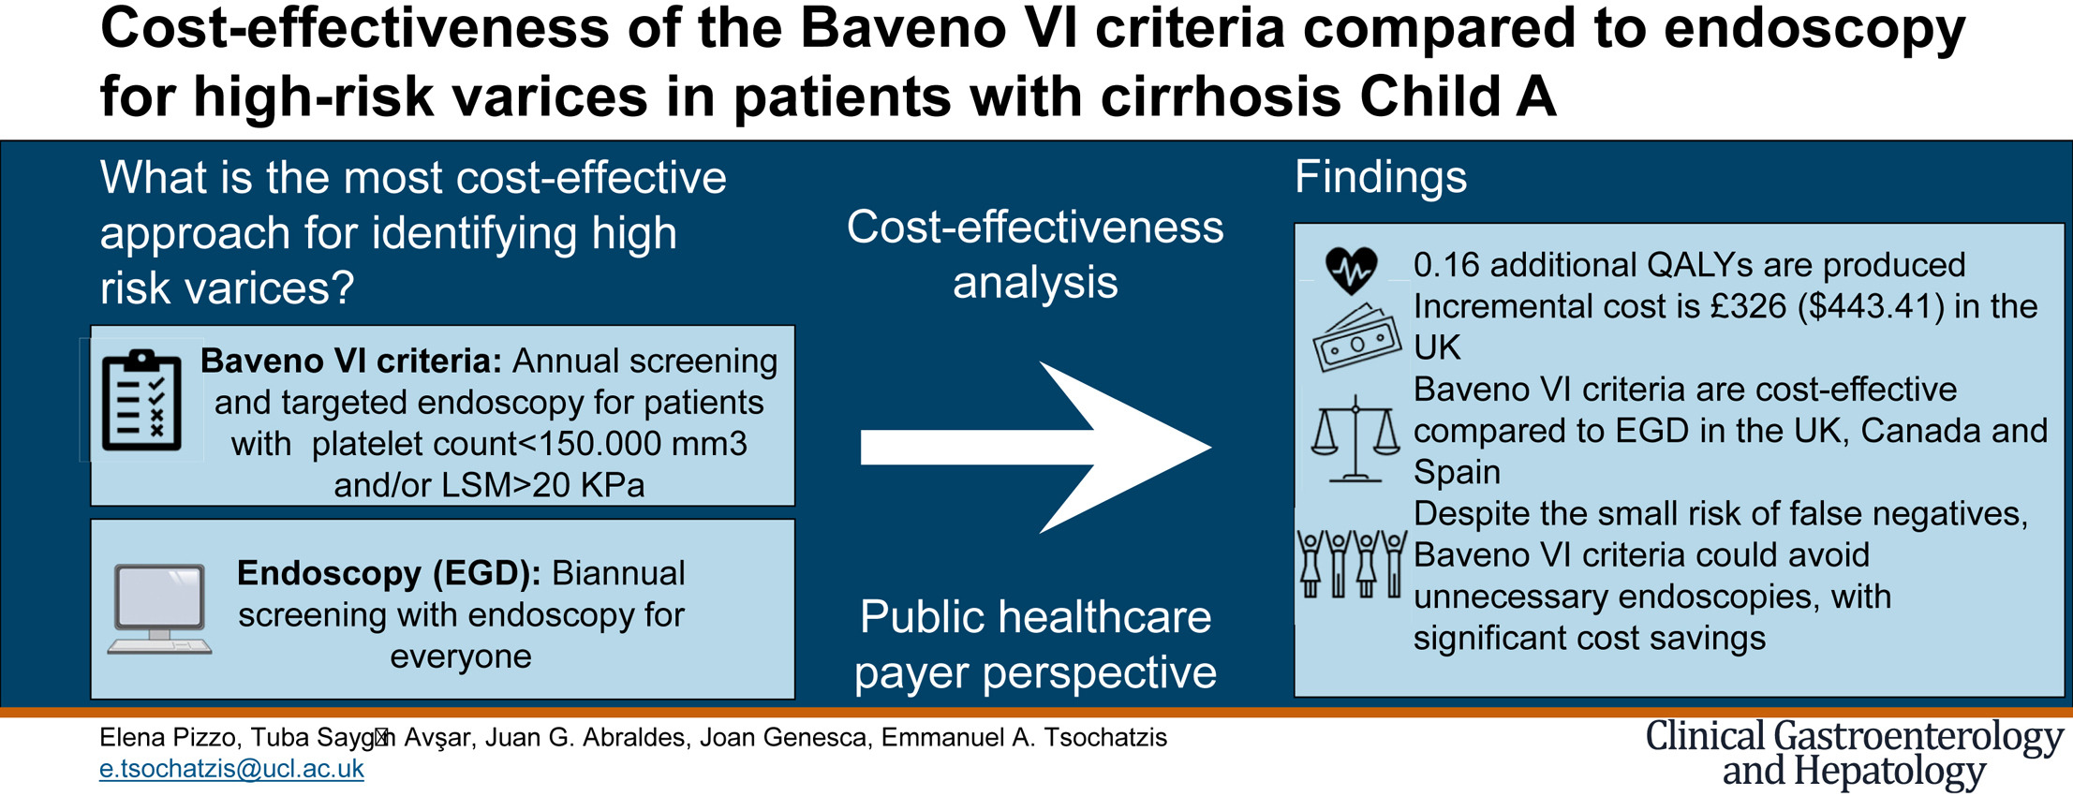
Cost effectiveness
For 1000 patients
Produced 0.16 additional QALYs at an incremental cost of £326 ($443.41) over 5 years, resulting in an incremental cost of £2081 ($2830) per additional QALY gained.
The incremental net monetary benefit of Baveno VI compared with OGD was £2808 ($3819) over 5 years per patient. Baveno VI criteria also were cost effective in Canada and Spain.

Slide 17
Benefits of Non-Invasive Methods
For Patients:
Less discomfort and risk.
Lower cost.
Suitable for repeated monitoring.
For Healthcare Systems:
Reduced burden on endoscopy services.
Accessible in remote or resource-limited settings.

Slide 18
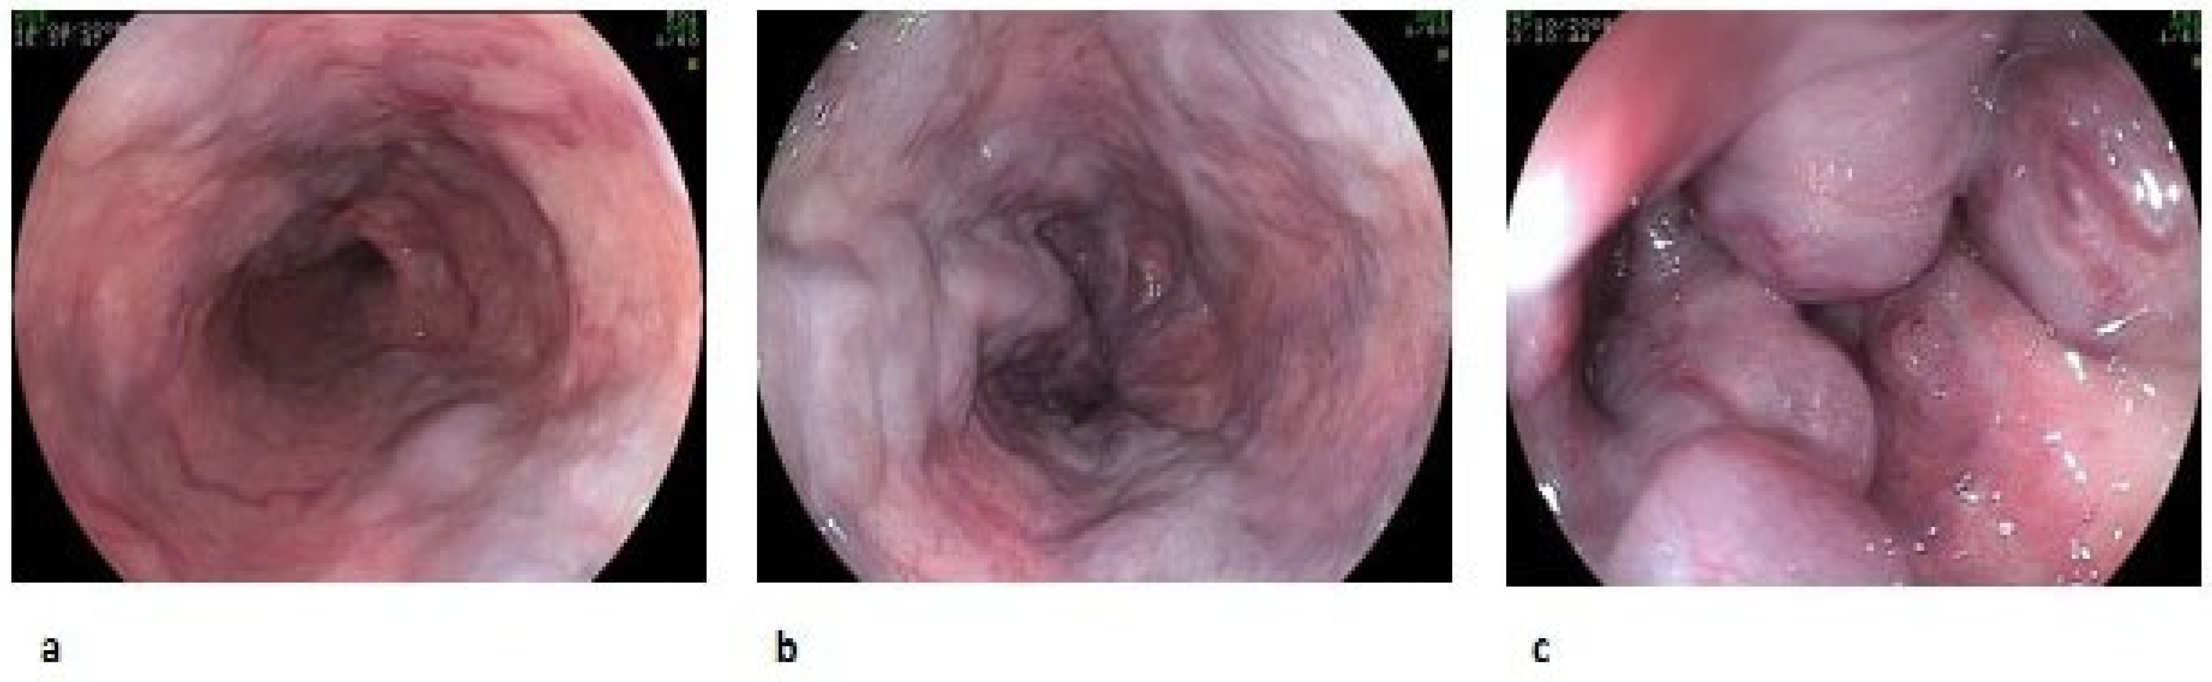
Limitations of Non-Invasive Testing
Cannot directly confirm variceal bleeding risk.
Variability in accuracy across different populations.
Need for standardisation of thresholds.

Slide 19
Hybrid Approaches
Combining non-invasive methods with selective endoscopy:
Use non-invasive tests to stratify risk.
Reserve endoscopy for high-risk cases or those with inconclusive results.

Slide 20
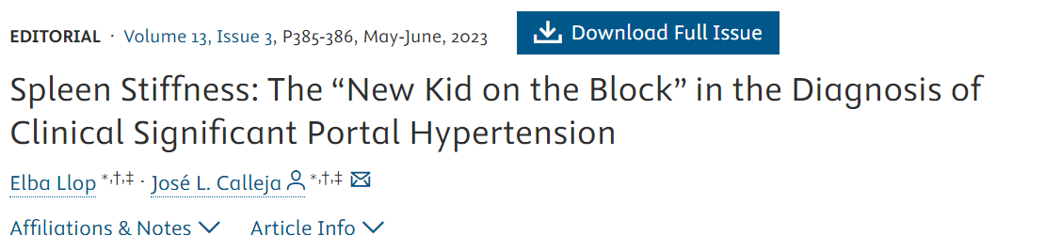
Splenic stiffness: NKOTB

Slide 21
Recommendations through Baveno VI
Garcia-Tsao, Abraldes. Gastroenterology (2021)

Slide 22
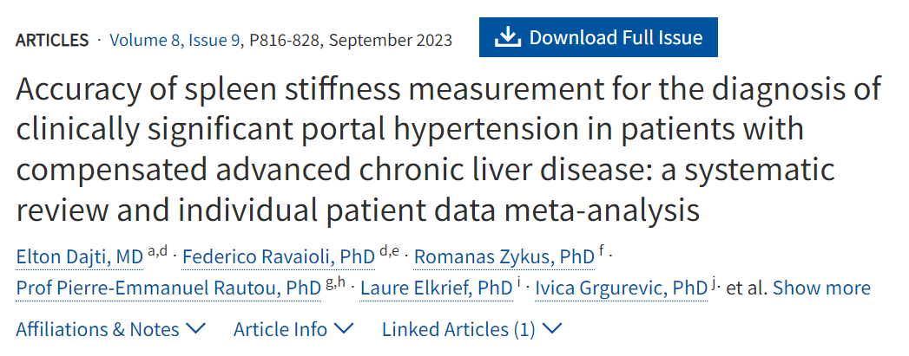
Splenic stiffness
The ‘grey zone’
Development of CSPH when Fibroscan < 20 kPa

Slide 23
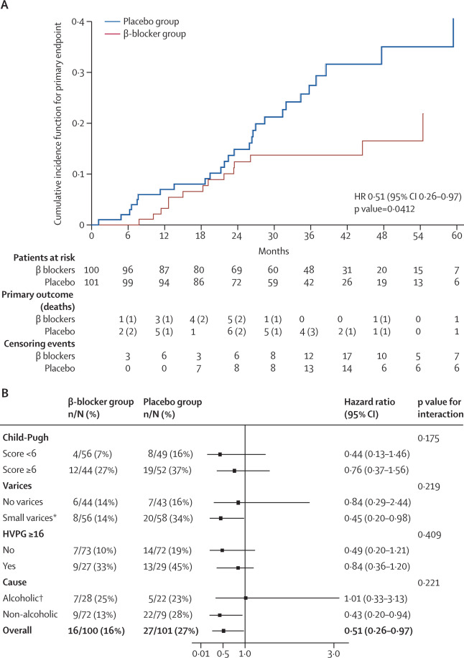
Identifying CSPH: What next?
Reduce pressure?
PREDESCI trial (Propranolol and Carvedilol for Preventing Decompensation in Cirrhosis)
Significant reduction in HVPG with carvedilol compared to propranolol
Decompensation or death occurred in 16% of patients receiving beta-blockers versus 27% in the placebo group (Hazard Ratio [HR] 0.51, p=0.04)

Slide 24
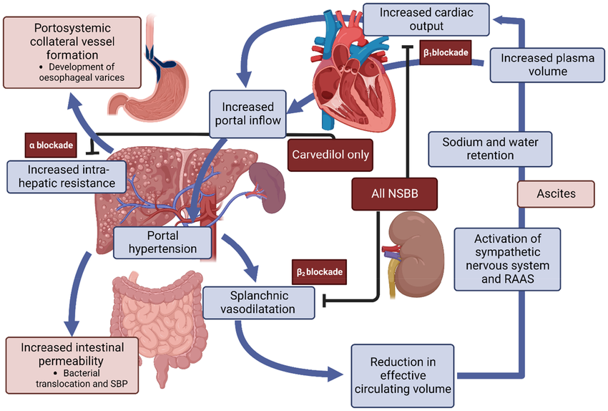
Beta blockers in CSPH
Gillespie et al. AP&T (2023)

Slide 25
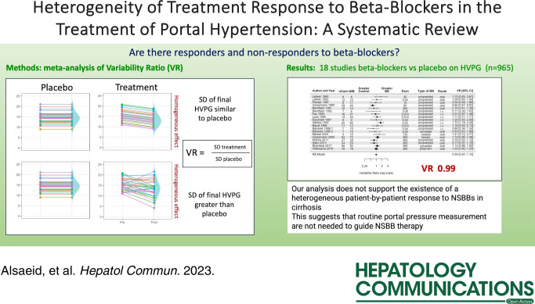
Effect of beta blockers

Slide 26
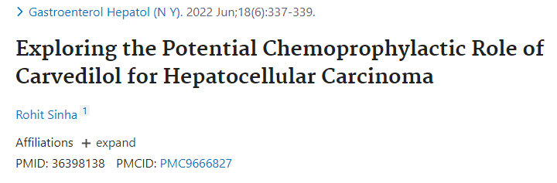
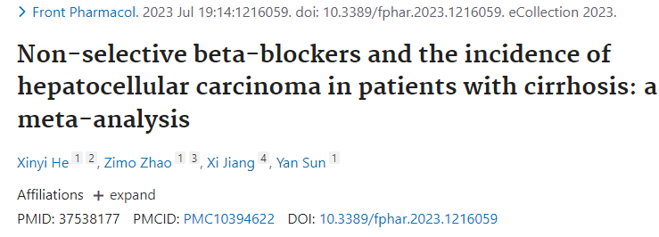
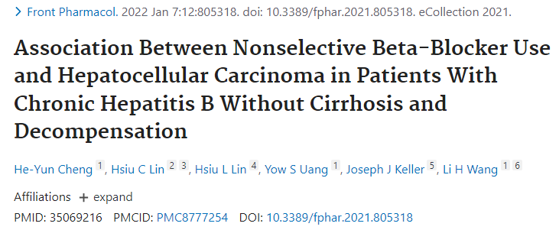
Carvedilol and HCC development

Slide 27
Carvedilol and HCC development
Link Between Carvedilol and HCC Development
Anti-Cancer Properties: Preclinical and some clinical studies have suggested that carvedilol may have anti-cancer properties:
Antioxidant Effects: Carvedilol exhibits antioxidant properties, reducing oxidative stress, which is a known contributor to the development of HCC.
Anti-Proliferative Activity: It has been shown to inhibit the growth and proliferation of cancer cells in vitro.
Anti-Angiogenic Effects: Carvedilol may reduce angiogenesis, the formation of new blood vessels, which is crucial for tumour growth and metastasis.

Slide 28
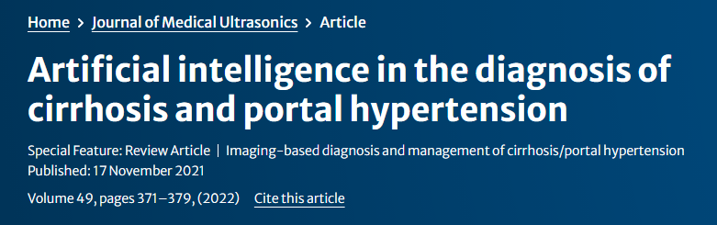
Future Directions
Enhanced imaging modalities (AI-assisted interpretation, 4D flow MRI).
Novel biomarkers targeting pathophysiological pathways.
Integration into liver disease management guidelines.

Slide 29
Discussion: The End for Endoscopy?
Endoscopy remains critical for high-risk and symptomatic patients.
Non-invasive methods show promise for low-risk stratification and regular monitoring.
Likely outcome: Complementary roles rather than complete replacement.

Slide 30
Conclusion
Non-invasive tests are revolutionizing CSPH assessment.
These methods reduce the need for invasive procedures in many cases.
Continued research is essential for validation and integration.

