Slide 1
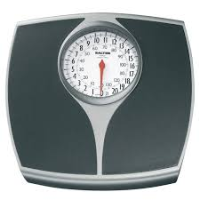
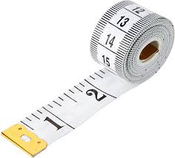
Obesity and the Upper GI Surgical Pathway
Sarah Perkins Tom Lander
Natasha Morris

Slide 2
Contents
What we want
What we’ve got
How can we use what we’ve got to get closer to what we want?
Proposed model
Potential challenges
What next?
Questions/ discussion

Slide 3
What we want
Bespoke nutritional intervention along the pathway, tailored to patient needs
Nutritional input to optimise fitness for surgery
Consistent messages for patients across regional patch
Reduced surgical risk
Improved patient outcomes

Slide 4
What we’ve got
No Dietetic prehab funding
Multiple bids / repeated applications for all relevant funding sources not successful
No Dietetic tier 2/3 weight management service in Bristol
Current UHBW Dietetic service:
2.2 WTE covering malignant and non malignant upper GI, HPB, colorectal inpatient surgery caseload, PN nutrition team caseload, outpatient Upper GI and HPB service and a subset of home enteral feeding patients
2 WTE BRI dedicated Oncology outpatient service covering all cancer sites
0.6 WTE WGH dedicated Oncology outpatient service covering all cancer sites (vacant)

Slide 5
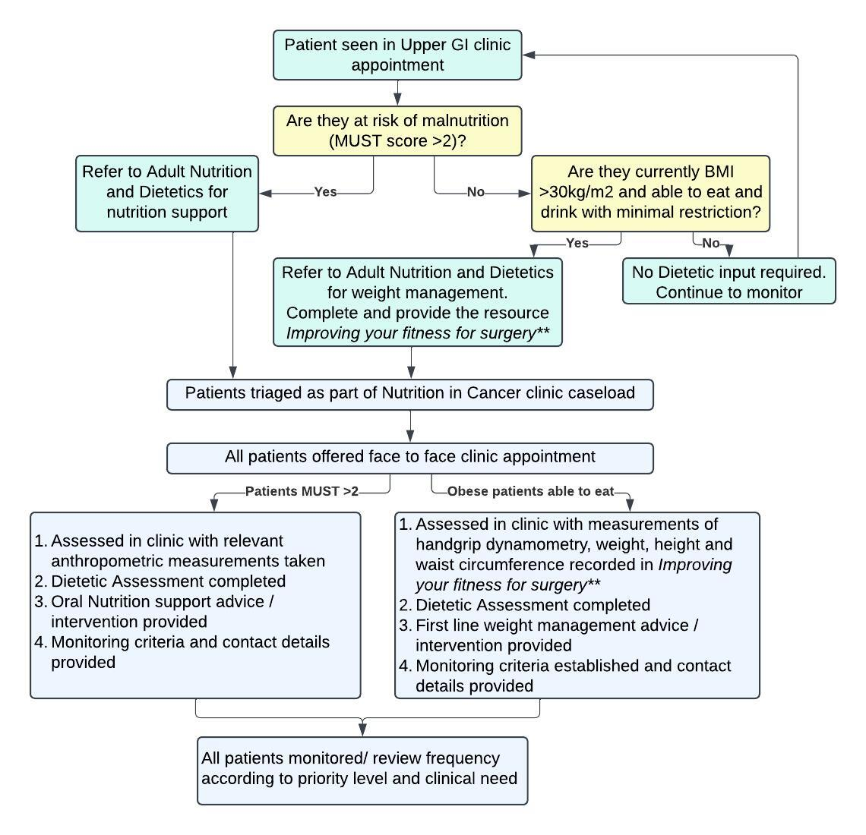
Proposed Model for UHBW patients
**working title

Slide 6
Improving your fitness for surgery
Patient resource including:
Tables to record weight, waist circumference and hand grip strength throughout treatment
Healthy eating advice tailored to Upper GI cancer patient group
Physical activity advice in liaison with prehab team
Target % weight loss set by surgical team with duration (5-10% likely to be clinically significant and still realistic)
Outlines risk of unintentional weight loss/ sarcopenia and potential of balancing nutrition support needs if situation changes (e.g. worsening dysphagia)
Local and regional Dietetic contact details

Slide 7
What if they’re out of area?
Clear documentation of nutritional aim in Upper GI clinic letter
Improving your fitness for surgery could be sent to regional Dietitian teams and follow the patient across the pathway

Slide 8
Potential Challenges
Little evidence for management of obesity in this context, but strong evidence for the risk of malnutrition
Other prehab services do not recommend weight loss for cancer patients
Contacted Upper GI specialist groups/ BDA specialist groups and does not appear to be an intervention provided elsewhere
Potential for mixed messages/ difficult to switch between nutrition support and weight management
Complexity of patient relationship with supplement drinks
Is this a realistic moment for behavioural change?
Patient specific factors: literacy, engagement, social circumstances

Slide 9
What next?
If we want to go ahead with this:
Can liaise with YDH/MPH/WGH/RUH Dietitians
Development of Improving fitness for surgery resource and agree criteria of patients to receive this
Draft sent round Dietetic and surgical teams for feedback
Launch of resource
Monitoring/ audit of this intervention

Slide 10
Questions/ discussion

