Slide 1
Oesophago-gastric Treatment Variation Workstream
Connecting and Empowering the Delivery of Cancer Care Across SWAG Communities

Slide 2
Process for selecting audit / GIRFT recommendations
Recs published in audit / GIRFT report
CP identifies in scope recs based on criteria*
CP ask audit team for their priority recs
Paper taken to Executive Board outlining chosen recs for sign off
CP ask for the relevant NHSE Clinical Lead to ratify the proposed recs
CP engage with Alliance Clinical Chairs and key stakeholders
*Criteria
Treatment specific
Improve survival outcomes
Wide variation in practice
Has an associated target
Timely data available
Notes:
CO cancer programme

Slide 3
2024/25 - Seven recommendations / five tumour sites
Audit | Recommendation | Target
Lung | Cancer Alliances chose 3 from the 12 x treatment recommendations identified in the 2022 GIRFT report
Prostate | Investigate why men with high-risk/locally advanced disease are not considered for radical local treatment. | >75%
Breast | Breast cancer surgical teams should examine their reoperation rates after breast conservation surgery to identify areas where reoperation rates can be reduced, whilst supporting safe breast conservation | No National Target (ASBrS suggest ~10%)
Bowel | Cancer Alliances should monitor and investigate regional and institutional variation in rates of adjuvant chemotherapy following resection of stage III colon cancer and ensure evidence-based chemotherapy policies are in place | 50%
OG | Reduce the number of patients with OG cancer waiting more than 62 days from referral to curative treatment, by identifying and implementing quality improvement interventions to improve speed and efficiency of treatment planning and delivery | 62 days

Slide 4
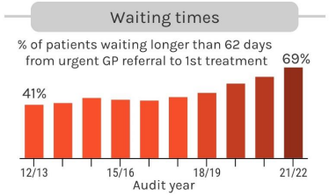

Slide 5
The role of the NHS Cancer Programme​ and recap of the national ask
Through delivery of the NHS Long Term Plan, we will transform cancer care and outcomes so that from 2028:​​
an extra 55,000 people each year will survive for five years or more following their cancer diagnosis;
and​​ three in four cancers (75%) will be diagnosed at an early stage​
To meet the long-term ambition, we must reduce the unwarranted variation in treatment that currently exists​
We are working to prioritise and implement those recommendations from clinical audits and GIRFT reports that will reduce variation in cancer treatment, improving survival outcomes​, through our Cancer Alliances and other levers in the system
NHS England are providing funding to Cancer Alliances to work with clinical teams to understand drivers of unwarranted variation and develop quality improvement initiatives to address them
The national focus in OG cancer is: Reduce the number of patients with OG cancer waiting more than 62 days from referral to curative treatment, by identifying and implementing quality improvement interventions to improve speed and efficiency of treatment planning and delivery

Slide 6
OG data - FDS to DTT median days waiting from FDS clock stop to cancer decision to treat
Median waiting time from the date patients are told they have cancer to the decision to treat date – all routes (including urgent suspect cancer/breast symptomatic/urgent screening/consultant upgrade)

Slide 7
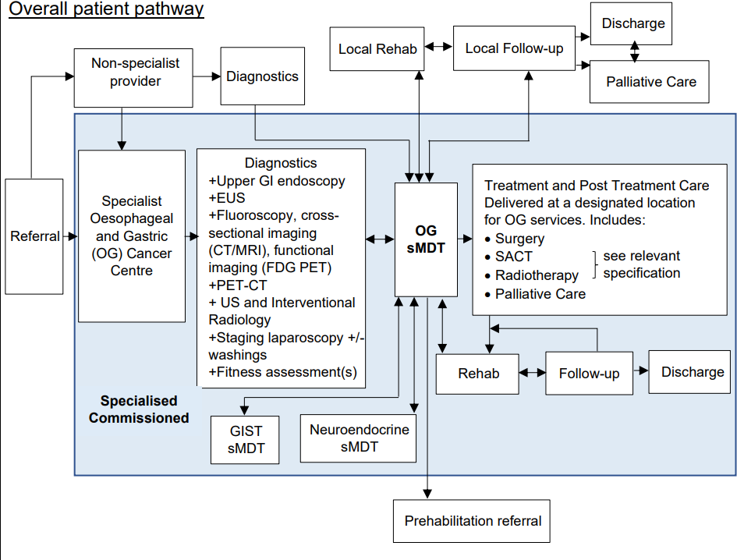
Diagnosis to DTT to first treatment
Oesophageal / GOJ / Gastric staging
Fitness assessment
CT and PET-CT
EUS
Staging laparoscopy
EUS FNA / bronchoscopy / EBUS
CT guided biopsy
Feeding adjuncts
Treatment intent and final TNM
Referral to oncology
Consultation
Radical CRT 3 – 4 weeks
Neo-adjuvant chemo 3 weeks

Slide 8
Additional data will be provided by the National Team to support work in this area
The National Team will be providing Cancer Alliances with two sets of data on a quarterly basis to support activity in this area:
Median 62-day performance
Median days between 28 day (FDS) and DTT

Slide 9
OG 2023/24 Q1 and 2024/25 Q1 FDS-DTT
Somerset, Wiltshire, Avon and Gloucestershire
Provider | Median Wait | Quartile | Median Wait | Quartile
UNIVERSITY HOSPITALS BRISTOL AND WESTON NHS FOUNDATION TRUST | 29.0 | 3 | 42.5 | 4
ROYAL UNITED HOSPITALS BATH NHS FOUNDATION TRUST | 30.0 | 3 | 39.0 | 4
SOMERSET NHS FOUNDATION TRUST | 18.0 | 2 | 25.0 | 2
SALISBURY NHS FOUNDATION TRUST | 31.0 | 3 | 4.5 | 1
GLOUCESTERSHIRE HOSPITALS NHS FOUNDATION TRUST | 21.5 | 2 | 21.0 | 2
NORTH BRISTOL NHS TRUST | 6.0 | 1 | 14.0 | 1
Connecting and Empowering the Delivery of Cancer Care Across SWAG Communities
Notes:
Variation comparison not appropriate due to specialist activity. But also the high evel SWAG median waits non curative doesn’t actually work as a metric to determine patient journey
Not comparable but perhaps indicate a lengthening of waits over past year so variation reduction work cant be determined by this data

Slide 10
NOGCA Report 2023
OG April 2020- March 2022: Median time from referral to start of curative treatment (days)
Somerset, Wiltshire, Avon and Gloucestershire
Provider | Median Wait | Patient No’s
UNIVERSITY HOSPITALS BRISTOL AND WESTON NHS FOUNDATION TRUST | 96 | 27
ROYAL UNITED HOSPITALS BATH NHS FOUNDATION TRUST | 84.5 | 20
SOMERSET NHS FOUNDATION TRUST | 87 | 19
SALISBURY NHS FOUNDATION TRUST | * | *
GLOUCESTERSHIRE HOSPITALS NHS FOUNDATION TRUST | 51 | 39
NORTH BRISTOL NHS TRUST | * | *
Next iteration of this data set due later this month – data completeness report has been published
Connecting and Empowering the Delivery of Cancer Care Across SWAG Communities
Notes:
But Covid!
Surgical centres UHBW and Gloucestershire

Slide 11
Request CAG guidance toward Quality improvement interventions to reduce waits to curative treatment ?
SWAG CAG Work I understand; done or being considered
PET prior to staging but at CAG recommendation CT requested at same time - particularly may be a risk if/when scopes move to the CDC
MDT streamlining in rewritten MDT SOP where appropriate but not restricting discussion where required
Accelerated CT staging; CT requested on the day of OGD showing suspicion of cancer for all patients
Collate and share OG curative breach reviews to identify
RUH Bath undertook breach review and identified potential opportunities incl.;
off pathway diagnostics visibility and expedition
anticipatory oncology appointment booking
Restarting the satellite clinic run by UHBW at RUH
Requesting DPD and other specialist tests by the surgeon or physician in advance
UHBW reviewed reasons for the 10 breaches* October 2023-September 2024 – could roll out across SWAG
6 were due to EUS,
No patients were identified as harmed by their extra waiting time.
Others shared at National programme event
Connecting and Empowering the Delivery of Cancer Care Across SWAG Communities
Notes:
From October 23-September 24 we had 10 breaches of the 62 day standard at UHBW for OG (not necessarily all curative patients) which were related to delays in the local diagnostic pathway. Of these, 6 were due to EUS, 1 due to PET scan, 2 due to histology reporting, and 1 for barium swallow (patient had been referred to H&N not OG). No patients were identified as harmed by their extra wating time. Getting similar information from the other providers could be a good first step as is less resource intensive and more descriptive than just numbers.

Slide 12
Combined PET/CeCT as a single investigation in oesophagogastric cancer staging: our experience during Covid-19 and beyond
Mr Michael Jones
ST7 Registrar in General Surgery
Gloucestershire Royal Hospitals NHS Foundation Trust

Slide 13
Improving 62-day performance for oesophago-gastric cancer
Mr Richard Gillies
Consultant Surgeon & MDT Chair
Oxford University Hospitals NHS Trust

Slide 14
Progress so far
Expedited appointments
PET/CT, laparoscopy, Bank Holiday advance planning
Considered but excluded same day CT
Expedited pathway
Vetting referrals daily, reduced MDT discussion
PET requesting at time of tertiary referral
Selective use of staging investigations
EUS (T2/3/4 aorta), laparoscopy (T1), PET/CT (gastric)
Exceptional individual performance
PET reporting
Enabling treatment
Feeding jejunostomy

Slide 15
Future progress
More than one clinic day per week (especially Monday)
Combined surgery / oncology clinics
One-stop clinics
Surgeon, CNS, dietitian, oncologist, POA, anaesthetist
Dedicated laparoscopy lists
One-stop short stay
All assessments and staging investigations within 7 days

Slide 16
The GM One Stop Lung Cancer Clinic
Patient & family
Shared decision making & optiisation
Lung cancer physicians
Thoracic anaesthetists
Clinical oncologists
St. Ann’s Hospice
CURE Tobacco dependency team
Thoracic surgeons
Prehab
4cancer
Oncogeriatrics
Cancer Nurse Specialists
Regional Business Case
1 x WTE Clinical Oncologist
1x WTE Thoracic Anaesthetist
Oncogeriatrician PAs
Prehab4cancer
Significant nursing resource
Launched June 2022
First 6 months 1x per week
2023: 2x weekly clinics
6 patients per clinic

