Slide 1
Surgical treatment of HCC
Reyad Abbadi
Consultant Hepatobiliary, Pancreatic and General Surgeon

Slide 2
HCC - Epidemiology
Liver cancer is the fastest-rising cause of cancer related deaths in the UK, 85% are HCC.
Around 85% of HCC cases occur in patients with cirrhosis.
According to Cancer Research UK, around 6,200 people are diagnosed with liver cancer each year. 80% are stage 3 or 4 at diagnosis. M:F, 2:1
Incidence of HCC has increased by 50% over the past decade and is expected to continue to rise.
Following a liver cancer diagnosis 40% will survive for 1 year or more and only 13% will survive 5 years or more

Slide 3
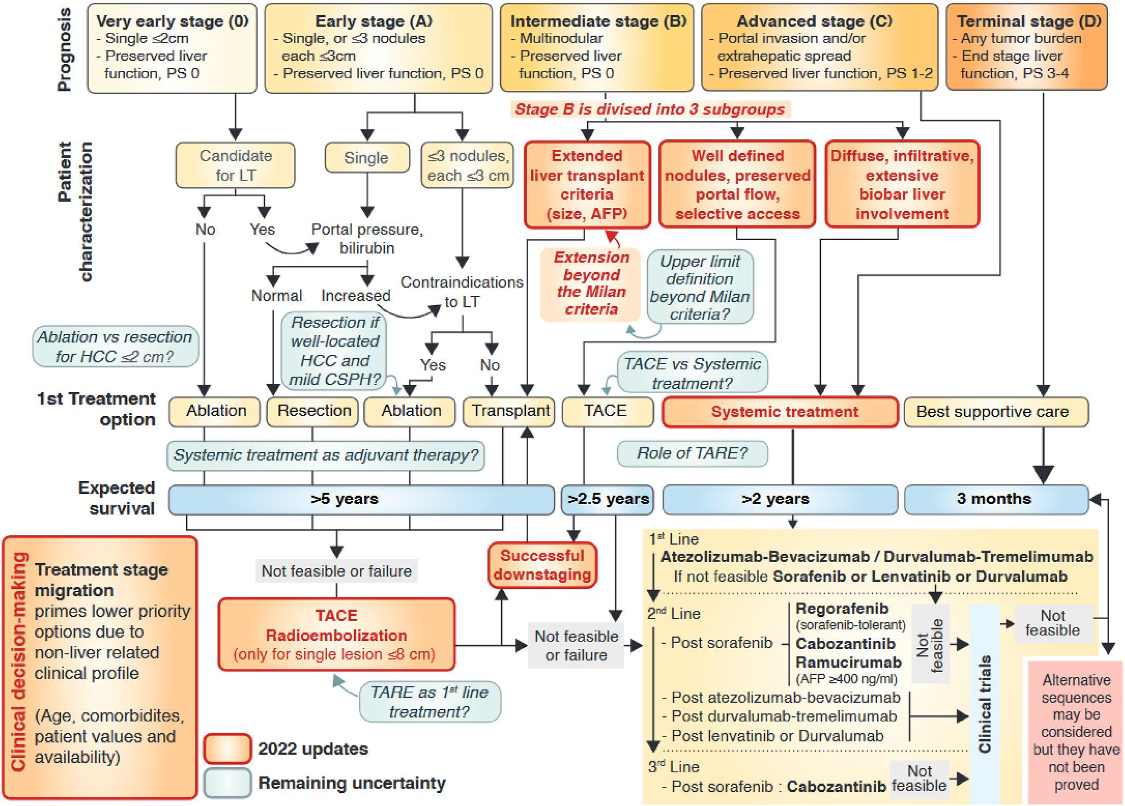
Management

Slide 4
Ways in which surgeons treat HCC
Liver transplantation
Liver resection
Assist in ablation

Slide 5
Factors used to determine treatment options
Patient – fitness, suitability and wishes. PS<2 for surgery
Liver function – level of dysfunction and future remnant
Tumour size and number – also staging
Portal hypertension

Slide 6
Fitness, suitability and wishes
Increasing detection in advanced age
Increasing cases in patients with metabolic syndrome with high BMI, cardiovascular disease and diabetes. OSA and raised right heart pressures and bleeding.
Alcohol/substance abuse and impact on post-op recovery, cardiac damage etc.
Wishes – surgery vs ablative therapy
CPET
Pre-habilitation

Slide 7
Liver function
If cirrhosis is present – Child Pugh-A level of function required.
Calculating liver volumes. Functional scanning.
Manipulating liver function/tumour, PVE, TAE, TA radiation.

Slide 8
Ideal surgical patient
Fit, PS 0 or 1
Preserved liver function – Child Pugh A
Solitary tumour
No macroscopic vascular invasion
No clinically significant portal hypertension

Slide 9
Aim of surgery
Achieve R0 – complete resection
Preserve >40% liver
Mortality <3%

Slide 10
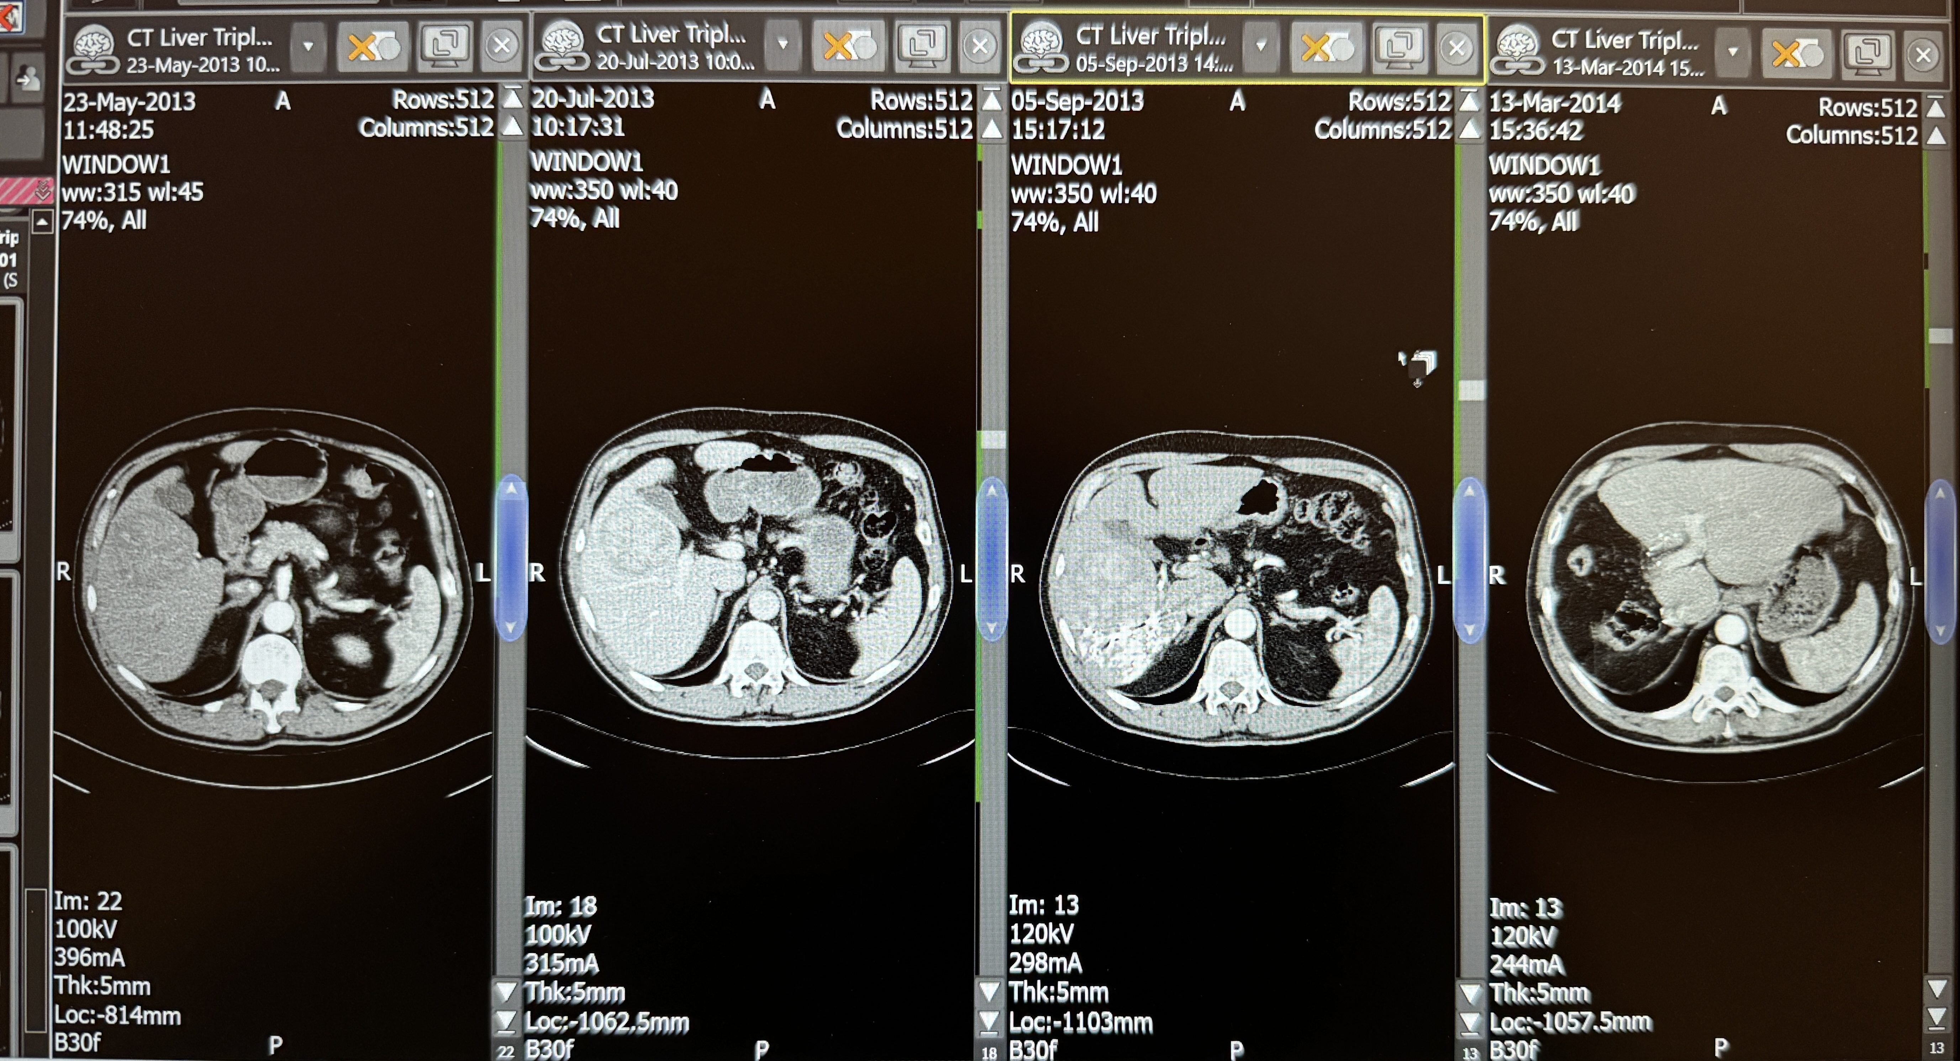
TACE and PVE

Slide 11
Tumour size and staging

Slide 12
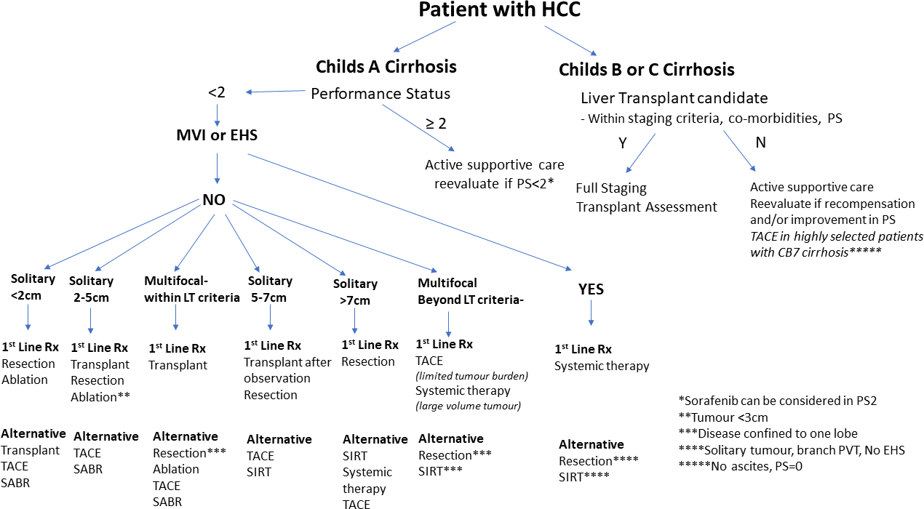
Suddle A, et al. Gut 2024;0:1–34. doi:10.1136/gutjnl-2023-331695

Slide 13
Tumour size -solitary 2 cm or less- Ablation or resection
Best seen as synergistic rather than competing.
Ablation has a better safety and economic profile. Surgery has better recurrence rate. However, surgery can be used as salvage for recurrence in most cases.

Slide 14
Tumour size- solitary >2cm
Within transplant criteria: Meta- analyses of observational studies suggest better safety profile for resection in the first year and better long-term survival in transplant as the entire diseased liver (source of further tumours) is removed but organ shortage is an important factor. Overall, probably equivalent with marginally better outcomes for OLT. However, for resectable patients surgery is first choice.
5-7 cm may be transplanted if stable for more than 6 months or resected.
Resection is feasible for tumours larger than 10cm with good 5 year survival (around 50%) in those with solitary lesion, no cirrhosis and no vascular invasion.

Slide 15
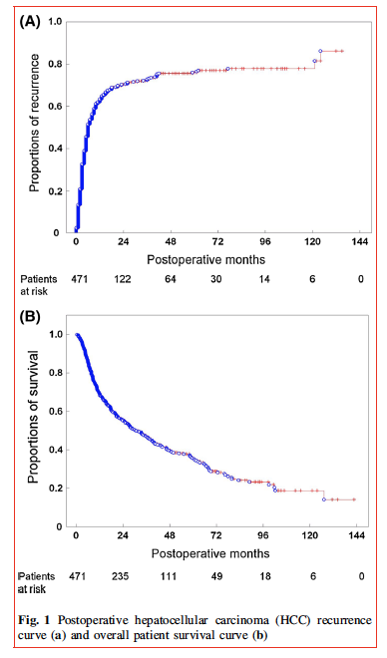
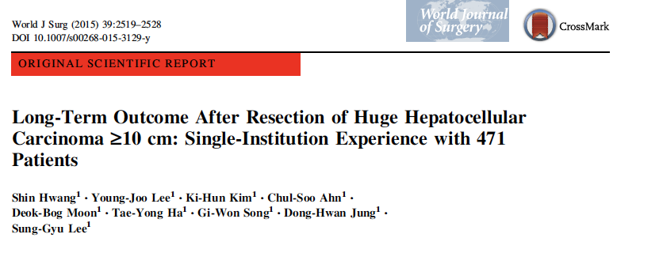
Tumours >10cm
471 patients.
Median tumour size 13cm.
93% solitary.
10% macroscopic portal vein invasion
2% bile duct invasion

Slide 16
Unclear areas – multiple lesions surgery vs OLT vs ablation

Slide 17
Multiple tumours-within OLT criteria
Meta- analyses of observational studies suggest better safety profile for resection in the first year and better long term survival in transplant as the entire diseased liver (source of further tumours) is removed but organ shortage is an important factor.
Overall, nearly equivalent outcomes with preference for OLT if organ availability and progression on waiting list were not an issue due to higher recurrence in resection patients.

Slide 18
Area of uncertainty - surgery in suitable lesions with “mild” CSPH

Slide 19
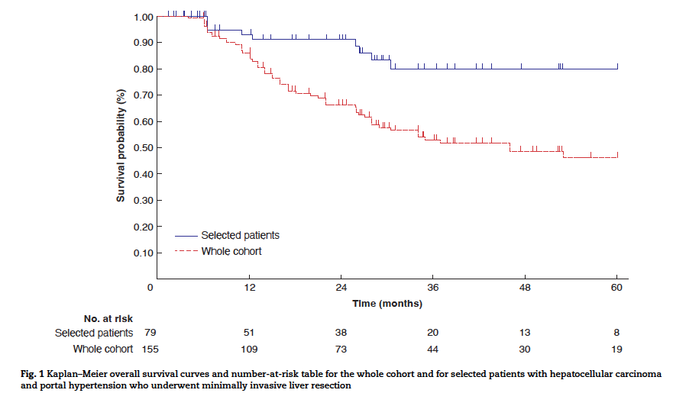
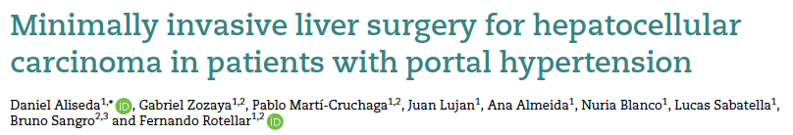

PHT & minimally invasive surgery
Systematic review of 6 studies
165 pure lap
3 lap assisted
14 hemihepatectomies
16 three segment
3 left lateral sectionectomies
Liver failure around 5%
Transient ascites 90%

Slide 20
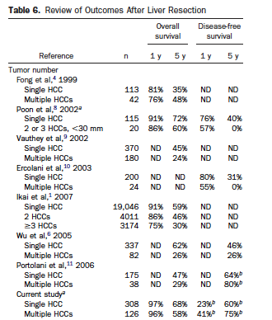

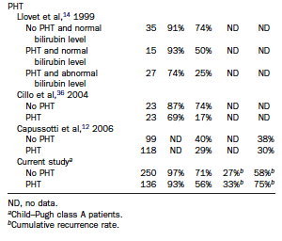
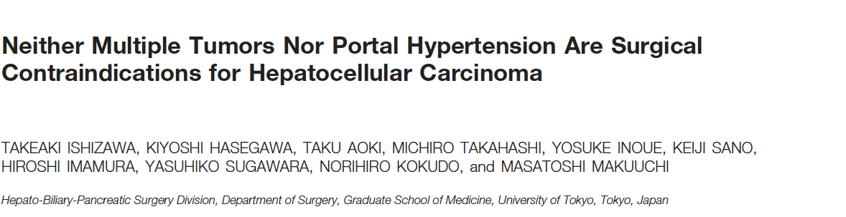

Resect all?
434 patients
126 (29%) multiple HCCs
22 (5%) had 4 or more HCCs
136 (31%) with PHT but only 79 with varices
313 (61%) cirrhotic
16% CP-B

Slide 21
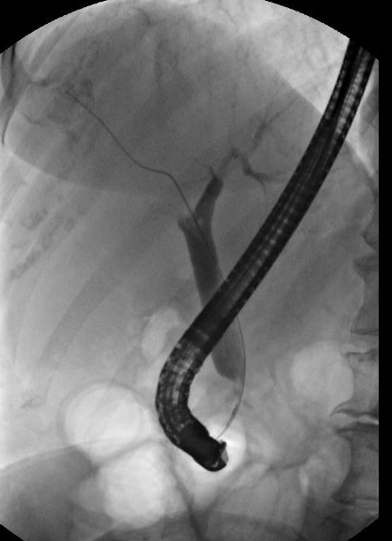
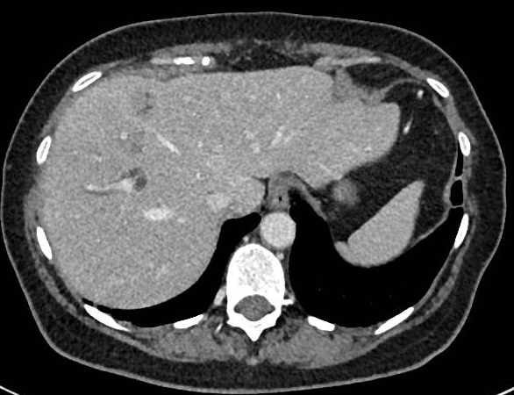
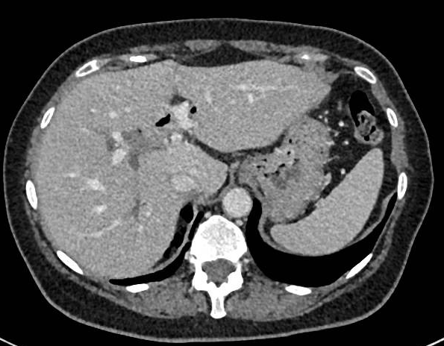
Resection after rupture

Slide 22
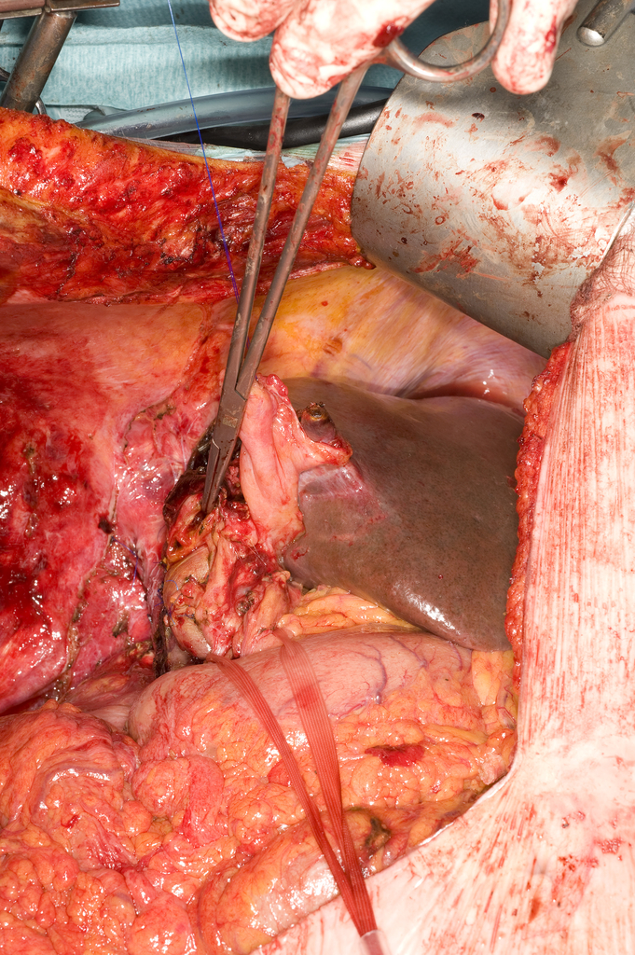
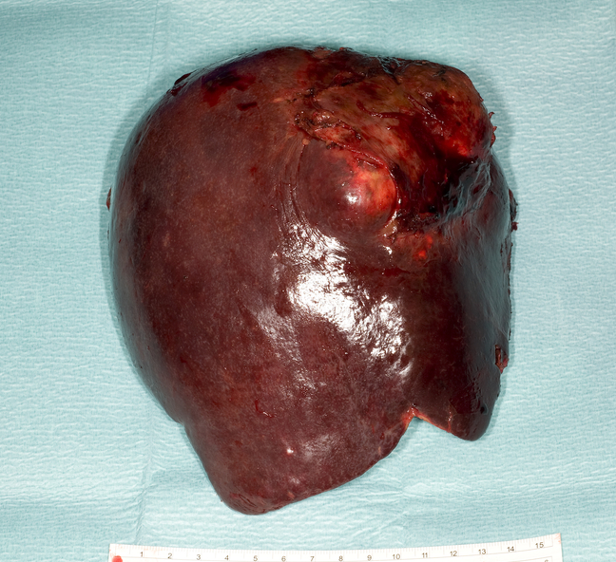
Resection after rupture
T4R0
Local recurrence within 5 months
Survival post –op around 9 months

Slide 23
Ideal surgical patient
Fit, PS 0 or 1
Preserved liver function – Child Pugh A
Solitary tumour
No macroscopic vascular invasion
No clinically significant portal hypertension

Slide 24
Resect all?
434 patients
126 (29%) multiple HCCs
22 (5%) had 4 or more HCCs
136 (31%) with PHT but only 79 with varices
313 (61%) cirrhotic
16% CP-B

Slide 25
Summary
Surgery for HCC is reserved for fit patients. PS 0 and 1.
With preserved liver function. Child-Pugh A.
Size and perhaps number of tumours do not preclude surgery in selected patients
Some patients with portal hypertension may be suitable for resection
Macroscopic vascular invasion is not a definite contraindication to surgery

Slide 26
Questions?

