Slide 1


Treatment options for the management of HCC:
A patient case discussion
Dr. Antonio D’Alessio
Specialist in Medical Oncology
Imperial Hospital, London
Reporting suspected adverse reactions after authorisation of the medicinal product is important. It allows continued monitoring of the benefit/risk balance of the medicinal product. Adverse events should be reported. Reporting forms and information can be found at www.mhra.gov.uk/yellowcard. Adverse events should also be reported to Roche Products Ltd. Please contact Roche Drug Safety Centre by emailing welwyn.uk_dsc@roche.com or calling +44 (0)1707 367554.
As Tecentriq and Avastin are biological medicines, healthcare professionals should report adverse reactions by brand name and batch number.
This is a Promotional Meeting organised by Chugai Pharma UK Ltd, on behalf of Roche Products Ltd. and intended for Healthcare Professionals from Great Britain. Prescribing information can be found at the end of the presentation.
C-GB-00001552 November 2024

Slide 2


Licensed indication
Tecentriq® (atezolizumab), in combination with Avastin® (bevacizumab), is indicated for the treatment of adult patients with advanced or unresectable hepatocellular carcinoma (HCC) who have not received prior systemic therapy^{1,2}
1. TECENTRIQ IV Summary of Product Characteristics. 2. TECENTRIQ SC Summary of Product Characteristics.

Slide 3
Adverse Events Reporting
Reporting suspected adverse reactions after authorisation of the medicinal
product is important. It allows continued monitoring of the benefit/risk balance
of the medicinal product.
Adverse events should be reported. Reporting forms and information can be
found at www.mhra.gov.uk/yellowcard. Adverse events should also be reported
to Roche Products Ltd. Please contact Roche Drug Safety Centre by emailing
welwyn.uk_dsc@roche.com or calling +44 (0)1707 367554.
As Tecentriq and Avastin are biological medicines, healthcare professionals should
report adverse reactions by brand name and batch number.

Slide 4
Disclosures
I have received educational support for congress attendance from Roche, speaker fees from Roche, AstraZeneca, and Chugai, and consultancy fees from Roche.

Slide 5
Phase III clinical trial: IMbrave150
A study of TECENTRIQ + Avastin compared with sorafenib in patients with untreated locally advanced or metastatic hepatocellular carcinoma¹
1. Finn R, et al. N Engl J Med 2020;382:1894-905

Slide 6
Study design ¹
Key eligibility criteria
≥18 years of age
Locally advanced or metastatic and/or unresectable HCC
No prior systemic therapy
Measurable disease per RECIST 1.1 that was not amenable to curative or locoregional therapies or that had progressed thereafter
ECOG PS 0 or 1
Child-Pugh A
Adequate haematological and organ function
Key exclusion criteria
History of autoimmune disease
HBV or HCV coinfection
Untreated or incompletely treated oesophageal or gastric varices (assessed with OGD and treated as per local clinical practice) with bleeding or high risk of bleeding
TECENTRIQ
1200 mg IV Q3W
+
Avastin
15 mg/kg Q3W
Stratification
Region (Asia, excluding Japan*/rest of world)
ECOG PS (0/1)
MVI and/or EHS (presence/absence)
Baseline AFP (<400/≥400 ng/mL)
Until loss of clinical benefit or unacceptable toxicity
Randomised
2:1
Survival follow-up
N=501
Co-primary endpoints
OS (assessed by blinded independent review; RECIST 1.1)
PFS (assessed by blinded independent review; RECIST 1.1)
Secondary endpoints included
ORR and DoR (investigator and independently assessed by RECIST 1.1 and HCC-specific modified RECIST)
Time to deterioration of QoL, physical functioning and role functioning (patient reported)**
Sorafenib
400 mg BID
(open-label)
Figure adapted from Finn R, et al. N Engl J Med 2020;382:1894-905. *Japan is included in rest of world. ** Deterioration was defined as a decrease from baseline of ≥10 points on the EORTC QLQ–C30 maintained for two consecutive assessments or a decrease of ≥10 points in one assessment followed by death from any cause within 3 weeks.
Abbreviations: AFP, alpha-fetoprotein; BID, twice daily; ECOG PS, Eastern Cooperative Oncology Group performance status; OGD, oesophagogastroduodenoscopy; EHS, extrahepatic spread; HBV, hepatitis B virus; HCC, hepatocellular carcinoma; HCV, hepatitis C virus; IRF, independent review facility; IV, intravenous; (m)RECIST, (modified) Response Evaluation Criteria In Solid Tumours; MVI, macrovascular invasion; ORR, objective response rate; OS, overall survival; PFS, progression-free survival; Q3W, once every three weeks.
1. Finn R, et al. N Engl J Med 2020;382:1894-905

Slide 7
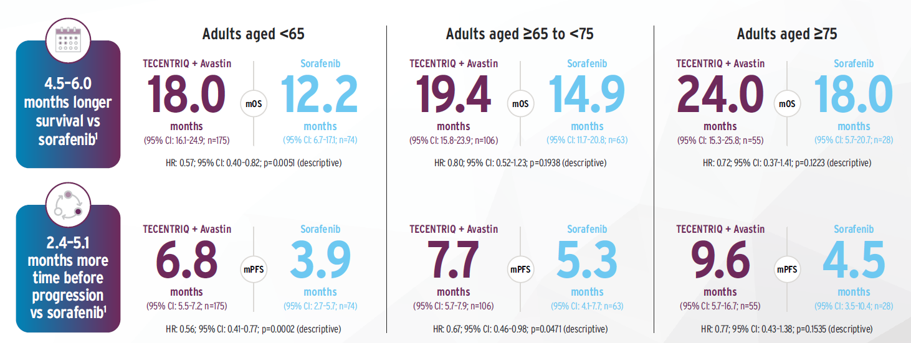
TECENTRIQ + Avastin provided generally consistent results across older and younger adults in a post-hoc sub group analysis¹
This is sub group analysis and caution must be observed when interpreting results with this data.
*All data presented are descriptive in nature as formal statistical significance cannot be derived from a post-hoc subgroup analysis.
CI, confidence interval; HR, hazard ratio; mOS, median overall survival; mPFS, median progression-free survival.
1. Li D et al. Liver Cancer 2022;11:558–571.

Slide 8
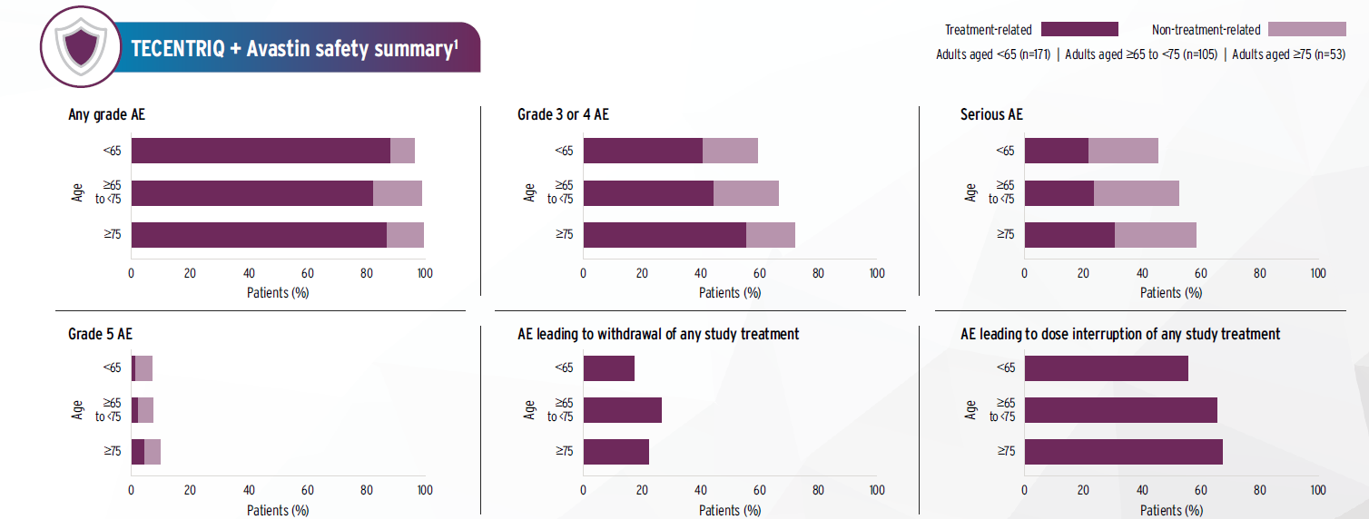
There were no clinically meaningful differences in safety profile or tolerability between age groups¹
*All data presented are descriptive in nature as formal statistical significance cannot be derived from a post-hoc subgroup analysis.
AE, adverse event.
1. Li D et al. Liver Cancer 2022;11:558–571.

Slide 9
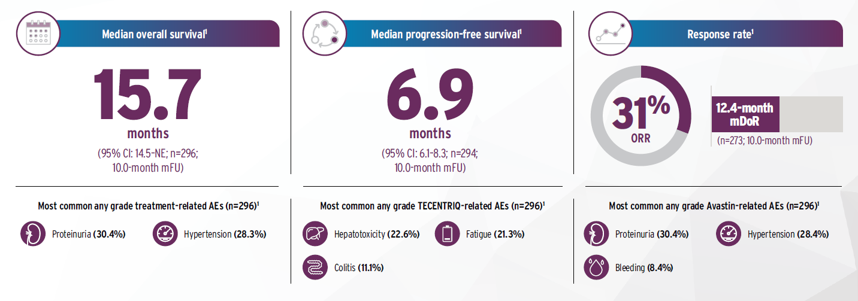
The efficacy and safety of TECENTRIQ + Avastin was generally reproducible in routine clinical practice¹⁻⁴
*Every retrospective study is limited by incomplete data collection and lack of standardisation in prior eligibility assessment.
AE, adverse event; CI, confidence interval; mDoR, median duration of response; mFU, median follow-up; NE, not estimable; ORR, objective response rate.
1. Fulgenzi CAM et al. Eur J Cancer 2022;175:204–213.

Slide 10
Real world evidence: AB-real study
A prospectively maintained database was generated enrolling patients treated with TECENTRIQ + Avastin for unresectable HCC across Europe, Asia and USA¹
1. Fulgenzi CAM et al. Eur J Cancer 2022;175:204–213.

Slide 11
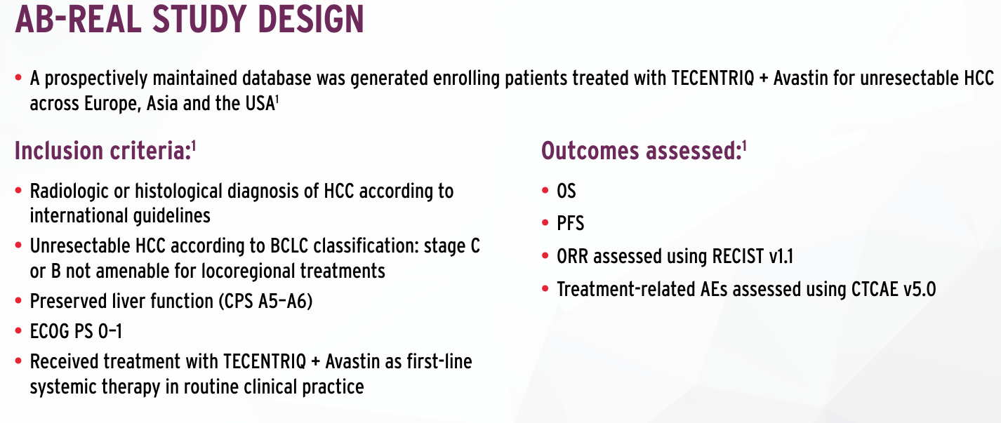
Study design ¹
AE, adverse event; BCLC, Barcelona Clinic Liver Cancer; CPS, Child-Pugh score; CTCAE, Common Terminology Criteria for Adverse Events; ECOG PS, Eastern Cooperative Oncology Group performance status; HCC, hepatocellular carcinoma; ORR, objective response rate; OS, overall survival; PFS, progression-free survival; RECIST, Response Evaluation Criteria in Solid Tumours.
1. Fulgenzi CAM et al. Eur J Cancer 2022;175:204–213.

Slide 12
Case Study
Clinical responses may vary. Please refer to SmPC for typical responses.

Slide 13

Meet the patient: SM
Presentation
History of presenting complaint
Patient characteristics:
Male, 69 years old
ECOG PS 0, BMI 33
Previous medical history:
Chronic ischemic heart in treatment with bisoprolol and clopidogrel
Moderate-severe COPD
Arterial hypertension
Hypercholesterolemia
  2006 (56 y.o.): First finding of raised AST/ALT (2 x u.l.n.) and HCV infection (anti-HCV and HCV RNA positive). No clinical or laboratory evidence of cirrhosis. Refuses biopsy and antiviral treatment
  2006-2019: Modest adherence to follow up visits
  2019 (69 y.o.): (under no surveillance) Focal liver lesion found at occasional ultrasonography.

Slide 14
Patient’s History
05/2019: Workup at the Hepatology Unit
Physical examination: features of CLD (firm hepatomegaly, splenomegaly, some spider naevi); no ascites, no encephalopathy. Other comorbidities stable.
Biochemistry
Virological assessment: HBsAg and anti-HIV negative; Anti-HCV positive, HCV-RNA 1,86 x 10⁶ IU/L, genotype 1b
US:
  hypoechoic focal lesion (∅ 2.5 cm) in liver segment S6 on a cirrhotic background
  splenomegaly (DL cm 13)
GI endoscopy: F1 oesophageal varices (bisoprolol shifted to carvedilol 12.5 mg/day)
PLT | 129.000/mm³ | INR | 1.1
AST/ALT | 69/74 UI/l (n.v.<40) | Albumin | 3.8 g/dl
Total bilirubin | 0.9 mg/dl | Alfa-fetoprotein | 8 ng/ml

Slide 15
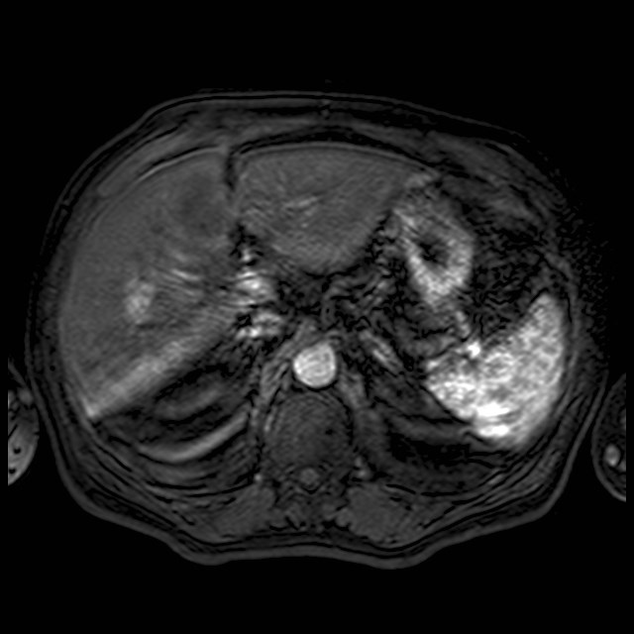
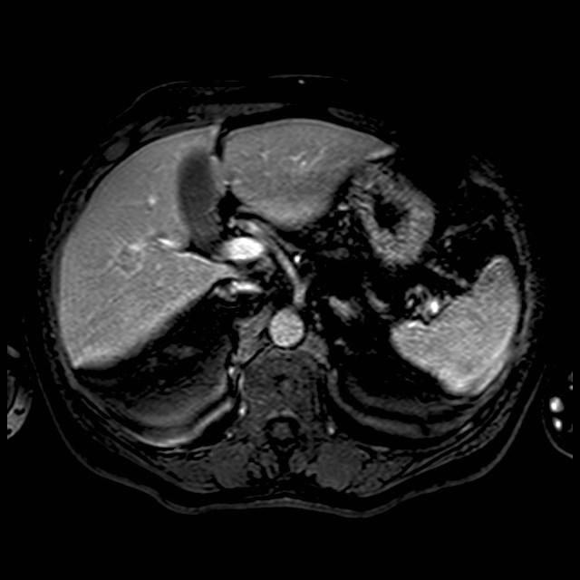
Magnetic Resonance – MRI (Jun 2019)
2 cm LiRADS 5 nodule in S6
Arterial phase
Portal phase

Slide 16
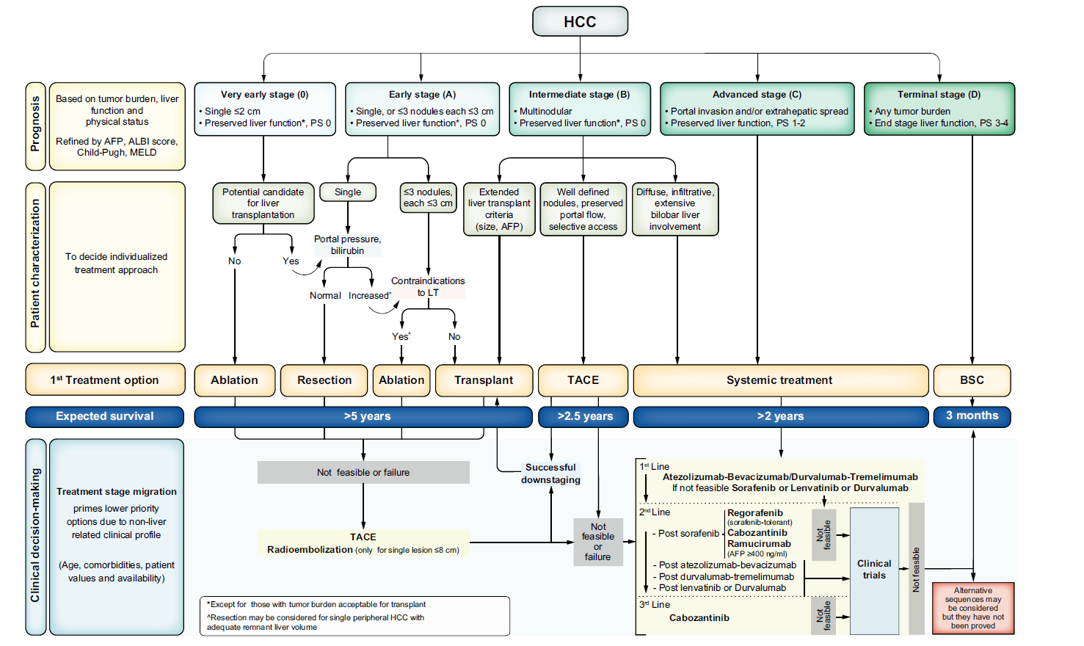
Where do we go from here
2 cm LiRADS 5 nodule in S6
Clinical update
- Age 69 years. Performance status 0;
Child-Pugh A5; MELD score 6;
Oesophageal Varices F1, PLT 129.000/mmc, AFP 8 ng/ml
- No extra-hepatic spread or macro-vascular invasion
Very Early stage HCC (BCLC 0); Milan in
Significant cardiopulmonary comorbidities
Notes:
Milan criteria: 1 <5cm
Up to 3 <3cm

Slide 17
How to continue?
a) Resection
b) Radiofrequency Ablation
c) Transplant
d) TACE
0) Biopsy?

Slide 18
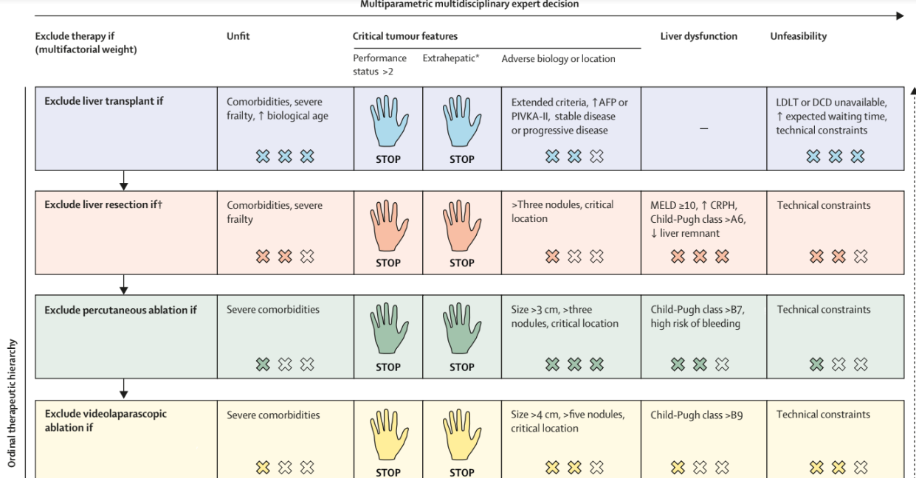
How to continue?
Multiparametric multidisciplinary expert decision
Vitale et al. Lancet Oncology, 2023

Slide 19
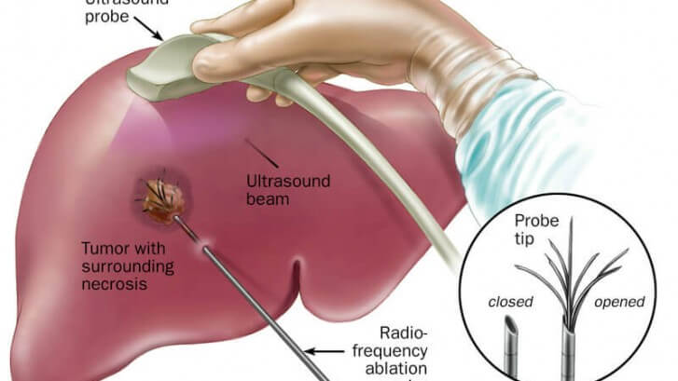
July 2019
Complete radiological response after percutaneous radiofrequency ablation (RFA)
Ultrasound
probe
Boctor E et al SPIE. 2010
10.1117/12.846092.

Slide 20
July 2019
Complete radiological response after percutaneous radiofrequency ablation (RFA)
US scan and biochemistry every 3 months and multiphasic CT or MR scan every 6 months
August 2019
Antiviral treatment with sofosbuvir/velpatasvir → Sustained virologic response (January 2019)

Slide 21
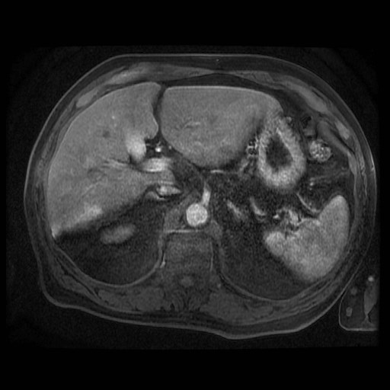
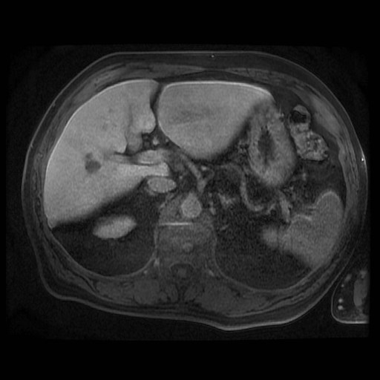
3 years after: August 2022
    Radiological evidence of local recurrence: nodule of 10 mm in contiguity of the previous treated lesion in S6 (LR-TR viable)

Slide 22
Clinical Update (Aug 2022)
Local recurrence in S6 (10 mm) after RFA (2019)
Clinical update
- Age 72 years. Performance status 0;
Child-Pugh A5; MELD score 7; ALBI grade 1
Oesophageal Varices F1, PLT 100.000/mmc.
AFP 10 ng/ml;
- No extra-hepatic spread or macro-vascular invasion;
Milan in.
Comorbidities stable

Slide 23
How to continue?
a) Resection
b) Percutaneous Ablation
c) TACE
d) OLT

Slide 24
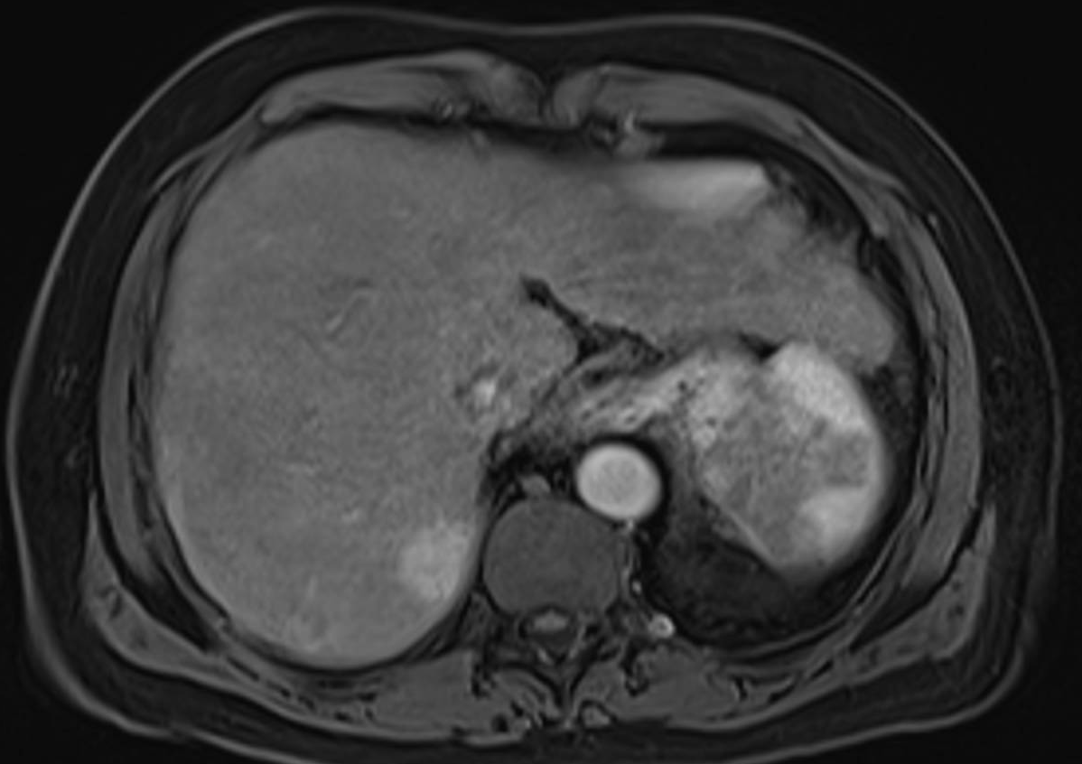
Treatment (Sep 2022)
Indication for second session of Radiofrequency Thermoablation
Oct 2022:
- increase of lesion in S6 to 35 mm
- 2 new Li-RADS 5 lesion in S7 (26 mm) and S2 (15mm)

Slide 25
How to continue?
a) Percutaneous Ablation
b) TACE
c) SIRT
d) Systemic therapy
e) Combination treatment

Slide 26
Where do we go from here
3 LiRADS 5 nodules, max 35mm
Clinical update
- Age 72 years. Performance status 0;
Child-Pugh A5
Compensated cirrhosis
AFP 100 ng/mL
No extra-hepatic spread or macro-vascular invasion
Intermediate stage HCC (BCLC B)

Slide 27
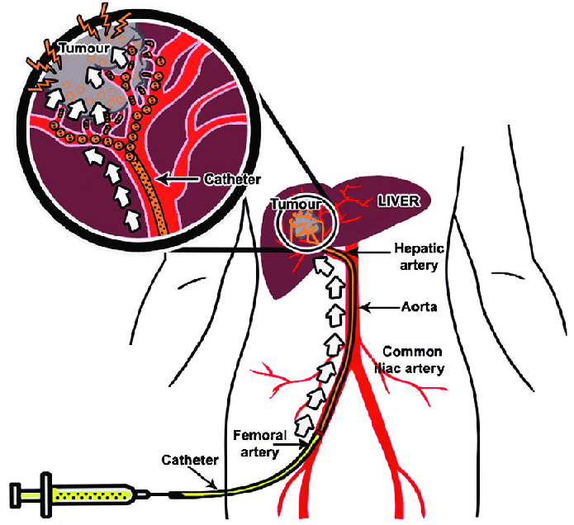
Treatment (Oct 2022)
MDT discussion: For Transarterial chemoembolisation (TACE)
Wang YX et al CJCR 2015. 27. 96-121.
Notes:
Maybe image with TACE procedure?

Slide 28
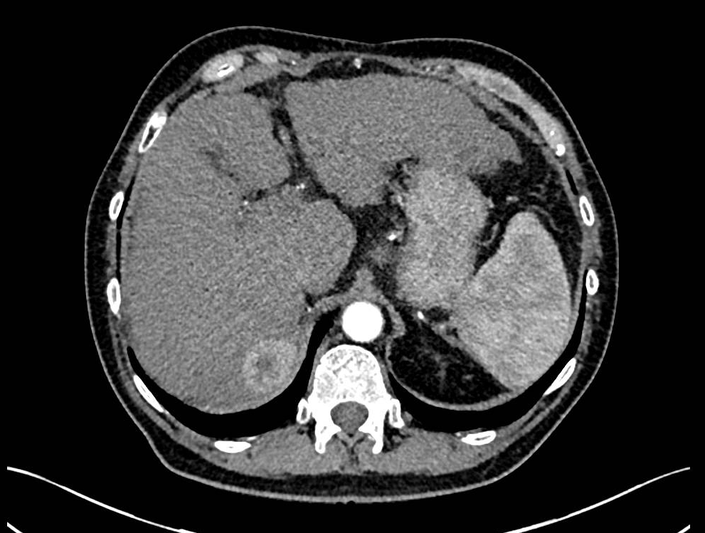
Treatment (Oct 2022)
MDT discussion: For Transarterial chemoembolisation (TACE)
January 2023 First restaging CT scan
Previously seen presumed HCC within segment VII has slightly increased in dimensions (3.5 cm previously, now 4 cm)…
…but demonstrates central necrosis presumably due to response to TACE
Notes:
Maybe image with TACE procedure?

Slide 29
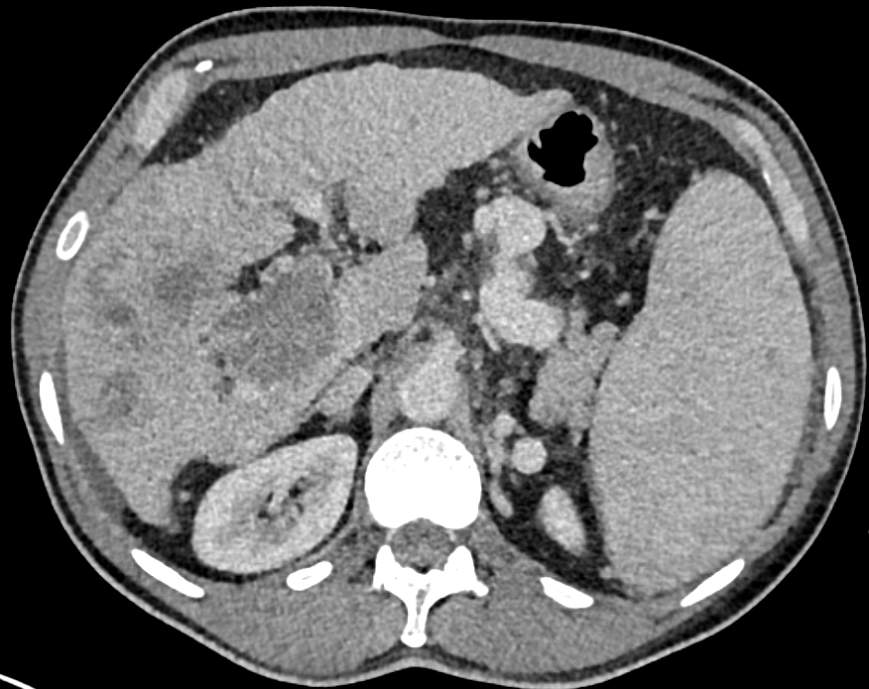
Treatment (Oct 2022)
MDT discussion: For Transarterial chemoembolisation (TACE)
January 2023 First restaging CT scan
Multifocal HCC relapse
Notes:
Maybe image with TACE procedure?

Slide 30
Where do we go from here
Multifocal disease, confined to the liver
Clinical update
- Age 72 years. Performance status 0
Child-Pugh A5
Compensated cirrhosis
AFP 200 ng/mL
No extra-hepatic spread or macro-vascular invasion
Intermediate stage HCC (BCLC B)

Slide 31
How to continue?
a) Percutaneous Ablation
b) TACE
c) SIRT
d) Systemic therapy
e) Combination treatment

Slide 32
Where do we go from here
Multifocal disease, confined to the liver
Clinical update
- Age 72 years. Performance status 0
Child-Pugh A5
Compensated cirrhosis
AFP 200 ng/mL
No extra-hepatic spread or macro-vascular invasion
Intermediate stage HCC (BCLC B)
Notes:
BCLC B: heterogeneous entity

Slide 33
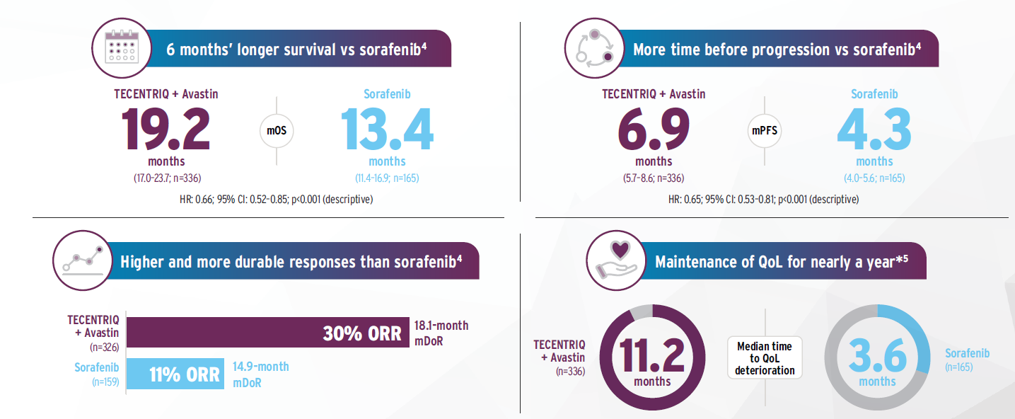
Despite inclusion of high risk patients in IMbrave150, TECENTRIQ + Avastin provided a significant mOS benefit while maintaining QoL¹⁻⁴
*QoL data are from the primary analysis of IMbrave150.
CI, confidence interval; HCC, hepatocellular carcinoma; HCP, healthcare professional; HR, hazard ratio; mDoR, median duration of response; mOS, median overall survival; mPFS, median progression-free
survival; ORR, objective response rate; QoL, quality of life; SC, subcutaneous.
1. Vogel A et al. Ann Oncol 2021;32:801–805. 2. TECENTRIQ SC Summary of Product Characteristics. 3. TECENTRIQ IV Summary of Product Characteristics. 4. Cheng AL et al. J Hepatol 2022;76:862–873.
5. Finn RS et al. N Engl J Med 2020;382:1894–1905.

Slide 34
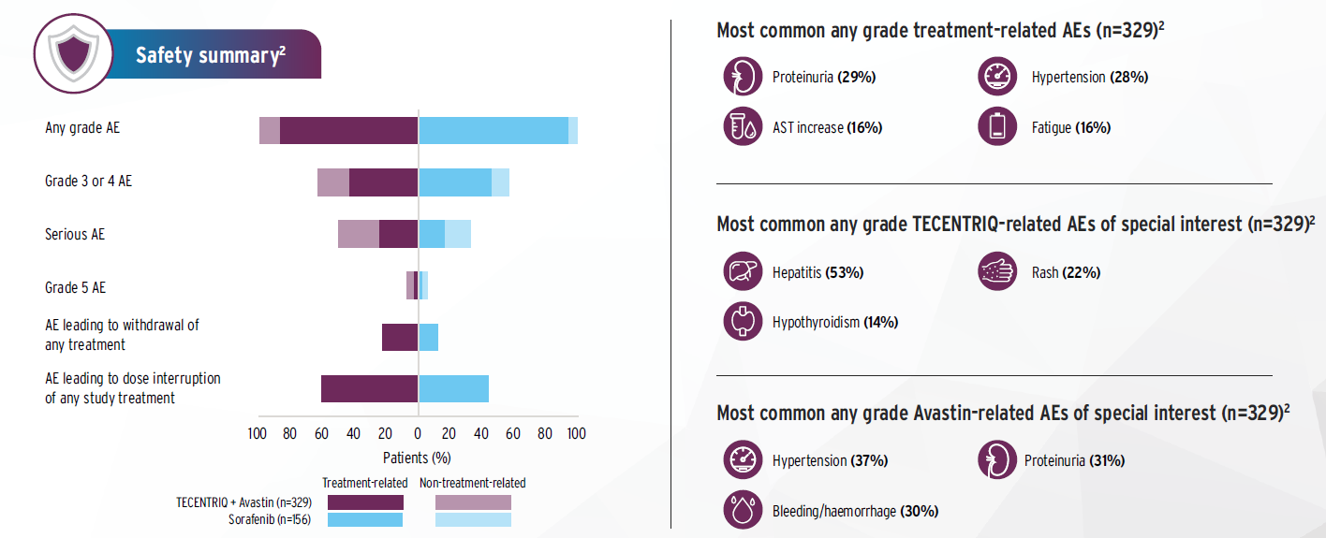
TECENTRIQ + Avastin demonstrated a generally manageable safety profile¹
AE, adverse event; AST, aspartate aminotransferase.
1. Finn RS et al. N Engl J Med 2020;382:1894–1905. 2. Cheng AL et al. J Hepatol 2022;76:862–873.

Slide 35
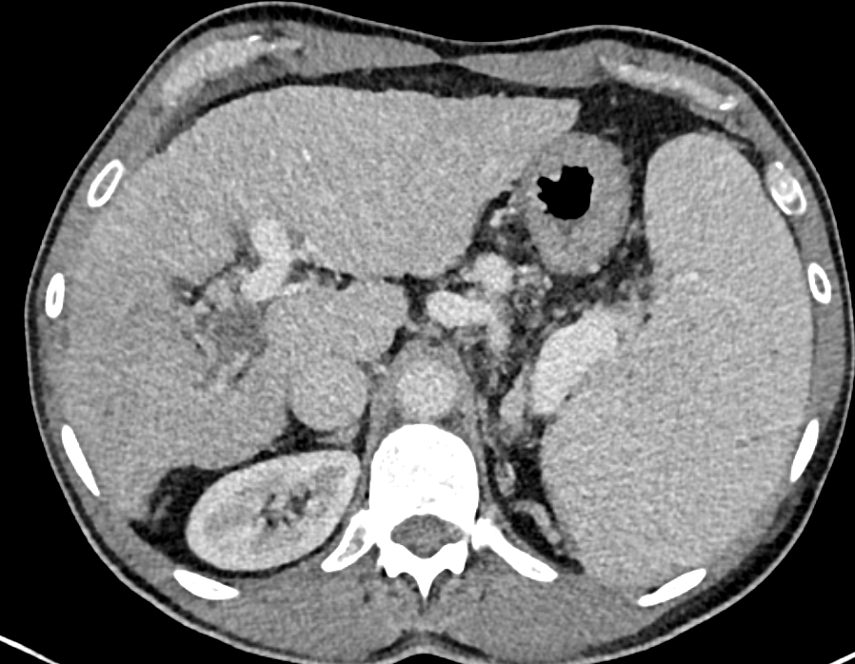
Treatment (Feb 2023)
MDT discussion: For Systemic therapy
Feb 2023
C1D1 Atezolizumab-bevacizumab
Best response: PR
Jul 2024 Ongoing
Notes:
Maybe image with TACE procedure?

Slide 36

Interactive discussion
Multifactorial assessment of tumour biology
BCLC B:
a heterogeneous category
When to switch to systemic therapy
Importance of treatment personalisation through MDT discussion

Slide 37



Please scan the QR codes or click on the URL to access prescribing information
TECENTRIQ SC
TECENTRIQ IV
AVASTIN
GREAT BRITAIN
GREAT BRITAIN
GREAT BRITAIN
https://www.emcpi.com/pi/43779
https://www.emcpi.com/pi/36932
https://www.emcpi.com/pi/15748
Reporting suspected adverse reactions after authorisation of the medicinal product is important. It allows continued monitoring of the benefit/risk balance of the medicinal product. Adverse events should be reported. Reporting forms and information can be found at www.mhra.gov.uk/yellowcard. Adverse events should also be reported to Roche Products Ltd. Please contact Roche Drug Safety Centre by emailing welwyn.uk_dsc@roche.com or calling +44 (0)1707 367554.
As Tecentriq and Avastin are biological medicines, healthcare professionals should report adverse reactions by brand name and batch number.

