Slide 1



Brain biopsies: a proposed guideline
Angelo Pichierri

Slide 2
Types of brain biopsies
Needle | Open | Endoscopic
Robotic / Stereotactic / Alignment systems | Navigated | +/- navigation
Percutaneous / MIS | Minicraniotomy | Minicraniotomy + corticotomy
Several mm3 of tissue | cm3 of tissue | Few mm3 of tissue
Deep lesions | Brain sections (+/-dura) Superficial lesions Inconclusive needle biopsy Vascular lesions | Intraventricular lesions
Day case | May require hospital stay | May require hospital stay
Good diagnostic yield | Excellent diagnostic yield | Yield limited by volume

Slide 3
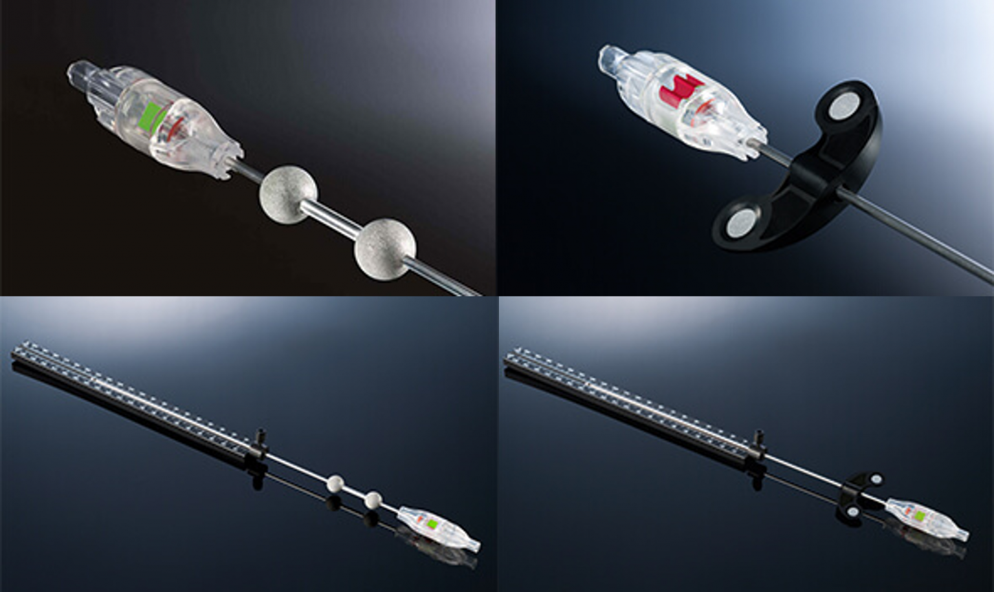
Type of needle biopsies
BrainLab | Medtronic
⌭ 10mm x 2mm | ⌭ 8mm x 2mm
V = 31mm³ | V = 25 mm³

Slide 4

Biopsy challenges
Accuracy of target
size of lesion
depth of lesion
registration error
procedure-related deviation
linear
angular
Macroscopic appearance of lesion
General agreement: “the more the better”
Samples
Morbidity

Slide 5
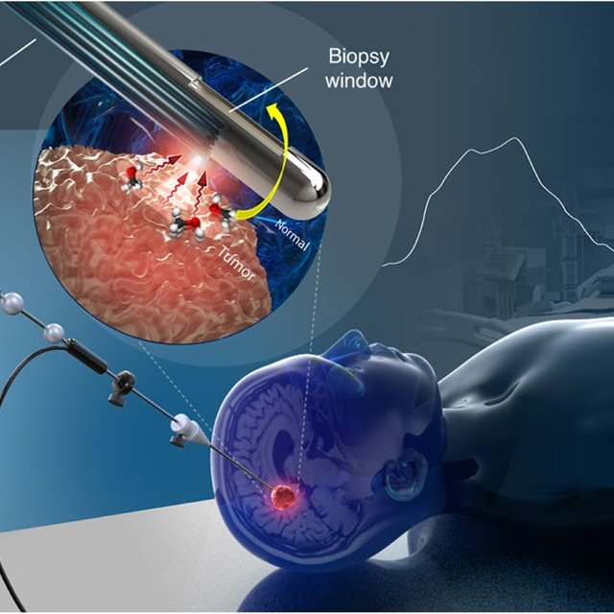

Current practice challenges
x4 samples, one per cardinal point

Slide 6
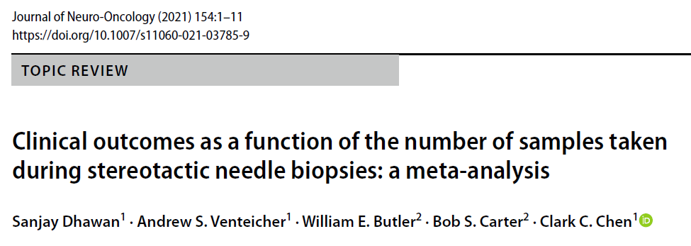
2416 patients from 28 cohorts

Slide 7
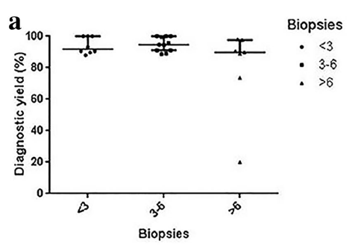
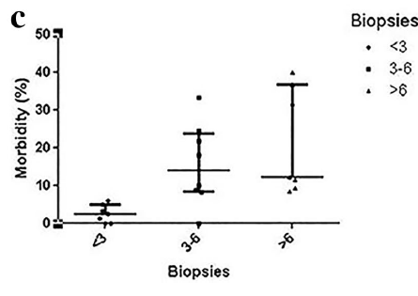
  No significant difference in mortality across groups
  Non-linear relationship between number of samples and morbidity
4%
16%
17%
H* 3%
H* 7%
H* 10%
*H= Haemorrhage
90%
94%
88%

Slide 8
Biopsy samples minimum requirements
Histology Genetics WGS
Some mm3
Formalin
A few mm3
Coackham pot
20 mins life @room ◦c
72 hours life in fridge
50 mm3 (2 cores)
Separate pot (white Coakham pot)
Formalin samples can be used for genetics
Genetics pot can be fixed in formalin afterwards
Excess genetics samples can be sent to WGS
Excess formalin samples cannot be sent to WGS

Slide 9
Recommendation for minimum sampling
Assuming biopsy needle cylinder is fully filled with tissue
Coakham pots: max 20 mins at room temperature; max 72 hours in fridge
 | Low risk | High risk*
Low yield variables | Formalin: 2 cores Coackham: 4+ cores | Formalin: 3 cores Coackham: -
High yield variables | Formalin: 1 core Coackham: 4+ cores | Formalin: 2 cores Coackham: -
*: biopsy would not be eligible for WGS analysis

Slide 10
Recommendation for minimum sampling
FRIDAY CASES
Assuming biopsy needle cylinder is fully filled with tissue
Coakham pots: max 72 hours in fridge: risk of deterioration until Monday
 | Low risk | High risk*
Low yield variables | Formalin: 4+ cores Coackham: 2 cores | Formalin: 3 cores Coackham: -
High yield variables | Formalin: 3+ cores Coackham: 2 cores | Formalin: 2 cores Coackham: -
*: biopsy would not be eligible for WGS analysis

