Slide 1

SWAG Lung Treatment variation Work Programme
Collate and deliver improvement against the 3 GIRFT lung cancer metrics chosen by CAG October 2022
Radical intent treatment should commence by day 49 of the overall NOLCP pathway. Furthermore, for surgery, thermoablation or radiotherapy, treatment should commence by day 16 after the decision to treat in line with NOLCP.
All trusts should have an overall radical treatment rate of 85% or more in those patients with NSCLC stages I-II and of performance status 0-2. This includes all treatment modalities (surgery, radiotherapy including SABR, multimodality treatment and therm
Trusts should record and monitor multimodality treatment in stage IIIA disease and offer radical intent treatment as standard in fit patients.

Slide 2
SWAG Lung Treatment variation Work Programme
SWAG | GIRFT Metric agreed by Lung CAG October 2022 | Data period | Position at the end of the quarter against the measure
Treatment Variation - GIRFT Implementation | Radical intent treatment should commence by day 49 of the overall NOLCP pathway. Furthermore, for surgery, thermoablation or radiotherapy, treatment should commence by day 16 after the decision to treat in line with NOLCP. | Q1 24/25 | Metric 1: 14.5% Metric 2: 24%
 | All trusts should have an overall radical treatment rate of 85% or more in those patients with NSCLC stages I-II and of performance status 0-2. This includes all treatment modalities (surgery, radiotherapy including SABR, multimodality treatment and therm | Q1 24/25 | 67.30%
 | Trusts should record and monitor multimodality treatment in stage IIIA disease and offer radical intent treatment as standard in fit patients. | Q1 24/25 | 50%
Notes:
Metric 1: Percentage of patients who start radical intent treatment by day 49 on NOLCP pathway (Please include numerical value for numerator & denominator)
Metric 2: Percentage of patients who start surgery, thermoablation or radiotherapy treatment by day 16 after the decision to treat in line with NOLCP (Please include numerical value for numerator & denominator) Numerator divided by Denominator
Metric 3• Numerator: Number of patients meeting all criteria as follows: (i) Stage I or II; (ii) Performance Status 0-2; (iii) NSCLC diagnosis; (iv) Who received radical intent treatment
• Denominator: Number of patients meeting all criteria as follows: (i) Stage I or II; (ii) Performance Status 0-2; (iii) NSCLC diagnosis (i.e. include all patients whether radical treatment was performed or not) Numerator divided by Denominator
Metric 4• Numerator: Number of patients meeting all criteria as follows: (i) Stage IIIA; (ii) Performance Status 0-1; (iii) NSCLC diagnosis; (iv) Who received received radical intent treatment
• Denominator: Number of patients meeting all criteria as follows: (i) Stage IIIA; (ii) Performance Status 0-1; (iii) NSCLC diagnosis (i.e. include all patients whether received radical intent treatment was recieved or not)

Slide 3
SWAG Lung Treatment variation Work Programme
Q1 | Data period | NBT
Treatment Variation - GIRFT Implementation | Q1 24/25 | Metric 1: 64% Metric 2: 83%
 | Q1 24/25 | 100%
 | Q1 24/25 | N/A 0/0
SFT
Metric 1: 0% Metric 2: 0%
N/A 0/0
33%
RUHB
Metric 1: 16% Metric 2: 26 %
41%
80%
GHFT (Q2)
Metric 1: 2% Metric 2: 11%
100%
0% 0/2
UHBW
Metric 1:8 % Metric 2: 38%
86%
N/A 0/0

Slide 4
SWAG Lung Treatment Variation Work Programme
Requires metric standardisation
Data review: Gloucestershire and NBT practice, Roche data dictionary and script– key points
Site 1st seen should report, not where treated – this is the case at NBT
LCType field is manually determined from a mix of histology and diagnosis codes determined locally that do exist in the cancer reg – a review to check and standardise is required.
NBT version is that anyone with a “M80413” histology code are labelled as SCLC, all without are labelled NSCLC if they have a diagnosis code beginning with C33, C34, C37, C38, C39, or C78, the rest don’t have an LC type added so are excluded, originally C45 included in NSCLC, but these were then removed.
Only USC referrals should be included? – it is unclear at this stage if that is the Roche algorithm or dependent on local set up. NBT currently pull all patients
Notes:
C45 mesothelioma

Slide 5
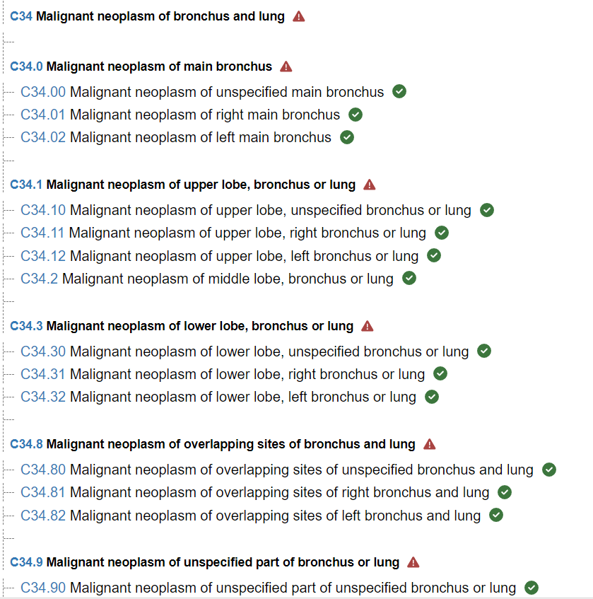
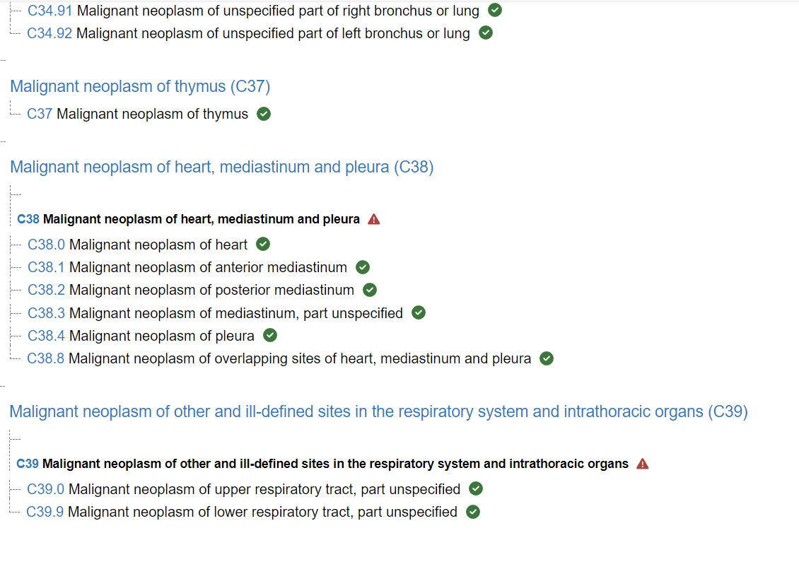
C33: Malignant neoplasm of trachea
C78: Secondary malignant neoplasm of resp and digestive organs

Slide 6
SWAG Local N/S led follow up 1 year post thoracic surgery
Draft Protocol discussion and sign off

Slide 7
SWAG Local N/S led follow up 1 year post thoracic surgery - Timeline
24/25: c£67k
25/26: c£136k
Activity | Month
 | January | February | March | April | May | June
Clinic Process established | Weston / SFT
 | RUHB?
Recruitment |  | Weston | SFT
 | RUHB?
Training | GHFT | SFT |  | Weston
 | RUHB?
Final Review and Sign off | GHFT |  |  | Weston
 | RUHB?
Live | GHFT / NBT | SFT |  |  | Weston
 | RUHB?
Notes:
C45 mesothelioma

Slide 8
SWAG Local N/S led follow up 1 year post thoracic surgery – SFT
Resource Type | Description | Cost in £ (2024/25) | Cost in £ (2025/26)
Personnel | 1x WTE band 4 HCA/co-ordinator | £6150 | £35k (inc. on costs) + pay award
Equipment | Desktop computer, keyboard, mouse & 24” monitors | £788
 | 1x Dual network point | £172
 | Jabre Evolve headset | £34.99
 | Telephone point and Telephone | £1k
 | Desk and chair | £800
Software | Usual PCs and access to RMS/SCR data bases and hospital systems | TBC
Training
Other
Estimated cost:
Total est. cost for 2024/25 | £ 8k
Total est. cost for 2025/26 | £ £35k + pay awards
Grand Total Cost | £ £43k

Slide 9
SWAG Local N/S led follow up 1 year post thoracic surgery – RUH Bath
Resource Type | Description | Cost in £ (2024/25) | Cost in £ (2025/26)
Personnel | 2 days of Band 7 nursing time, rising to 2.5 days is the second year. 1 hour of consultant time a week to provide oversight to service, support with scan reviews and MDT discussion. 1 day of Band 3 admin support per week to type up letters and input data into surveillance spreadsheet, organise scan and follow ups. | 2 days B7- plus 30% on costs = £27,460.00 | 2.5 days B7 - plus 30% on costs = £34,325.84
 |  | 1 hour consultant time per week - £5159.44 | 1 hour consultant time per week - £5159.44
 |  | 1 day Band 3 admin plus 30% on costs - £6,675.24 | 1 day Band 3 admin plus 30% on costs - £6,675.24
Equipment | Laptop – don’t have sufficient space within Respiratory to undertake this additional activity so will need to be undertaken in another outpatient department £775 + VAT | £930 | 0
Software
Training
Other
 | Total | £ 39,294.68 | £ 46,160.52
Notes:
c86k

Slide 10
SWAG Local N/S led follow up 1 year post thoracic surgery - Weston
Estimated cost:
Total est. cost for 2024/25- 15,996£
Total est. cost for 2025/26 - 54725 £
Grand Total Cost-70,721£
Notes:
C45 mesothelioma

Slide 11
SWAG Lung Treatment variation work programme planning 25/26
Treatment variation programme 2025/26: focuses on a specific GIRFT lung metric: Ensure at least 70% of patients with NSCLC stage IIIB-IVB and PS 0-1 receive systemic anti-cancer therapy (SACT) in line with NICE guidance.
National programme suggest latest quarterly data reported SWAG flagged as having 3 providers who fall below the 70%
Below data is NLCA July 2023
Provider | Proportion
NBT | 41.88%
UHBW | 46.14%
SFT | 21.4%
Notes:
GHFT 79.64
RUH 72.65
SDH 77.57

Slide 12
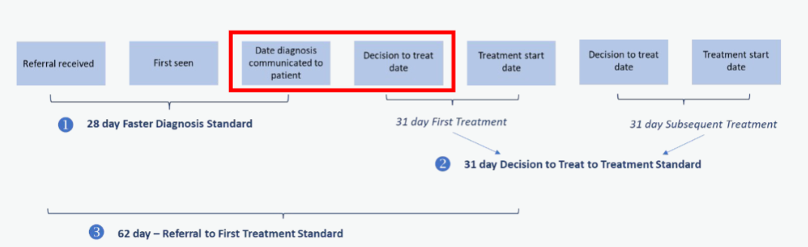
SWAG Lung Planning 2025/26
Lung pathway 62-day performance including staging and treatment phases focus of Operational Performance work programme bringing more scrutiny and funding.
Sep-24 62d | Glos | North Bristol | Royal United Bath | Salisbury | Somerset | UHBW | SWAG overall (commissioner-based)
Lung | 47.3% (27.5) | 46.4% (14) | 53.7% (20.5) | 54.2% (12) | 64.3% (21) | 59.8% (41) | 57.3% (143)
Notes:
GM 1 stop – Henry GHFT version

