Slide 1
SWAG Lung Cancer CAG
3rd December 2024
Louise Medley
Consultant Medical Oncologist
SW GLH Solid Cancer Lead
ctDNA Update
Tissue Update
Questions/Feedback from CAG
@SWGenomics / @SWGLH / @NHSgms

Slide 2
ctDNA in NSCLC
Phase 3
‘No patient should be diagnosed with Stage IIIB*/IV NSCLC without having had a ctDNA test’
* Not radically treatable

Slide 3
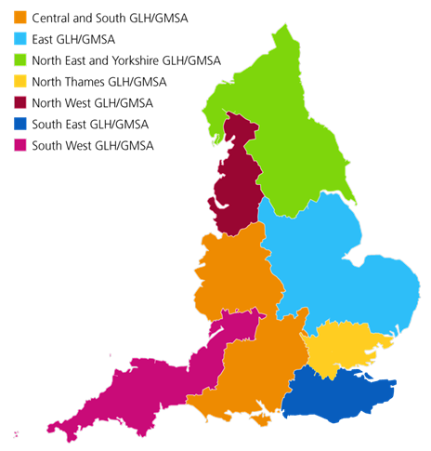
Onboarding
All 9 trusts within the South West GMSA are now onboarded
Total tests carried out 359 (> 9% of total ctDNA tests nationwide)
Averaging 51 tests per month (up from 46 in Sept)
Weekly Lung GTEB set up, now been running for approx 3 months
50% of Trusts regularly attending GTEB meetings
Notes:
Include: Map of trusts, table/chart of tests each month

Slide 4
ctDNA Samples by Trust
Notes:
Onboarding now complete
Chart shows number of tests carried each month by each individual trust. Areas to reach out to: TSFT, UHBW & UHPT where we have seen drops in the tests being carried out. This could be due to natural fluctuation of patients but probably worth looking into
Chart shows number of GTEB attendances per trust. Note each trust attendance is recorded once per GTEB regardless of how many clinicians are present

Slide 5
ctDNA Current Challenges
Turnaround times from RMH
Remain 14 days from lab receipt to report
Failure Rates from RMH
-Technical issues have meant increased failure rate and re- running samples leading to increased TAT
-Contingency plan may be used (Guardant Reports)
Time from RMH report release to clinical team acting on report
Local data?
Notes:
Onboarding now complete
Chart shows number of tests carried each month by each individual trust. Areas to reach out to: TSFT, UHBW & UHPT where we have seen drops in the tests being carried out. This could be due to natural fluctuation of patients but probably worth looking into
Chart shows number of GTEB attendances per trust. Note each trust attendance is recorded once per GTEB regardless of how many clinicians are present

Slide 6
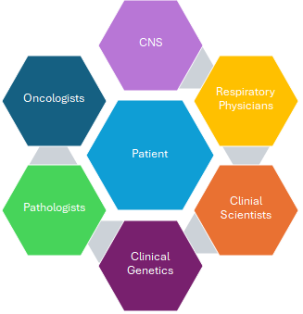
Next Steps
Onboarding
2) GTEB Engagement
1) Review local trust pathways
Review pathways
Update stakeholder mapping – Have leads/contacts changed?
Monitor monthly data from GMS to support trusts who may want support
Work with Lung Cancer leads to map local pathways for ctDNA
Use pathways to identify gaps/delays e.g access to Phlebotomy, training, logistics or informatics)
2) GTEB Engagement
Identify blockers to GTEB engagement
Notes:
Onboarding now complete
Chart shows number of tests carried each month by each individual trust. Areas to reach out to: TSFT, UHBW & UHPT where we have seen drops in the tests being carried out. This could be due to natural fluctuation of patients but probably worth looking into
Chart shows number of GTEB attendances per trust. Note each trust attendance is recorded once per GTEB regardless of how many clinicians are present

Slide 7
Questions to the Room
How confident do you feel:
In reading the ctDNA reports you are getting?
In acting upon the ctDNA report if it demonstrates an actionable variant (eg ALK, EGFR etc)
Do you think ctDNA has helped improve your pathway to treatment?
Do you have ctDNA results available at Lung MDM for discussion

Slide 8
Tissue Molecular Testing in NSCLC
Update
Turnaround times (RNA and DNA)
Remain 10-14 days from lab receipt to report
Failure Rates RNA
Local examples vary but as low as 12%
Reporting of New Gene Targets
New Report Layout
* Not radically treatable

Slide 9
Reporting of New Gene Targets
NOW
No real change for NSCLC panels as these are already reported in SW
25/26
APR 25
Additional targets reported for NSCLC (clinical trials, germline findings)
Notes:
Onboarding now complete
Chart shows number of tests carried each month by each individual trust. Areas to reach out to: TSFT, UHBW & UHPT where we have seen drops in the tests being carried out. This could be due to natural fluctuation of patients but probably worth looking into
Chart shows number of GTEB attendances per trust. Note each trust attendance is recorded once per GTEB regardless of how many clinicians are present

Slide 10
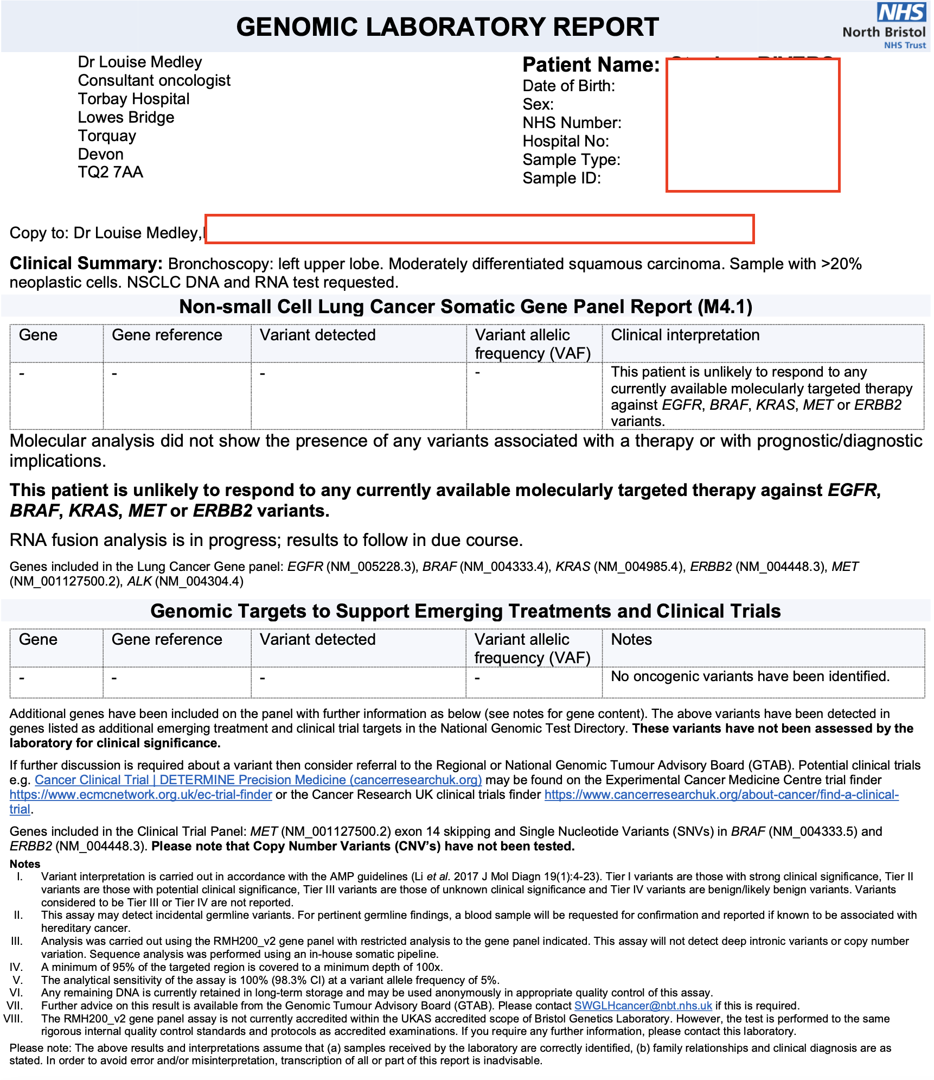
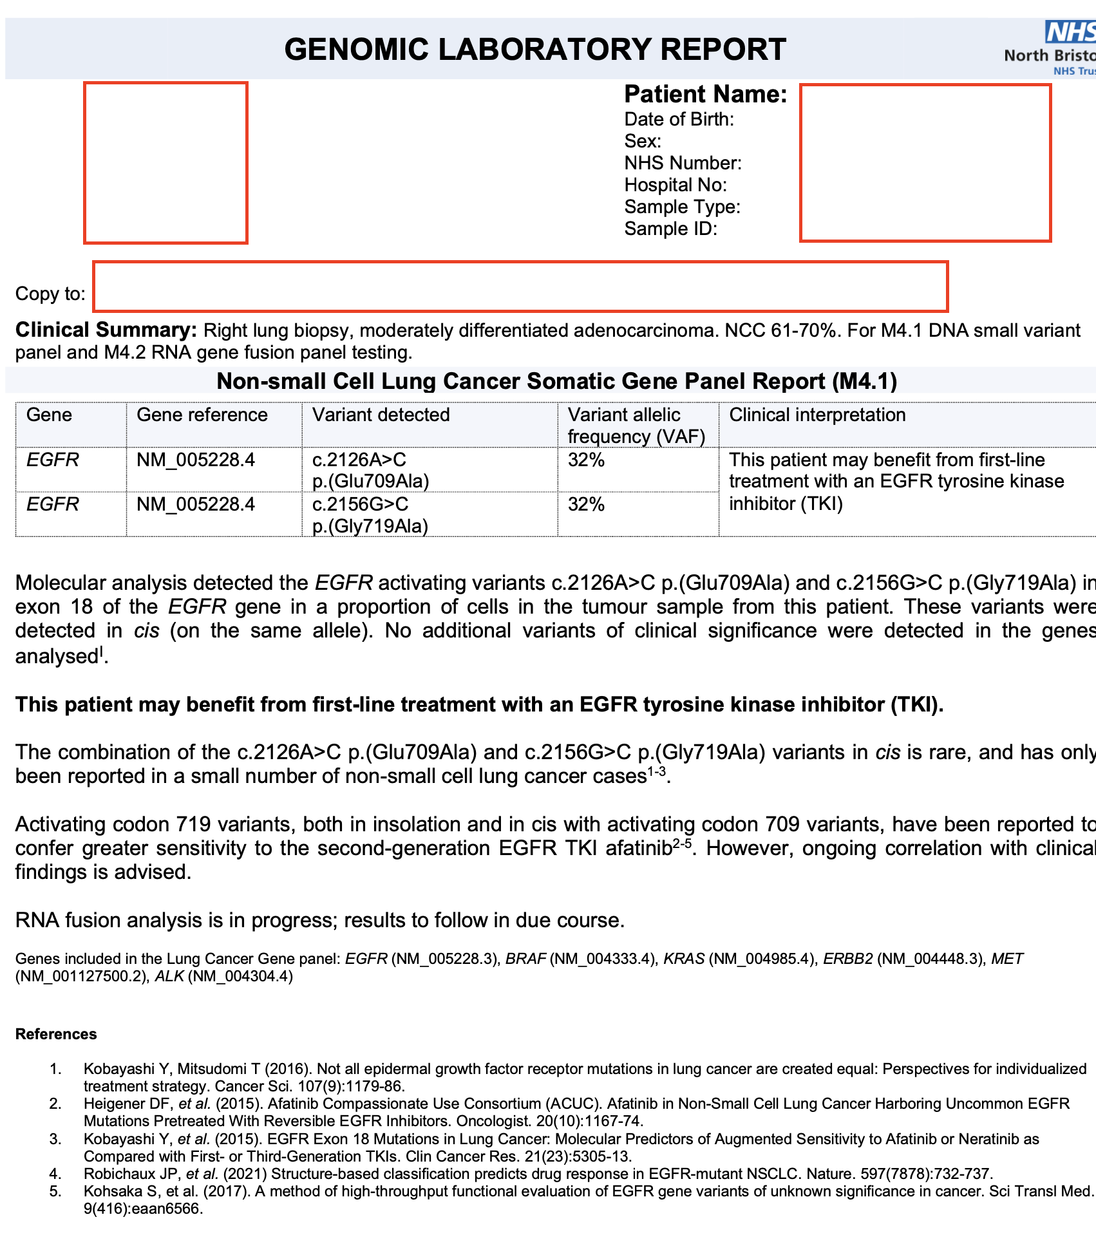

Slide 11
Questions to the Room
How confident do you feel:
In reading the Tissue reports you are getting?
In acting upon the report if it demonstrates a possible research variant or possible germline finding (eg BRCA)
How do you document the tissue (and ctDNA) results on your MDT outcome?
How are you in your MDM going to manage the potential new information from extra reporting?

Slide 12
Questions for GMSA/GLH Teams
ruth.bagg2@nhs.net
louise.medley@nhs.net
@SWGenomics / @SWGLH / @NHSgms

