Slide 1
SWAG Network Lung Cancer
Clinical Advisory Group
Research Update
Claire Matthews
3/12/2024

Slide 2
Research Delivery Network vision, mission and purpose

Slide 3
Research Delivery Network
Vision
The UK is a global leader in the delivery of high quality, commercial and non commercial research that is inclusive, accessible and improves health and care.
Mission
Enabling the health and care system to attract, optimise and deliver research across England.
We do this as part of the NIHR’s overall mission to improve the health and wealth of the nation through research.

Slide 4
Research Delivery Network (RDN) purpose
Support the successful delivery of high quality research, as an active partner in the research system.
Increase capacity and capability of the research delivery infrastructure for the future.
This means research can:
Reach more people
Address changing population needs
Support the successful delivery of high quality research
Increase capacity and capability of the research delivery infrastructure for the future

Slide 5
Delivering on RDN’s purpose
RDN focuses on strategic support for the whole portfolio, rather than day-to-day involvement in individual studies, except on request
Sites are supported to monitor their own performance of individual studies, build study-level capacity and consider research delivery in research applications
RDN increases understanding of and supports work to address strategic issues that cut across sites, regions or settings. This might be through a strategic project we lead, by supporting projects led by partners, or by providing the intelligence and evidence to enable others to make change
Agile Delivery Teams provide additional targeted support for individual studies and help us to build capacity and capability where it is needed.

Slide 6
RDN change statements
A new organisation building on the successes of the Clinical Research Network (CRN). The Research Delivery Network (RDN) differs from the CRN in the following ways:
A single organisation with greater consistency of experience for customers
Collective responsibility and joint leadership of the organisation
A collegiate and a customer-focused partner
Stronger focus on strategic development of research capacity and capability, nationally and regionally, with partners
Emphasis on continuous improvement, learning and value for money in every part of RDN

Slide 7
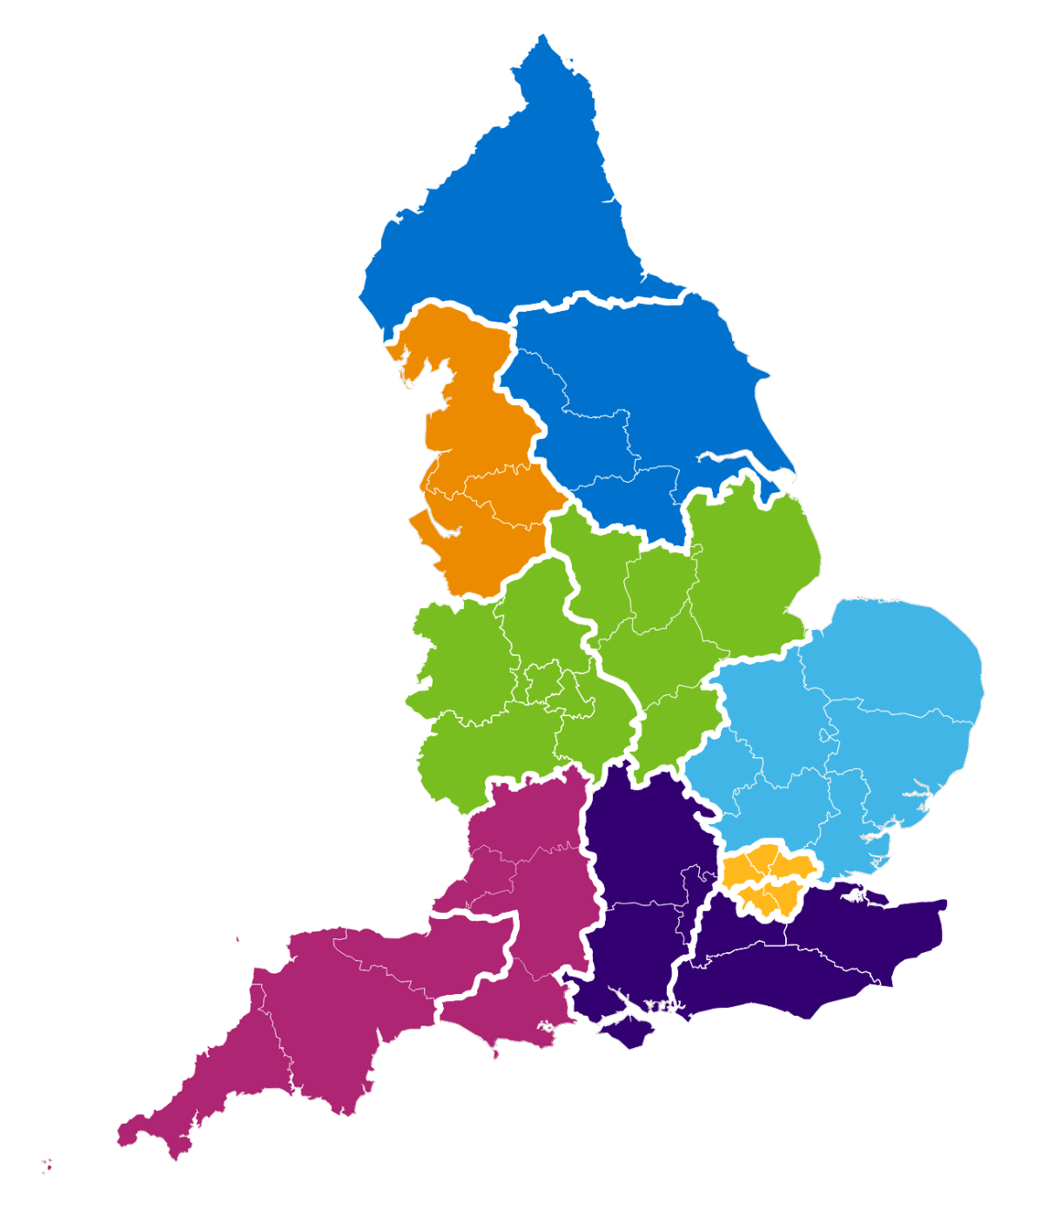
Combined Regional (Network) map
NHS England Region | Regional Research Delivery Network (RRDN) |  | RRDN Hosts
North East and Yorkshire | A | North East and North Cumbria | The Newcastle upon Tyne Hospitals NHS Foundation Trust
 | B | Yorkshire and Humber | Leeds Teaching Hospitals NHS Trust
North West | C | North West | Manchester University NHS Foundation Trust
Midlands | D | East Midlands | University Hospitals Of Leicester NHS Trust
 | E | West Midlands | The Royal Wolverhampton NHS Trust
East of England | F | East of England | Norfolk and Norwich University NHS Foundation Trust
London | G | North London | Barts Health NHS Trust
 | H | South London | Guy’s & St Thomas’ NHS Foundation Trust
South East | I | South Central | University Hospital Southampton NHS Foundation Trust
 | J | South East | Royal Surrey NHS Foundation Trust
South West | K | South West Central | University Hospitals Bristol and Weston NHS Foundation Trust
 | L | South West Peninsula | Royal Devon University Healthcare NHS Foundation Trust
A
B
C
D
E
F
G
K
I
H
J
L

Slide 8
South West
NHSE Region | Regional Research Delivery Network |  | ICS Areas | NHS Trusts | Additional information
South West | K | South West Central | Bath & North East Somerset, Swindon & Wiltshire Bristol, North Somerset & South Gloucestershire Dorset Gloucestershire | GWH FT​ RUHB FT Salisbury NHS FT AWP NHS Trust NBristol NHS Trust UHBW FT Dorset County H FT Dorset Healthcare U FT SWAS FT UHD FT GHC FT GH FT | Population: 3.3m NHS Trusts: 11 Studies: 1,496 Participants: 109,964
 | L | South West Peninsula | Cornwall and The Isles of Scilly Devon Somerset | [2 trusts] [4 trusts] Somerset FT Yeovil DH FT | Population: 2.3m NHS Trusts: 10 Studies: 1,409 Participants: 67,604
Networks K and L -
‘South West Central’
and ‘South West Peninsula’
K
L

Slide 9
Development of RDN’s strategy and services
RDN-wide strategy based around settings and organisational vision and purpose
Study Support Service
AcoRD / NCVR
Agile Research Delivery Team
Support for out of hospital settings
Life Sciences Partnership & Growth (includes key accounts and customer engagement)
Workforce Development
Finance (includes funding model and financial management)
Data & Analytics
Planning
Contractual Management including performance framework
Public Engagement
Specialities and Settings
Strategic Development
Study Participation Inclusion
Communications
Stakeholder engagement

Slide 10
Lung Cancer Portfolio Overview

Slide 11
National Recruitment to Lung Cancer Studies
Apr 2023 - Mar 2024
Apr 2024 - Nov 2024
Data cut 26/11/2024
Source: ODP All Portfolio

Slide 12
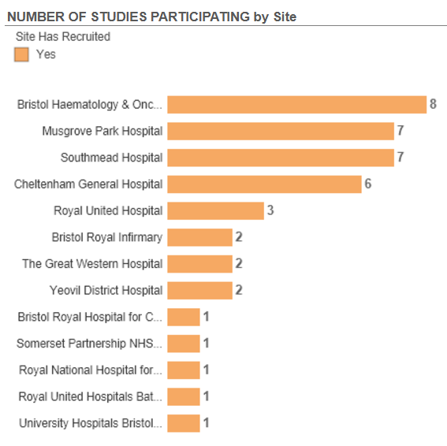
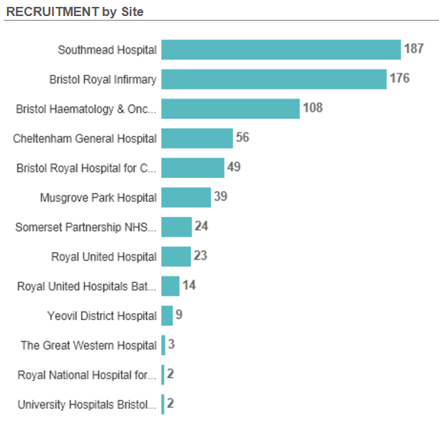
Studies and Recruitment by site Apr 2022 - present
Pleural Effusion Biomarker Study
NIHR BioResource - Rare Diseases (210)
NIHR BioResource - Rare Diseases (49)
Data cut 27/11/2024
Source: ODP All Portfolio

Slide 13
Studies open to recruitment
43 Studies currently open to recruitment in the region, 38 with recruitment
Highest recruiting studies (Eng):
NIHR BioResource - Rare Diseases 22,391
ICI Genetics - 2437
Lighthouse - 748
SCOOT - 590
Assess-meso - 508
Studies open in the last 12 month on following slide
Full list here: Lung Cancer open studies NOV24

Slide 14
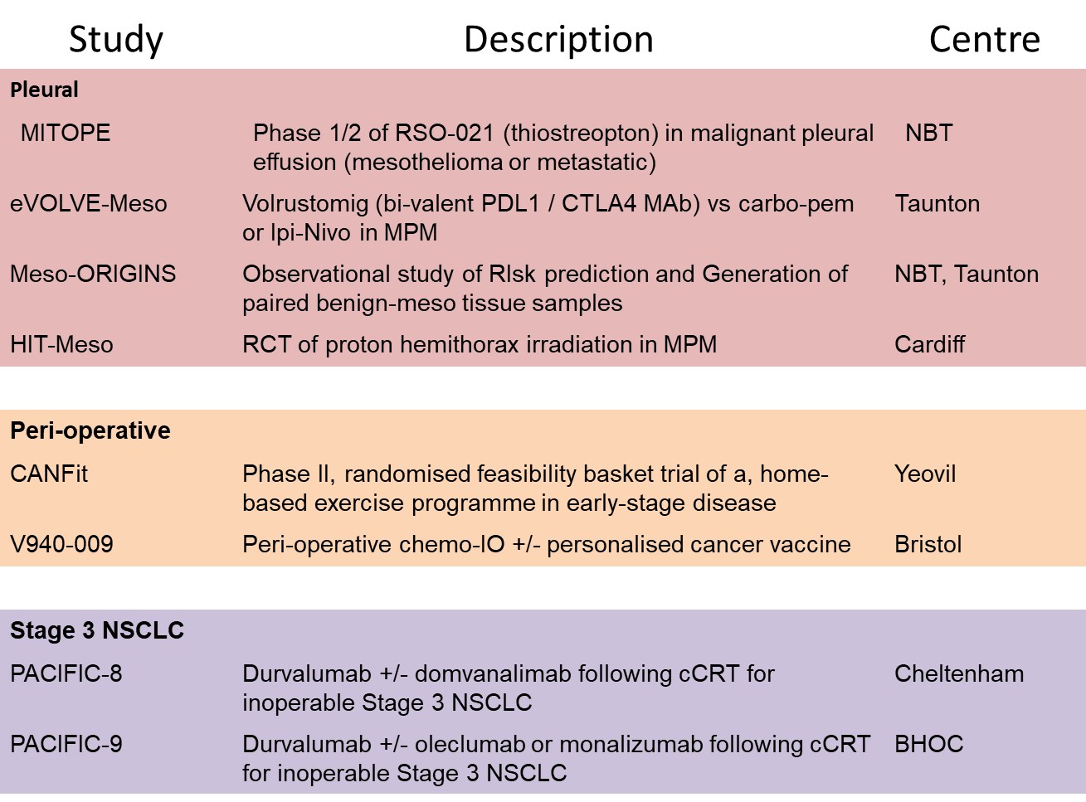

Slide 15
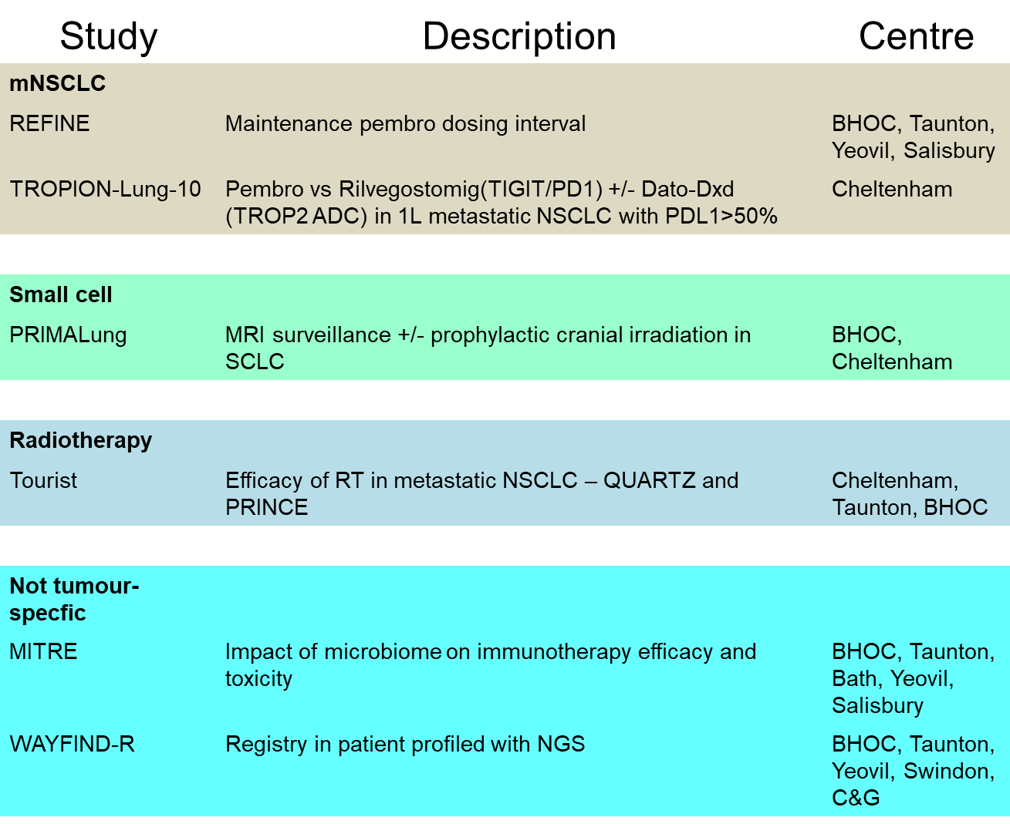

Slide 16
Opening soon
BRAF V600E
CFT1946-1101 NSCLC pre-treated with BRAFi and PDL1i BHOC
Ph 1/2 - CFT1946 (oral BIDAC degrader) +/- trametanib
KRAS G12C
KRASCENDO-2 1L NSCLC with KRAS G12C
Divarasib + pembro vs chemo + pembro BHOC
Further studies in several centres awaiting selection

Slide 17
Studies opened in the last 12 months
CPMS ID | Short Name | Sites | Opening | Closure | Sample Size Eng | Eng Recruits
61516 | H2H ph3 in 2L NSCLC divarasib vs soto or ada |  | 10/10/2024 | 30/09/2025 | 39 | 2
58100 | A Phase I/II trial of UCB4594 in participants with advanced cancer. |  | 15/09/2024 | 01/11/2028 | 167 | 0
62639 | QUARTZ LUNG (TOURIST Platform) | Chelt, Mus, Yeov (all in set up) | 31/07/2024 | 30/06/2027 | 280 | 1
61676 | PRINCE (TOURIST Platform) | BHOC, Chelt, Weston, Mus, Yeov | 31/07/2024 | 31/03/2026 | 300 | 4
57397 | TROPION-Lung10 | Chelt | 25/06/2024 | 27/08/2027 | 21 | 1
57349 | Integrated Short-term Palliative Rehabilitation in Incurable Cancer |  | 08/05/2024 | 02/10/2025 | 38 | 13
54260 | LION | GWH, RUH, Yeov | 08/05/2024 | 10/04/2026 | 89 | 6
57835 | NHS Cancer Vaccine Launchpad (NHS CVLP) | BHOC, Chelt, RUH, SDH, GWH, Mus, Yeo | 17/04/2024 | 01/05/2025 | 9951 | 297
55290 | HIT-Meso | NBT | 28/03/2024 | 30/06/2026 | 132 | 11
56318 | CANFit: home-based exercise programme for patients with cancer | Mus, Yeov | 04/12/2023 | 28/03/2025 | 660 | 8
55363 | eVOLVE-Meso |  | 24/11/2023 | 30/09/2025 | 40 | 42
Data cut 27/11/2024
Source: ODP All Portfolio

Slide 18
REFINE-Lung - Seeking new sites
REFINE-Lung: A randomised phase III trial of reduced frequency pembrolizumab immunotherapy for first-line treatment of patients with advanced non-small cell lung cancer (NSCLC) after 6 months of standard therapy utilising a novel multi-arm frequency-response optimisation design.
REFINE-lung will test whether reduced pembro dose frequency after 6 months of standard treatment is safe and effective. Patients treated with 1st line pembro who are progression free and otherwise planning to continue therapy at 6 months were initially randomised to control 6 weekly versus interventional 12 weekly therapy. Interim analysis showed that the 12 weekly treatment is no less effective, and subsequent patients are now also being randomised to 9, 15 and 18 weekly treatment frequency arms.
IDMC found no reason whatsoever why this trial should not progress to the definitive 5 arm trial. Importantly, patients who progress on a reduced frequency arm will be offered re-escalation to standard 6 weekly therapy.
Due to submit a substantial amendment to the trial before the end of 2024 which will reduce the sample size to 1100 patients (from 1750 originally) and extend the recruitment period to February 2027 and study end date to August 2028.
Contact REFINE-Lung@imperial.ac.uk
Notes:
Currently open at BHOC& Yeovil; Salisbury EoI; GWH Feasibility.

Slide 19
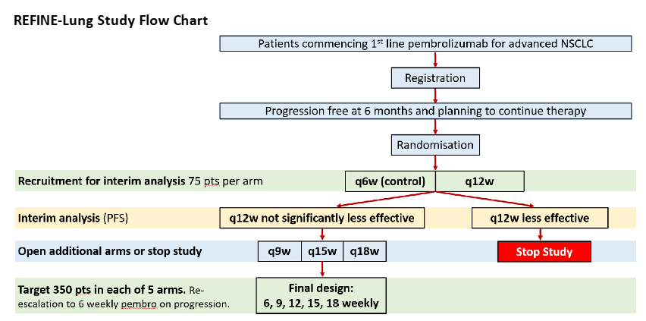
REFINE-Lung (CPMS 52203)

Slide 20
Cancer Vaccine Lung Studies - National
CPMS ID | Short Name | Title | Status | Opening | Closure
64774 | BNT327-07 - BioNTech - NSCLC - 4781/0096 | A Phase II, multisite, open-label, single arm trial of BNT327 in combination with docetaxel in second-line stage IV or recurrent non-small cell lung cancer (NSCLC) following chemoimmunotherapy | In Setup, Pending Approval | 15/03/2025 | 31/03/2027
60826 | V940-009 | Phase 3 Randomized Double-blind Placebo-controlled Study of Adjuvant Pembrolizumab W/WO V940 in Resectable Stages II-IIIB(N2) NSCLC for patients not achieving pCR after receiving Neoadjuvant Pembrolizumab with Platinum-based Doublet Chemotherapy Followed by Surgery | In Setup, Pending Approval | 09/10/2024 | 17/05/2029
58195 | Phase 3 Study of ONC-392 vs Docetaxel in NSCLC | Phase 3, Two-stage, Randomized Study of ONC-392 Versus Docetaxel in Metastatic Non-Small Cell Lung Cancers that Progressed on PD-1/PD-Ll Inhibitors | Open, With Recruitment | 26/02/2024 | 25/07/2027
57876 | LuCa-MERIT-1 | LuCa-MERIT-1: First-in-human, open label, Phase I dose confirmation trial evaluating the safety, tolerability and preliminary efficacy of BNT116 alone and in combinations in patients with advanced non-small cell lung cancer | Open, With Recruitment | 09/04/2024 | 31/07/2025
55753 | Mobilize Trial | Phase 1/2 Study of mRNA 4359 Administered Alone and in Combination With Immune Checkpoint Blockade in Participants with Advanced Solid Tumors | Open, With Recruitment | 24/08/2023 | 28/10/2025

Slide 21
PRES 2023/24
report summary

Slide 22
Summary
59,237 participants across the West of England volunteered to take part in health and care research
Participants in the region were recruited into a total of 637 studies
6,209 people completed a survey; 6,103 responses to the adult survey and 106 responses to the children and young people survey (CYP)
Data cut 05/11/2024
Source: ODP All Portfolio
Notes:
Responses showed that the majority of people taking part in research had a positive experience, with their interaction with research delivery colleagues being an essential part of this experience.

Slide 23
Responses by specialty
Specialty | Responses
Public Health | 4,390
Cardiovascular Disease | 251
Cancer | 213
Infection | 185
Primary Care | 176
Respiratory Disorders | 127
Reproductive Health and Childbirth | 86
Anaesthesia, Perioperative Medicine and Pain Management | 78
Mental Health | 42
Children | 30
Diabetes | 28
Stroke | 27
Metabolic and Endocrine Disorders | 27
Musculoskeletal Disorders | 25
Dementias and Neurodegeneration | 24
Renal Disorders | 22
Data cut 05/11/2024
Source: ODP All Portfolio
Notes:
Responses were received across 24 of 31 specialty areas. The chart above shows the specialties with over 20 responses. The large number of responses from public health studies is due to the high number of responses from ALSPAC.

Slide 24
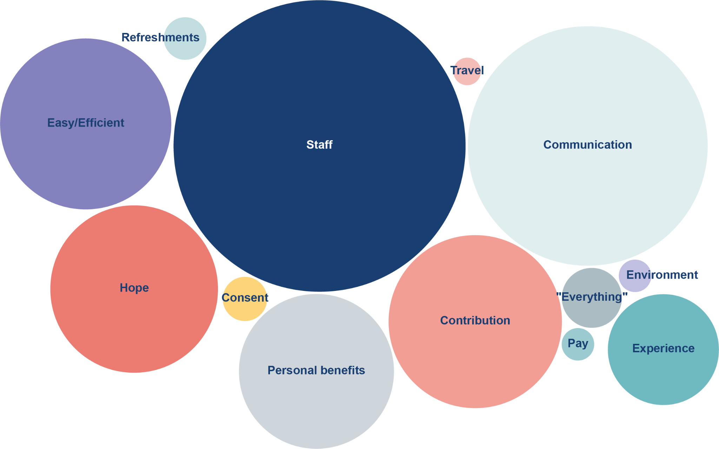
What was positive about your research experience?
Data cut 05/11/2024
Source: ODP All Portfolio
Notes:
76% of respondents left a comment explaining what made their research experience positive. From these comments we identified the following themes:
The 3 top themes remain the same as last year: research delivery staff, good communication and contributing to improving healthcare. This year there has been an increase in the proportion of comments related to good communication, moving from the third highest theme to the second highest. It is positive to see an increase in comments around communication as this is a theme that is often highlighted as the area that needs the most improvement.
Consent is a new theme that we identified this year. This relates to people feeling that there wasn’t any pressure to take part, that they were given the time to make their decision and that it was made clear that they could withdraw their consent at a later date if they wanted to. This is something that is often discussed as part of Informed Consent training, so it is positive to see these comments coming through.

Slide 25
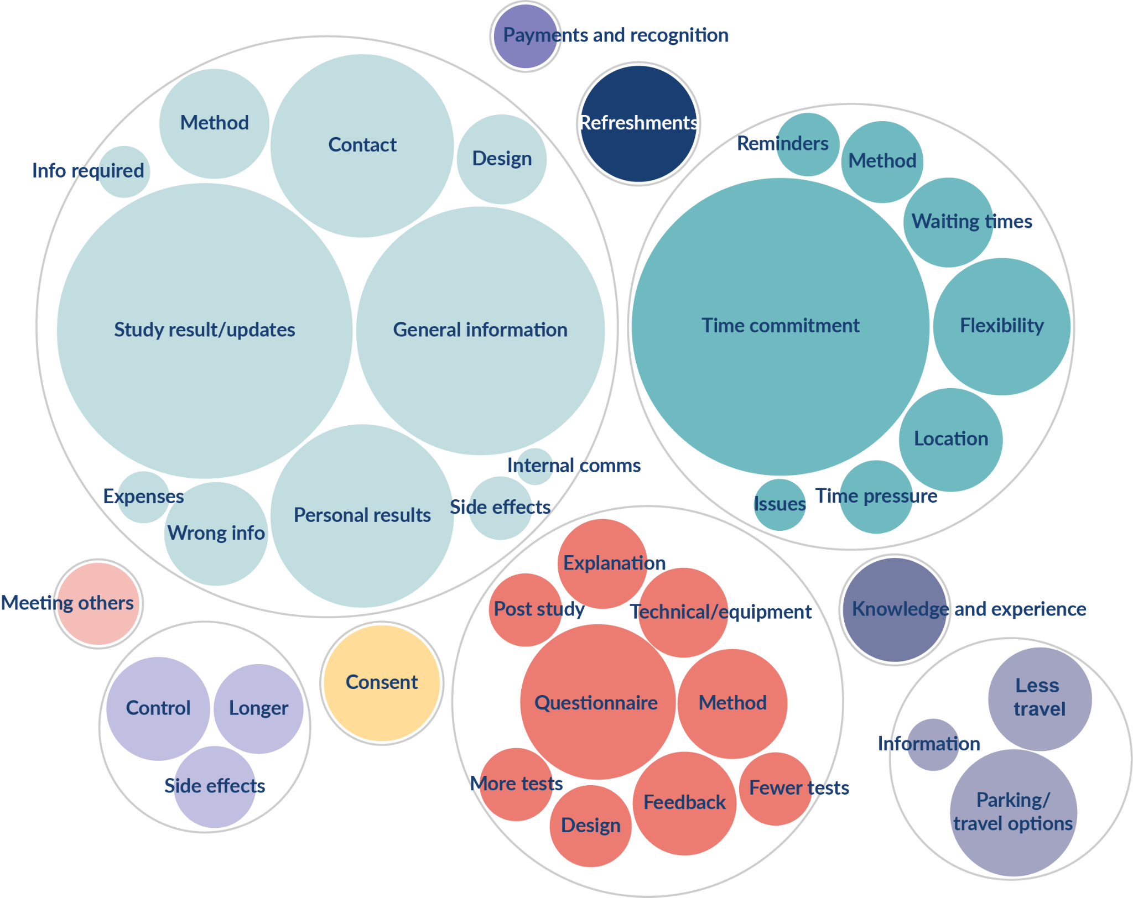
What would have made your research experience better?
Communication
Procedures and materials
Appointments
Travel
Study related
Consent
Refreshments
Knowledge and experience
Meeting others
Payments and recognition
Data cut 05/11/2024
Source: ODP All Portfolio
Notes:
21% left a comment about what could have made their research experience better. This table shows the themes that we identified from these comments.
Although fewer participants left comments about what would have made their experience better, the themes identified are broadly the same as last year.
Through the PRES survey, communication has consistently been identified as the biggest area for improvement. This is the 4th year in a row that it has been highlighted as the most common issue. It’s important that more work is done to ensure participants are kept updated and informed about the research studies that they are taking part in. At the RDN we will continue to champion the importance of communication with participants and encourage our sites to put processes in place to ensure this happens. A number of our sites have already started to implement initiatives to address this, such as participant newsletters, but this needs to be more consistent across the region.

Slide 26
PRES working group
Formed a PRES working group made up of representatives from our Partner Organisations, as well as members of the public.
Meets monthly to discuss and implement improvement projects based on feedback from the survey.
Led to changes in research delivery, such as offering appointments outside of working hours, buying a coffee machine and creating cards with contact details.
One of the priority projects is a participant leaflet to answer common questions that are frequently raised through PRES, such as explaining why it can take a long time for study results to be shared and the importance of participants on the control arm.
Data cut 05/11/2024
Source: ODP All Portfolio

Slide 27
Recommendations and next steps
Communication
Procedures and materials
PRES delivery
Data cut 05/11/2024
Source: ODP All Portfolio
Notes:
Identify ways communication with participants can be improved, especially in relation to sharing the results of the study and providing regular updates
Ensure new participants are given general information in a clear and concise way about the study, such as its aims and timescales
Explore ways of ensuring participants understand how to get in contact with the study team
Where possible, provide participants with results to their personal tests or explain why these cannot be provided
Ensure all procedures are fully explained to participants and that they know how to use any equipment that is required as part of their participation
Where possible, ensure all equipment required for research appointments is available and working correctly
Explore ways to record whether each participant has been offered a PRES survey to ensure that everyone taking part in research is offered the opportunity to share their feedback

Slide 28
Associate Principal Investigator
Scheme
Six month in-work training opportunity, providing practical experience for healthcare professionals starting their research career.
People who would not normally have the opportunity to take part in clinical research in their day to day role have the chance to experience what it means to work on and deliver a NIHR portfolio trial under the mentorship of an enthusiastic Local PI.
CIs working with a CTU can register their study on the scheme
https://www.nihr.ac.uk/health-and-care-professionals/career-development/associate-principal-investigator-scheme.htm

Slide 29
Principal Investigator Pipeline Programme
(PIPP)
Overview
Research delivery nurses or midwives
12 to 18 months
Free if you’re eligible
Live virtual lessons, online learning and hands-on experience
Cohort 4 applications open at the end of March 2025
Please email nursingandmidwifery@nihr.ac.uk for more information
https://www.nihr.ac.uk/career-development/clinical-research-courses-and-support/principal-investigator-pipeline-programme

Slide 30
NIHR ODP https://odp.nihr.ac.uk/
Open data platform. Data on performance across whole RDN, including all specialty areas
NIHR Be Part of Research https://bepartofresearch.nihr.ac.uk/
See which studies are open across the country
Find a Clinical Research Study (ODP) http://csg.ncri.org.uk/portfolio/portfolio-maps/
Search for a study to fit criteria. Good for horizon scanning, eligibility criteria

Slide 31
RRDN Contacts
swc.rrdn@nihr.ac.uk
Study Support Service Manager: claire.matthews@nihr.ac.uk
CAG Research Lead: gareth.ayre@uhbw.nhs.uk

