Slide 1


NLCA Updates
Somerset, Wiltshire, Avon & Gloucestershire Cancer Services Clinical Advisory Group Meeting
3rd December 2024
Dr Lauren Dixon
NLCA Clinical Fellow

Slide 2


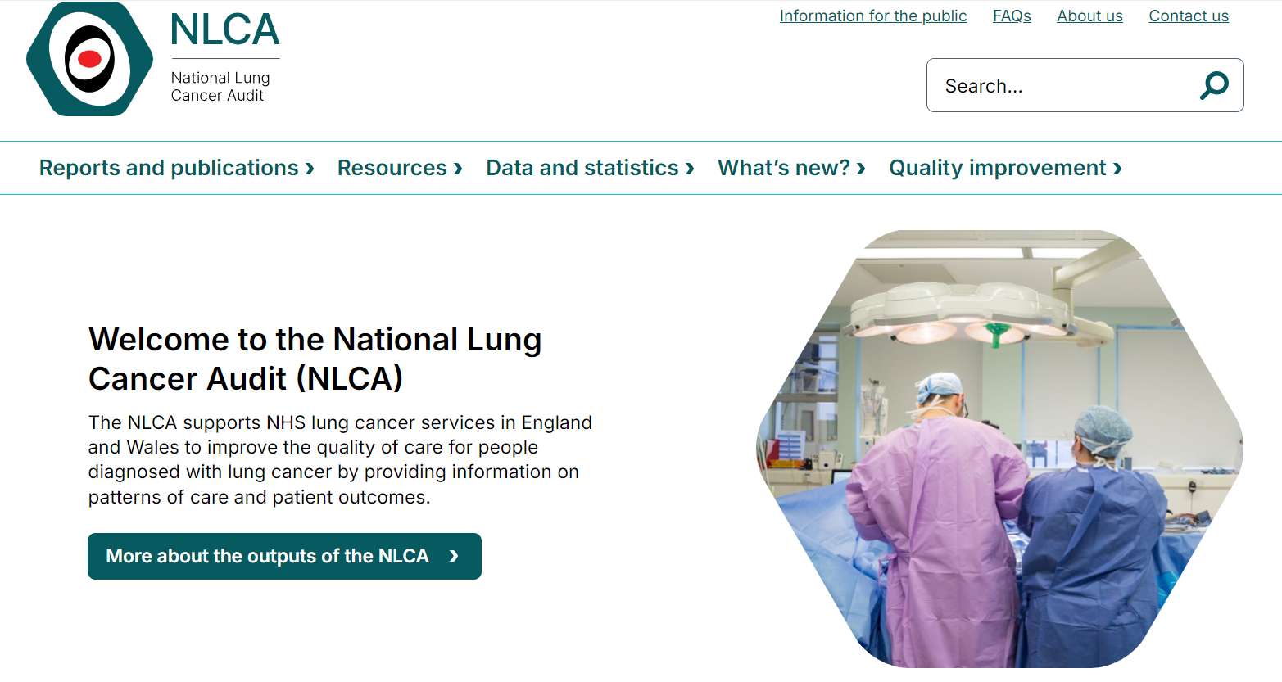
NLCA in 2024
State of the Nation 2024
Quarterly reporting
Early Signal Reporting
Joined NATCAN
New website
Patient and Public Involvement (PPI) Forum
Extended projects

Slide 3
State of the Nation 2024
Patients diagnosed 1st January 2022 – 31st December 2022
Data for England – Rapid Cancer Registration Dataset (RCRD)
Data for Wales – Gold Standard dataset
NEW online interactive dashboard for trust level data
Key findings…

Slide 4
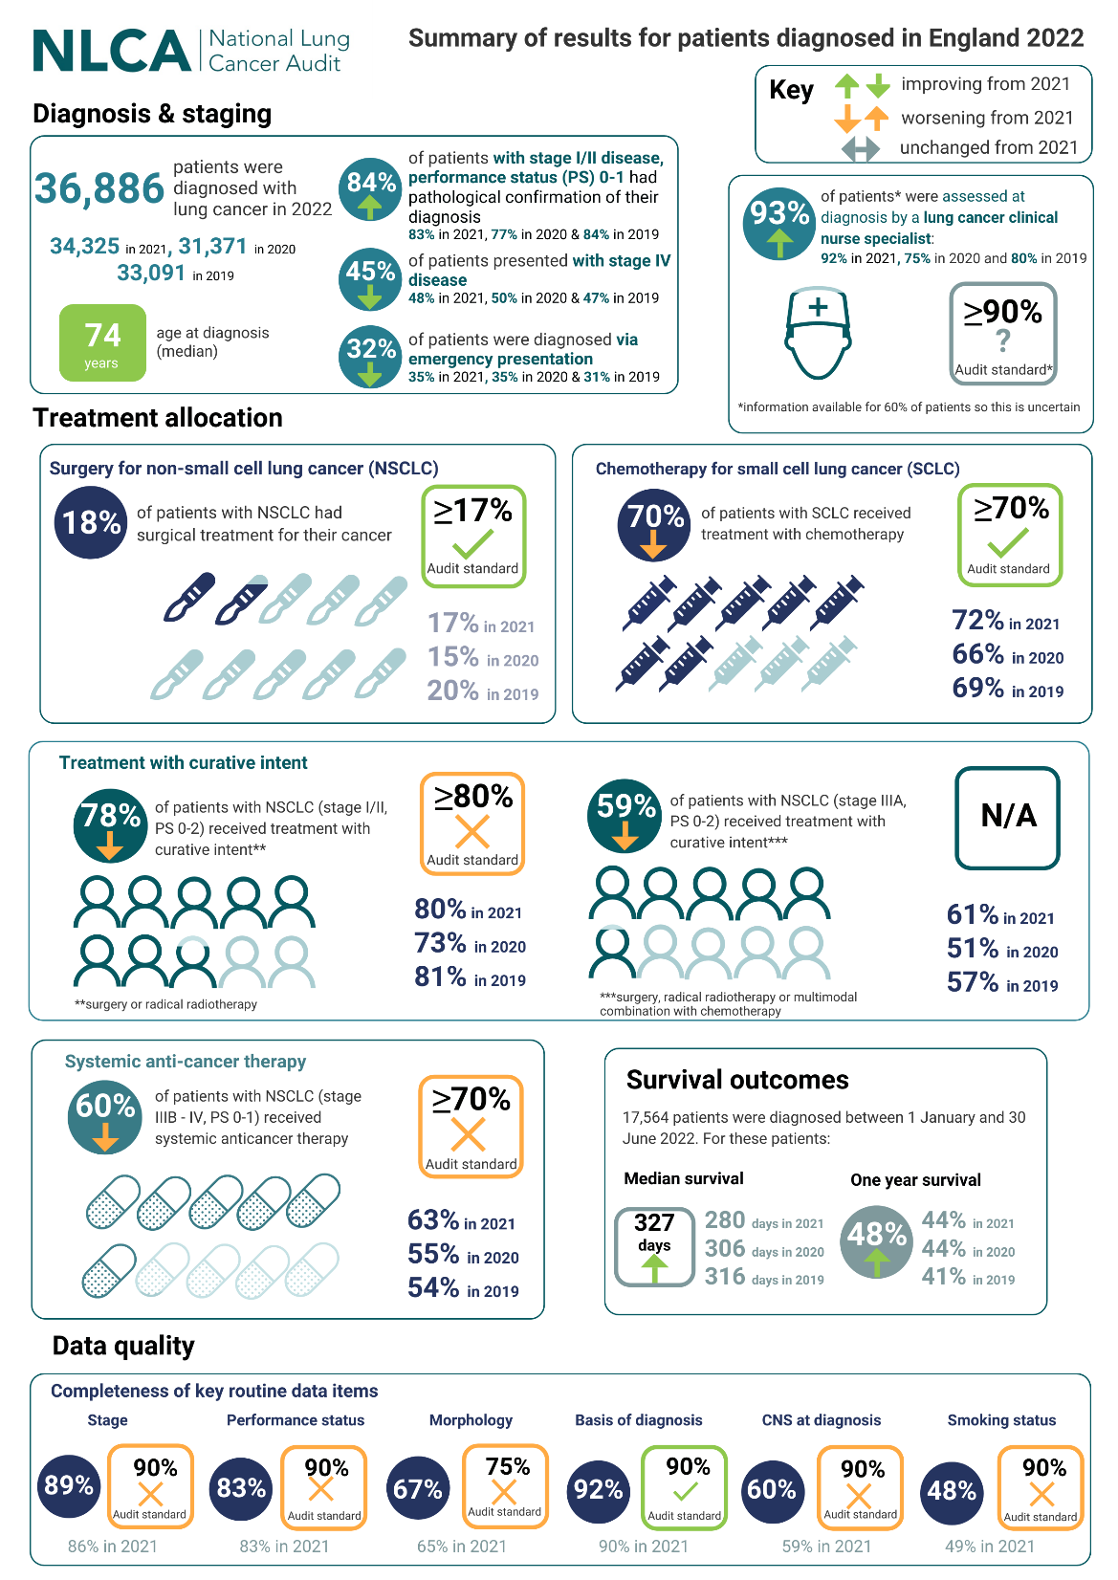
England in 2022
1,087 patients diagnosed from TLHC

Slide 5
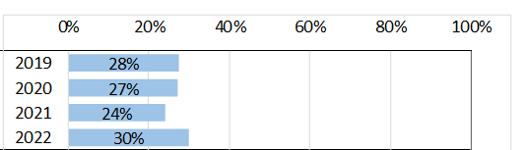
Stage I/II at Diagnosis
England
Wales

Slide 6
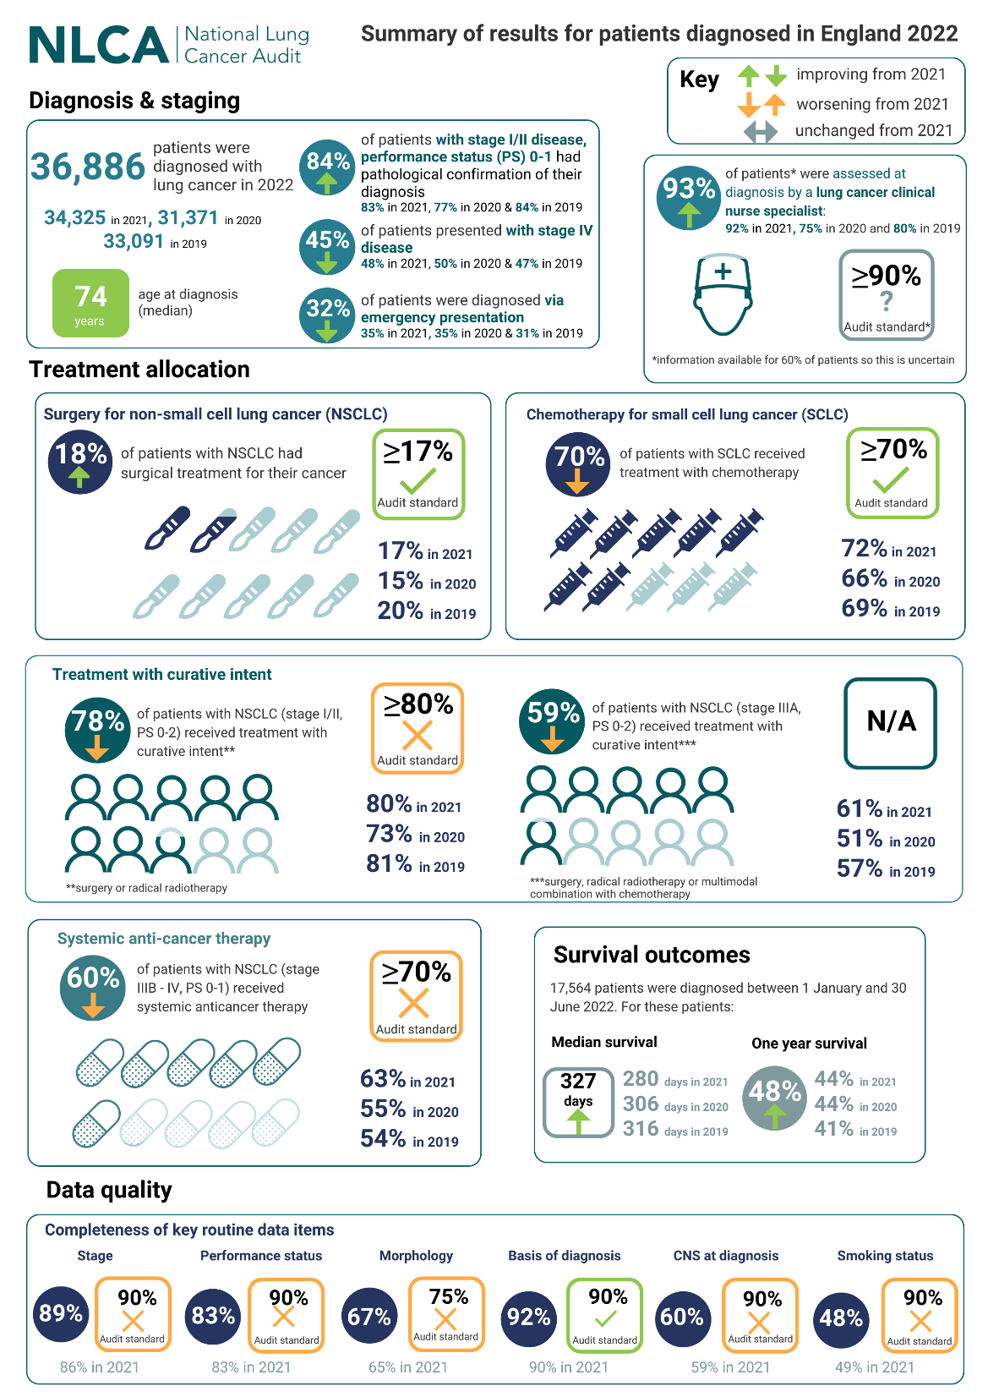
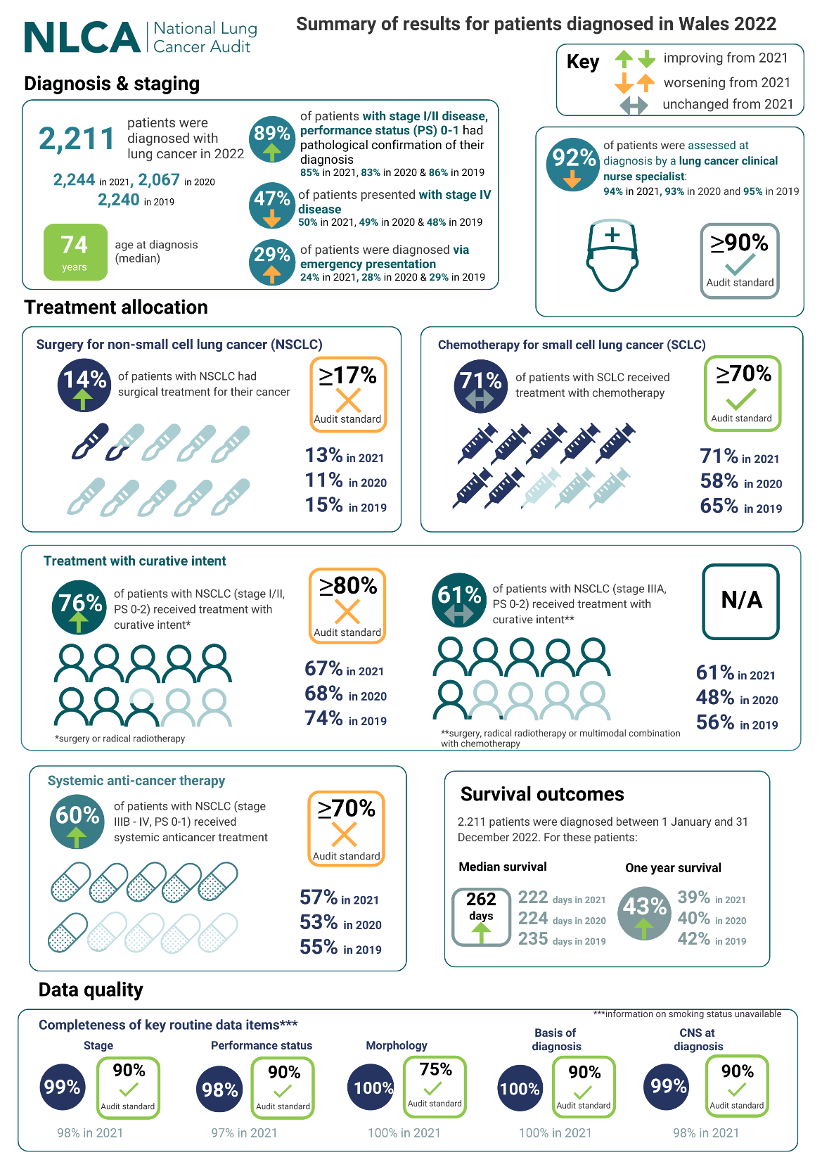
Surgery for NSCLC
England
Wales
Increase in absolute surgical resection number
2022: 6236
2021: 5392

Slide 7
SACT for NSCLC (stage IIIB-IV, PS 0-1)
England
Wales

Slide 8
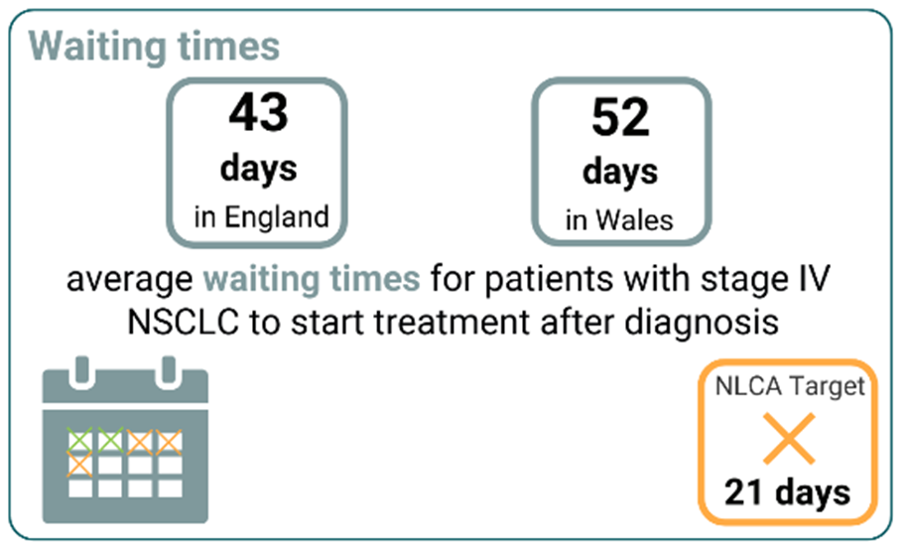
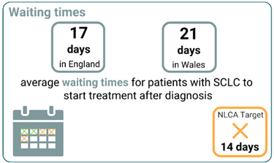
Waiting Times
NSCLC
SCLC

Slide 9
Survival
England
Wales

Slide 10
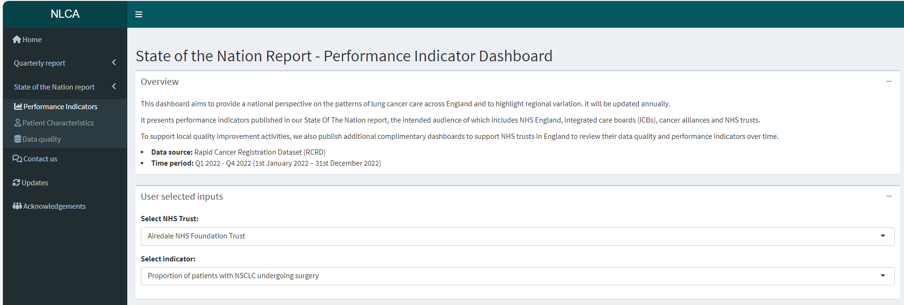
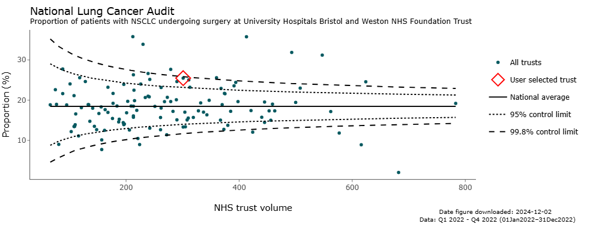
New SotN Dashboard
Performance indicators
Patient characteristics
Data quality

Slide 11
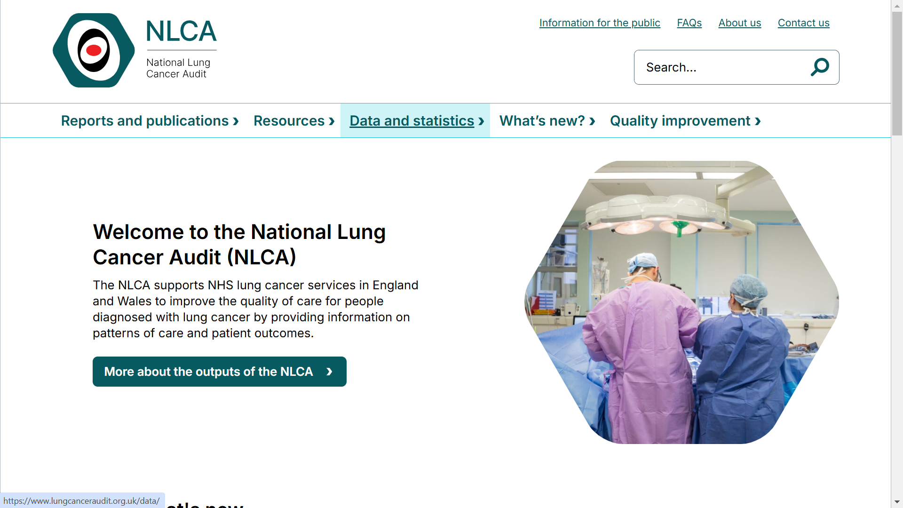

Slide 12
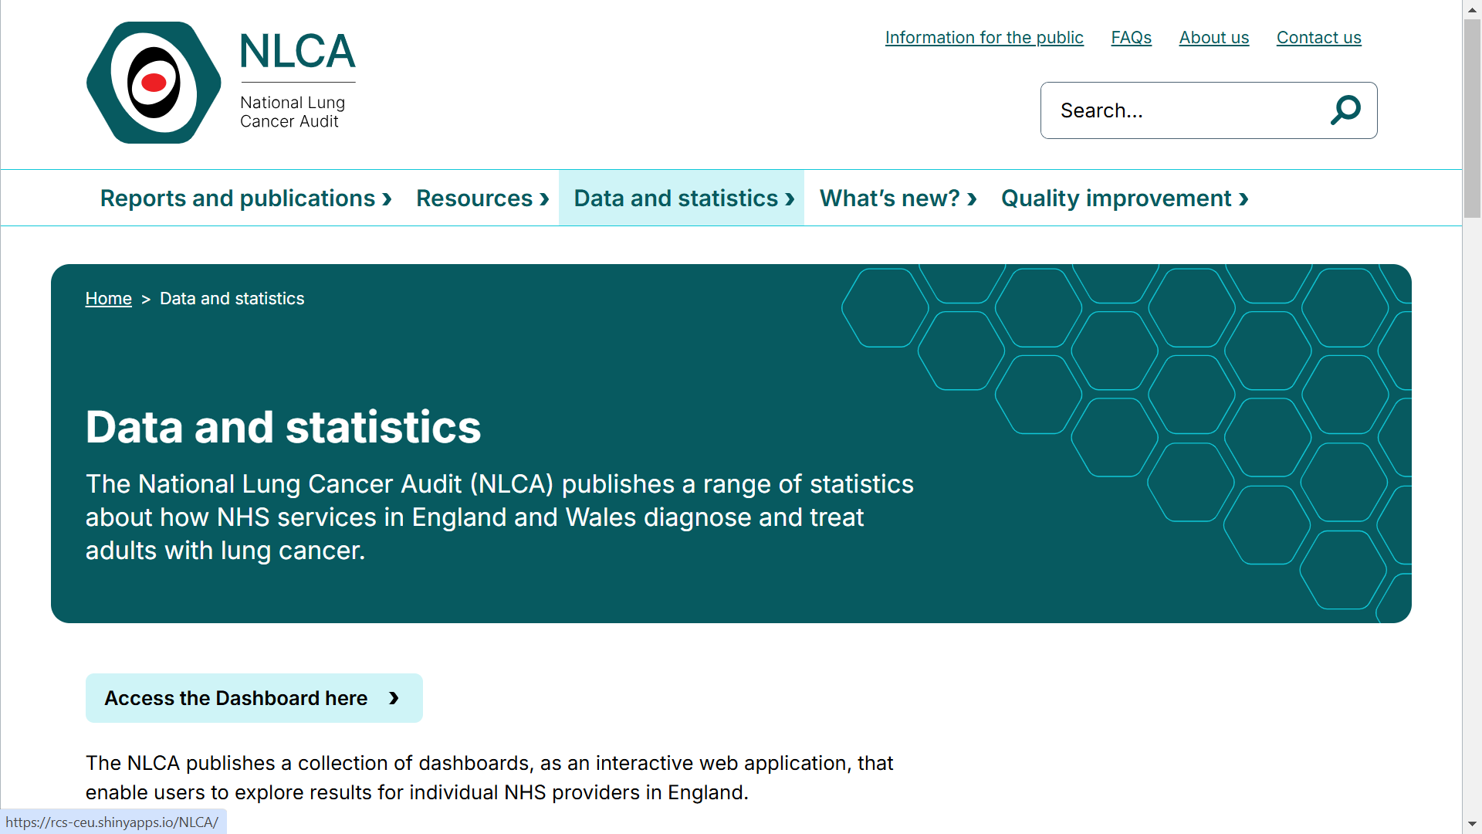

Slide 13
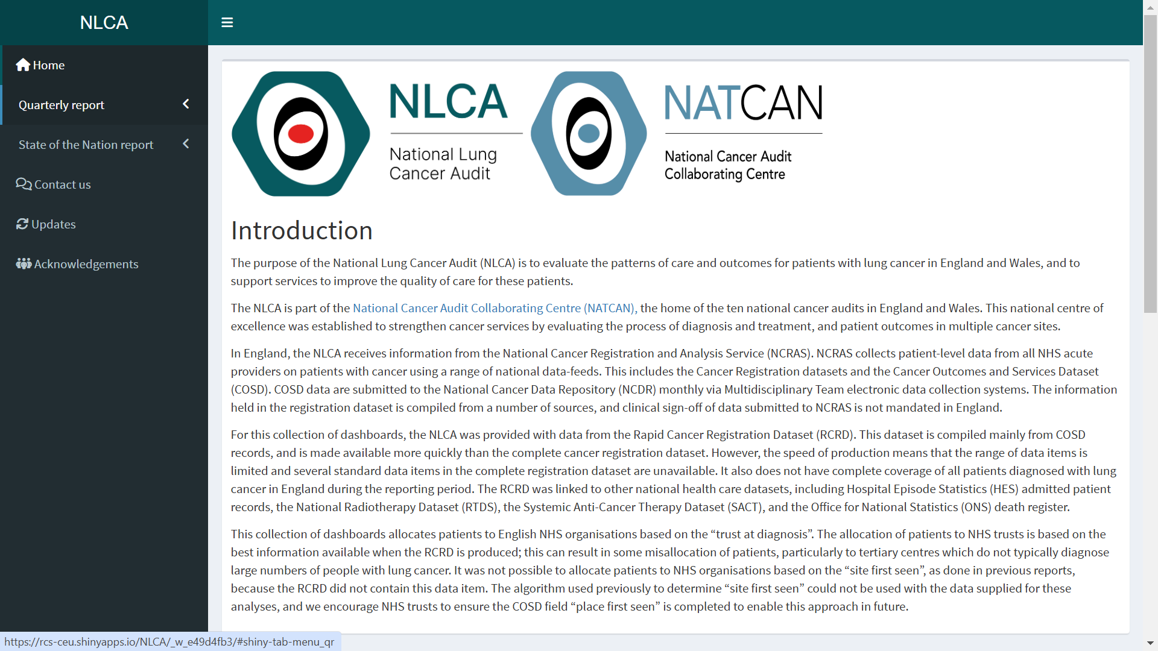

Slide 14
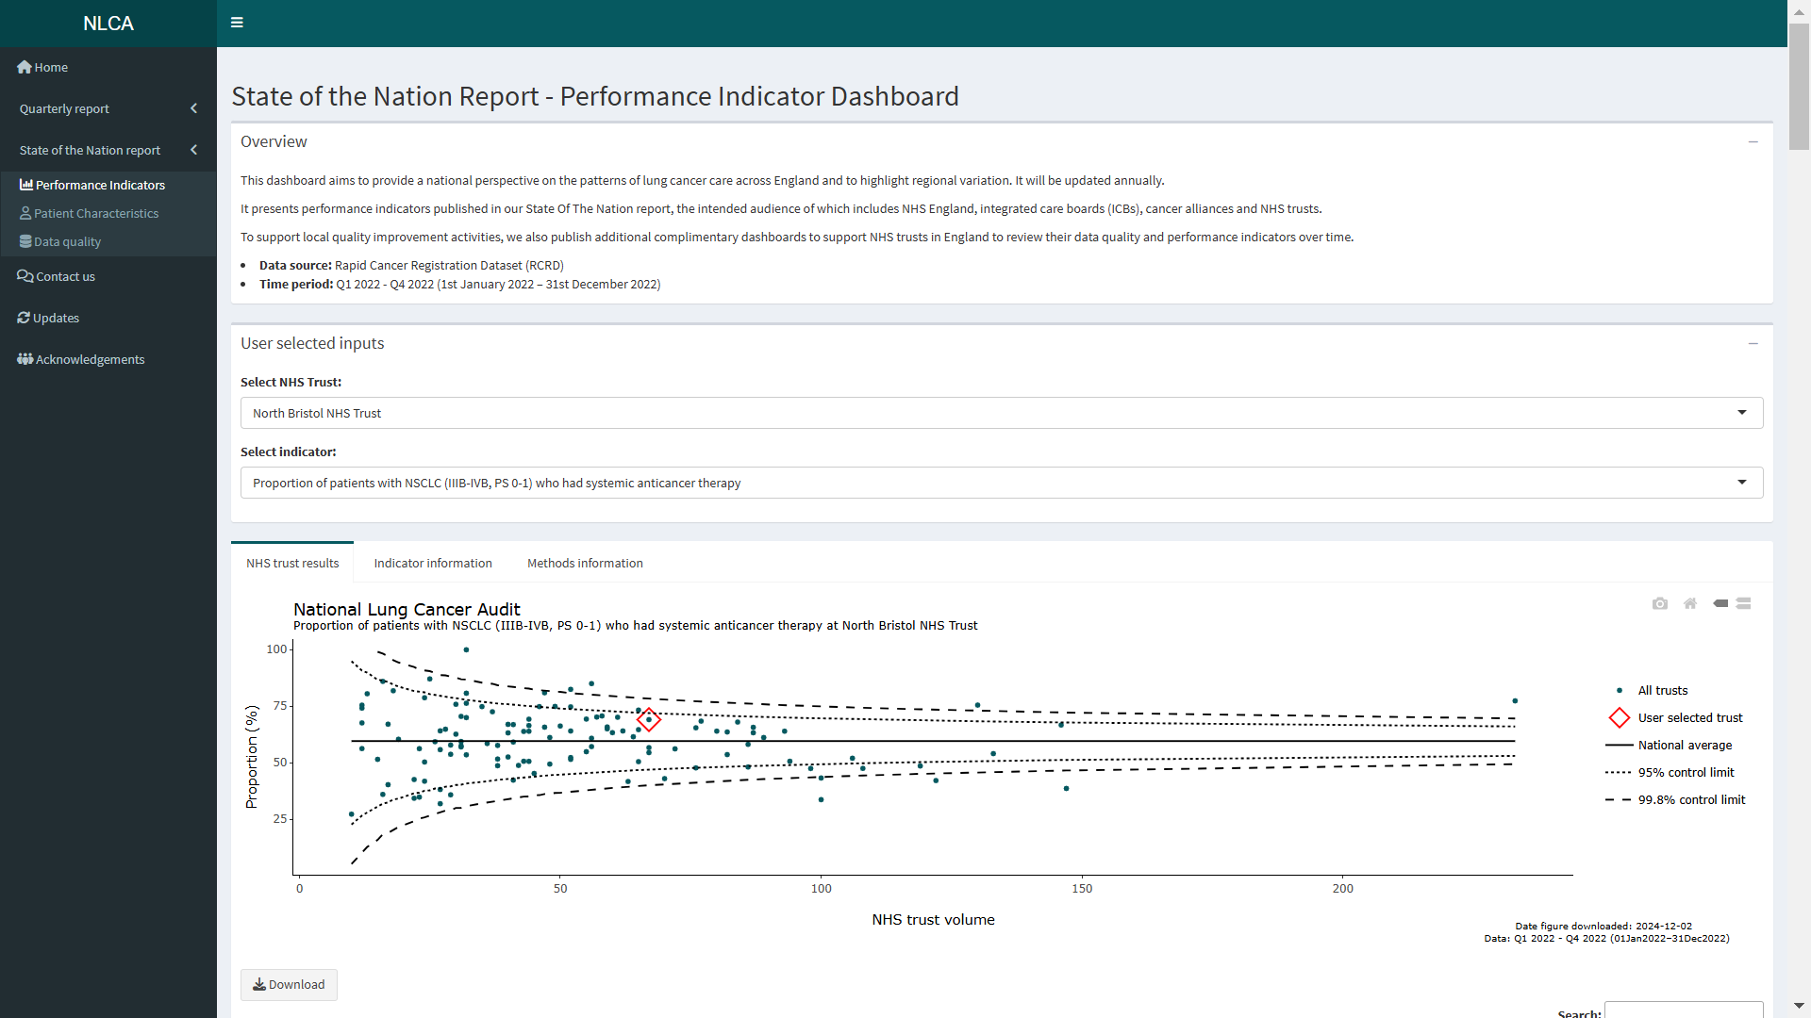

Slide 15
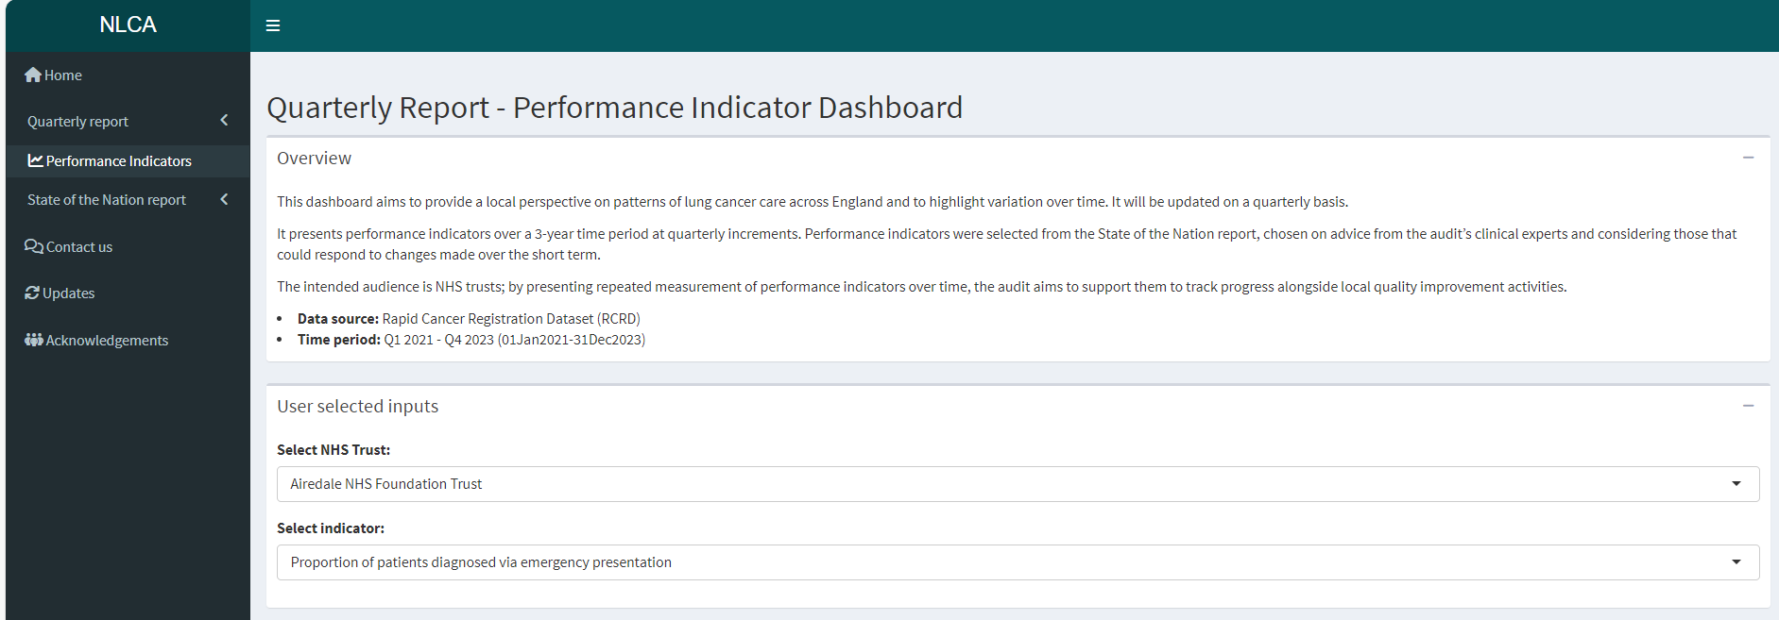
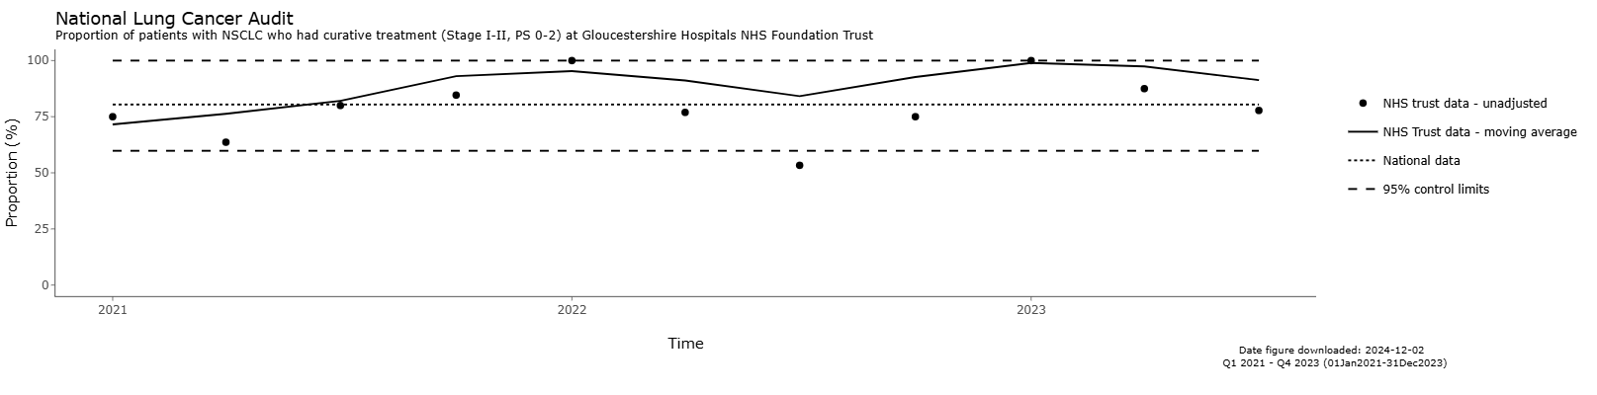
Quarterly Reporting
January, April, July, October
Trends over time
Aid local QI

Slide 16
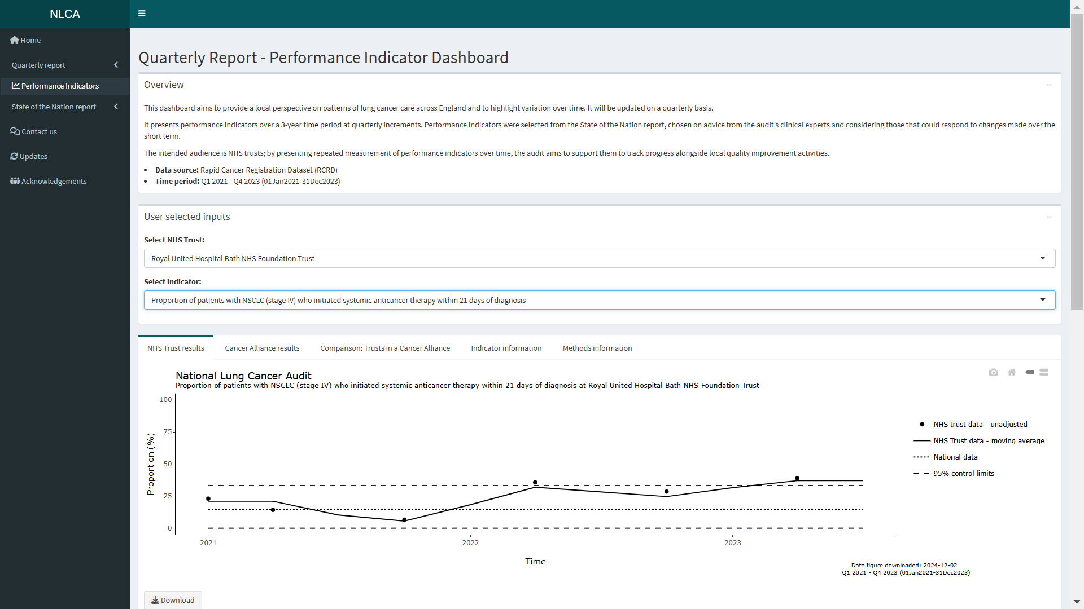

Slide 17
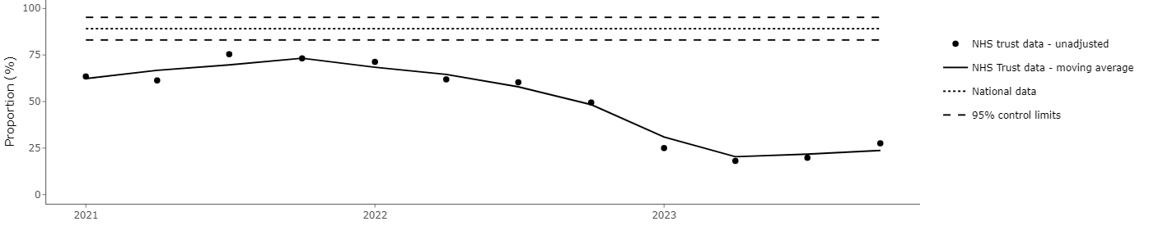
Early Signal Reporting
In alignment with quarterly reports
Positive and negative sigals
Identifies trusts consistently above/below national averages
Identifies trusts trending up/down over time points

Slide 18
Extended projects: SACT Utilisation
Based on findings from SotN report 2024
Ongoing project to investigate the utilisation of SACT in England
Looking at treatment variation of patient demographics and cancer alliances
Aiming to publish in peer-reviewed journal

Slide 19
Next steps: Molecular/ Biomarker Data
First extract of molecular data
Linked to gold-standard data (2017-2021)
Number of tests, test method (NGS), positive tests, mutation type
Linked to SACT database – positive mutation appropriate SACT regime
Timing of testing
Y

Slide 20
Next steps: Molecular/ Biomarker Data
Indicators in development:
  Proportion of patients with stage 4 NSCLC (PS0-1) receiving molecular testing (with NGS)
  Proportion of patients with stage 4 NSCLC (PS0-1) with EGFR+ receiving appropriate SACT regime
  Proportion of patients with stage 4 NSCLC (PS0-1) with ALK receiving appropriate SACT regime

Slide 21
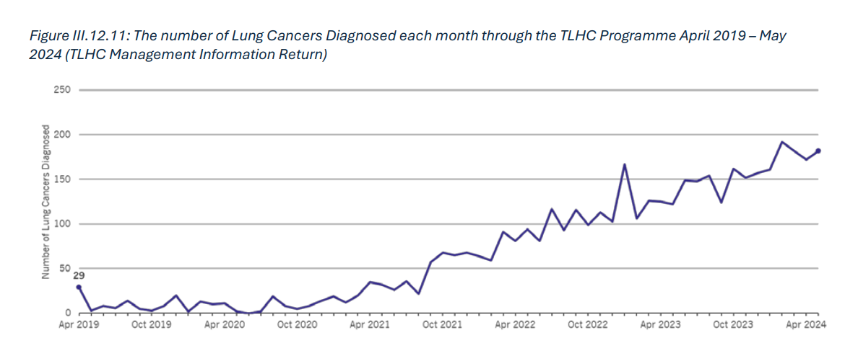
Next steps: Screening Data
COSD field CR1600 - route to diagnosis (17. Screening)
Variable accuracy in RCRD
Working with NDRS to improve the algorithms used to identify screen-detected patients
Figure from Darzi Report
September 2024

Slide 22


Other News
‘Trust first seen’
New website went live in April 2024
NLCA joined NATCAN
PPI forum

Slide 23

Thank you!
Contacts:
ldixon@rcseng.ac.uk
nlca@rcseng.ac.uk
lungcanceraudit.org.uk
Scan here to visit our website!

