Slide 1
Neuropathology
Back to full consultant staffing
Lab manager, Quality Manager in situ.
Appointed Band 6 BMS, and last week a Band 5
NMSK → CCS directorate
Digital Transformation

Slide 2
Nanopore
Teaching sessions and preliminary set up - 10th and 20th Jan
Retrospective Testing – Jan/Feb 2025
Piloting March/April 2025

Slide 3
The future is NOW

Slide 4
The future is NOW

Slide 5
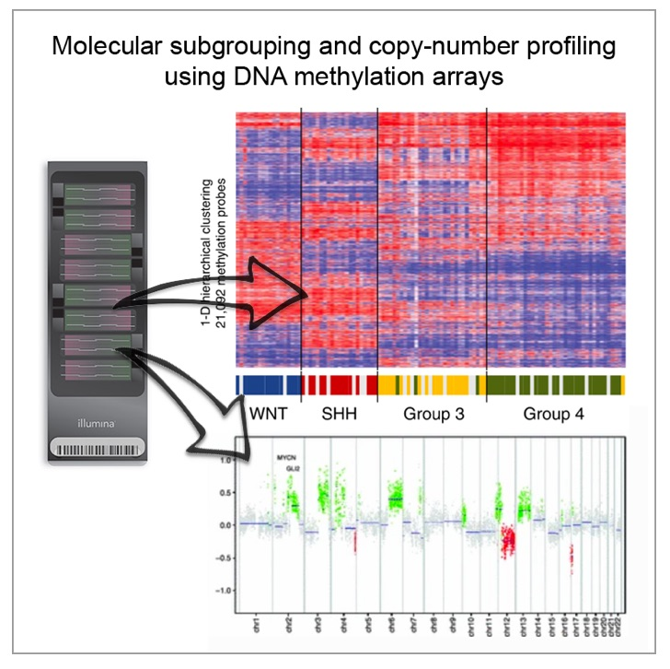
In 2022, methylation testing was introduced into the ‘WHO Classification of CNS Tumours’ as an integral part of the diagnosis of many tumour types.
Principle: Each tumour has its own specific ‘fingerprint’ or methylation profile

Slide 6
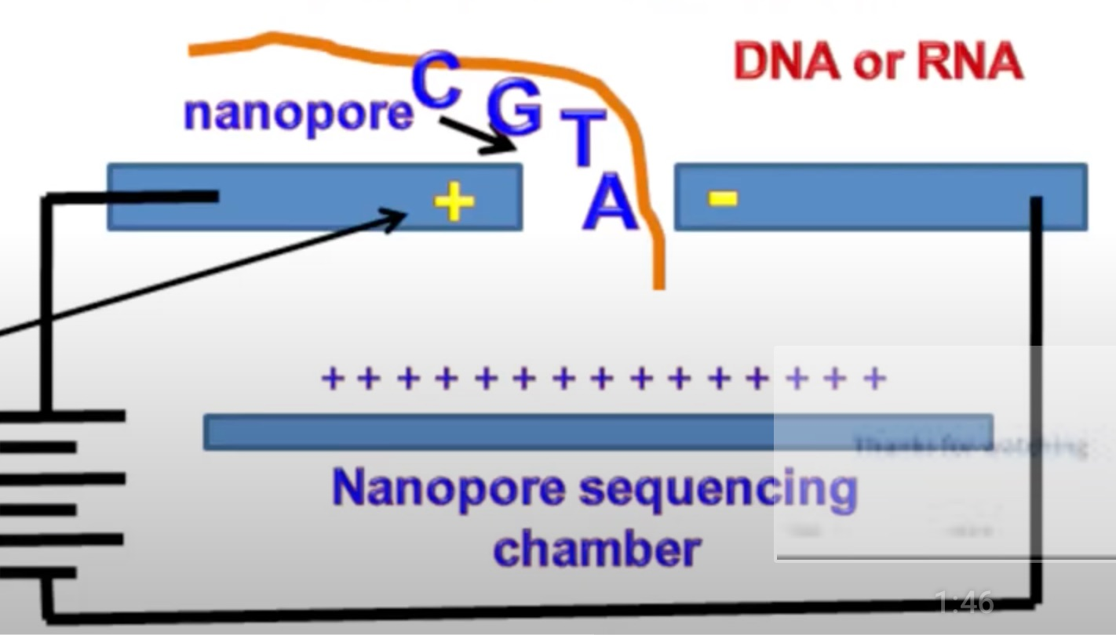
How can Nanopore technology help?
COST EFFICIENT
FASTER
BETTER COVERAGE
SIMPLER
ACCURATE
HAPPIER CLINICIANS
SEQUENCING & METHYLATION
HAPPIER
PATIENTS
Notes:
Nanopore sequences genes by allowing DNA to pass through an electrical membrane and nanopores. As they move through they disrupt the current which can be analysed to determine the sequence of base pairs.
Traditional methods require more prolonged specimen preparation & often require more samples

Slide 7
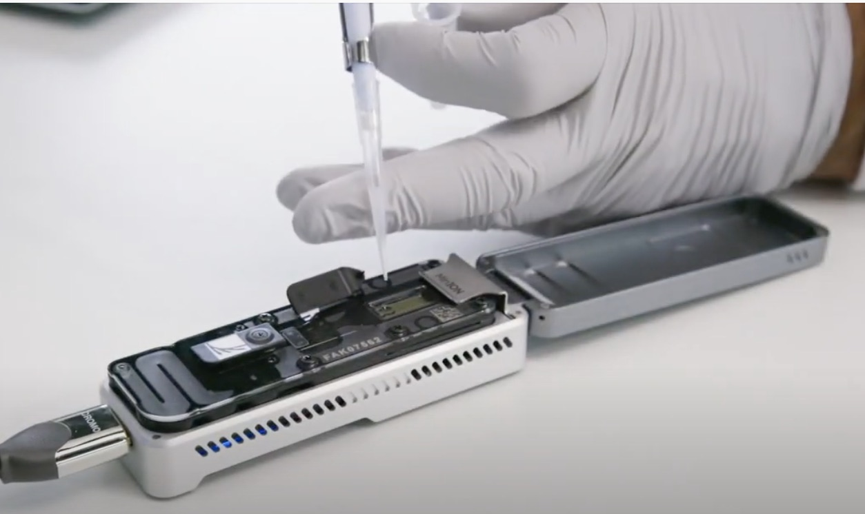
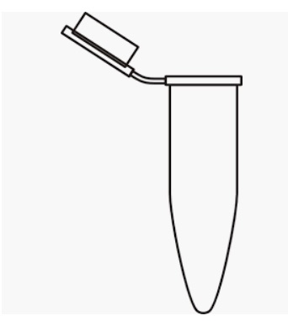
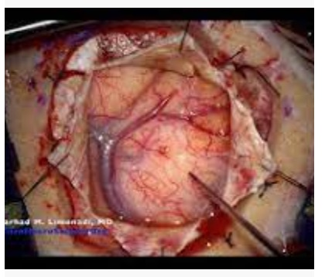
THE PROCESS
Extraction
& Preparation
60 minutes
Lab
Sequencing 30 minutes (20-60 +
Library Preparation
Real Time
Analysis
MiniKNOW
DIAGNOSIS
Methylation Website
Notes:
The minION is a portable device with a flow cell that has sensors which can detect the signal from the nanopores. The data is processed via computer using Oxford MiniKnow software, and can then be analysed using oxford software (EPI2ME) or straight into the Heildeberg Classifier
Can also give IDH, MGMT status at time.

