Slide 1
Neo-adjuvant Audit
The Bristol Experience
A summary of patients that have gone through the neo-adjuvant pathway (August 2023-August 2024)
Stelios Gaitanakis & Rachel Houston

Slide 2
Neo-adjuvant Patients
48 patients referred from regional MDT’s as potential neo-adjuvant candidates.
27 completed treatment pathway
21 not completed

Slide 3
Not completed
8 Upfront surgery.
5 patient choice -spread between 5 different consultant surgeons. Pre-op Staging 3x T3N0M0, T2bN0M0, T3N1M0.
1 shared decision making, patient keen for surgery upfront, surgeons and oncologist agree due to comorbidity + central bulky LN, (post op histology T2aN1R0 SQCC)
1 oncologist rejected neo adjuvant due to comorbidities (post op histology T2bN0R0 no adjuvant offered)
1 EGFR mutation so straight to surgery
5 Unfit for surgery
4 declined by surgeon- decision made at start of pathway (2 would not have tolerated pneumonectomy which was likely, 1 patient very high risk CPET V02max 10 with comorbidities+, 1 patient PS 2, poor CPET, poor mobility-near housebound.)
1 declined by surgeon decision made following neo adjuvant treatment. (Original consultation telephone call, no CPET. Post neo-adjuvant patient breathless, poor mobility, high risk CPET, possible pneumonectomy)
4 disease progression
For 3 patients the post neo-adjuvant PET upstaged (additional satellite nodules, pleural mets, bone mets.
1 patient delayed pathway significantly and in this time disease became unresectable.
2 upstaged to M1a prior to treatment (pleura & brain)
1 benign disease pre-treatment PET = complete resolution
1 Neo complications/toxicity​
1 death during neo adjuvant treatment-admission to ITU post 2 cycles -neutropenic sepsis then colitis, then fungal lung infection -RIP.​

Slide 4
Peri-operative Data
7 ITU admissions (25%), 6 planned 1 unplanned (bleeding).
Mean LOS 5 days
16 completed via VATS
(60%)
7 converted from VATS to open
(PA arterioplasty, adhesions, hostile hilum& bleeding, tumour crossing fissures & tumour invasion of PA.)
(Conversion rate 25%)
4 planned thoracotomy.
27 Operations
1 Unresectable
23 lobectomy
1 bi-lobectomy
2 pneumonectomy

Slide 5
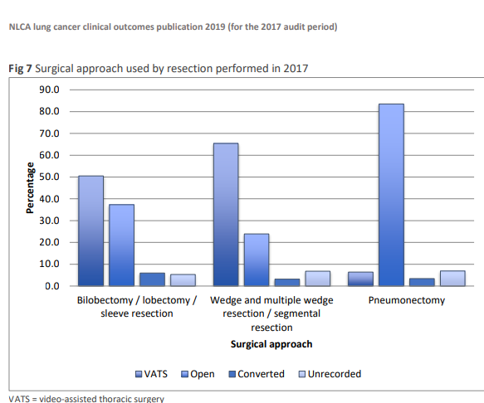
Peri-operative data

Slide 6
Notable Op Note Comments
“Very difficult case, filmy adhesions throughout lower and middle lobe to chest wall. Diaphragm and mediastinum, enlarged and adherent nodes. Slow dissection. Tranexamic acid given.”
“Complex dissection due to extra-pleural adhesions and hilar fibrosis/adhesions”
“Planned conversion to open, unexpected widespread adhesions, matted hilum requiring clamp and oversew.”

Slide 7
Post op Complications
Unresolved vocal chord paresis with unsafe swallow (1 patient)
Pulmonary Embolism (1 patient)
Significant intra-op bleeding (1 patient)
Severe surgical emphysema, prolonged air leak discharged with drain (1 patient)
OABX for chest infection in community (1 patient)
Temporary vocal chord paresis (1 patient)
Severe Oesophagitis (1 patient)
No RTT or mortality

Slide 8
Histopathological Analysis
Out of 27 patients.
19 Adenocarcinoma
6 SQCC
2 poorly differentiated NSCLC.

Slide 9
Post-operative Histopathological Analysis
19 patients downstaged (70%). Of those, 2 patients avoided a pneumonectomy, (both downstaged from T4 to T1 (PDL1 100% and 3%)
4 patients no difference 1) SQCC 2) adeno PDL1 30% 3) SQCC PDL1 >1% 4) Adeno PDL1 20%
3 upstaged 1) post op RT 2) local recurrence 3) brain mets detected post op
6 patients had complete pathological response 1) Adenocarcinoma (PDL1 90% & TTF1 positive) 2) SQCC PDL1 <1%, 3-5) + x 3 adeno PDL1 <1% 6) Adenocarcinoma (PDL1 15%)
1 patient open and close unresectable , ctg biopsy showed Poorly differentiated NSCLC. Partial response to treatment. Left thoracotomy-unresectable disease pleura + diaphragm. Pathology report showed combined small cell and SQCC.
No obvious correlation of disease response and PDL1 percentage.

Slide 10
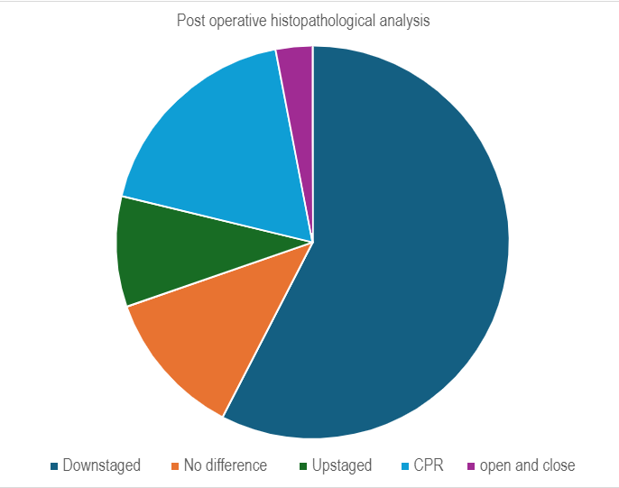

Slide 11
Number Eligible | Total
48 |  | Patients considered for pathway
 | 3 | Unsuitable due to stage | 2 upstaged, 1 benign disease
45
8 |  | Unsuitable for neo-adjuvant
 | 4 | Surgically unfit
 | 2 | Oncologically unsuitable | 1 EGFR, 1 comorbidity
 | 1 | Shared decision surgical/oncology
 | 1 | Significantly delayed pathway becoming unresectable
37
 | 5 | Surgery Upfront Patient Choice

Slide 12
Number Eligible | Total
32 |  | Commenced Neo-adjuvant Chemo/IO
 | 1 | Death
 | 3 | Post Neo-adjuvant imaging progression
 | 1 | Declined by surgeon following chemo/IO
5 | 15.6% | Did not have surgery | 16.8% in trial
27 |  | Underwent Surgery
 | 1 | Inoperable
6 | 22.22% | Pathological Complete response | Same as trial
2 | 7.4% | Pneumonectomy rate | 9% in trial *3.5% of all resections nationally in 2017 *5.8% of all resections nationally in 2013 *Royal College of physicians, Society for Cardiothoracic Surgery in Great Britain and Ireland ( 2020). National Lung Cancer Audit. Lung Cancer Clinical Outcomes Publication.

Slide 13
Cases to consider
Neo adjuvant challenges but good outcomes
1 patient had episodes of neutropenic sepsis multiple LRTI-surgical resection delayed to allow for improvement in fitness. (T4N0 to T1cN0.)
1 patient neutropenic sepsis and deranged LFTS so stopped after 2 cycles but went on to have surgical resection. (T3N2 to T1aN0 PCR.)
The role of post treatment PET
T1bN1 adeno, underwent chemo/IO PET declined request. CT imaging only MDT outcome for surgery.
Underwent upper lobectomy.
8 weeks post op sternal and adrenal mets detected (can be seen in retrospect on post treatment CT).
Post op histology
SQCC combined small cell (open and close)
Large Cell Neuroendocrine Tumour
Both had ctg biopsy showing poorly differentiated NSCLC.

