Slide 1
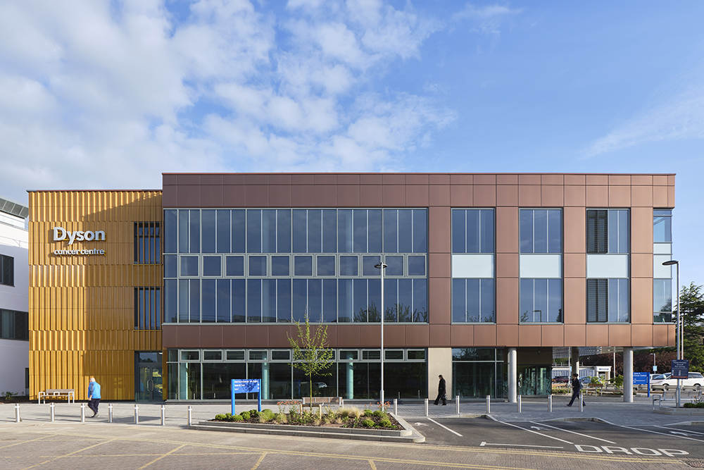
Perioperative SACT
Ashley Cox
Consultant Clinical Oncologist
Dyson Cancer Centre
Royal United Hospital Bath

Slide 2
For a longtime it was simple…
Post operative (adjuvant) chemotherapy:
Primary >=40mm and/or any node positive
4 cycles (12 weeks) platinum + vinorelbine chemotherapy
5% absolute increase in 5 year survival
Post operative radiotherapy:
Consider if R1 resection
Worse outcomes with post-op radiotherapy for incidental N2

Slide 3
Pre vs post op chemotherapy
Pre-op (neo-adjuvant) | Post-op (adjuvant)
Earlier treatment of systemic disease | Delay in treating systemic disease
Select out aggressive phenotypes
Local progression may make inoperable
May delay surgery due to toxicity | No delay to surgery
May result in increased peri-operative surgical complications and length of stay | Significant proportion of eligible patients may not be fit enough to start adjuvant therapy
Meta-analysis of pre-operative chemotherapy show similar survival benefit to post-operative

Slide 4
SACT simplified
Immunotherapy (PD-L1/PD-1 inhibitors)
ineffective again EGFRm and ALK positive NSCLC in metastatic trials
Excluded from peri-operative trials
PD-L1 tumour proportions score (TPS)
Predictive and prognostic
EGFR and ALK status necessary to determine treatment

Slide 5
Surgical landscape
Terminology
5 year overall survival is poor
Adjuvant
post-operative
Neo-adjuvant
pre-operative
Perioperative
pre and post operative

Slide 6
EGFR mutations
ADAURA trial
ECOG PS 0-1
Common EGFR mutations
Adjuvant chemotherapy optional
Placebo vs 3 years Osimertinib
Stage IB to IIIB (not N3) R0
T2a (>3cm) N0
T3/4 N2

Slide 7
ALK positive
ALINA trial
NICE approval 2024
ALK positive
ECOG 0-1
Alectinib 2 years vs chemo
Stage IIA-IIIB
T2b (>4cm) N0
T3/4 N2

Slide 8
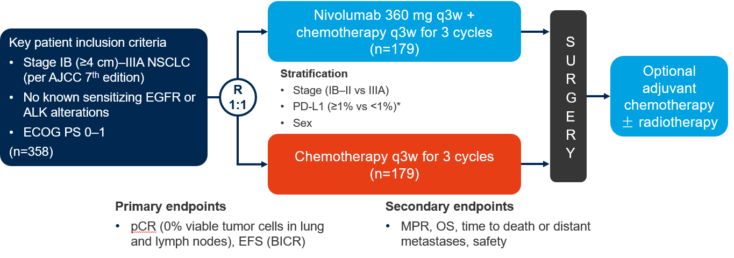
Neo-adjuvant chemo-nivolumab
Checkmate-816

Slide 9
Pathological Complete Response

Slide 10
Checkmate-816: EFS 3-year update

Slide 11
Checkmate-816: OS 3 year update

Slide 12
Neoadjuvant: Checkmate-816 Surgery?
 | Chemotherapy alone (%) | Nivolumab + chemotherapy (%)
Surgery | 75.4 | 83.2
Reason for not having surgery
Disease progression | 9.5 | 6.7
Adverse events | 1.1 | 0.6
Other | 10.6 | 7.8
'if the patient with stage III disease does not have progressive disease during neoadjuvant nivolumab plus chemotherapy but does not have a resection and is then treated with chemoradiotherapy, the patient may be eligible for maintenance durvalumab subject to all the relevant durvalumab treatment criteria applying'

Slide 13
Summary – neo-adjuvant chemo-immuno
Checkmate-816 established standard of care
3 cycles neo-adjuvant (adjuvant chemotherapy optional)
24% pathological complete response
15-20% patients do not have surgery
PDL-1 status
Europe (EMA) NOT licensed for PD-L1<1%
Sub-group and meta-analysis → does demonstrate benefit

Slide 14
Peri-operative chemo-immunotherapy
Several trials using:
Neo-adjuvant chemo-immunotherapy THEN Adjuvant immunotherapy
Pembrolizumab (KEYNOTE-671) – NICE approval 2024
Durvalumab (AEGEAN)
Nivolumab (Checkmate 77T)
+ others

Slide 15
KEYNOTE-671

Slide 16
Unanswered questions
Perioperative strategy vs neo-adjuvant only
4 cycles vs 3 cycles of neo-adjuvant treatment
Adjuvant immunotherapy
Is the adjuvant immunotherapy beneficial?
Who benefits?
Added toxicity (including financial)
Capacity
KEYNOTE-671 now available in your local centre

Slide 17
Current options – resectable NSCLC
Baseline molecular results
ALK positive → surgery → Stage IIA-IIIB (>=4cm)→alectinib
EGFRm → surgery → Stage IB-IIIB (>3cm) → (chemo) → Osimertinib
EGFR/ALK negative Stage IIA-IIIB:
3 cycles chemo-nivolumab → Surgery → (chemo)
4 cycles chemo-pembrolizumab → Surgery → Pembrolizumab
Other:
Surgery → Stage IIB (>5cm)-IIIB & PD-L1>50%) → chemo → atezolizumab
Surgery → incidental stage IIA-IIIB → chemotherapy

