Slide 1

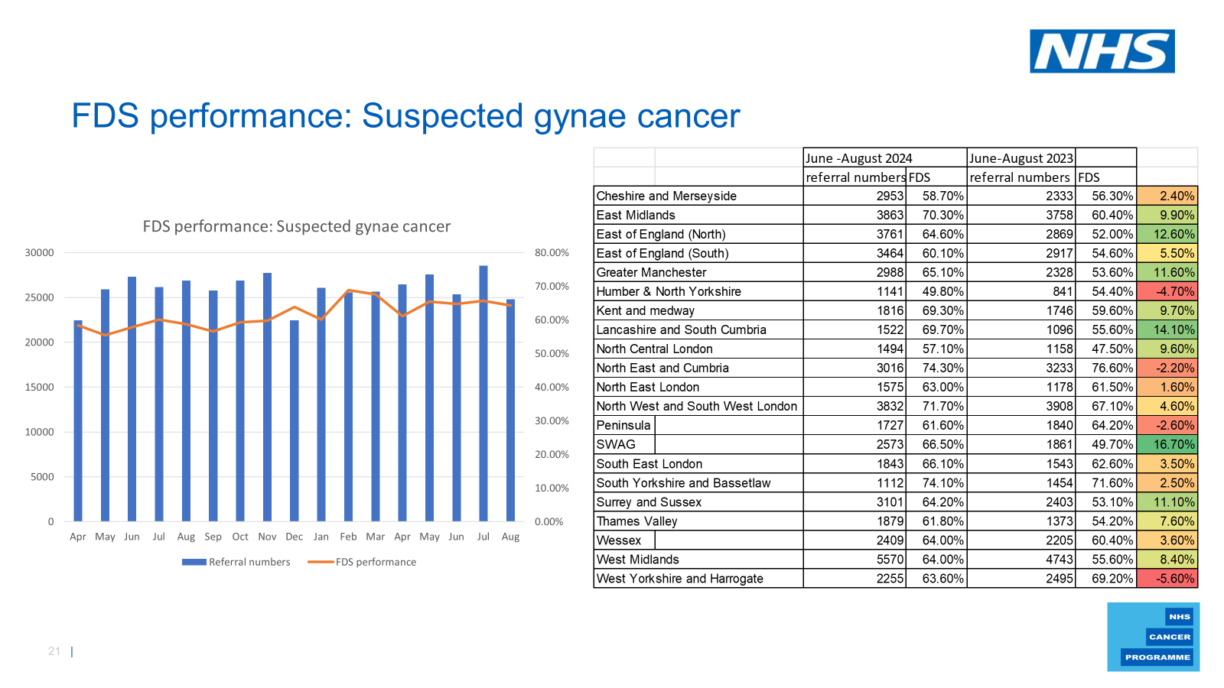

SWAG Performance: Benchmark
Performance improvement the best nationally and sustained
September 24/25 SWAG FDS performance 66.1% compared to September 23/24 when FDS was only 39.3% - so an improvement of 26.8% year on year
Connecting and Empowering the Delivery of Cancer Care Across SWAG Communities

Slide 2
NCP priority pathway: SWAG Funded initiatives
Front Door triage @ SFT
One Stop UHBW incl. equipment
Hysteroscopy training incl. myosure
Self-referral Post Menopausal bleeding service SFT and RUH Bath
Clinical Staffing
Short term gynae specific WLIs
c20% of the performance and priority pathway allocation
Connecting and Empowering the Delivery of Cancer Care Across SWAG Communities

Slide 3
National Cancer Programme 25/26
Remains a priority pathway for national cancer programme faster diagnosis programme
Rationale:
3rd highest contributor to FDS breaches (15%), ​
Low FDS performance (65%) with high difference in cancer vs non-cancer (27%)​
Deliverables
Improvement plans where FDS performance is below 64%
Clear triage model in place with sufficient safety netting by end of Q4
Understand and reduce the FDS variation between cancer and non-cancer
Deliver unscheduled bleeding on HRT pathways for 100% of services by Q2
Complete a targeted project on improving Hysteroscopy delivery in the context of patient care and improved FDS performance by Q4​
Define and deliver straight to CT from abnormal ultrasound for Ovarian Cancer by Q4.​
Key project for Ovarian pathway improvement.​

Slide 4
Provider | Implementation Status for unscheduled bleeding on HRT. | Womens health hubs (Are any in place, location? Are they involved in Unscheduled bleeding process/pathway?) | Direct access to TVUS in place and incorporated for use as part of unscheduled bleeding on HRT pathway/process? | Go live Date for unscheduled bleeding on HRT pathway/process. | A one-stop shop is in place in the Trust. | Type of triage in place e.g. admin-led, nurse-led, consultant-led? | Please describe any pathology challenges, if known. | Please briefly describe any workforce challenges, if known. | Please briefly describe any hysteroscopy challenges, if known.
GLOUCESTERSHIRE HOSPITALS NHS FOUNDATION TRUST | Unknown at provider level
UNIVERSITY HOSPITALS BRISTOL AND WESTON NHS FOUNDATION TRUST | Partial implementation | Set up phase | Yes | January ICE delay | Yes - Bristol site only, plan to introduce @WGH with cons expansion | Consultant and specialist nurse | Capacity - but overall should be decreased with the new guideline recommendations | A&G for primary care may increase. Sonography support for direct referral | Hysteroscopy capacity expanded additional nurse hysteroscopist (in addition to 2 current) being trained
NORTH BRISTOL NHS TRUST | Planning​ | In place but not directly involved in planning stage. | Yes. | January ICE delay | No | Admin led. | TAT are within tollerance. | Clinical staffing challenges have reduced capacity short to medium term. | Recruitment challenges for fixed term role.
ROYAL UNITED HOSPITALS BATH NHS FOUNDATION TRUST | Live | Yes - Women's Health Hubs in place. No - not directly involved. | Yes | 12/09/2024 | Yes | Sonographer-led triage. | Capacity limitations but should be reduced with implementation of guidance. Ensuring adequate sample taken. | Sonographer and clinical assessment time negatively impacting on other gynaecological services. Pathology consultant recruitment. Admin capacity. | Yes - hysteroscopy is largely uncecessary and adds length to the pathway without value.
SALISBURY NHS FOUNDATION TRUST | Partial implementation | No | Yes | Plan for December 2024 | Yes | Admin-led (clinician led being explored) | Yes, delays in histology. Average of 11 day turnaround | Curently no clinical triage of referrals | Aging scopes, but successful capital bid.
SOMERSET NHS FOUNDATION TRUST | Planning​ | Women's health hubs are in place, but these are not currently supporting the unscheduled bleeding pathway. | Part of the planning discussion. | Q4 | No | Nurse-led | Staff shortages and lack of physical space - currently being reviewed Trustwide increase in pathology reporting in gynae. . | Staffing shortages across primary and secondary care | No specific challenges identified.
Notes:
USB on HRT pathway BMS guidance in place with delays to governance PC DA USS 6/52 part e.g ICE BNSSG January
Womens Health hubs exist but not utilised
DA USS mostly available
Variation in triage
Path / workforce / hysteroscopy challenges (OPH in PA c23days)

Slide 5
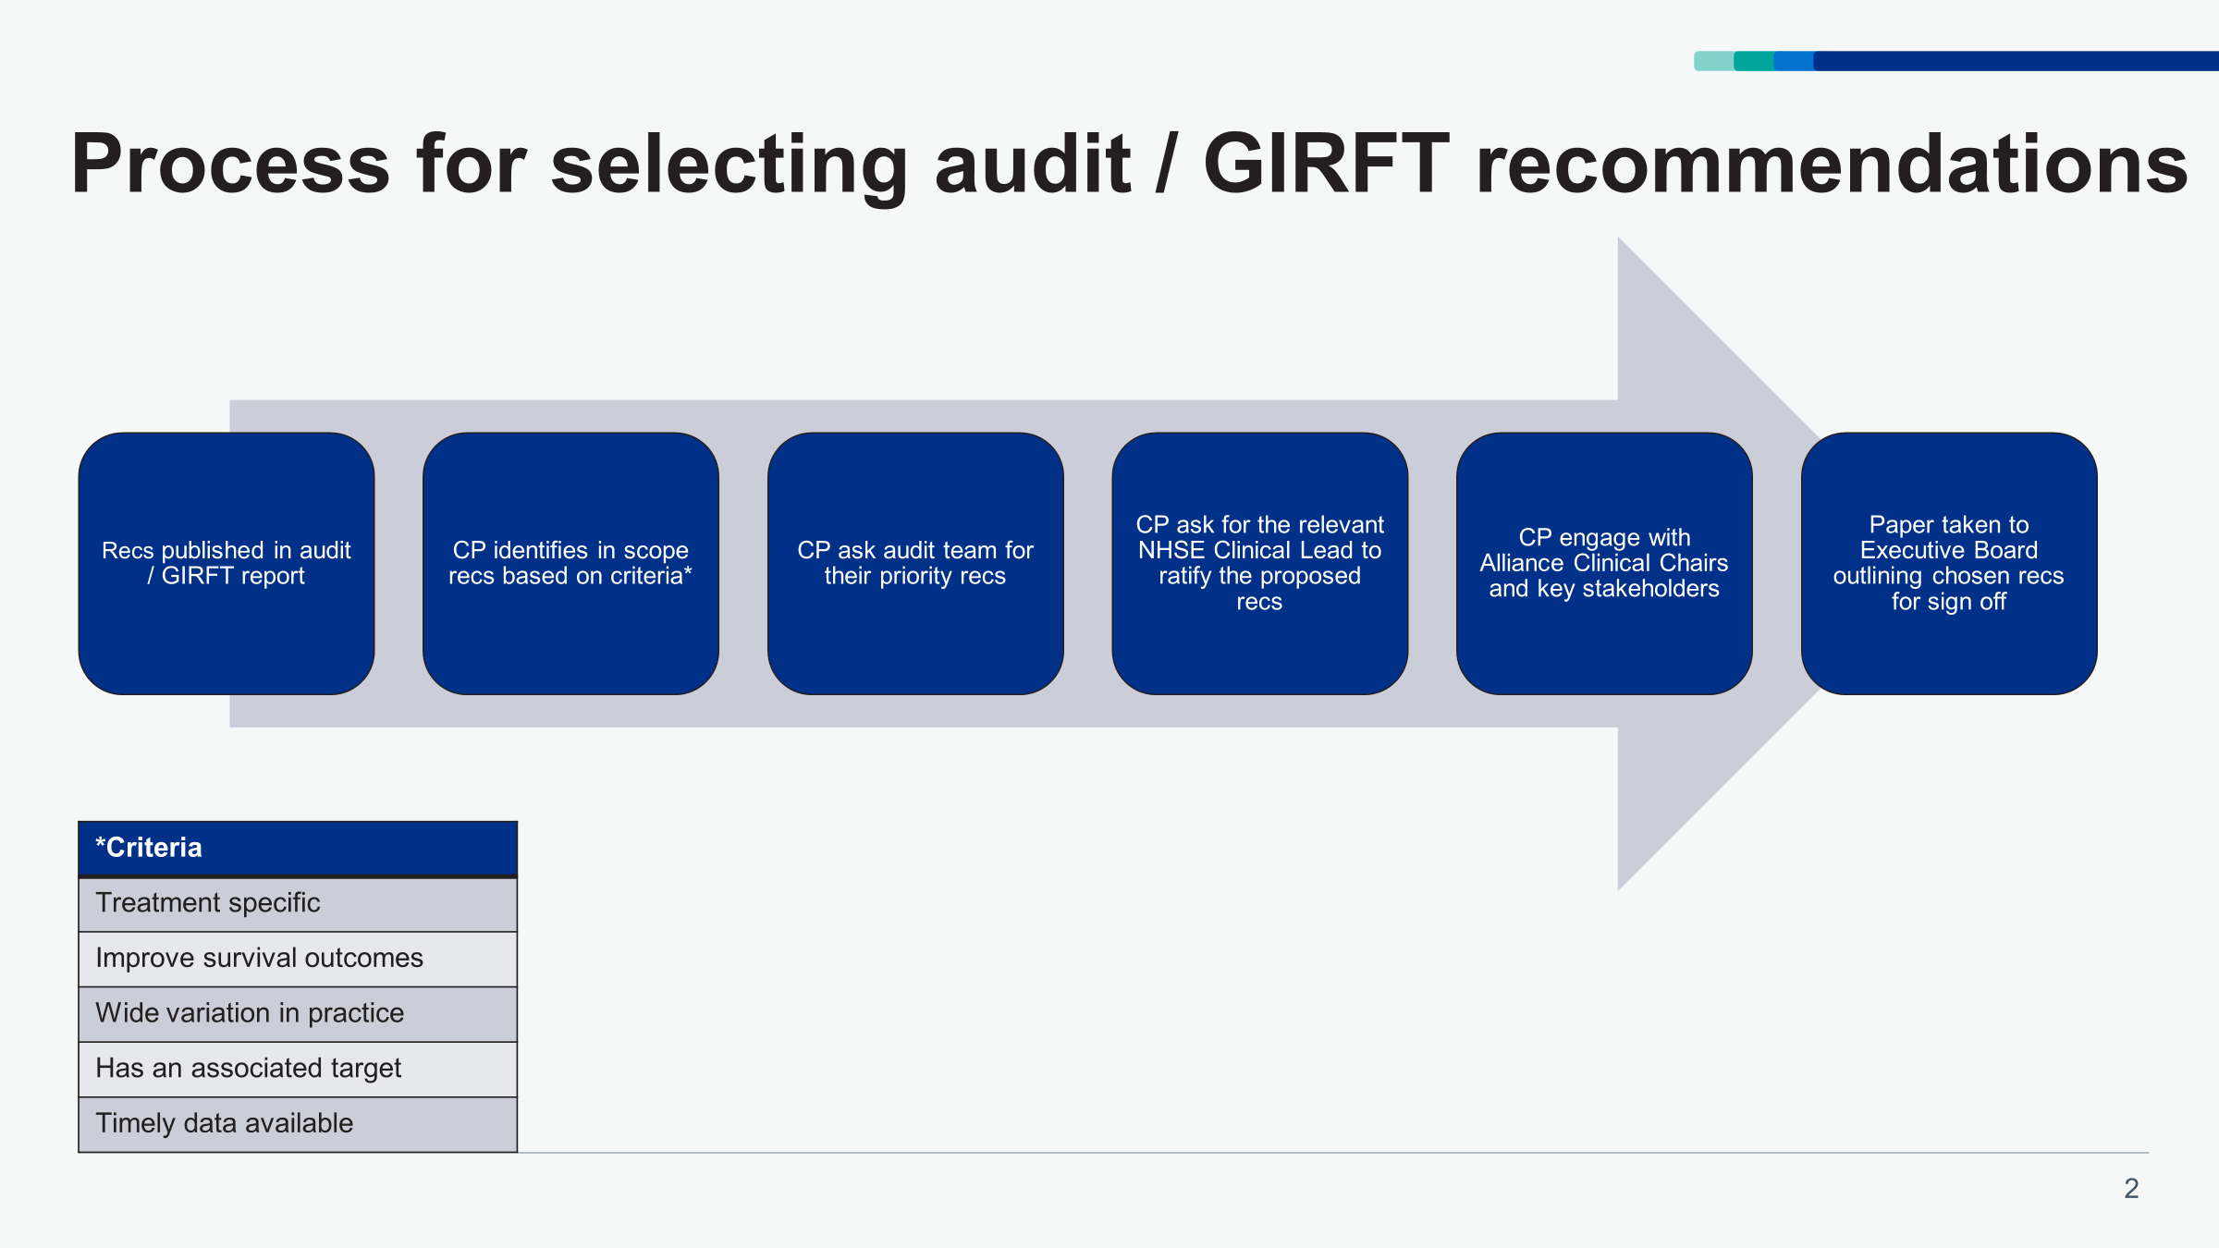
National Cancer Programme 25/26
National Ovarian Cancer Audit: Comes into the Treatment variation programme​

Slide 6
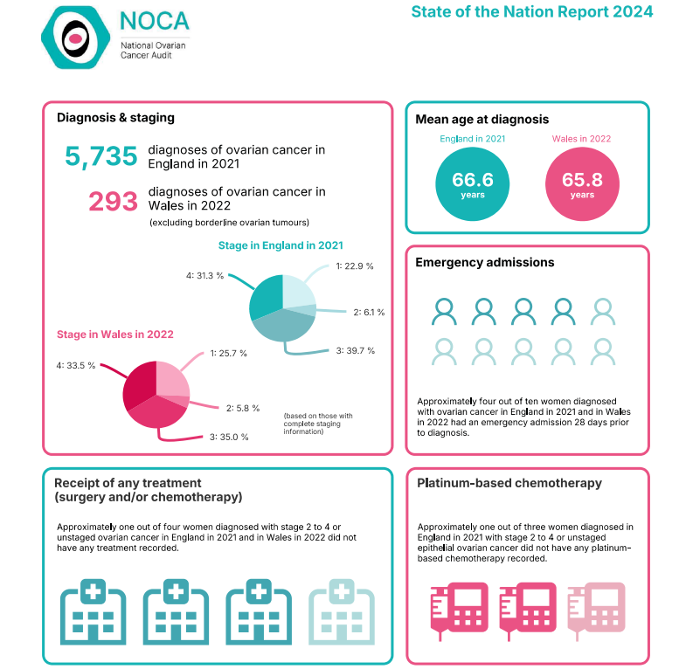
National Cancer Programme 25/26
Target: 80% of women with stage 2-4, or unstaged ovarian cancer receiving treatment of any type.
Targeted focus based on most recent data available to the national programme and subject to change
2021 1 Provider in SWAG*
England: 72.7%
UHBW: 79%
SFT: 79%
GHFT: 76%
RUH Bath 89%

