Slide 1
A UK national survey of pre-operative imaging and lymph node staging practices in early-stage endometroid endometrial cancer
Miss Hannah Pierce
MBChB MA MRCOG
Gynaeoncology Fellow
RCOG surgical skills fellow
Vice-chair education-National trainee committee

Slide 2
BGCS Survey- demographics
Online survey open between 26th January to 2nd August 2024
69 responses representing 82% of UK cancer centres.
83% of responses were from cancer centres and 16% from cancer units
61% of responses were from consultant gynaeoncologists.

Slide 3
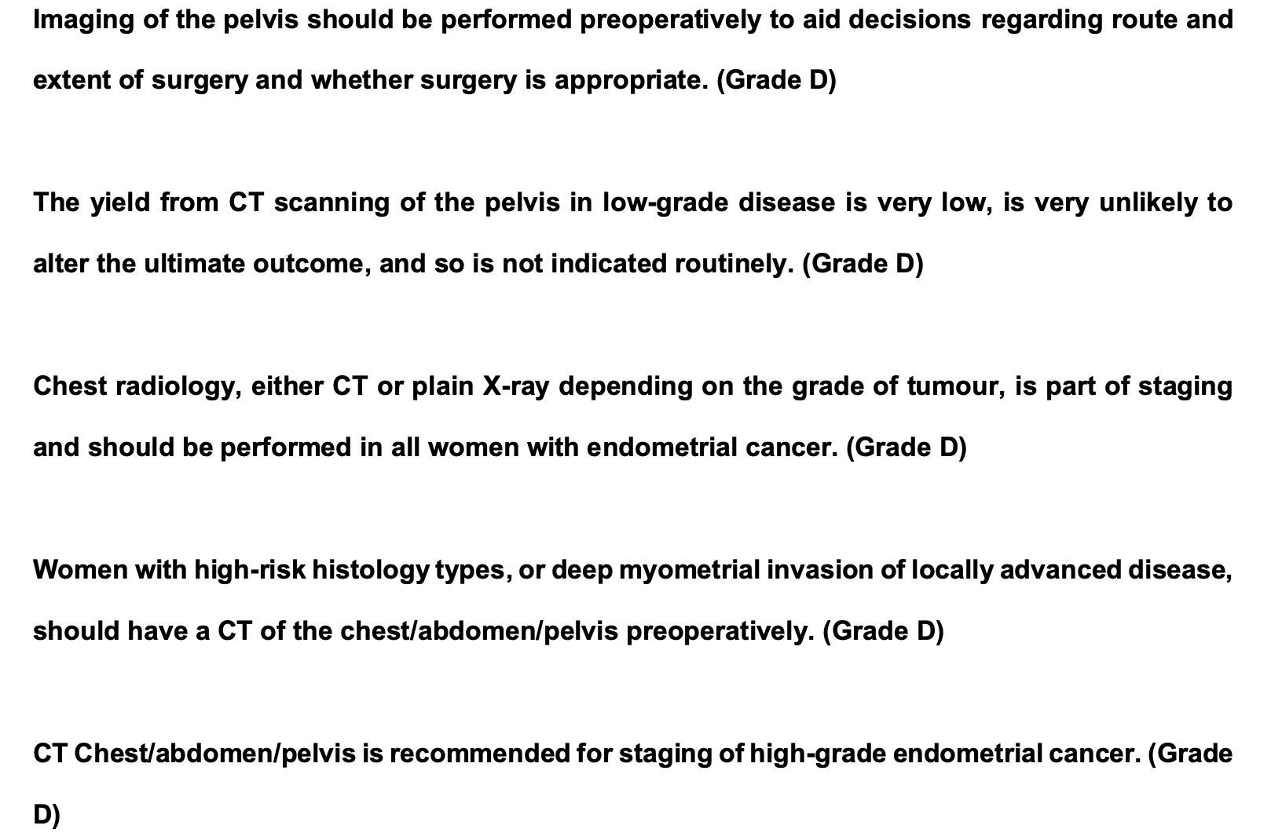
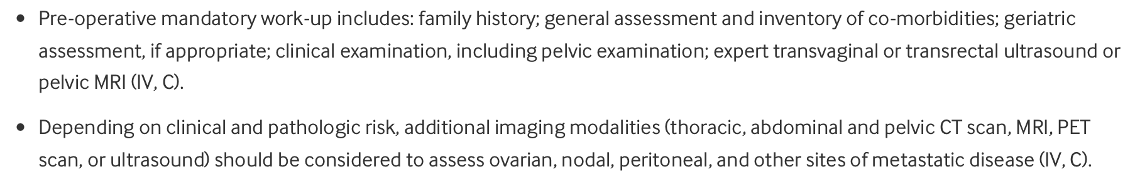
Pre-operative imaging

Slide 4
Pre-operative imaging
Grade 1:
46% perform MRI/USS only
28% MRI/USS + CXR
25% MRI/USS + CT
Grade 2:
39% MRI/USS only
19% MRI/USS + CXR
33% MRI/USS + CT
7% CT only

Slide 5
Molecular classification
64% of respondents do not use molecular classification
82% of these do not routinely have the results back pre-operatively.
22% sometimes use molecular classification and 14% routinely use it.

Slide 6
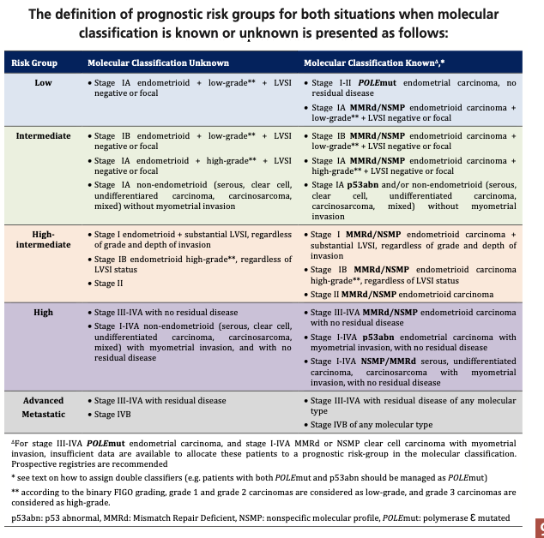
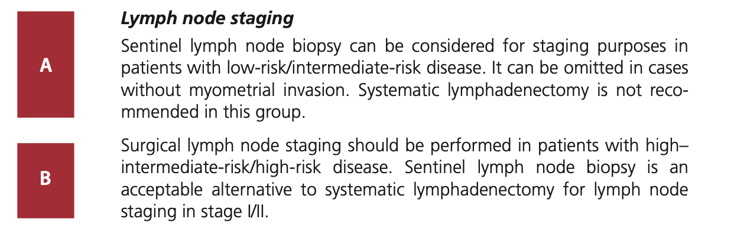
ESGO Guidelines

Slide 7
LN staging without molecular classification

Slide 8
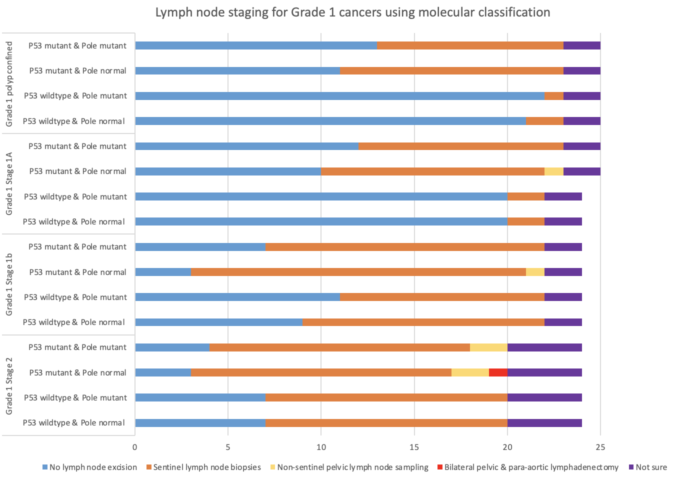

Slide 9
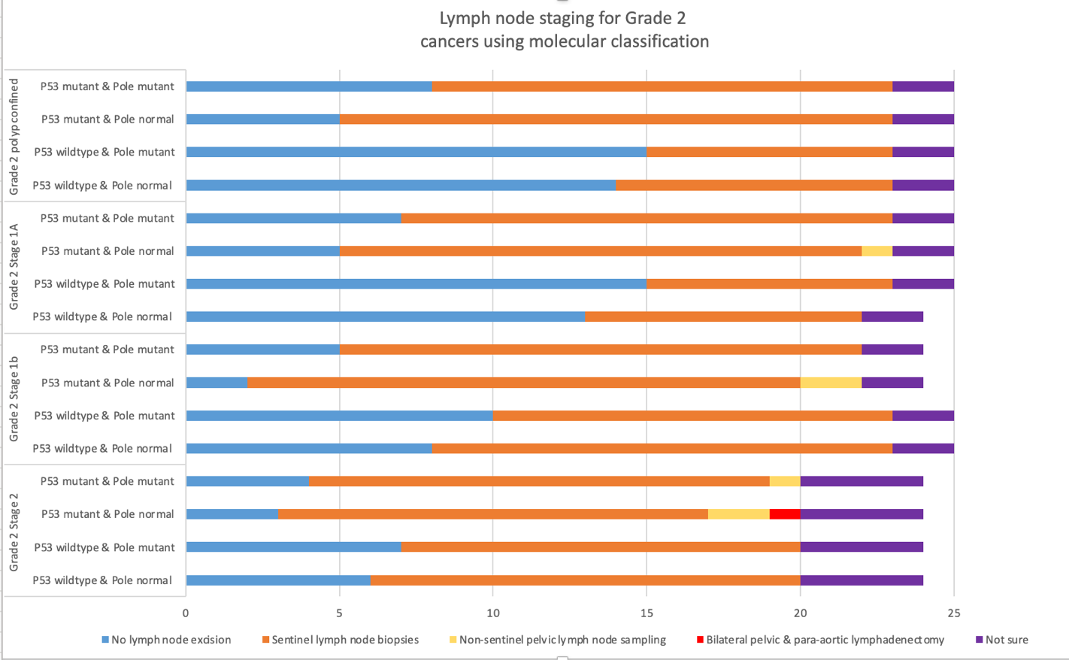

Slide 10
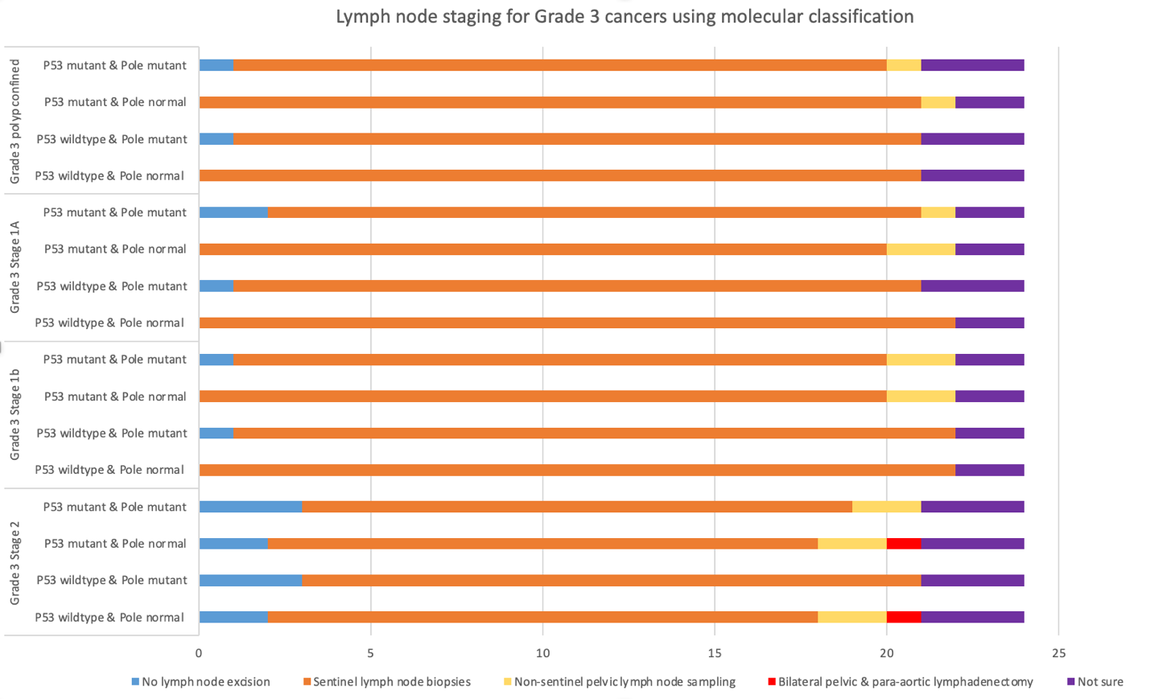

Slide 11
RATes of pelvic LN metastasis
STUDY | G1 Stage 1A | G1 Stage 1B | G2 Stage 1A | G2 Stage 1B | G3 Stage 1A | G3 Stage 1B
Creasman et al (1987) 621 patients | 2% | 4% | 8% | 10% | 11% | 26%
Praiss et al (2020) 161,960 patients | 1.1% | 8.6% | 2.9% | 13.7% | 4.8% | 16.9%
Vargas et al (2014)
Grade 1-2, <50% invasion and tumour size <2cm
Risk of nodal mets 1.4%

Slide 12
summary
There is significant variation in pre-operative imaging for grade 1 and 2 endometroid endometrial cancers.
Could we reduce the number of CTs performed in this cohort?
There is also variation in lymph node staging selection for grade 1 stage 1b and grade 2 stage 1a endometroid endometrial cancers.
Service implications?

Slide 13
Thank you
Any questions?

