Slide 1
Upper tract surveillance
in high risk non-muscle invasive bladder cancer:
who to scan, how often, and for how long?
Rebecca Smith, Jennifer Martin, Yamin Pa Lin, Kate Warren, Helena Burden
Southmead Hospital, North Bristol NHS Trust

Slide 2
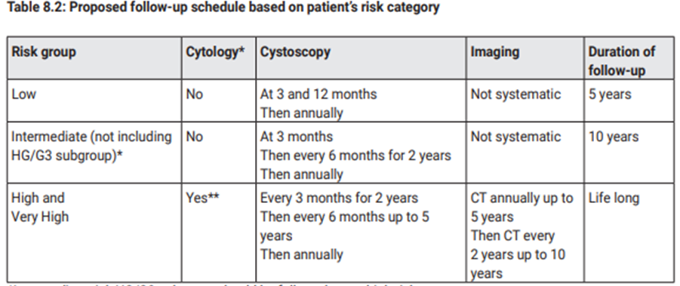
Introduction
NICE : no guidance on imaging follow-up protocol
NBT: CTU every 2 years/if recurrence
https://uroweb.org/guidelines/non-muscle-invasive-bladder-cancer

Slide 3
Aim
To propose an appropriate upper tract surveillance protocol, by evaluating:
Incidence of upper tract urothelial carcinoma (UTUC) recurrence in patients with high risk non-muscle invasive bladder cancer (HRNMIBC)
Radiation exposure of CTU surveillance
Risk factors for UTUC recurrence in HRNMIBC

Slide 4
Method
317
no. of patients diagnosed with HRNMIBC 2008-2018
(G3, T1, CIS)
283
for analysis
Retrospective data collection in 2024
Demographics
Histological diagnosis
Imaging results
Radiation dose
Follow-up time
Recurrence/progression
34
exclusions (incomplete data, incorrect histology, no CTU, primary UTUC)

Slide 5
Results: Demographics & histology
Mean age at diagnosis
72 years
34% CIS
23% G3Ta
35
92
37%
G3T1
81% Male

Slide 6
Results: Follow-up & surveillance imaging
Mean follow-up time
7.2 years
Mean no. surveillance CTU per patient
2.2
Mean radiation dose per scan
17.7mSv
≈ 7 years background radiation
≈ 1in 2000 additional lifetime malignancy risk
0.2
16.2
No. followed up >10 years
32
(11%)
Mean interval time between CTU
1.9 years
https://www.gov.uk/government/publications/medical-radiation-patient-doses/patient-dose-information-guidance

Slide 7
Results: UTUC recurrence
UTUC recurrence
16
(5.7%)
Mean time initial diagnosis to UTUC recurrence
5.2 years
UTUC recurrence at:
<5 years = 3.5%
5-10 years = 2.1%
>10 years = 0
0.9
8.4
10
(3.5%)
underwent nephroureterectomy

Slide 8
Results: Risk factors for UTUC recurrence
Significantly increased risk of UTUC recurrence in patients with
Recurrent HRNMIBC (27%)
vs. those without (4%)
RR=7.12 , X2=20.9, p val=<0.00001
No significant increased risk of UTUC recurrence associated with
CIS present (17%)
vs. CIS absent (16%)
RR=1.02, X2=0.006, p value=0.94
Also:
T1 histology
G3 histology
Progression to MIBC

Slide 9
Conclusion
HRNMIBC UTUC recurrence rate 5.7%
No new UTUC recurrence seen >10years follow-up
Consider risk stratifying HRNMIBC patients for CTU surveillance depending on fitness for surgery and high risk bladder recurrence status
If no high risk bladder recurrence, consider stopping at 5 years
If high risk bladder recurrence, up to 10 years

