Slide 1
GIRFT – Bladder cancer SWAG CAG Meeting Jan 2025
Mr John McGrath
National Clinical Lead - GIRFT Urology
Consultant Urologist - NBT

Slide 2
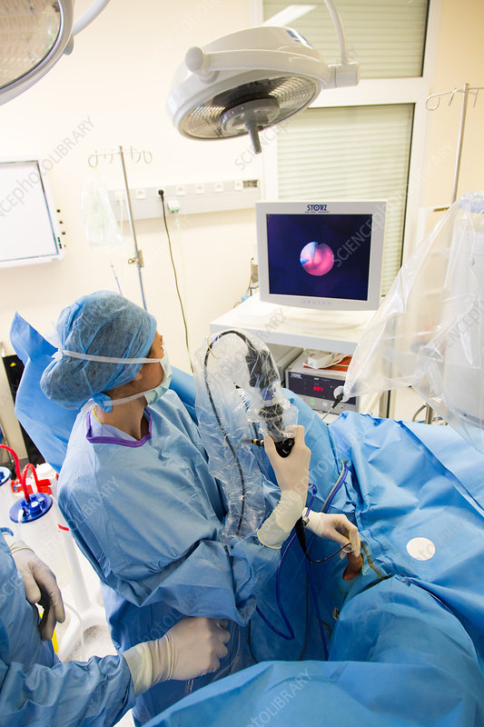
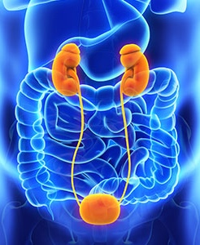
Urology in numbers
1.85 million
Follow-up OP contacts
180 K
900,000
New OP consultations
180,000 minor or
intermediate procedures
Endoscopic / day case
1.8K
Nephrectomy
6,000
18,000 major procedures
Cystectomy
2,000
50% PSA and haematuria
15% LUTS
Prostatectomy
8,000
PSA
Bladder cancer
Post-cancer treatment
1,000 Urologists
400 trainees
? SAS
? CNS
Notes:
For non-urologists (majority)

Slide 3
Urology in numbers
1.85 million
Follow-up OP contacts
180 K
900,000
New OP consultations
180,000 minor or
intermediate procedures
Endoscopic / day case
1.8K
Nephrectomy
6,000
18,000 major procedures
Cystectomy
2,000
50% PSA and haematuria
15% LUTS
Prostatectomy
8,000
PSA
Bladder cancer
Post-cancer treatment
1,000 Urologists
400 trainees
? SAS
? CNS
Notes:
For non-urologists (majority)

Slide 4
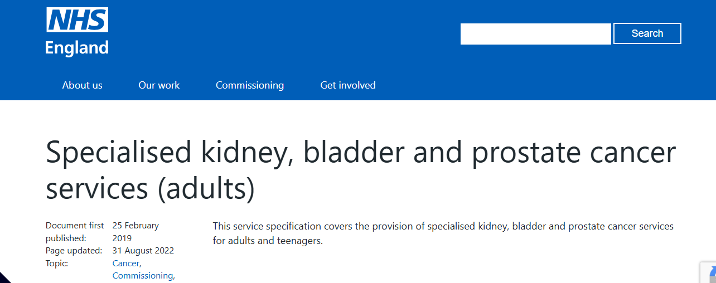
Conversion rates to treatment
150
Outpatients
10
Admitted - DC
1
Admitted - major
Notes:
We are an OP specialty but previously guidance almost exclusively focused on major surgery

Slide 5
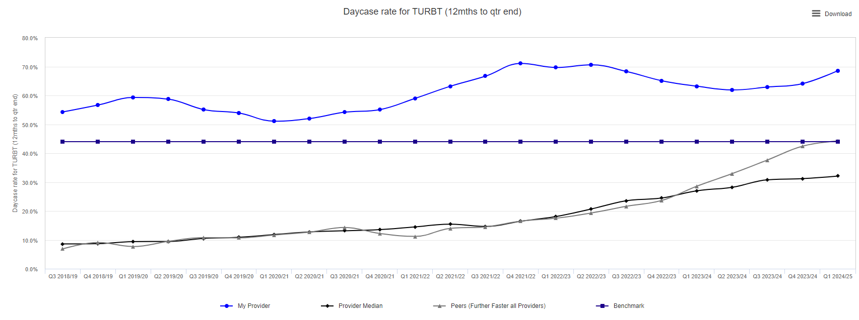
Bladder cancer surgery (TURBT)
85%
5%
45%
8%
Notes:
Add additional text box

Slide 6
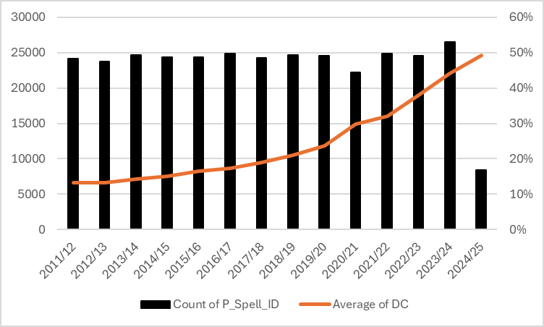
Day case rates for TURBT by year
50%
12%
Notes:
Now 1 in 2 patients or more get a DC op

Slide 7
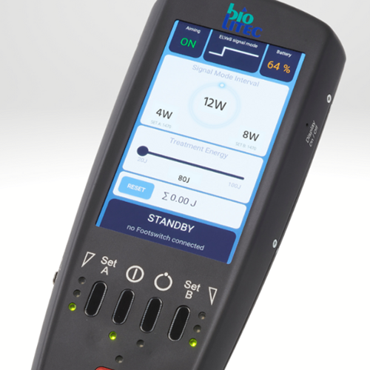
Scaling innovation – daycase to outpatient
Notes:
Innovation pitch for two slides

Slide 8
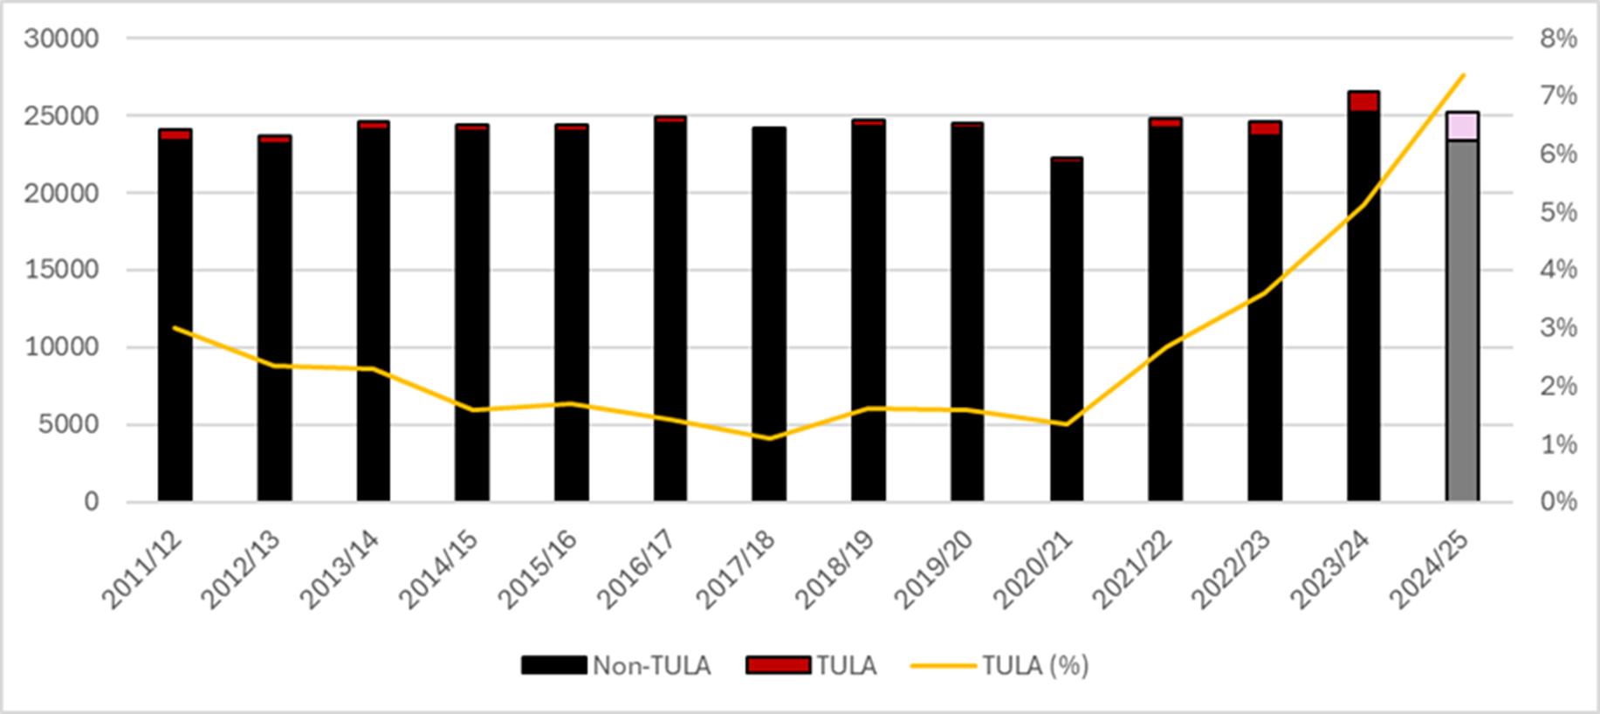
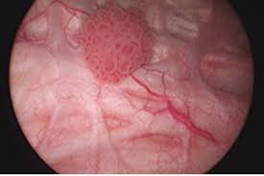
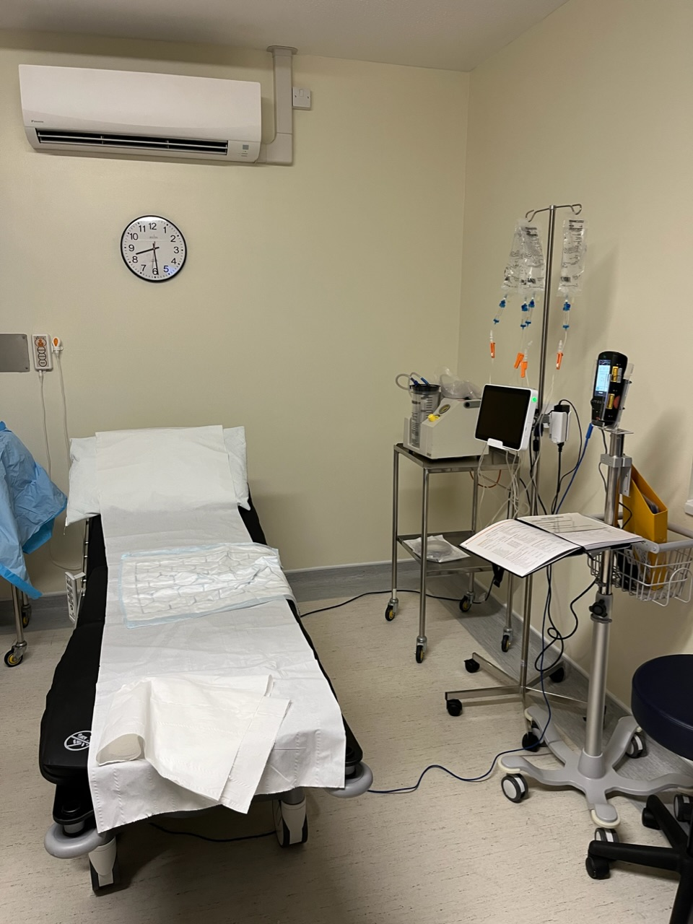
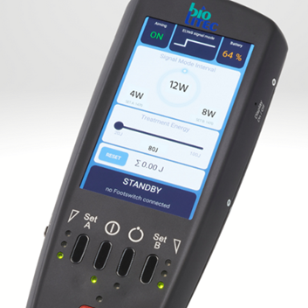
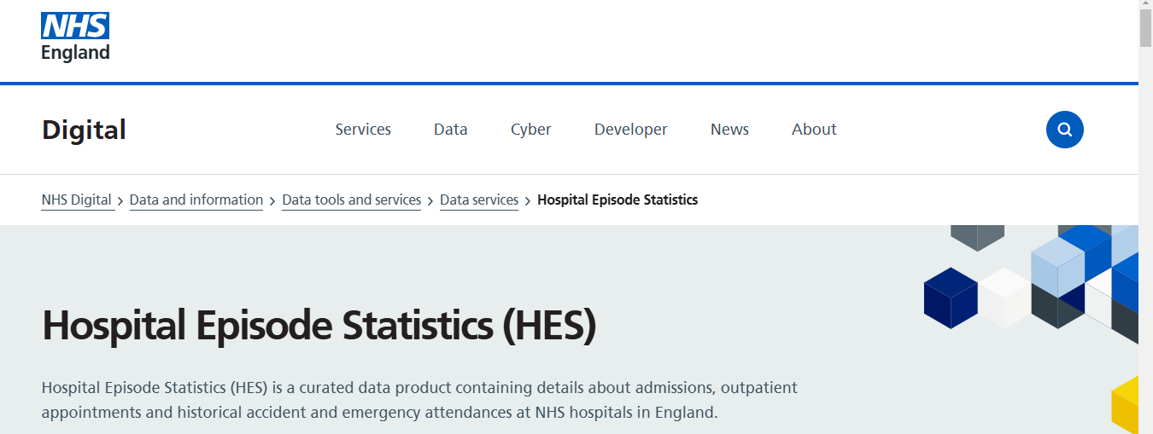
TULA (transurethral laser ablation)
Data suggests 7,000 cases in last 12 months
> 120 lasers deployed in NHS
Equivalent to 1,750 theatre sessions England
Or 25% of all major prostate surgery

Slide 9
National TULA Guidance – 19th Nov Rapid guideline development
Notes:
New methodology being tested for rapid guidance. Experts for a day. Record. ChatGPT etc and ? A guide in a day??

Slide 10
National Guidance
Indications
Setting up services
Training
Data collection

Slide 11
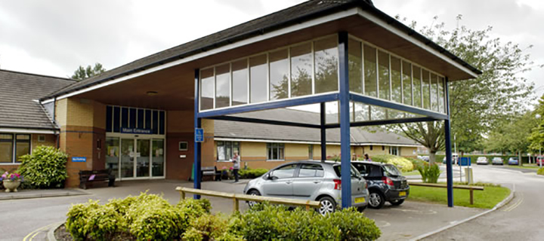
Facilities - Urology Investigation Units (UIU) / CDHs
Diagnostic | Therapeutic
Flexible cystoscopy | Intra-vesical chemotherapy
Imaging | Laser ablation of tumours
Prostate biopsy | Catheter care
Bladder biopsy | Botulinum toxin (OAB)
Urodynamics | Circumcision
Notes:
Facilities must mirror workload

Slide 12
Decarbonising the bladder cancer pathway

Slide 13
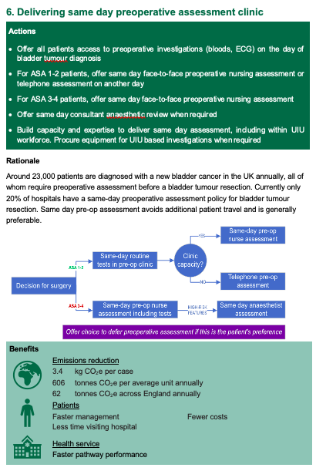
Clinically-led
Data-driven
Expert-informed
Notes:
The ELLA guide – talk about the journey it went on

Slide 14
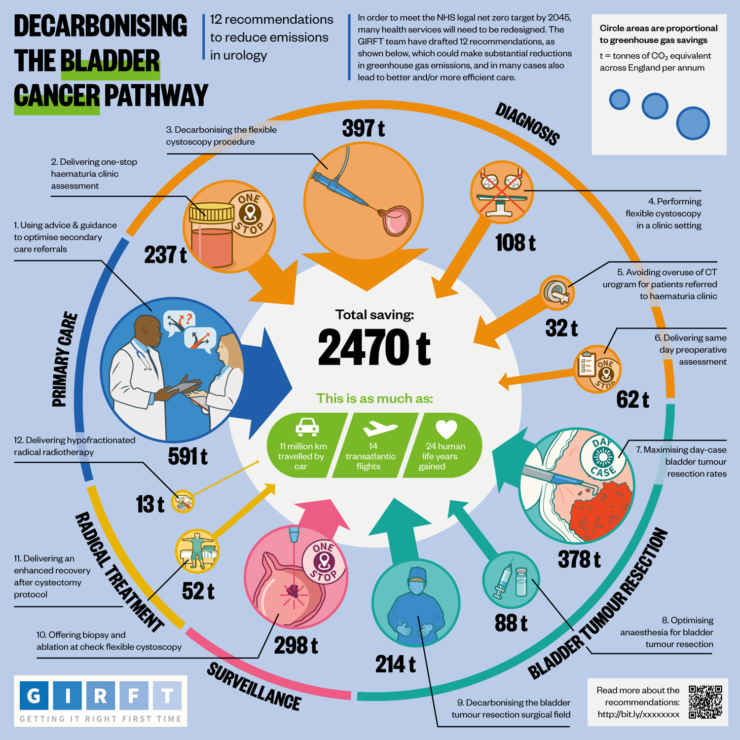
Notes:
BMJ infographic Link to Green NHS

Slide 15
Impact
Health
Equity
Data
Trials
Notes:
Funding – opportunity to put GIRFT at the centre of this research

Slide 16
National audits – bladder cancer

Slide 17
Proposed alternative:
Number off guidelines
Number of these put through A&G first

Slide 19
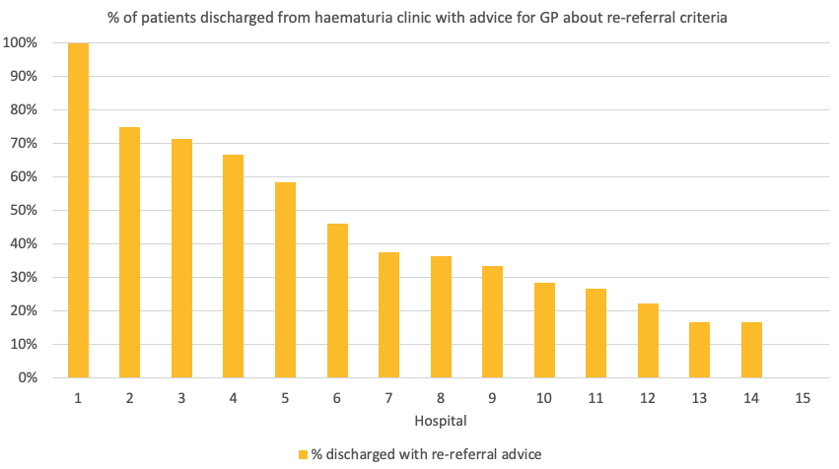

Slide 20
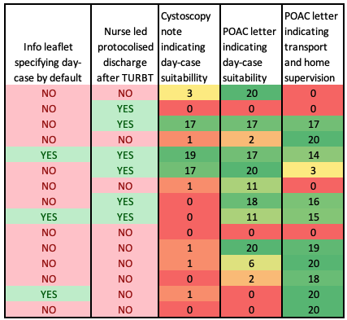
Day case readiness
Site dependent?

Slide 21
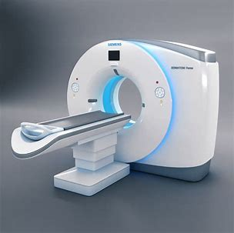
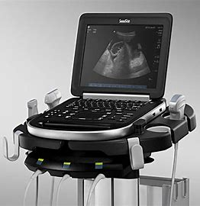
Imaging in haematuria

Slide 22
6. Perform upper tract ultrasound first line for haematuria, and CT urogram for selected high risk patients
First line 53% of units
First line 47% of units

Slide 23
CT urogram as first-line imaging
Purpose – to detect upper tract urothelial cancer (UTUC)
UTUC rate across 2WW referrals:
0.3% - 1.59%
Vh
Ultrasound detects about 66% of UTUC
Would miss UTUC for ~ 0.1 – 0.5% of referrals… if no clinical judgement used
CT-first pathway would subject ~60-80% to unnecessary radiation
Notes:
Because the overall cancer rate is around 20% for IDENTIFY studies and we’re assuming every cancer would get CT imaging (which isn’t actually the case so this could still be an overestimate)

Slide 24
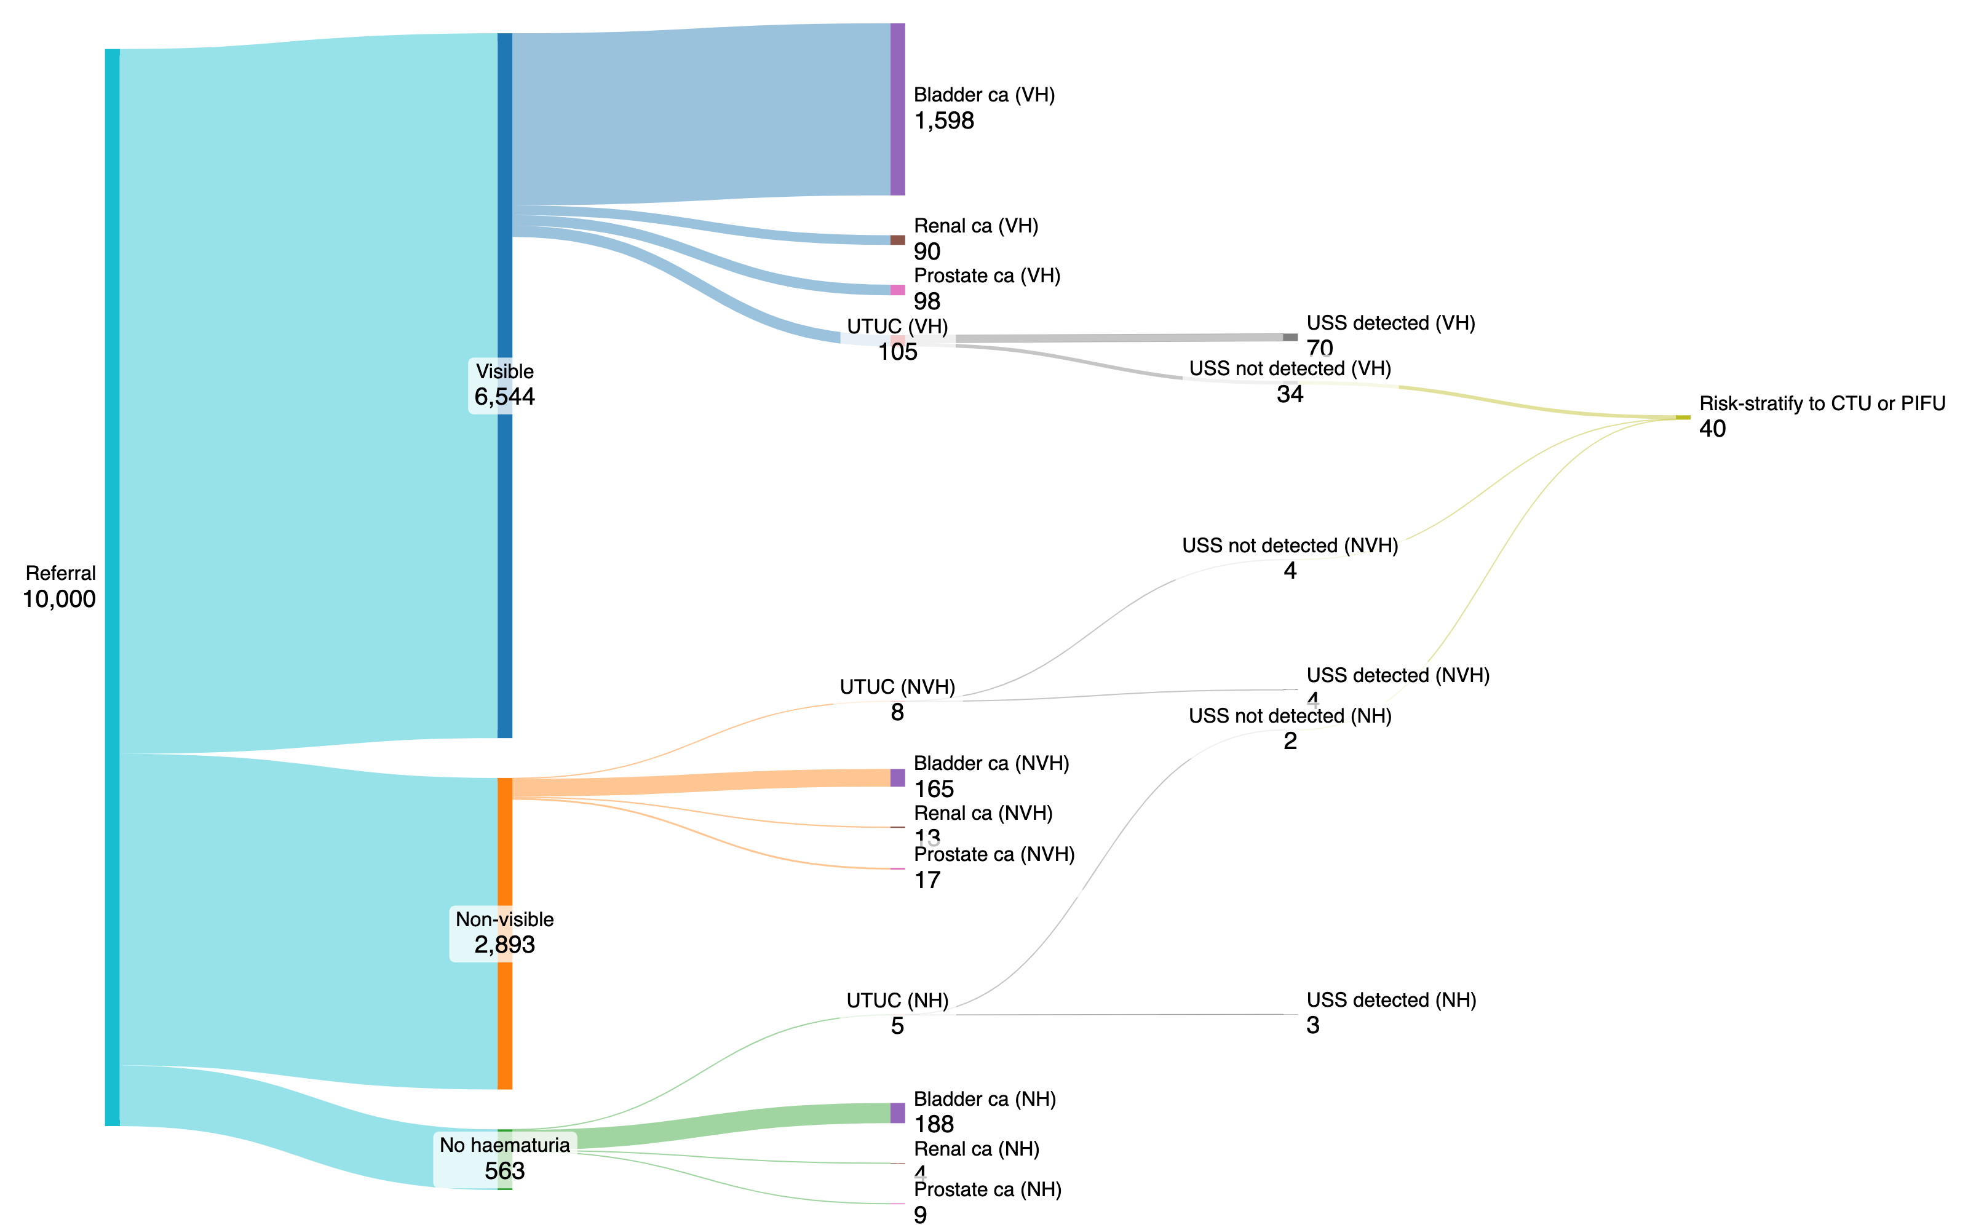
Incidence and USS diagnostic accuracy data from the IDENTIFY 1 study (N = 10,896), scaled for 10,000 patients
Notes:
https://sankeymatic.com/build/
// Enter Flows between Nodes, like this:
// Source [AMOUNT] Target
Referral [6544] Visible
Referral [2893] Non-visible
Referral [563] No haematuria
Visible [105] UTUC (VH)
Visible [1598] Bladder ca (VH)
Visible [90] Renal ca (VH)
Visible [98] Prostate ca (VH)
Non-visible [8] UTUC (NVH)
Non-visible [165] Bladder ca (NVH)
Non-visible [13] Renal ca (NVH)
Non-visible [17] Prostate ca (NVH)
No haematuria [5] UTUC (NH)
No haematuria [188] Bladder ca (NH)
No haematuria [4] Renal ca (NH)
No haematuria [9] Prostate ca (NH)
UTUC (VH) [70] USS detected (VH)
UTUC (NVH) [4] USS detected (NVH)
UTUC (NH) [3] USS detected (NH)
UTUC (VH) [34] USS not detected (VH)
UTUC (NVH) [4] USS not detected (NVH)
UTUC (NH) [2] USS not detected (NH)
USS not detected (VH) [34] Risk-stratify to CTU or PIFU
USS not detected (NVH) [4] Risk-stratify to CTU or PIFU
USS not detected (NH) [2] Risk-stratify to CTU or PIFU
USS not detected (NH) [2] PIFU

Slide 26
One-stop - definition
Flexible cystoscopy
Diagnosis & management
Upper tract imaging

Slide 27
Benefits
Faster diagnosis and management
Convenience
Lower cost
Less worry
More equitable
Better RTT performance
Better use of clinician time
Less road travel
USS-first pathway

Slide 28
One-stop haematuria sequencing
Ultrasound then cystoscopy:
Facilitates management discussion immediately after the cystoscopy
Avoids a second notes review when imaging is reported later

Slide 29
Delivering one-stop haematuria assessment
Actions
Offer as standard a one-stop service involving upper tract ultrasound, clinical assessment, and flexible cystoscopy during one hospital visit.
Arrange for ultrasound to take place before flexible cystoscopy to enable a diagnosis and management discussion immediately after cystoscopy.
Consider additional sonographer capacity to support one-stop clinics.
Acquire additional sonography or cystoscopy equipment when it will be frequently used and support one-stop clinic activity, for example in a urology investigation unit (UIU) setting.

Slide 30
New national guidance
2025
Advert for Chair
Clinical reference group
Bladder

Slide 31
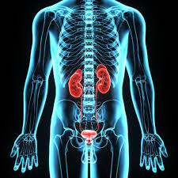
Topics to consider Referral criteria – including NVH One-stop assessment Imaging recommendations Same day POAC Bladder scheduling meeting Dedicated bladder cancer lists Decarbonisation SPI-MMC MMC / BCG

Slide 32
Outpatient Recovery and Transformation
Community-based – intermediate care alternatives
One Stop Shops
Diagnostic tests
Super Clinics
Diagnostic tests
Group Consultations
Referral
Outpatient appointment
Discharge or follow-up
Referral Optimisation
Appointment Optimisation
Follow-up Optimisation
Pre-referral specialist advice (A&G or advice and refer)
Post-referral specialist advice (RAS)
Referral guidelines
Remote monitoring
Patient Initiated Follow-Up (PIFU)
Discharge/FU guidelines
Validation
Face-to-Face or Remote
Missed appointments (DNAs or WNB)
Cancellations
Validation
Workforce Skill Set
Medical Support Worker/Clinic Scribe Support
Digital solutions: patient apps / portals

