Slide 1
Outpatient FEES
Dani Holbrook
Jan 25

Slide 2
Aim of pilot study
To implement and evaluate an outpatient FEES service for patients under the care of Head and Neck cancer (H&N) and Bristol Haematology and Oncology Centre (BHOC) Speech and Language Therapy (SLT) teams.

Slide 3
Background
H&N cancer and its treatments are well known to be associated with significant dysphagia, with dysphagia often being cited as in the top three most significant impactors to quality of life (Wilson et al., 2011).
FEES guides appropriate and safe feeding recommendations in the H&N population (Starmer et al., 2021)
National and international recommendations (BAHNO standards of care 2020; H&N cancer MDT guidelines, NICE Guidance on cancer services: Improving Outcomes in Head and Neck Cancer)

Slide 4
VF vs FEES
FEES may be more optimal for many H&N patients:
Significant (often unilateral) anatomical abnormalities as a result of their cancer or treatment
Oedema or change to the quality of the pharyngeal mucosa (more commonly following (chemo)-radiotherapy) easier visualised with FEES.
Repeatable
Biofeedback – helpful for teaching strategies
The choice between FEES and VF allows for a more optimal instrumental assessment service for H&N / BHOC patients.

Slide 5
Hurdles to leap
Evaluating the evidence base. Establishing the clinical need. Benchmark against other trusts
Training requirements (extensive competencies)
Room availability
Kit (including safe transport of scope across road and down hill..!)
Impact on service (time taken, kit limitations)
Uploading videos to evolve from stack

Slide 6
Clinic set up
90 minute clinic slot
First 30 minutes: FEES procedure completed
Second 30 minutes: Analysis and report writing
Final 30 minutes: Patient provided with feedback (showing images, education) and patient feedback questionnaire completed. Reduces need for additional feedback appointment.

Slide 7
Analysis
Average waiting time for OP FEES: 16 days
Reduction in VF referrals and waiting times: Prior to FEES, wait time 31 days. Following OP FEES, VF wait time 18 days
More ‘un-booked’ H&N VF slots offered to general acute SLT team – shows benefit to wider SLT service

Slide 8
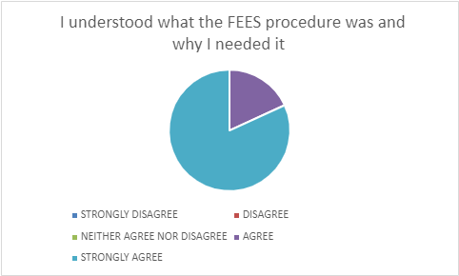
Patient feedback

Slide 9
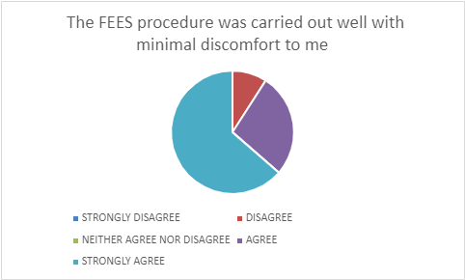
Patient feedback
Notes:
10 out of 11 patients reported the procedure was carried out well and with minimal discomfort. The patient that reported discomfort struggled to tolerate the procedure and a more condensed version of the assessment was performed. Despite this the clinical question was answered sufficiently.

Slide 10
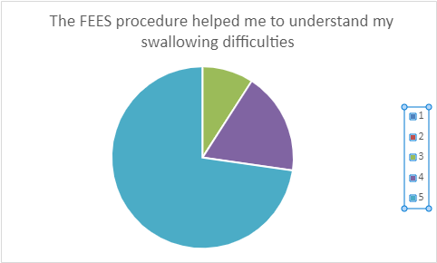
Patient feedback
Notes:
10 out of 11 patients agreed that the assessment helped them to understand their difficulties. For the patient that did not agree or disagree that assessment ruled out a swallowing difficulty, it helped inform onward referral to another service.

Slide 11
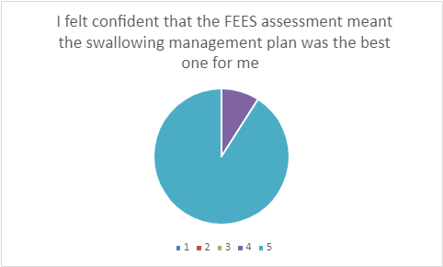
Patient feedback
Notes:
Strongly agree or agree
Really positive feedback from MDT colleagues

Slide 12
Summary of patient feedback
Vast majority of patients found the procedure acceptable and were happy with the information provided. The assessment was helpful in answering their question and they felt confident that it supported an optimal management plan.

Slide 13
Benefits
Clinically beneficial – can be preferential tool over VF in some cases
Assessment and therapeutic tool – biofeedback to help therapy. Repeatable.
Reducing demand on VF clinic
In line with standards (BAHNO)
Recently able to diagnose internal lymphodema (in absence of external lymphodema) and onward referral to lymphodema team

Slide 14
Established service / future directions
1x OP FEES slot per week (currently ringfenced for BHOC / H&N patients on SLT caseload)
Any un-utilised slots to be turned into general OP slots with 48 hours notice to ensure optimal use of SLT time.
Considering if we could move FEES to BRI clinic space to more easily share resources across IPs.
Futureproof: if demand increases, business proposal to support increase in staffing to support increase slot numbers

