Slide 1
Regional non muscle invasive bladder cancer
Miss Helena Burden
Urology Consultant

Slide 2
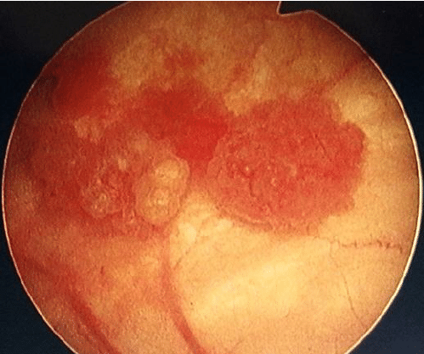
NMIBC
80% of all bladder cancer
Highly recurrent disease
Often no continuity for patients
Multiple contact points in urology

Slide 3
Regional NMIBC
Coherence within the region
Pathway mapping
Surveillance protocols
Access to all treatment options/research
Data

Slide 4
Coherence within region
Oversight of pathway
NMIBC specialist/champion in each unit
NMIBC regional group (sts/cns)

Slide 5
Trust coherence
MDT attendance
Bladder scheduling meeting
Pathway mapping
Safety
High quality
Evidence based
Cutting edge

Slide 6
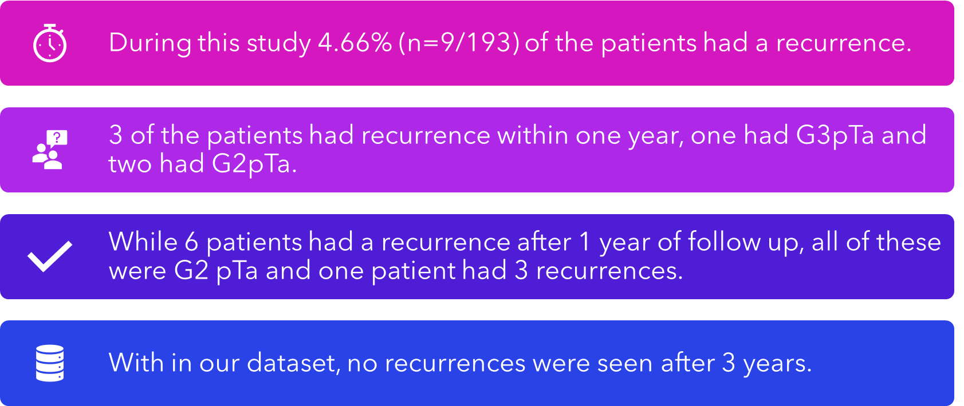
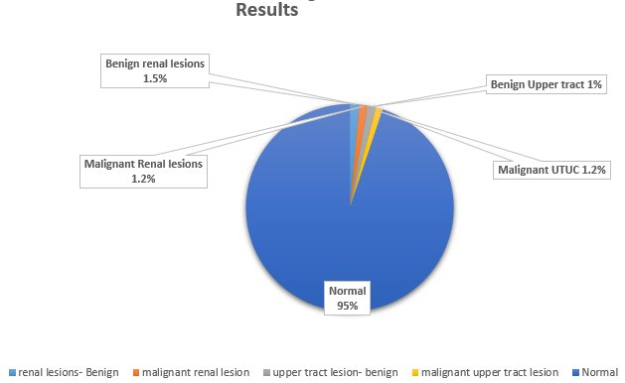
Surveillance protocols
Evidence based protocol
Regional protocol
Low risk NMIBC – recurrence
CTU high risk
VH pathway imaging

Slide 7
Patient access
NMIBC regional group ?pt rep
Blue light/TULA
HIVEC
Research studies eg moonrise

Slide 8
SW TULA collaborative
Representatives from Cornwall, Plymouth, Exeter, Taunton, Bristol.
Aim – data collection as region
- feed into national TULA GIRFT guidance
NHS Secure Data Entry team
Data manager at NBT interim solution

Slide 9
Data
Quality
Data gathering

Slide 10
Regional possibilities
SW TULA collaborative
SW NMIBC group
NMIBC champion in each unit
Coherence to regional evidence based guidance
CTU surveillance in high risk disease
Bladder cancer dashboard

Slide 11
Questions?
Helena.burden@nbt.nhs.uk

