Slide 1
SWAG Network Urological Cancer
Clinical Advisory Group - Bladder
Research Update
Claire Matthews
07/01/2025

Slide 2
Research Delivery Network
vision, mission and purpose

Slide 3
Research Delivery Network
Vision
The UK is a global leader in the delivery of high quality, commercial and non commercial research that is inclusive, accessible and improves health and care.
Mission
Enabling the health and care system to attract, optimise and deliver research across England.
We do this as part of the NIHR’s overall mission to improve the health and wealth of the nation through research.

Slide 4
Research Delivery Network (RDN) purpose
Support the successful delivery of high quality research, as an active partner in the research system.
Increase capacity and capability of the research delivery infrastructure for the future.
This means research can:
Reach more people
Address changing population needs
Support the successful delivery of high quality research
Increase capacity and capability of the research delivery infrastructure for the future

Slide 5
RDN change statements
A new organisation building on the successes of the Clinical Research Network (CRN).
The Research Delivery Network (RDN) differs from the CRN in the following ways:
A single organisation with greater consistency of experience for customers
Collective responsibility and joint leadership of the organisation
A collegiate and a customer-focused partner
Stronger focus on strategic development of research capacity and capability, nationally and regionally, with partners
Emphasis on continuous improvement, learning and value for money in every part of RDN

Slide 6
Delivering on RDN’s purpose
RDN focuses on strategic support for the whole portfolio, rather than day-to-day involvement in individual studies, except on request
Sites are supported to monitor their own performance of individual studies, build study-level capacity and consider research delivery in research applications
RDN increases understanding of and supports work to address strategic issues that cut across sites, regions or settings. This might be through a strategic project we lead, by supporting projects led by partners, or by providing the intelligence and evidence to enable others to make change
Agile Delivery Teams provide additional targeted support for individual studies and help us to build capacity and capability where it is needed.

Slide 7
Development of RDN’s strategy and services
RDN-wide strategy based around settings and organisational vision and purpose
Study Support Service
AcoRD / NCVR
Agile Research Delivery Team
Support for out of hospital settings
Life Sciences Partnership & Growth (includes key accounts and customer engagement)
Workforce Development
Finance (includes funding model and financial management)
Data & Analytics
Planning
Contractual Management including performance framework
Public Engagement
Specialities and Settings
Strategic Development
Study Participation Inclusion
Communications
Stakeholder engagement

Slide 8
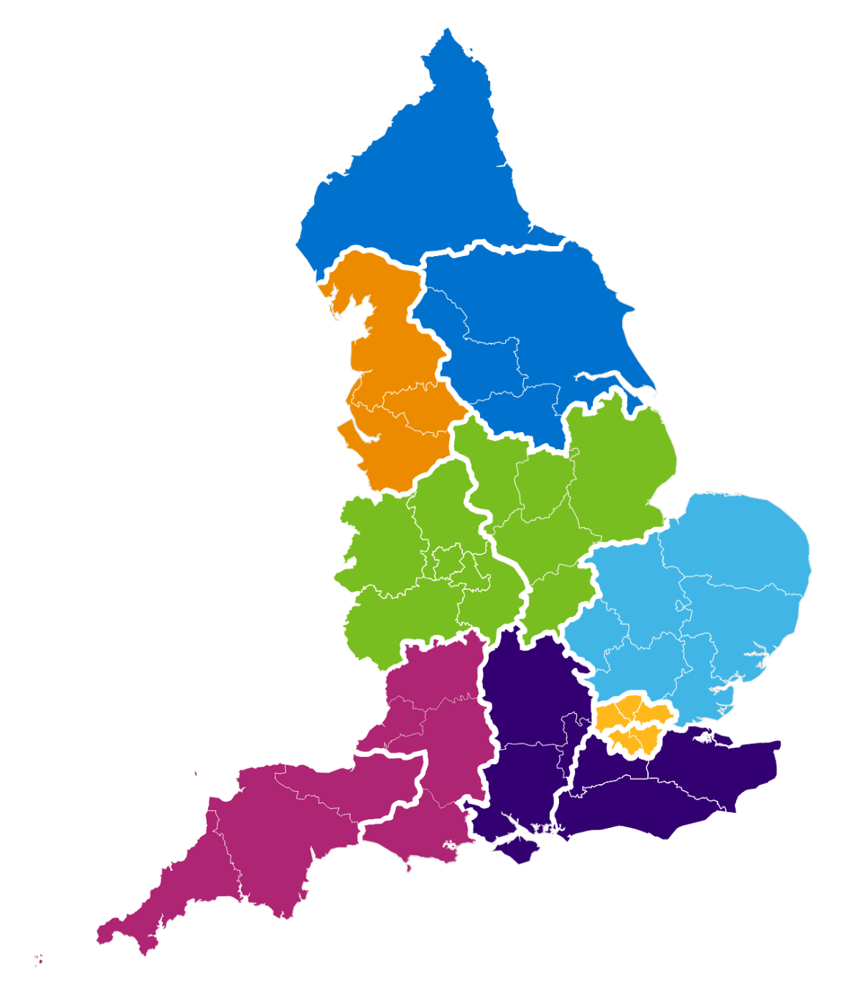
Combined Regional (Network) map
NHS England Region | Regional Research Delivery Network (RRDN) |  | RRDN Hosts
North East and Yorkshire | A | North East and North Cumbria | The Newcastle upon Tyne Hospitals NHS Foundation Trust
 | B | Yorkshire and Humber | Leeds Teaching Hospitals NHS Trust
North West | C | North West | Manchester University NHS Foundation Trust
Midlands | D | East Midlands | University Hospitals Of Leicester NHS Trust
 | E | West Midlands | The Royal Wolverhampton NHS Trust
East of England | F | East of England | Norfolk and Norwich University NHS Foundation Trust
London | G | North London | Barts Health NHS Trust
 | H | South London | Guy’s & St Thomas’ NHS Foundation Trust
South East | I | South Central | University Hospital Southampton NHS Foundation Trust
 | J | South East | Royal Surrey NHS Foundation Trust
South West | K | South West Central | University Hospitals Bristol and Weston NHS Foundation Trust
 | L | South West Peninsula | Royal Devon University Healthcare NHS Foundation Trust
A
B
C
D
E
F
G
K
I
H
J
L

Slide 9
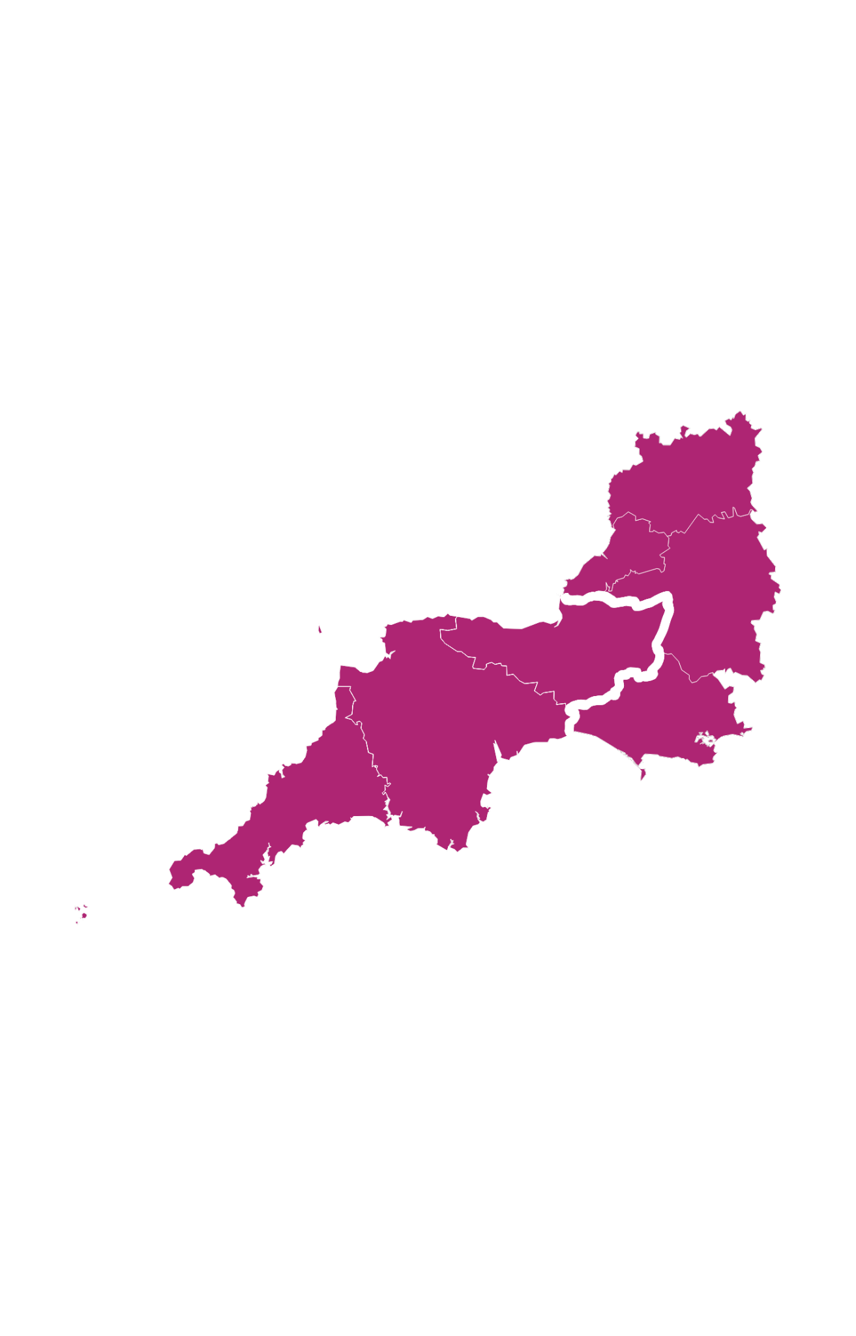
South West
NHSE Region | Regional Research Delivery Network |  | ICS Areas | NHS Trusts | Additional information
South West | K | South West Central | Bath & North East Somerset, Swindon & Wiltshire Bristol, North Somerset & South Gloucestershire Dorset Gloucestershire | GWH FT​ RUHB FT Salisbury NHS FT AWP NHS Trust NBristol NHS Trust UHBW FT Dorset County H FT Dorset Healthcare U FT SWAS FT UHD FT GHC FT GH FT | Population: 3.3m NHS Trusts: 11 Studies: 1,496 Participants: 109,964
 | L | South West Peninsula | Cornwall and The Isles of Scilly Devon Somerset | [2 trusts] [4 trusts] Somerset FT Yeovil DH FT | Population: 2.3m NHS Trusts: 10 Studies: 1,409 Participants: 67,604
Networks K and L -
‘South West Central’
and ‘South West Peninsula’
K
L

Slide 10
Bladder Cancer Research Portfolio

Slide 11
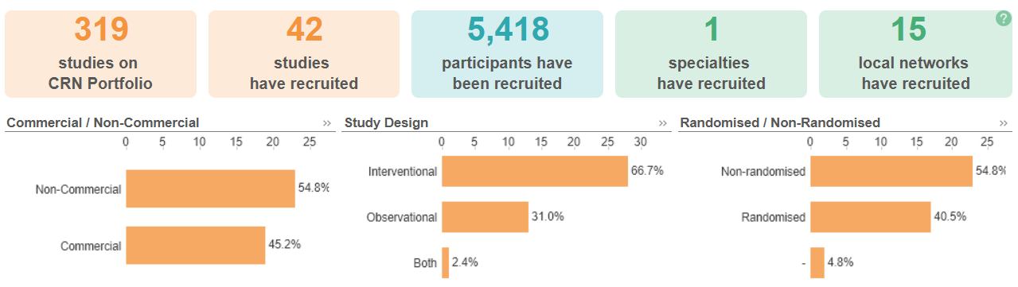
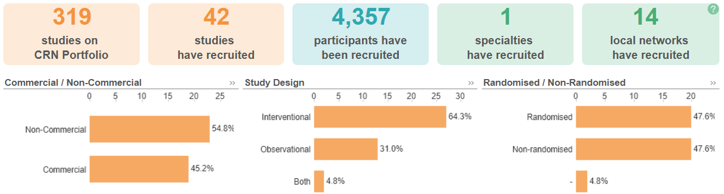
National Bladder Cancer Research Recruitment
Apr 23 - Mar 24
Apr 24 - Dec 24
Data cut 03/01/2025
Source: ODP All Portfolio

Slide 12
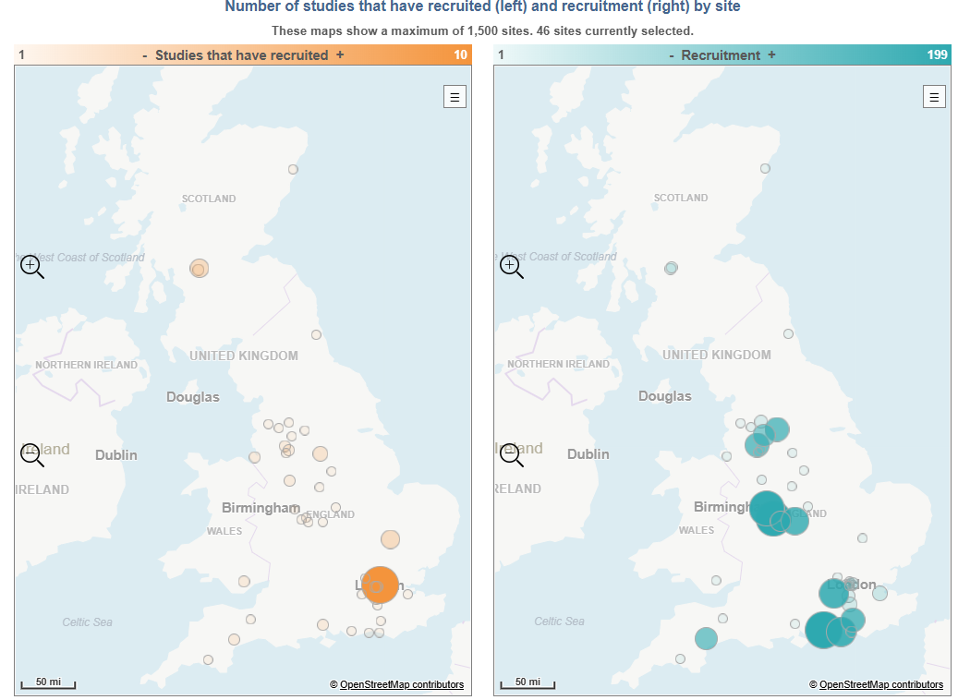
National Bladder Cancer Research Recruitment
28 studies currently open nationwide. Only one bladder specific study currently open in the region
Rad-IO: A multi-stage randomised trial of durvalumab (Medi4736) with chemoradiotherapy with 5-fluorouracil and mitomycin C in patients with muscle-invasive bladder cancer
Musgrove Park Hospital; Dr Emma Gray
Recruitment 1 of 3
Due to close 31/01/2025
Data cut 03/01/2025
Source: ODP All Portfolio

Slide 13
Studies in set-up/under consideration in SWAG region
CPMS ID | Short Name | Title | Site | Planned Opening | Planned Closure | Sample Size Eng | Sponsor
60886 | BO45230 iNEST Personalised Bladder Cancer Vaccine Study | A Randomized Phase Ii, Double-Blind, Multicenter Study Evaluating The Efficacy And Safety Of Autogene Cevumeran Plus Nivolumab Versus Placebo Plus Nivolumab As Adjuvant Therapy In Patients With High-Risk Muscle-Invasive Urothelial Carcinoma | Salisbury (EoI) | 01/07/2024 | 22/02/2027 | 20 | BioNTech SE
55197 | HIVEC - HEAT | Multi-centre, single-arm, interventional trial of HIVEC® (hyperthermic intravesical mitomycin medac) for patients with BCG-unresponsive nonmuscle-invasive bladder cancer. | Southmead (Feasibility - Dr Helena Burden) | 13/01/2025 | 31/08/2025 | 208 | University of Leicester
53292 | R392101 | A phase III, single-arm study to evaluate the efficacy and safety of ONCOFID-P-B (paclitaxel-hyaluronic acid conjugate) administered intravesically to patients with BCG-unresponsive Carcinoma in Situ of the bladder with or without Ta-T1 papillary disease | Salisbury (EoI) | 30/11/2024 | 31/12/2025 | 20 | Fidia Farmaceutici S.P.A.
Data cut 03/01/2025
Source: ODP All Portfolio

Slide 14
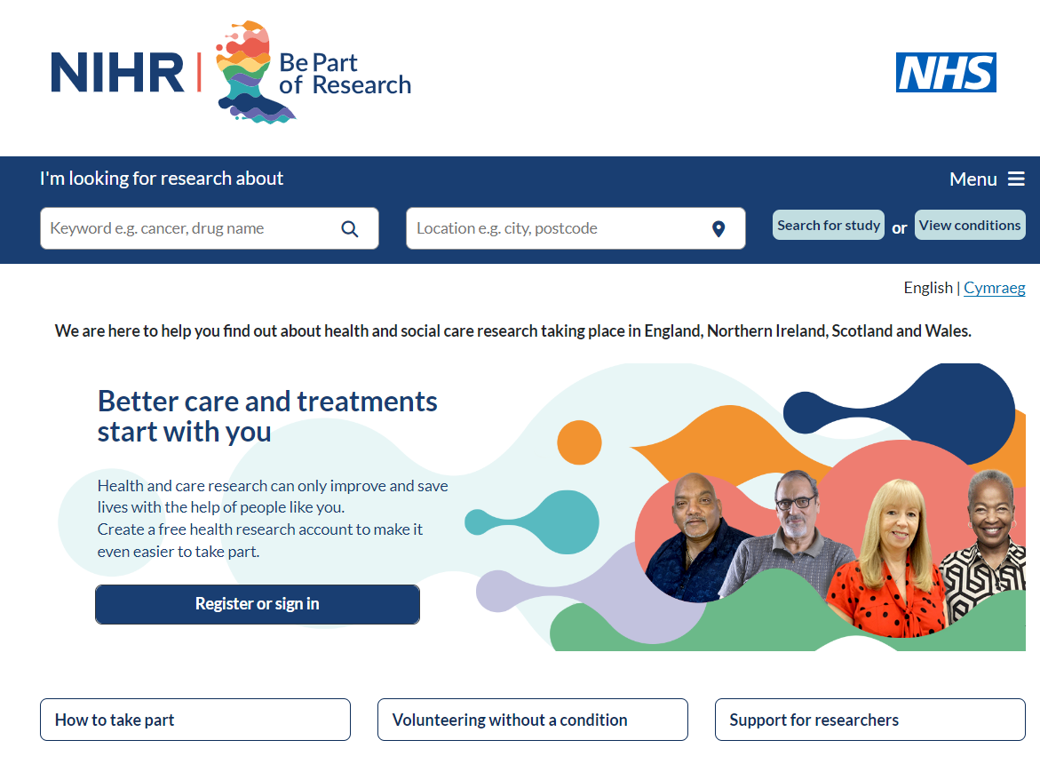

Be Part of Research is a UK-wide service that helps people find and take part in health and care research across nearly every health condition.
A resource for:
patients or their families keen to get involved in research
Researchers looking for target population for research
https://bepartofresearch.nihr.ac.uk/
Data cut
Source: ODP All Portfolio

Slide 15

Associate Principal Investigator
Scheme
Six month in-work training opportunity, providing practical experience for healthcare professionals starting their research career.
People who would not normally have the opportunity to take part in clinical research in their day to day role have the chance to experience what it means to work on and deliver a NIHR portfolio trial under the mentorship of an enthusiastic Local PI.
CIs working with a CTU can register their study on the scheme
https://www.nihr.ac.uk/health-and-care-professionals/career-development/associate-principal-investigator-scheme.htm

Slide 16

Principal Investigator Pipeline Programme
(PIPP)
Overview
Research delivery nurses or midwives
12 to 18 months
Free if you’re eligible
Live virtual lessons, online learning and hands-on experience
Cohort 4 applications open at the end of March 2025
Please email nursingandmidwifery@nihr.ac.uk for more information
https://www.nihr.ac.uk/career-development/clinical-research-courses-and-support/principal-investigator-pipeline-programme

Slide 17
NIHR ODP https://odp.nihr.ac.uk/
Open data platform. Data on performance across whole RDN, including all specialty areas
NIHR Be Part of Research https://bepartofresearch.nihr.ac.uk/
See which studies are open across the country
Find a Clinical Research Study (ODP) http://csg.ncri.org.uk/portfolio/portfolio-maps/
Search for a study to fit criteria. Good for horizon scanning, eligibility criteria

Slide 18
RRDN Contacts
swc.rrdn@nihr.ac.uk
Study Support Service Manager: claire.matthews@nihr.ac.uk
CAG Research Lead: amit.bahl@uhbw.nhs.uk

