Slide 1
SWAG Cancer Alliance: SACT Capacity and Demand Project Group
Update for SACT CAG, Fri 18th Oct 2024

Slide 2
Overview of SACT Capacity and Demand modelling requirement
National Cancer Alliance Planning Pack requirement for all Alliances in 2024/25 –
SACT delivery remains a challenge across the country. Cancer Alliance to lead a bi-annual evaluation of demand and capacity across the footprint that will enable Alliances to identify any challenges to delivery.
Carry out demand and capacity assessment of SACT services
Identify any challenges to SACT delivery and escalate appropriately – e.g. variation in Oncology DNA rates across our geography
Share good practices and challenges within the region and with other Cancer Alliances.

Slide 4
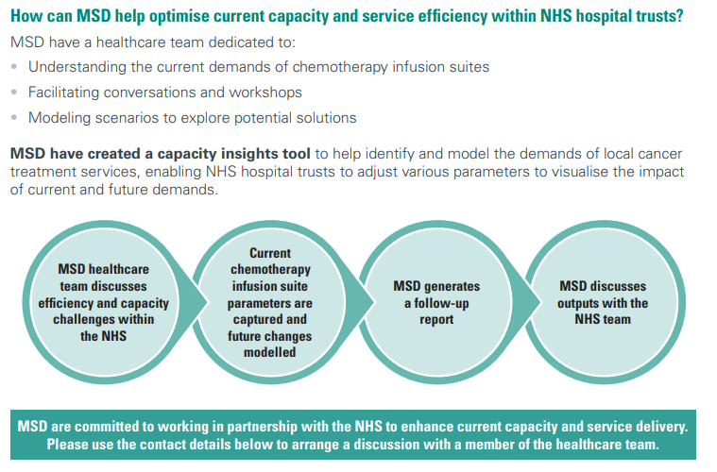
Collaborative Working - MSD UK (msd-uk.com)

Slide 5
Data
Agreed timeframe for data in scope
Access to funding for staff time to support the work
Time & Motion Modelling
All Provider Trusts to participate
Agreed duration – e.g. several days repeated over 2 consecutive weeks – 2 or more full consecutive weeks
Access to funding for staff time to support the work
All complete to same level dataset
Option to have onsite support from Alliance Team
Reporting
All Trusts to receive bespoke report and offer of Alliance/ MSD supported review meeting
Alliance to host workshop style session for all Trusts to share findings, review and agree next steps
All Provider Trusts to participate
Deadline for return of ‘green’ information by Weds 23rd Oct
Deadline for completion of Time & Motion element end of Nov
Reporting collated and issued to each Provider with Provider and Alliance level recommendations end of the year/ Jan 20205

Slide 6
Time & Motion progress to date:
Feedback from RUH
Planning conversations with all Providers
Funding support
Collation of outputs and support with this

Slide 7
Data collection template issued with guidance – for completion by each Provider
Time & Motion template issued with guidance resource funding
Time & Motion ‘test site’ study – SWAG to support and share learning with other sites
All sites to complete Time & Motion study – reporting collated into CIT/ to MSD
Provider Reports made available – Provider/ SWAG/ MSD Review Meetings Scheduled
Project Group Learning Session – outputs so far, next steps, out of area learning
First round reporting to SWAG Delivery Group/ Repeat process!
Next steps – planning overview

Slide 8
Shaping The Future of Systemic Anti-Cancer Therapy (SACT): Overcoming Challenges & Fostering Innovation
Dr Anne Rigg, National Specialty Advisor for SACT:
SACT Capacity and Demand work has been a way of getting SACT into the Planning Pack
Variation in approaches for completing this work, recognition that it is challenging to gather information and benefit in making the local process being managed to add value rather than ‘ticking a box’
Call from attendees (mix of SACT Provider Teams and Alliance Teams) for more national support for the challenges around SACT delivery
UK SACT Board planning to develop and publish SACT Protocols to help reduce unwarranted variation and duplication of workload
Updated Chemotherapy/ SACT Service Specifications in production and will be shared in draft soon
BOPA figures indicate a national growth in SACT demand of circa 6-7%

Slide 9
Shaping The Future of Systemic Anti-Cancer Therapy (SACT): Overcoming Challenges & Fostering Innovation

Slide 10
Examples of common challenges across the region:
Increasing number of patients – including patients receiving maintenance treatments
Increasing number of complex regimes
Loss of experienced SACT nurses and lack of experienced nurse with complex regimes
Pharmacy staff shortages
Pharmacy and medical provision, limiting some expansion such as administration of treatments at weekends and increased treatments in the satellite units.
Incorrect prescriptions/chasing prescriptions/decisions
Bloods results not in a timely manner
High levels of sickness absence
High turnover of staff in chemo day unit due to the availability of other opportunities within the centre such as CNS roles, trials, Practice educators and Advanced practitioners.
SACT administration is such a specialised role, this results in a significant training need and supernumerary period for new starters on the unit.
Physical space and chair capacity within the services, resulting in cramped units and limited opportunity for expansion in some of the current buildings

Slide 11
Examples of best practice already
in progress:
The utilisation of satellite service
Band 5- Band 6 progression to improve staff retention
Implementation of delivering more medication at home
Completing SACT nurse sign off in a timely manner (practice facilitator)
Capacity management across two Trust sites
Time and motion study assess nurse time requirements for SACT appointment times.
Work in place to transition more inpatient SACT regimens to day case to improve patient experience and reduce treatment delays
Project in place scoping ambulatory care
Use of Sub-cutaneous SACT where available so that it can be given in injections lists rather than the Chemo day unit
Patients are taught to self-administer Denosumab to reduce hospital visits, improve patient experience and release injection list capacity
All treatment administration and nursing and medical notes are completed electronically, so we do not use paper patient records on our day units

